Slide 1


Eco Team Action Plan
St. Chad’s RC Primary School
2021 - 2022

Slide 2

Our Chosen Topics
We looked at the Environmental Review and picked three of the ten Eco-Schools topics to focus on this year.
We chose:
Biodiversity
Litter
Transport

Slide 3
Creating an Action Plan
We worked in groups and rotated around each of the topics:
Biodiversity
Litter
Transport
Everybody contributed to each of the topics, they helped reflect on what we had already done and what we still needed to do. These reflections would help inform the action plan.

Slide 4
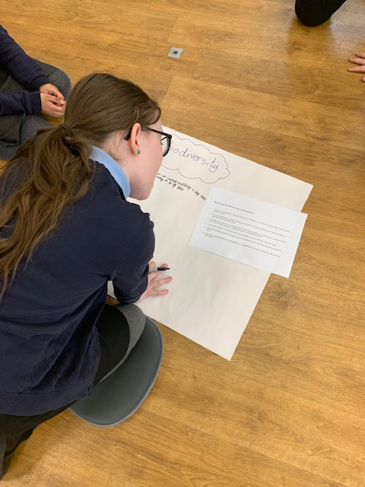
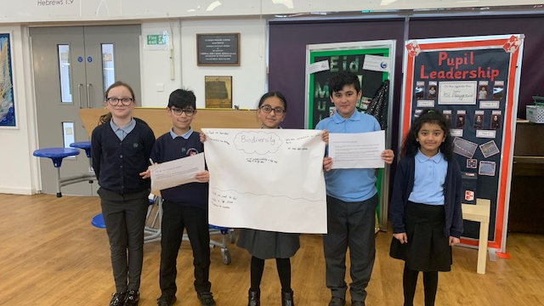

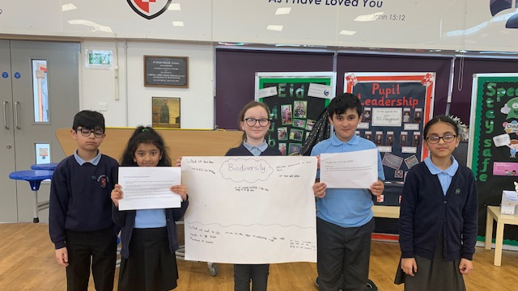
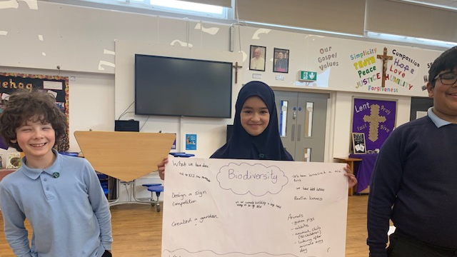
Biodiversity

Slide 5
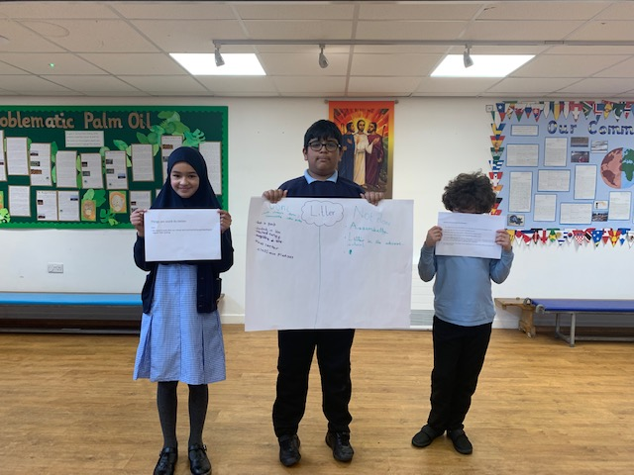
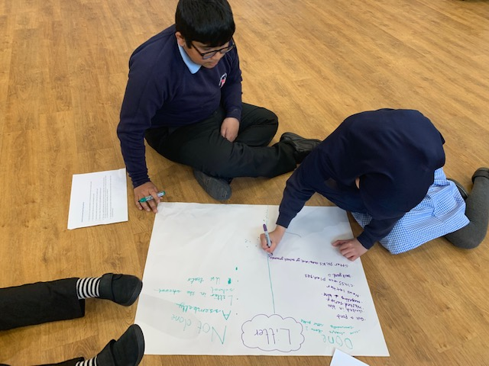
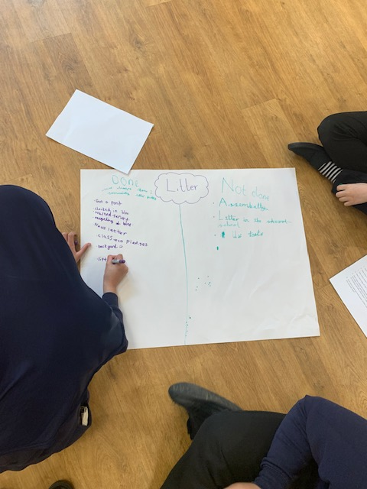

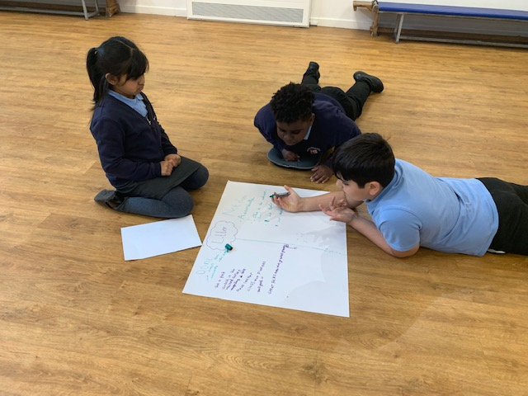
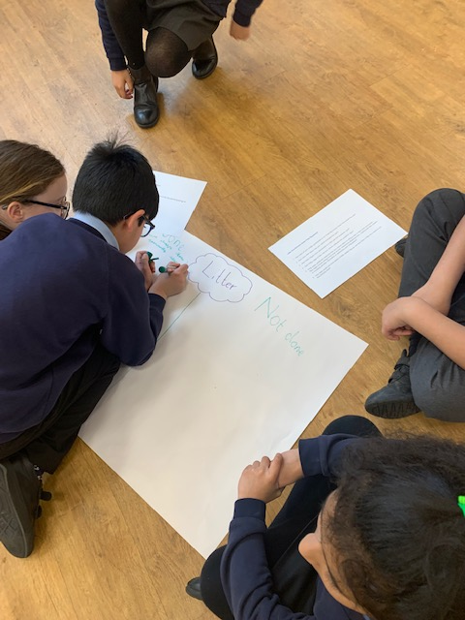
Litter

Slide 6

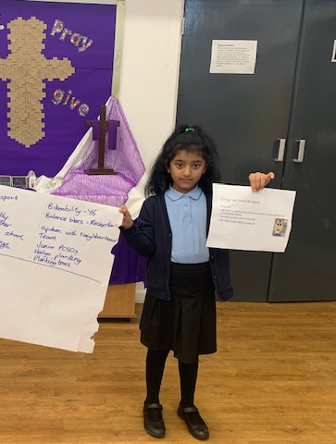
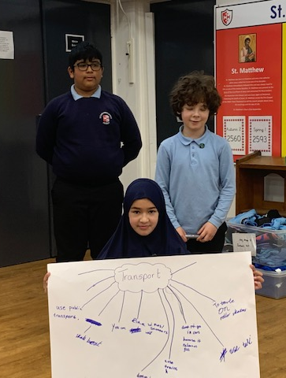
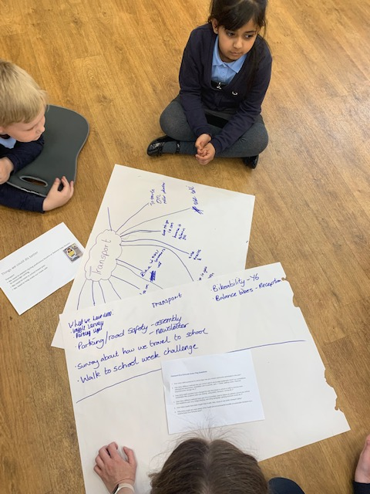
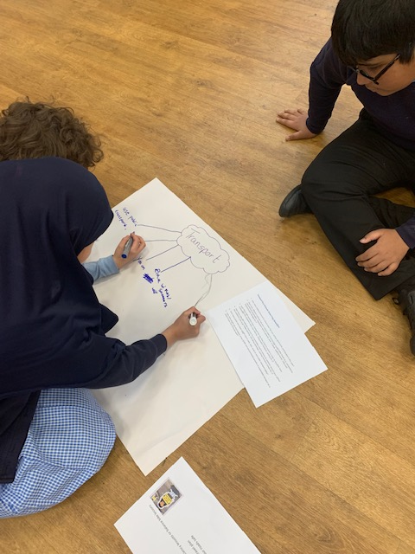
Transport

Slide 7
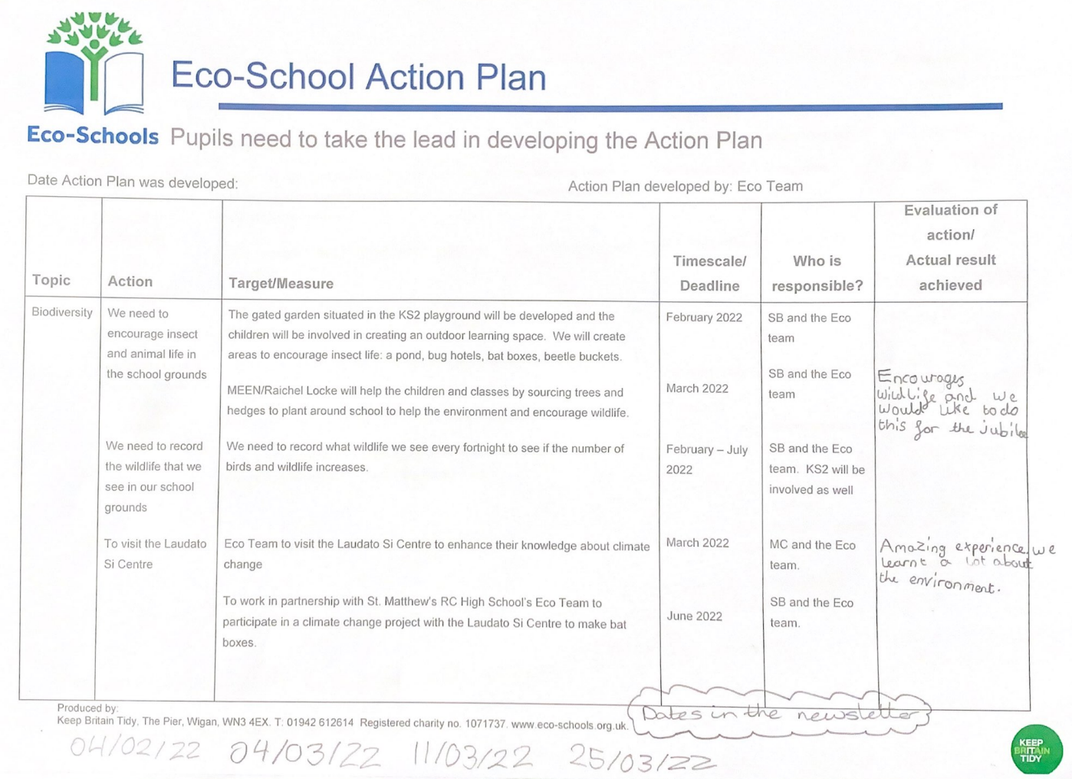

Slide 8
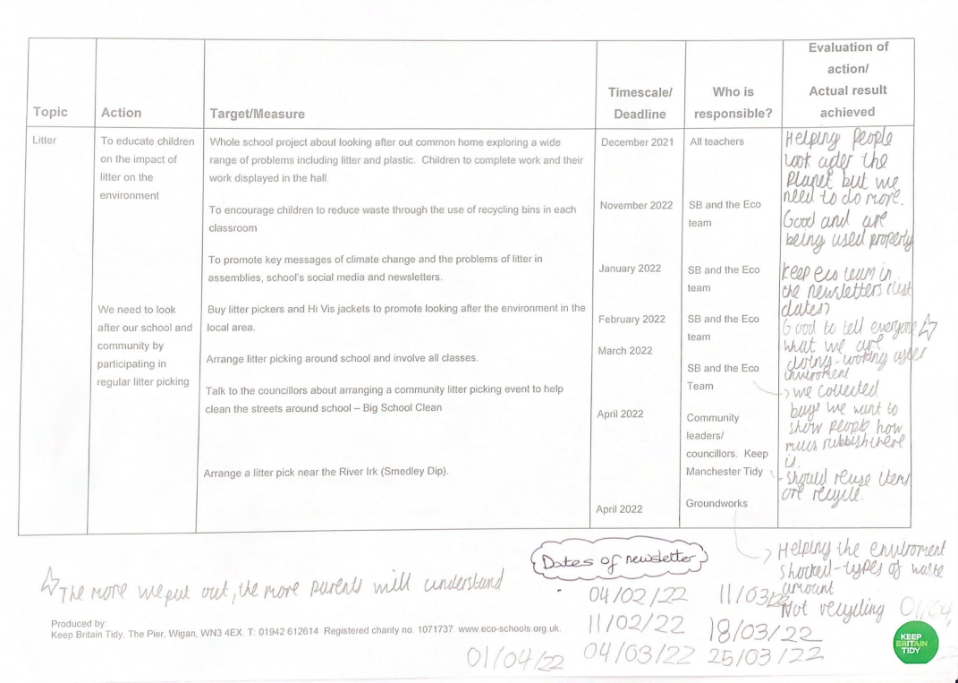

Slide 9
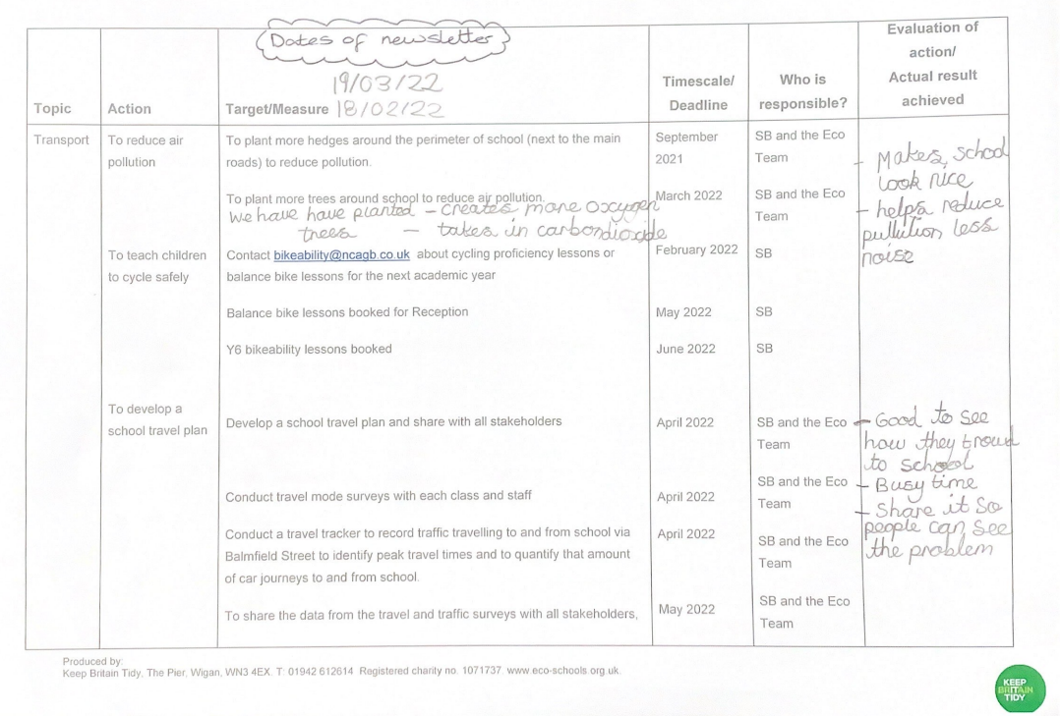

Slide 10
