Slide 1
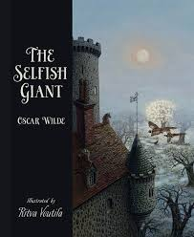
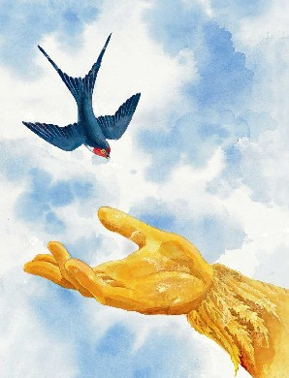
Year 6 Spring 1 Curriculum Overview
RE This term, children explore the Local Church (Community) and Eucharist (Relating) through scripture, discussion, and reflection. They learn how the Church is a community where people serve, belong, and celebrate together. The Eucharist teaches them about sacrifice, thanksgiving, and sharing, deepening their relationship with God and others. Through the story of the Last Supper, they reflect on Jesus' presence in Holy Communion. At home, families can discuss how they participate in the Church and what the Eucharist means in their faith journey. | Writing Year 6 will explore formal writing through Oscar Wilde’s The Selfish Giant. They will develop rich descriptions using expanded noun phrases and enhanced sentence structure with semi-colons. Pupils have also practised using passive voice to create an impersonal tone and subjunctive form for formal effect. Their final piece— a newspaper report on the missing boy—demonstrates their ability to write with precision, structure, and sophisticated language choices.
Maths We will develop skills in converting units of measure, ratio, area and perimeter. Children will learn to confidently convert between metric units (e.g., grams to kilograms, centimetres to metres) and apply this knowledge in problem-solving contexts. Pupils will explore ratios to compare quantities and solve real-life challenges. In geometry, they will calculated area and perimeter of various shapes. | Reading We will develop inference skills by exploring Oscar Wilde’s The Happy Prince. Through close reading, children will analyse character emotions, themes of sacrifice, and the deeper meanings behind the prince’s actions. By using textual evidence, pupils will learn to read between the lines and interpret hidden messages in the story.
History This term, we will explore the contributions and challenges of the Windrush Generation. We will learn how Caribbean migrants helped rebuild post-war Britain: enriching society through culture, work, and resilience. Pupils will also explore the discrimination and hardships they faced. | Art We have explored the vibrant colours, patterns, and culture of Caribbean art. Inspired by traditional and modern artists, they will create tropical landscapes, carnival masks, and bold geometric prints, using various materials. This creative session celebrates the rich artistic heritage of the Caribbean.
Science In this unit, pupils learn about evolution and inheritance through the work of Charles Darwin. They explore how living things change over time and how offspring inherit characteristics with natural variation. Pupils learn how some features help organisms survive and reproduce through natural selection, and how fossils provide evidence for evolution. The unit develops pupils’ use of scientific vocabulary, explanation skills, and evidence-based thinking. | PE This term, Year 6 will continue to learn more about teamwork, passing, and movement skills in netball. They have learned key rules, positions, and strategies, so will be improving their coordination, communication, and accuracy while playing in small-sided games.
 | Homework

