Slide 1

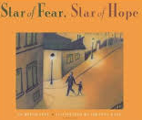
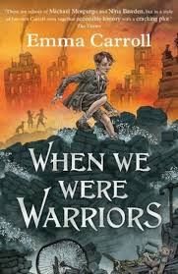
Year 6 Autumn 1 Curriculum Overview
RE Children know that it is in the love of a family that Christians first experience the reality of Church. They will deepen this understanding by learning and understanding more about God’s love and care of people and that His love is unconditional and never ending. Children will explore scripture and have opportunities to link these beliefs with their own lives. | Writing Using the text, Star of Fear, Star of Hope, children will have opportunities to work on using cohesive devices. These are words or phrases that help link ideas in writing, making it easier to follow. Children will learn to use things like pronouns, conjunctions (e.g., and, because), and time adverbials (e.g., then, next) to create smoother, more connected sentences.
Maths In the Year 6 maths unit on place value and the four operations, students deepen their understanding of large numbers, including decimals, and how to manipulate them through addition, subtraction, multiplication, and division. They also learn to apply these operations in problem-solving contexts, using strategies like long division and multi-step calculations. | Reading Using the text, When we were Warriors, children will develop their inference skills by reading between the lines to understand information that isn't directly stated in a text. They use clues from the text and their own background knowledge to interpret characters’ feelings, motives, and underlying themes.
Geography In this geography unit, Year 6 students will compare the port cities of Liverpool, Widnes, and Rotterdam, exploring their historical and economic importance. They will examine how these cities developed around their waterways, the industries they support, and the impact of these industries on the environment. | Art From the Ancient Maya to modern-day street art, children look at how artists convey a message. Exploring imagery, symbols, expressive mark making, and ‘chiaroscuro’ children consider audience and impact to create powerful drawings to make their voices heard.
Science In our unit on electricity, children will explore the principles of electric circuits, including how to build series and parallel circuits and the concepts of conductors and insulators. Through hands-on experiments and interactive activities, they develop a deeper understanding of electricity's role in everyday life and its importance in technology. | PE Year 6 will take part in swimming on Tuesday afternoons and Multi-sports buddying skills on Friday afternoons
 | Homework Children are expected to do 3 reading plus lessons, spellings practice and maths homework each week. Children should also aim to read for 15 minutes per day.

