Slide 1
‘Successful Start’ 2025
A successful start

Slide 2
A Successful Start
To help you to support your child in having a smooth transition into Reception in September, we feel the the following information will assist you.
Please also note that a wealth of information, such as school policies, can be found on the school’s website.
All children will start school on Tuesday 2nd September at their allocated time. From Wednesday 3rd September doors will open from 8:40am till 8:50am

Slide 3
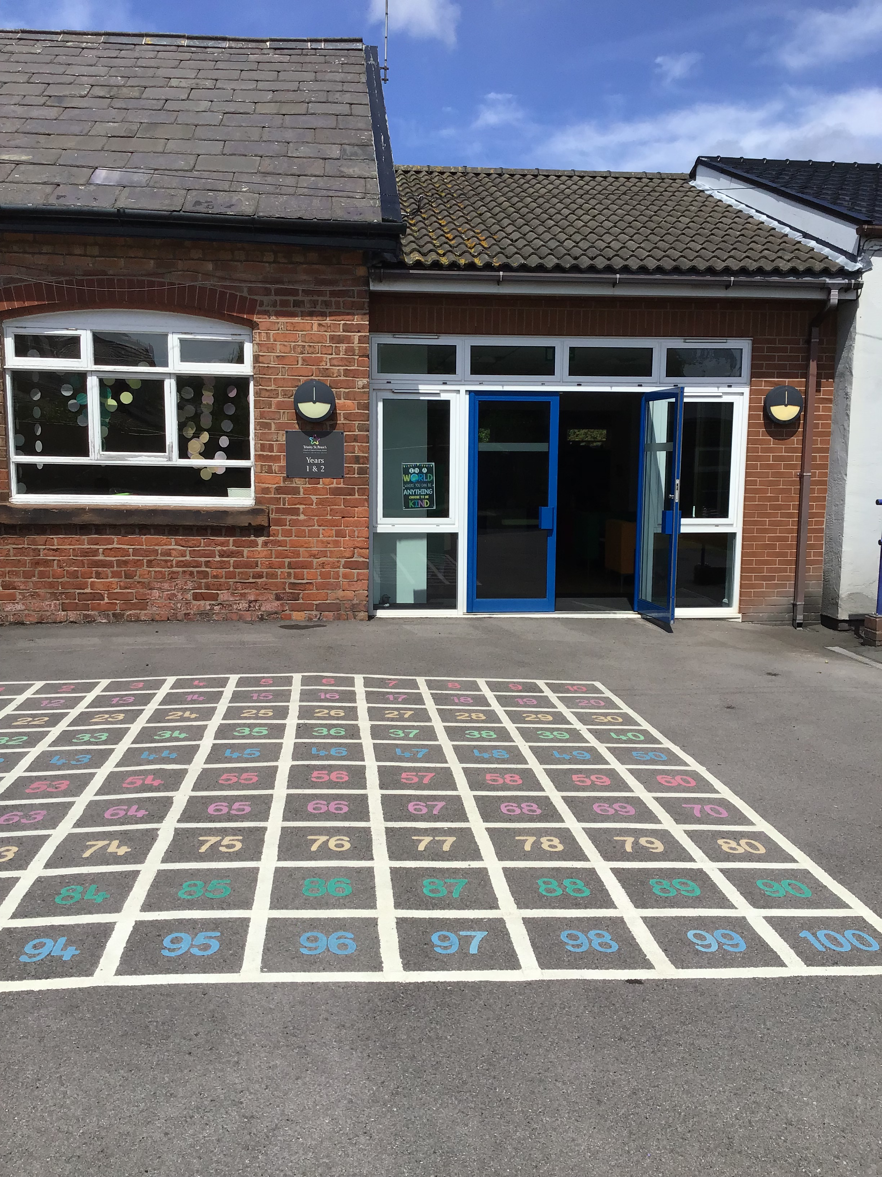
The School Day
In September, school will start promptly each morning at 8.50 am. However, the Key Stage 1 door - situated on the Key Stage 1 playground - will be open from 8.40 am.

Slide 4
The School Day
The school day will finish at 3:05pm. Children should be collected promptly from the Key Stage 1 door - situated on the Key Stage 1 playground.

Slide 5
Leave of absence
Children are in school for 190 days. This means there are 175 days for holidays etc. The school no longer has holiday forms in operation. Only applications for exceptional leave should be given to the school.
Any child whose absence has been unauthorised for longer than 4.5 days will result in a fine for the parents. This is the Department for Education's policy which the school must adhere to. Ofsted will also ensure the school complies with this.

Slide 6
Attendance
Attendance of 95% for the year equals 10 days that your child has been absent, that is 2 full school weeks of your child’s learning missed for that year.
Attendance of 90% for the year equals 19 days that your child has been absent, that is almost 4 school weeks missed.
Attendance of 85% for the year equals 29 days that your child has been absent per, that is almost 6 school weeks missed.
Punctuality matters
Being frequently late for school adds up to lost learning,
Arriving 5 minutes late every day adds up to over 3 days lost each year
Arriving 15 minutes late every day adds up to 2 weeks absence a year
Arriving 30 minutes late every adds up to 19 days absence a year

Slide 7
Uniform
Children are expected to wear the Foundation Stage uniform. It is important that your child’s name is clearly marked in all clothing and shoes. It would be very helpful if your child can recognise their name in their clothing.
The school uniform can only be purchased from Whittakers, Southport. This forms part of the school’s safeguarding procedures so it is important that all our families abide to this.
Children are able to play outside in all weather so it is really useful if your child can bring an all-in-one waterproof suit and a pair of wellingtons to leave in school. Please practise taking on and off their shoes and putting their own wellingtons on.
Please can a spare pair of underwear, t-shirt, jogging bottoms and socks also be
provided and kept in their school book bag everyday in case of emergencies.
For further information regarding the school’s uniform,
please read this policy.

Slide 8
Book Bag
It would be really helpful if your child could bring a book bag (available from the school office or Whittakers) every day. It is useful when taking home pictures, reading books and water bottles.
In the Summer, their book bag will safely store their sun cream and hat.

Slide 9
Sun Safety
When it is sunny, we encourage children to wear sun hats when playing outside. Please send a name labelled sun hat into school each day for your child.
We also ask you to apply sun cream before your child comes to school on sunny days.
Please also provide your child with a small bottle of roll on sun cream, including a clear name label, to apply themselves during the day.

Slide 10
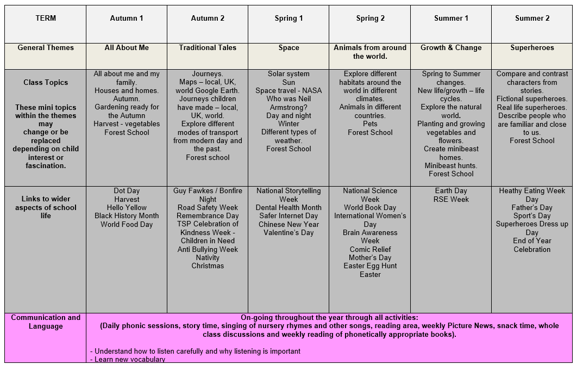
Curriculum
The Reception curriculum map, which outlines all the units taught across the each subject and their main objectives, can be found by clicking here.*
*Please note that amendments may be made throughout the year.

Slide 11
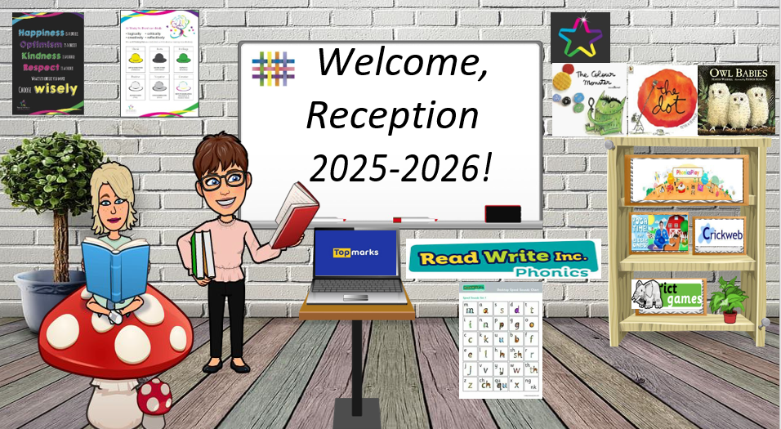
Additional Home Learning
On the final Reception Blog, you will also notice that there is also a section entitled ‘ Reception’s Virtual Classroom’. Your child will be able to use this image to quickly access the various websites we use by clicking on the various objects.

Slide 12
PE Kit
Children in Reception will access PE time every Monday and this will take place in the school hall or outdoor area.
Children will complete PE sessions in their uniform and must wear trainers with Velcro fastenings only on this day only.
No extra PE kit is needed.

Slide 13
Homework
There are times when Reception are set ‘Phonics Homework’, which is accessible via Tapestry.
We also encourage you to share any visits, events, celebrations or achievements that your child has taken part in outside of Reception via Tapestry. These can then be added to your child’s Learning Journal.

Slide 14
In preparation for September:
Children in Reception eat hot meals and are encouraged to do so by themselves. All children will need to practise the use of cutlery. Children should be competent at using a knife and fork independently.
Please also ensure that your child is able to do the following:
Take their coat on and off and hang it on their peg;
Wash and dry their hands;
Wipe their own bottom after using the toilet;
Open and close a water bottle;
Take their shoes on and off;
Put on their all-in-one waterproof independently.

Slide 15
Reading
As part of the children’s Read Write Inc. phonics sessions, the children in Reception will read daily to an adult. During these sessions, adults will support them with their phonetical awareness, pronunciation a decoding skills providing them with feedback. Each week, the ditty / book the child has read in class during these sessions will be sent home to develop their fluency. These books are matched to their phonetical ability. This means that, all being well, your child is able to read the book sent home with confidence. In addition to this, they will also receive an extra ‘Book Bag Book’ which they will not have read that week, this book will be the same level as their reading book.
Please record in your child’s Reading Record Book if they have read at home. The book is for parent use only.
On the ‘Learning at Home’ section of the school website, a recommended
Reading list titled ‘Recommended reading list for 4-year-olds’ is provided.

Slide 16
Behaviour and Anti Bullying Posters
These posters have been created by the pupils for the pupils. These posters are in line with the school’s values and are displayed and referred to throughout the school.

Slide 18
Contacting the Class Teacher
During the school year you may need to contact the class teachers.
You can do this by:
- Email reception@tsp.sefton.school;
Telephone call;
Pre-arranged appointment only.
Please kindly note, the teacher will check the class inbox each school morning at 8.30 am. A member of staff will endeavour to respond within 48 hours.
If there is a matter of urgency, please contact the school office as normal.
Class teachers are available to meet with parents by appointment only
between the hours of 8.15 am and 4.30 pm at a mutually convenient
and agreed time. The School Communication Policy can be found here

Slide 19
Contacting the SENDCo
If you would like to contact Mrs Molloy with a SEN related query or concern, you can contact her on the SENDCo account: SENDCO@tsp.sefton.school
Contacting the School Office
During the school year you may need to contact the school office.
You can do this by:
- Email - admin@tsp.sefton.school
Telephone – 01704 876391

Slide 20
Safeguarding
If you have a safeguarding concern, you can contact Mrs Pringle or a member of the Safeguarding Team: Mrs Martin (Deputy HT) or Mrs S Bevin and Mrs J Molloy (Early Year Leads/Senior Teachers).
Alternatively you can make a direct referral to Sefton Council by calling 0345 1400845 (8am - 6pm) or by contacting the emergency duty team on 0151 934 355 for urgent advice outside of office hours. Further information can be found here on the school website.

Slide 21
Home School Agreement
The Home School Agreement for September 2025 can be found here, which explains:
the school’s aims;
the school’s responsibilities towards its pupils;
the responsibility of each pupil’s parents;
what the school expects of its pupils.
This simple agreement between the school, parent and pupil outlines effective ways in which we can agree to work together to foster and maintain respectful and proactive relationships as your child moves through school.

Slide 22
Weekly Updates
The Reception class blog will be updated at the start and end of each half term. There will also be a weekly update on Tapestry of ‘What we have been doing this week’.
We also use Instagram to celebrate learning. Please follow your child’s class for updates:
@tsp_primary

