Slide 1
September 2025
Transition Guide

Slide 2
A Successful Start
To help you to support your child in having a smooth transition into Year 4 in September, we feel that the following information will assist you.
Please also note that a wealth of information, such as school policies, can be found on the school’s website.

Slide 3
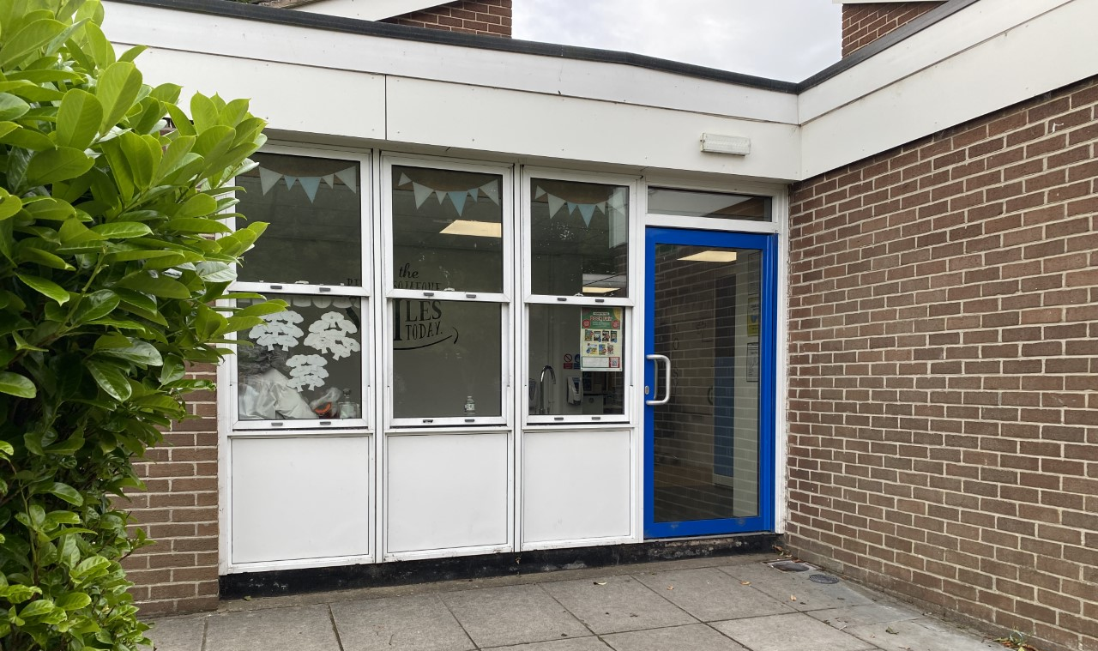
Start of the School Day
School starts promptly each morning at 8.50 am. However, the Year 4 classroom - situated next door to Year 3 classroom - will be open from 8.40 am.
During this time, children in Year 4 will complete ‘4-a-day’ calculations
which impacts positively on children’s arithmetic skills. Therefore, it is
advised that children are in school as early as possible.

Slide 4
End of the School Day
The school day will finish at 3:05pm and children should be collected promptly from outside the Year 4 classroom at this time, unless they are attending Clubhouse or an extracurricular club.
If your child has any alternative collection arrangements, please inform the school office: admin@tsp.sefton.school and Miss Mcvey via the Y4 email account: y4@tsp.sefton.school

Slide 5
What to bring
Children in Year 4 should only bring to school:
A school book back or a small bag
A small packed lunch bag
Water bottle
Reading book on their reading day
School PE kit bag when attending swimming or an extracurricular club.
Recorder on Monday’s (if not kept in school)
We would be grateful if parents can consider the size of the bag their child is bringing to school and whether a bag is in fact necessary. Large backpacks are proving to be difficult to fit in our lockers.

Slide 6
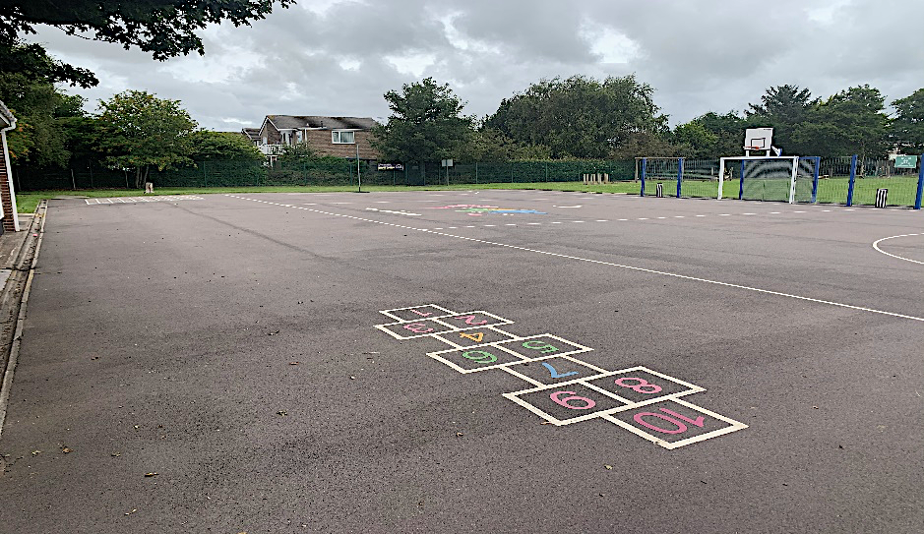
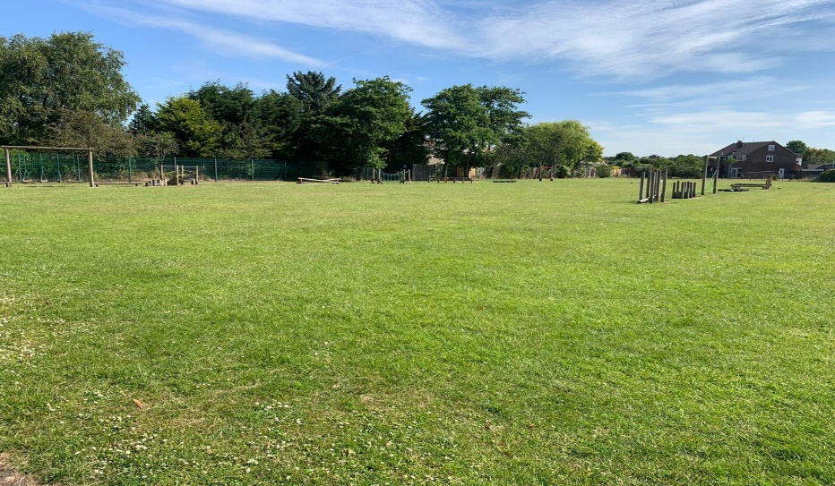
Break times & Snacks:
The children will spend break times and lunch times on the Key Stage 2 playground and field (weather depending) pictured below.
Children are encouraged to bring a healthy snack for morning break and an optional piece of fruit for the afternoon. As we promote healthy schools, children only eat healthy snacks at morning break-time and not
chocolate based snacks, crisps or similar. Fruit, yogurt, dried fruits
and other healthy snacks only are permitted.

Slide 7
Mobile Phones:
The use of mobile phones in school is strongly discouraged, as is the use of any other devices that allow for private communication, such as Smartphone watches. The school cannot take responsibility for loss or damage to such devices.
However, it is recognised that some pupils do require such devices for their journeys to and from school. Therefore, a letter with further information will be sent to all families at the start of the academic year.
If you give permission for your child to bring their phone or Smartphone watch into school - once you have read the terms of agreement – you will need to inform Miss Mcvey via the Y4 email address.

Slide 8
Leave of Absence:
Children are in school for 190 days. This means there are 175 days for holidays etc. The school no longer has holiday forms in operation. Only applications for exceptional leave should be given to the school.
Any child whose absence has been unauthorised for longer than 4.5 days may result in a fine for the parents. This is the Department for Education's policy which the school must adhere to. Ofsted will also ensure the school complies with this.

Slide 9
Attendance:
Attendance of 95% for the year equals 10 days that your child has been absent, that is 2 full school weeks of your child’s learning missed for that year.
Attendance of 90% for the year equals 19 days that your child has been absent, that is almost 4 school weeks missed.
Attendance of 85% for the year equals 29 days that your child has been absent per, that is almost 6 school weeks missed.
Punctuality matters:
Being frequently late for school adds up to lost learning:
Arriving 5 minutes late every day adds up to over 3 days lost each year;
Arriving 15 minutes late every day adds up to 2 weeks absence a year;
Arriving 30 minutes late every adds up to 19 days absence a year.

Slide 10
Uniform
All children should wear the correct school uniform in line with the uniform policy. This includes the school’s indoor and outdoor PE kit. All uniform should be labelled.
Please note, as per policy: children must wear a charcoal grey jumper/cardigan and the school’s charcoal jogging suit with school logo that can only be purchased from Whittakers, Southport or from Team TSP’s pre-loved uniform shop. Wearing school uniform forms part of the school’s safeguarding procedures so it is important that all our families abide to this.
Parents should always consult with school if a modification to the school’s uniform is required for their child’s needs.
For further information regarding the school’s uniform,
please read this policy.

Slide 11
PE
All children will access two hours of allocated PE time per week.
The children will have their first PE lesson of the week on a Tuesday afternoon and their second PE lesson on Wednesday afternoon, which will be a Swimming lesson in the Autumn term.
Children should come to school wearing their PE Kit on their designated PE days and wear their Winter Uniform before February half term.
If a child is unable to take part in a PE lesson, an email should be sent from the parent/guardian to the child’s class teacher.

Slide 12
Wednesday Afternoon – Swimming
During the Autumn term, the Year 4 pupils will attend swimming sessions at Formby Pool on a Wednesday afternoon as they have been doing in Year 3.
For swimming lessons, Formby Pool and Sefton Aquatics Team have specific rules regarding swimwear for school swimming lessons as detailed below:
• All children must wear a swimming cap.
• Boys must wear tight fitting swimming trunks/shorts - no baggy shorts.
• Girls must wear a one-piece appropriate swimming costume.
• Strictly no earrings or jewellery. Earrings cannot be covered with tape.
• All children will need a towel.

Slide 13
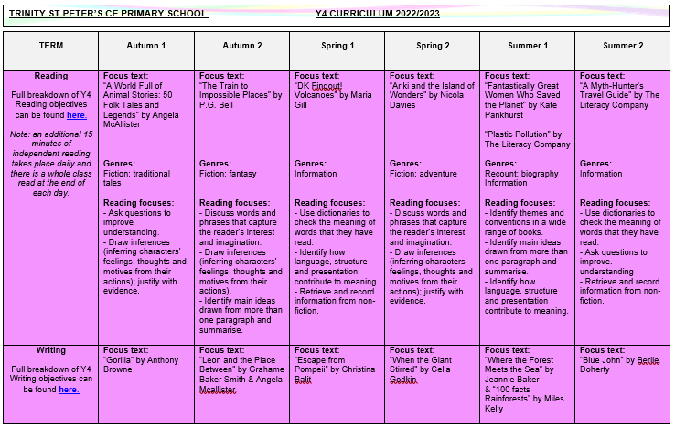
Curriculum
The Year 4 curriculum map, which outlines all the units taught across the each subject and their main objectives, can be found by clicking here.*
*Please note that amendments may be made throughout the year.

Slide 14
Music Provision
Children in Year 4 continue recorder lessons from a Sefton Music Service tutor, as part of the school’s Music provision. These sessions take place every Monday afternoon.
Children can bring in their own recorder from home or use one provided by school. Children are encouraged to take their recorders home each week to practise but must ensure that they are returned to school the following Monday.
It is responsibility of the child/guardian to keep the instruments in full working order and any issues should be reported to the child’s class teacher.

Slide 15
Weekly Spellings
Every Friday, a spelling list will be uploaded onto the 'Spellings' section of your child’s Google Classroom. The spellings will then be tested in class the following Friday.
We want every child to feel like they have given their best and not feel overwhelmed by the spelling test. Therefore, children are encouraged to learn the number of spellings from the spelling list they feel confident in recalling. If you find it beneficial for your child to just learn the first 3, 5 or 7 spellings on the list, please do so.
Spellings should be practised at home ready to be tested the following Friday. Additional exposure to the weekly spelling lists will also take place in class throughout the week.
Spelling results will be recorded on Google Classroom each week.

Slide 16
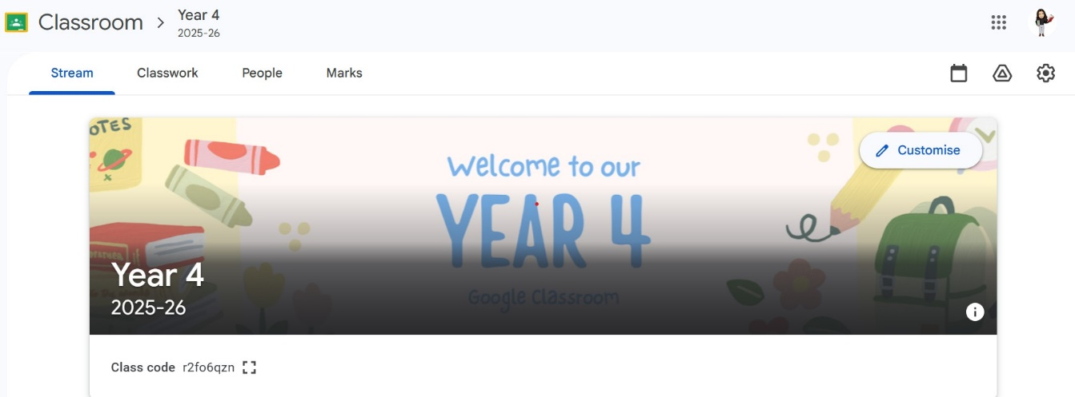
Additional Home Learning
Your child will sign up to their new Google Classroom in September. This will be a platform for learning in school and additional resources that can be used at home. Login details will be shared in September to access at home.
If your child wishes to do any additional work at home over summer, they will still be able to access last year’s classroom.

Slide 17
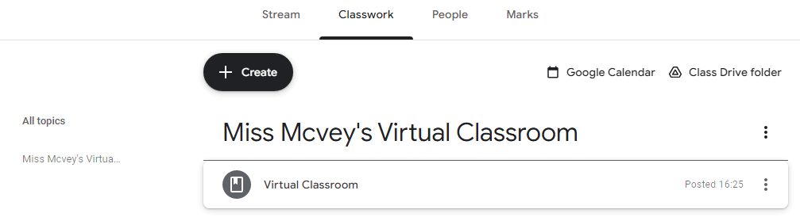
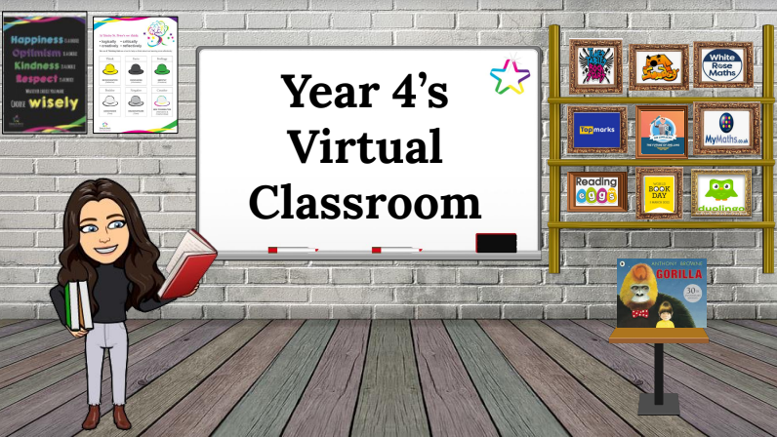
Additional Home Learning
Virtual classrooms will continue to be shared with children and parents each half-term via the Year 4 class blog and Google Classroom.
Your child will be able to use the image within Google Classroom to quickly access the various websites we use by clicking on the various objects. Children will be reminded on how to do this in September.

Slide 18
Additional Home Learning
Regular practice of times tables and related number facts will benefit and support your child’s mathematical knowledge and understanding.
By Year 4, national curriculum expectations are that children should know ALL multiplication tables (and related division facts) up to 12 x 12 with fluent recall.
The ‘Times Tables Rock Stars’ and ‘Sumdog’ apps/websites are particularly effective tools to cement these essential number facts. Your child has individual login details for these websites which are available via Google Classroom.
Please also remember to check the ‘Learning at Home’ section of the
school website as there are many other useful websites and
tutorials available that are appropriate for each key stage.

Slide 19



Additional Home Learning
For additional materials to support your child throughout Year 4, we would recommend the CGP workbooks, which can offer further help for general revision in Maths, SPaG and Reading, as well as specific, targeted areas in these subjects.

Slide 20
Reading
In Year 4, all children will be given the opportunity to read daily in class, using a book either from the school reading scheme or the class library. There will also be a class text, which will be read by Miss Mcvey and explicit Reading lessons will also be taught during each half-term.
Sharing and reading books with your child is one of the most important activities you can do at home:
An extra 10 minutes, five times per week equals 1800 minutes of reading throughout the school year.
20 minutes of reading per day exposes readers to 1.8 million words per year.
On the ‘Learning at Home’ section of the school website, a recommended reading list titled ‘100 Books to Read in Year 4’ is provided.
Should parents want to share any information about their child’s
reading at home, they can email the class teacher via the class
account.

Slide 21
Behaviour and Anti Bullying Posters
These posters have been created by the pupils for the pupils. These posters are in line with the school’s values and are displayed and referred to throughout the school.

Slide 23
Contacting the Class Teacher
During the school year you may need to contact the class teacher.
You can do this by:
- Email y4@tsp.sefton.school;
Telephone call;
Pre-arranged appointment only.
Please kindly note, the teacher will check the class inbox each school morning at 8.30 am. A member of staff will endeavour to respond within 48 hours.
If there is a matter of urgency, please contact the school office as normal.
Class teachers are available to meet with parents by appointment only
between the hours of 8.15 am and 4.30 pm at a mutually convenient
and agreed time. The School Communication Policy can be found here.

Slide 24
Contacting the SENDCo
If you would like to contact Mrs Martin with a SEN related query or concern, you can contact her on the SENDCo account: SENDCO@tsp.sefton.school
Contacting the School Office
During the school year you may need to contact the school office.
You can do this by:
- Email - admin@tsp.sefton.school
Telephone – 01704 876391

Slide 25
Home School Agreement
The Home School Agreement can be found here, which explains:
the school’s aims;
the school’s responsibilities towards its pupils;
the responsibility of each pupil’s parents;
what the school expects of its pupils.
This simple agreement between the school, parent and pupil outlines effective ways in which we can agree to work together to foster and maintain respectful and proactive relationships as your child moves through school.

Slide 26
Safeguarding
If you have a safeguarding concern, you can contact Mrs Pringle or a member of the Safeguarding Team: Mrs Martin (Deputy HT) or Mrs S Bevin and Mrs J Molloy (Early Year Leads/Senior Teachers).
Alternatively you can make a direct referral to Sefton Council by calling 0345 1400845 (8am - 6pm) or by contacting the emergency duty team on 0151 934 355 for urgent advice outside of office hours. Further information can be found here on the school website.

Slide 27
Weekly Updates
The Year 4 class blog will be updated at the start and end of each half term.
We also use Instagram to celebrate learning. Please follow our school account to see your child’s class updates:
@tsp_primary

