Slide 1
‘Successful Start’ 2025
Nursery Transition Guide

Slide 2
A Successful Start
To help you to support your child in having a smooth transition into Nursery in September, we feel that the following information will assist you.
Please also note that a wealth of information, such as school policies, can be found on the school’s website.

Slide 3
On Tuesday 2nd September, all Nursery pupils will be invited into school, to meet staff and visit the classroom for a short stay and play. Parents have been informed of their time for their short visit via email. Current Nursery children return to Nursery as normal
On Wednesday 3rd , Nursery pupils have a staggered start time to ensure a smooth arrival and transition to their first day. Nursery pupils will be invited into school at either 8.45am, 9.00am, 9.15am. Parents have been informed of their start time.
From Thursday 4th September, Nursery pupils are to arrive from 8.45am
(morning session to start at 8.50am).

Slide 4
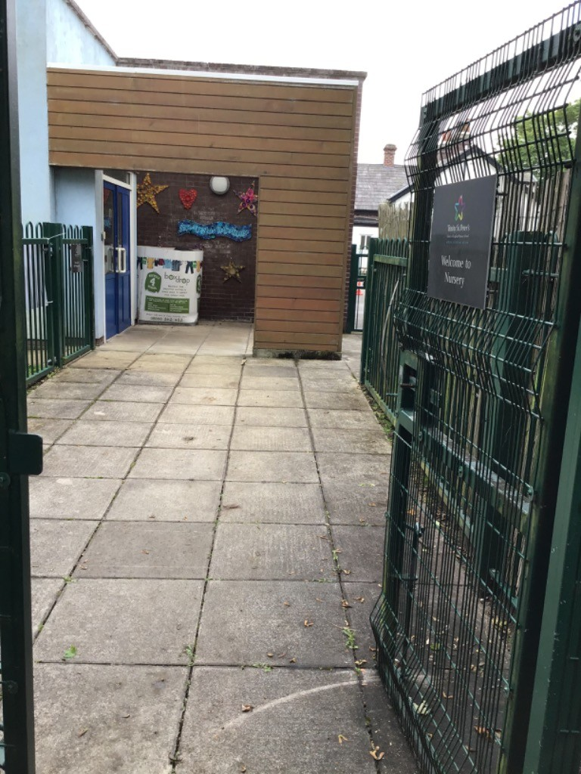
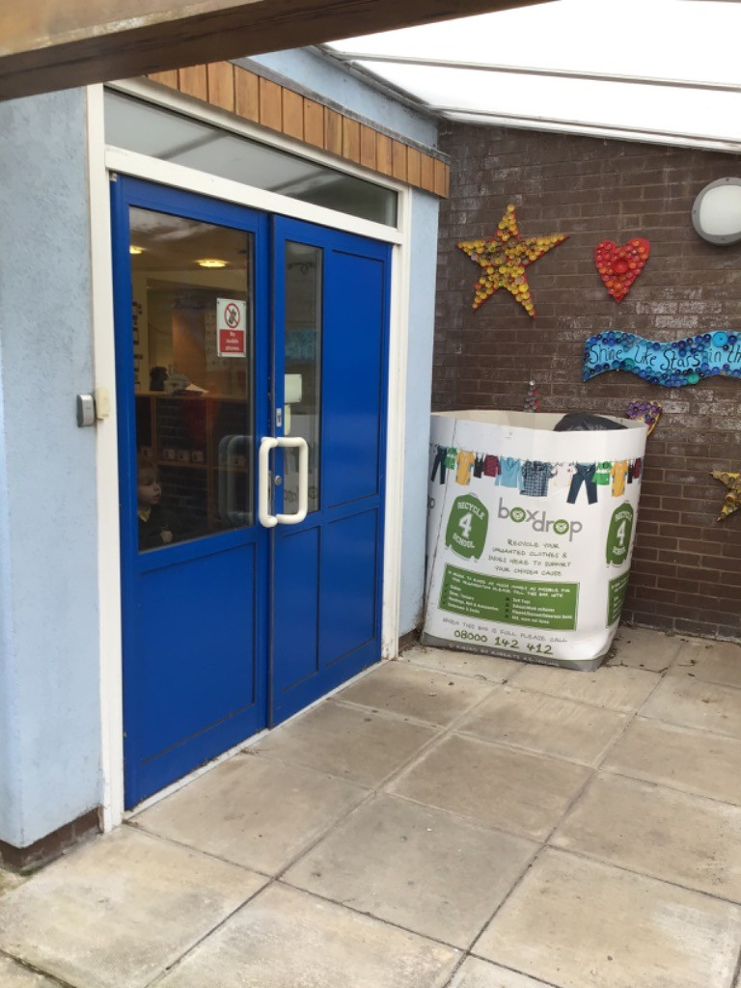
The School Day -
Nursery will start promptly each morning at 8.50 am. However, the Nursery main entrance door will be open from 8.45 am each day.

Slide 5
The School Day :
The Nursery morning session starts at 8.50am and ends at 11.50am. The Nursery door will be open daily from 8.45am until 8.55am
The Nursery afternoon session starts at 12.00 noon and ends at 3.00pm and the Nursery door will be open daily just before 12.00 noon and 2.55pm for the afternoon session.
Children who do either morning or afternoon sessions should be collected and dropped off promptly by a parent/designated adult via the Nursery Main Entrance door.
If your child is attending Clubhouse, they can be collected from Clubhouse at your agreed time.
Late Fees
In the case of late collection from Nursery, a fee of £10 per child will apply
if they are not collected after 5 minutes of their session ending.

Slide 6
Lunch time
Nursery Lunchtime is from 11.15am. The children will eat a school dinner in the school hall and return to their Nursery classroom / outdoor area for play.
If your child is attending all day or only attending a morning session, they will be able to have a school lunch at a cost of £2.81 per day.
Children who are only attending a morning must be collected at 11.45am and children who are only attending an afternoon session must have eaten their lunch before being dropped off at 12.00noon.

Slide 7
Leave of Absence:
If your child is absent from school, please email the class account or contact the office explaining the reason. If you know in advance that your child will be absent please email the class account or contact the office explaining the reason.

Slide 8
Uniform
Children are expected to wear the Foundation Stage uniform. It is important that your child’s name is clearly marked in all clothing and shoes. It would be very helpful if your child can recognise their name in their clothing.
The school uniform can only be purchased from Whittakers, Southport. This forms part of the school’s safeguarding procedures so it is important that all our families abide to this.
Children are able to play outside in all weather so it is really useful if your child can bring an all-in-one waterproof suit and a pair of wellingtons to leave in school. Please practise taking on and off their shoes and putting their own wellingtons on.
Please can a spare pair of underwear, polo shirt, jogging bottoms and socks also be provided and kept in their school book bag everyday in case of emergencies.
For further information regarding the school’s uniform,
please read this policy.

Slide 9
Book Bag
It would be really helpful if your child could bring a book bag (available from the school office or Whittakers) every day. It is useful when taking home pictures, reading books and water bottles.
Children in the school Nursery will have a ‘Belongings Box’ that will be used to keep their water bottles, pictures and in the summer their sun cream and hat safe.

Slide 10
Sun Safety
When it is sunny, we encourage children to wear sun hats when playing outside. Please send a name labelled sun hat into school each day for your child.
We also ask you to apply sun cream before your child comes to school on sunny days.
Please also provide your child with a small bottle of roll on or spray sun cream which is named for them to apply themselves during the day.

Slide 11
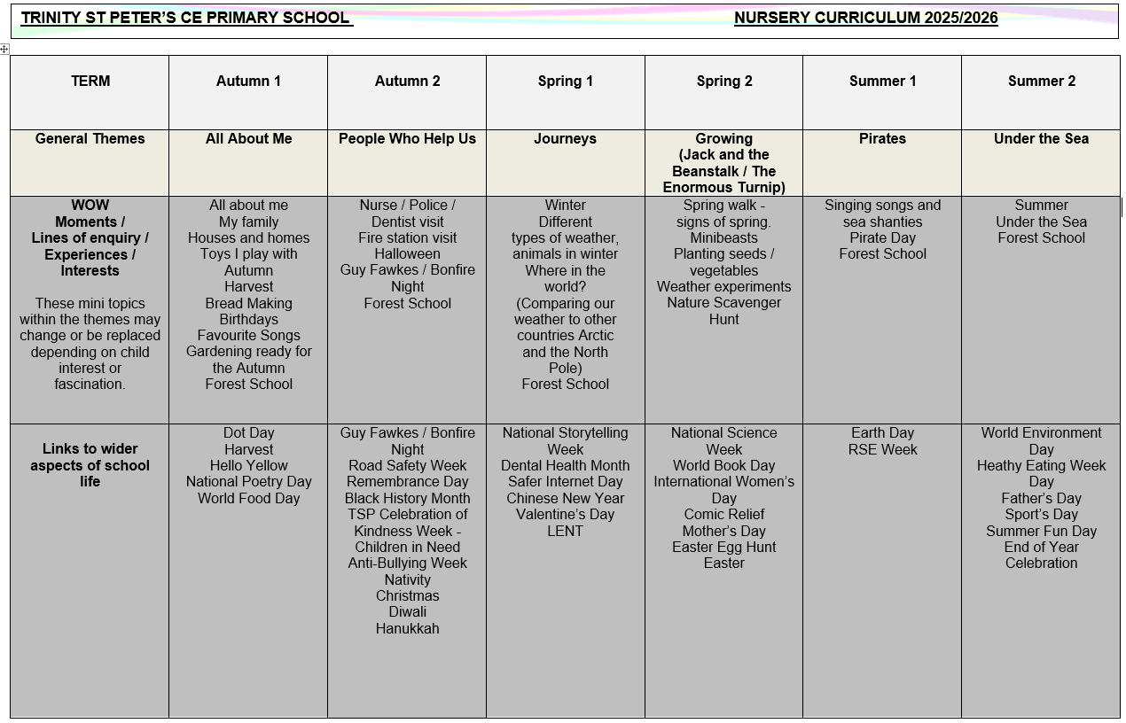
Curriculum
The Nursery curriculum map, which outlines all the units taught across the each subject and their main objectives, can be found by clicking here.*
*Please note that amendments may be made throughout the year.

Slide 12
PE
Children in Nursery will access PE time every Monday and this will take part in the school hall or outdoor area.
Children will complete PE sessions in their uniform and must wear trainers with Velcro fastenings only on this day only.
No extra PE kit is needed.

Slide 13
Homework
We encourage you to share any visits, events, celebrations or achievements that your child has taken part in outside of Nursery via Tapestry. These can then be added to your child’s Learning Journal.

Slide 14
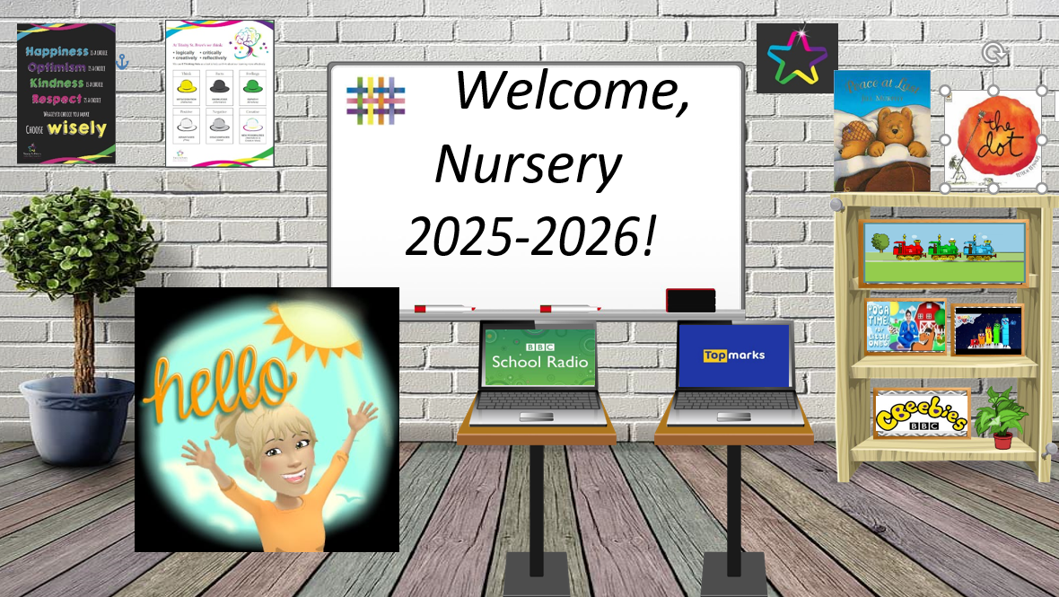
Additional Home Learning
On the final Nursery Blog, you will also notice that there is also a section entitled ‘ Nursery’s Virtual Classroom’. Your child will be able to use this image to quickly access the various websites we use by clicking on the various objects.

Slide 15
Things to practise over the Summer holidays with your child -
Please ensure that your child is able to do the following:
Take their coat on and off and hang it on their peg;
Identify their name with the support of a photograph;
Wash and dry their hands;
Get on and off the toilet independently;
Pull their underwear down to their ankles when needing the toilet;
Wipe their own bottom after using the toilet;
Open and close a water bottle;
Open a sandwich out of foil or cling film and take wrappers off a fruit bar /
cake / biscuit or any other items in their lunchbox;
Use a knife, fork and spoon when eating their dinner;

Slide 16
Reading
All children will a receive a book from our class library to share at home each week, to develop their love for reading.
Throughout the year, the children will be provided with the Ruth Miskin list of recommended rhymes, traditional tales and books, again to share at home. We will be focusing on a different aspect from this list each term.
Sharing and reading books with your child is one of the most important activities you can do at home:
An extra 10 minutes, five times per week equals 1800 minutes of reading throughout the school year.
20 minutes of reading per day exposes readers to 1.8 million words per year.
On the ‘Learning at Home’ section of the school website, a recommended
Reading list titled ‘Recommended reading list for 3-year-olds’ is provided.

Slide 17
Behaviour and Anti Bullying Posters
These posters have been created by the pupils for the pupils. These posters are in line with the school’s values and are displayed and referred to throughout the school.

Slide 19
Contacting the Class Teacher
During the school year, you may need to contact the class teachers.
You can do this by:
- Email nursery@tsp.sefton.school;
Telephone call;
Pre-arranged appointment only.
Please kindly note, the teacher will check the class inbox each school morning at 8.30 am. A member of staff will endeavour to respond within 48 hours.
If there is a matter of urgency, please contact the school office as normal.
Class teachers are available to meet with parents by appointment only
between the hours of 8.15 am and 4.30 pm at a mutually convenient
and agreed time. The School Communication Policy can be found here.

Slide 20
Contacting the SENDCo
If you would like to contact Mrs Molloy with a SEN related query or concern, you can contact her on the SENDCo account: SENDCO@tsp.sefton.school
Contacting the School Office
During the school year you may need to contact the school office.
You can do this by:
- Email - admin@tsp.sefton.school
Telephone – 01704 876391

Slide 21
Safeguarding
If you have a safeguarding concern, you can contact Mrs Pringle or a member of the Safeguarding Team: Mrs Martin (Deputy HT) or Mrs S Bevin and Mrs J Molloy (Early Year Leads/Senior Teachers).
Alternatively you can make a direct referral to Sefton Council by calling 0345 1400845 (8am - 6pm) or by contacting the emergency duty team on 0151 934 355 for urgent advice outside of office hours. Further information can be found here on the school website.

Slide 22
Home School Agreement
The Home School Agreement for September 2025 can be found here, which explains:
the school’s aims;
the school’s responsibilities towards its pupils;
the responsibility of each pupil’s parents;
what the school expects of its pupils.
This simple agreement between the school, parent and pupil outlines effective ways in which we can agree to work together to foster and maintain respectful and proactive relationships as your child moves through school.

Slide 23
Weekly Updates
The Nursery class blog will be updated at the start and end of each half term. There will also be a weekly update on Tapestry of ‘What we have been doing this week’.
We also use Instagram to celebrate learning. Please follow your child’s class for updates:
@tsp_primary

