Slide 1
September 2024
Transition Guide

Slide 2
A Successful Start
To help you to support your child in having a smooth transition into Year 4 in September, we feel that the following information will assist you.
Please also note that a wealth of information, such as school policies, can be found on the school’s website.

Slide 3
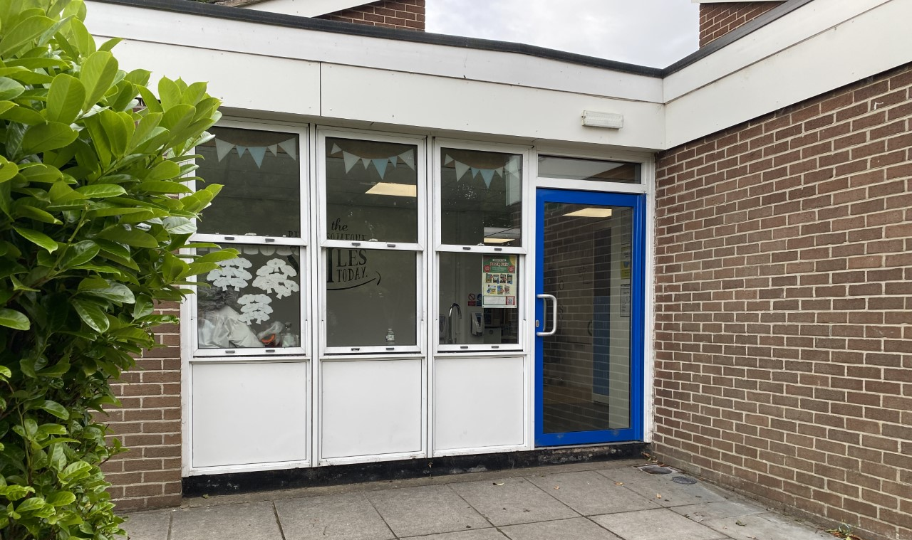
The School Day:
School starts promptly each morning at 8.50 am. However, the Year 4 classroom - situated next door to Year 3 classroom - will be open from 8.40 am.
During this time, children in Year 4 will complete ‘4-a-day’ calculations
which impacts positively on children’s arithmetic skills. Therefore, it is
advised that children are in school as early as possible.

Slide 4
The School Day
The school day will finish at 3:05pm and children should be collected promptly from outside the Year 4 classroom at this time, unless they are attending Clubhouse or an extracurricular club.
If your child has any alternative collection arrangements, please inform Miss Mcvey via the Y4 email account: y4@tsp.sefton.school

Slide 5
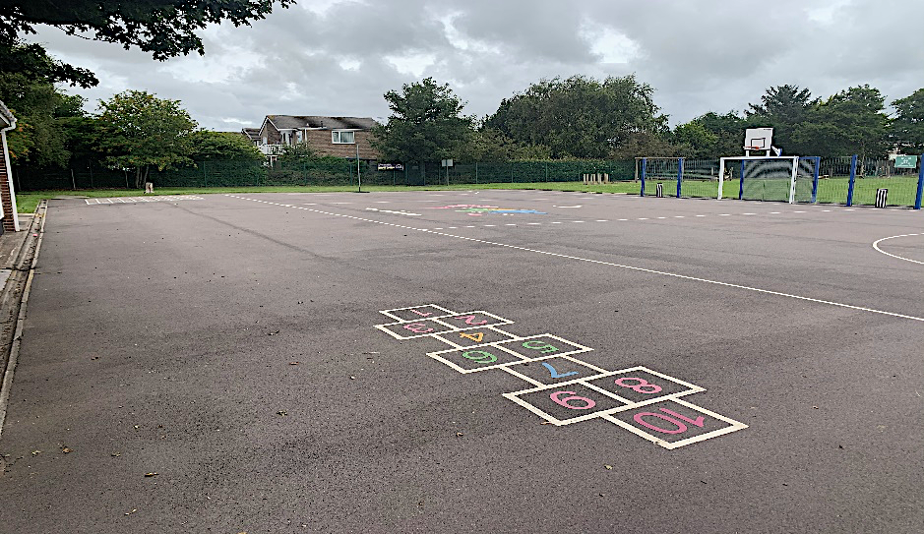
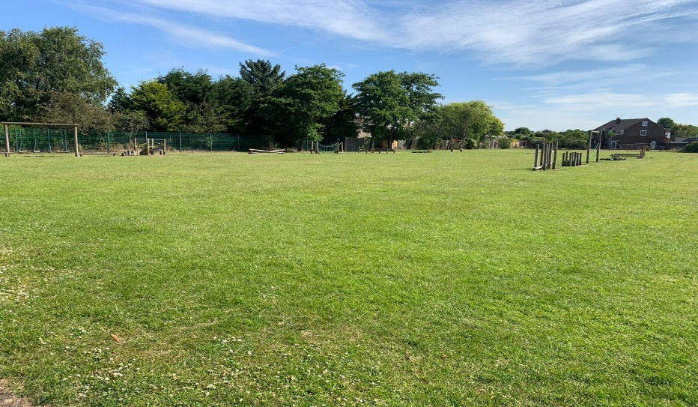
Break times & Snacks:
The children will spend break times and lunch times on the Key Stage 2 playground and field (weather depending) pictured below.
Children are encouraged to bring a healthy snack and a bottle of
water (ideally reusable) to school. As we promote healthy schools,
children only eat healthy snacks at morning break-time and not
chocolate based snacks, crisps or similar. Fruit, yogurt, dried fruits
and other healthy snacks only are permitted.

Slide 6
Mobile Phones:
The use of mobile phones in school is strongly discouraged, as is the use of any other devices that allow for private communication, such as Smartphone watches. The school cannot take responsibility for loss or damage to such devices.
However, it is recognised that some pupils do require such devices for their journeys to and from school. Therefore, a letter with further information will be sent to all families at the start of the academic year.
If you give permission for your child to bring their phone or Smartphone watch into school - once you have read the terms of agreement – you will need to inform Miss Mcvey via the Y4 email address.

Slide 7
Leave of Absence:
Children are in school for 190 days. This means there are 175 days for holidays etc. The school no longer has holiday forms in operation. Only applications for exceptional leave should be given to the school.
Any child whose absence has been unauthorised for longer than 4.5 days may result in a fine for the parents. This is the Department for Education's policy which the school must adhere to. Ofsted will also ensure the school complies with this.

Slide 8
Attendance:
Attendance of 95% for the year equals 10 days that your child has been absent, that is 2 full school weeks of your child’s learning missed for that year.
Attendance of 90% for the year equals 19 days that your child has been absent, that is almost 4 school weeks missed.
Attendance of 85% for the year equals 29 days that your child has been absent per, that is almost 6 school weeks missed.
Punctuality matters:
Being frequently late for school adds up to lost learning:
Arriving 5 minutes late every day adds up to over 3 days lost each year;
Arriving 15 minutes late every day adds up to 2 weeks absence a year;
Arriving 30 minutes late every adds up to 19 days absence a year.

Slide 9
Uniform
All children should wear the correct school uniform. This includes the school’s indoor and outdoor PE kit. All uniform should be labelled.
Please note, as per policy: children must wear a charcoal grey jumper/cardigan and the school’s charcoal jogging suit with school logo that can only be purchased from Whittakers, Southport or from Team TSP’s pre-loved uniform shop. Wearing school uniform forms part of the school’s safeguarding procedures so it is important that all our families abide to this.
Parents should always consult with school if a modification to the school’s uniform is required for their child’s needs.
For further information regarding the school’s uniform,
please read this policy.

Slide 10
Uniform
Children in Year 4 should only bring to school:
A small packed lunch bag ;
School PE kit bag when attending an extracurricular club.
On occasions, where children may need to bring a larger bag to school, parents should provide school with the reason for this. Due to the cloakroom area, large bags are not to be brought to school on a daily basis.
For further information regarding the school’s uniform,
please read this policy.

Slide 11
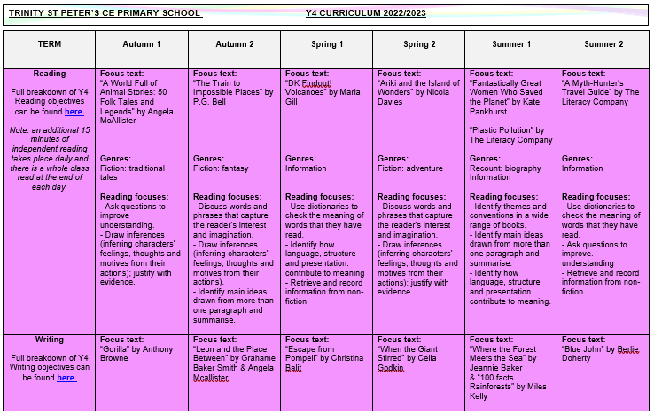
Curriculum
The Year 4 curriculum map, which outlines all the units taught across the each subject and their main objectives, can be found by clicking here.*
*Please note that amendments may be made throughout the year.

Slide 12
PE
All children will access two hours of allocated PE time per week.
On the two days allocated for your child’s PE lessons, your child is to come to school wearing their outdoor PE kit.
If a child is unable to take part in a PE lesson, an email should be sent from the parent/guardian to the child’s class teacher.
Parents should always consult with school if a modification to the school’s uniform is required for their child’s needs.
For further information, please read this policy.

Slide 13
PE Kits
Children should come to school wearing their PE Kit on their designated PE days and wear their Winter Uniform for Spring Term 1 (before February half term).
For further information, please read this policy.

Slide 14
PE Lessons – Autumn Term
The children will have their first PE lesson of the week on a Tuesday afternoon.
The children will have their second PE lesson of the week on Wednesday afternoon, which will be a Swimming lesson in the Autumn term.
Please ensure your child comes to school each Tuesday and Wednesday wearing the appropriate kit.

Slide 15
PE Lessons – Swimming
During the Autumn term, the Year 4 pupils will attend swimming sessions at Formby Pool on a Wednesday afternoon.
More information will follow when we return to school, but it may be advisable to take your child swimming when possible over the summer holidays, if you feel they still lack confidence.
For swimming lessons, Formby Pool and Sefton Aquatics Team have specific rules regarding swimwear for school swimming lessons as detailed below:
• All children must wear a swimming cap.
• Boys must wear tight fitting swimming trunks/shorts - no baggy shorts.
• Girls must wear a one-piece appropriate swimming costume.
• No earrings or jewellery.
• Children will need a towel.

Slide 16
Music Provision
Children in Year 4 receive recorder lessons from a Sefton Music Service tutor, as part of the school’s Music provision. These sessions take place every Monday afternoon.
The children should have the opportunity to take their instruments home after their lesson but must ensure that they are returned to school the following Monday.
It is responsibility of the child/guardian to keep the instruments in full
working order and any issues should be reported to the child’s
class teacher.

Slide 17
Spelling
Your child will continue to learn their spelling using the Read Write Inc Spelling Programme. Each day, your child will complete a series of activities linked to a specific spelling strategy.
They will then select six spellings from the week, which will be bespoke to them, for them to practise at home. These will be recorded in their Log Books.
These spellings will not be tested in school, instead, they are to be practised at home to further embed their spelling knowledge, which will enable them to successfully include them in their independent writing.

Slide 18
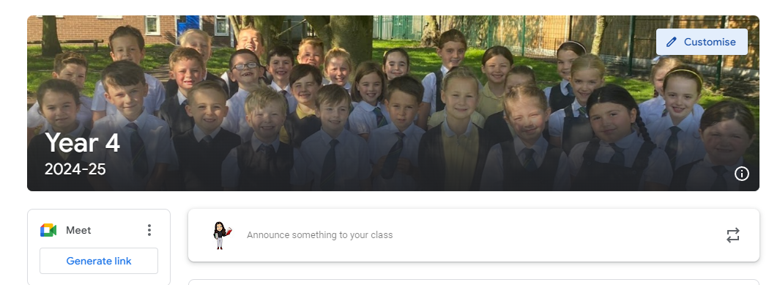
Additional Home Learning
Your child will sign up to their new, virtual classroom on Google Classroom in September.
If your child wishes to do any additional work at home, they will still be able to access last year’s classroom and their login details for the various sites they can use to support their independent learning (including Get Epic and TT Rockstars).

Slide 19
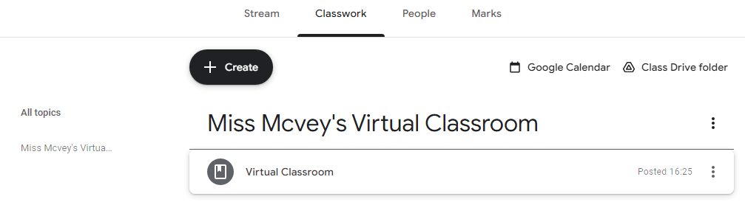
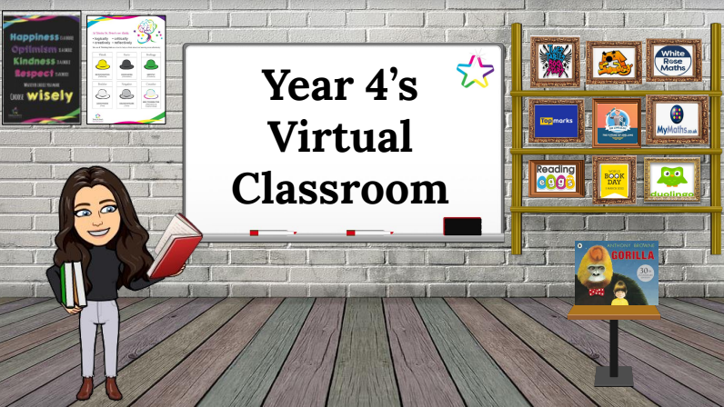
Additional Home Learning
Virtual classrooms will continue to be shared with children and parents each half-term.
Your child will be able to use the image within Google Classroom to quickly access the various websites we use by clicking on the various objects. Children will be reminded on how to do this in September.

Slide 20
Additional Home Learning
Regular practice of times tables and related number facts will benefit and support your child’s mathematical knowledge and understanding.
By Year 4, national curriculum expectations are that children should know ALL multiplication tables (and related division facts) up to 12 x 12 with fluent recall.
The ‘Times Tables Rock Stars’ and ‘Sumdog’ apps/websites are particularly effective tools to cement these essential number facts. Your child has individual login details for these websites which are available via Google Classroom.
Please also remember to check the ‘Learning at Home’ section of the
school website as there are many other useful websites and
tutorials available that are appropriate for each key stage.

Slide 21



Additional Home Learning
For additional materials to support your child throughout Year 4, we would recommend the CGP workbooks, which can offer further help for general revision in Maths, SPaG and Reading, as well as specific, targeted areas in these subjects.

Slide 22
Reading
In Year 4, all children will be given the opportunity to read daily in class, using a book either from the school reading scheme or the class library. There will also be a class text, which will be read by Miss Mcvey and explicit Reading lessons will also be taught during each half-term.
Sharing and reading books with your child is one of the most important activities you can do at home:
An extra 10 minutes, five times per week equals 1800 minutes of reading throughout the school year.
20 minutes of reading per day exposes readers to 1.8 million words per year.
On the ‘Learning at Home’ section of the school website, a recommended reading list titled ‘100 Books to Read in Year 4’ is provided.
Should parents want to share any information about their child’s
reading at home, they can email the class teacher via the class
account.

Slide 23
Behaviour and Anti Bullying Posters
These posters have been created by the pupils for the pupils. These posters are in line with the school’s values and are displayed and referred to throughout the school.

Slide 25
Contacting the Class Teacher
During the school year you may need to contact the class teacher.
You can do this by:
- Email y4@tsp.sefton.school;
Telephone call;
Pre-arranged appointment only.
Please kindly note, the teacher will check the class inbox each school morning at 8.30 am. A member of staff will endeavour to respond within 48 hours.
If there is a matter of urgency, please contact the school office as normal.
Class teachers are available to meet with parents by appointment only
between the hours of 8.15 am and 4.30 pm at a mutually convenient
and agreed time. The School Communication Policy can be found here.

Slide 26
Contacting the SENDCo
If you would like to contact Mrs Martin with a SEN related query or concern, you can contact her on the SENDCo account: SENDCO@tsp.sefton.school
Contacting the School Office
During the school year you may need to contact the school office.
You can do this by:
- Email - admin@tsp.sefton.school
Telephone – 01704 876391

Slide 27
Home School Agreement
The Home School Agreement for September 2024 can be found here, which explains:
the school’s aims;
the school’s responsibilities towards its pupils;
the responsibility of each pupil’s parents;
what the school expects of its pupils.
This simple agreement between the school, parent and pupil outlines effective ways in which we can agree to work together to foster and maintain respectful and proactive relationships as your child moves through school.

Slide 28
Safeguarding
If you have a safeguarding concern, you can contact Mrs Pringle or a member of the Safeguarding Team: Mrs Martin (Deputy HT) or Mrs S Bevin and Mrs J Molloy (Early Year Leads/Senior Teachers).
Alternatively you can make a direct referral to Sefton Council by calling 0345 1400845 (8am - 6pm) or by contacting the emergency duty team on 0151 934 355 for urgent advice outside of office hours. Further information can be found here on the school website.

Slide 29
Weekly Updates
Every Friday, class teachers update their class blog with highlights from the learning week.
We also use Twitter to celebrate learning. Please follow your child’s class for updates:
@Year4TSP

