Slide 1

‘Successful Start’ 2024
Transition Guide

Slide 2
A Successful Start
To help you to support your child in having a smooth transition into Year 2 in
September, we feel that the following information will assist you.
Please also note that a wealth of information, such as school policies, can be found on the school’s website.

Slide 3
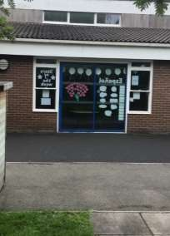
The School Day
In September, school will start promptly each morning at 8.50 am. However, the
Year 2 door will be open from 8.40 am.
During this time, children in Year 2 will complete ‘4-a-day’ calculations which impacts positively on children’s arithmetic skills. Therefore, it is advised that children are in school as early as possible.

Slide 4

The School Day
The school day will finish at 3:05pm and children should be collected promptly from outside the Year 2 door at this time, unless they are attending Clubhouse or an extracurricular club.

Slide 5
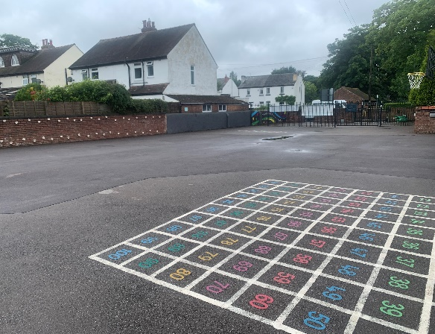
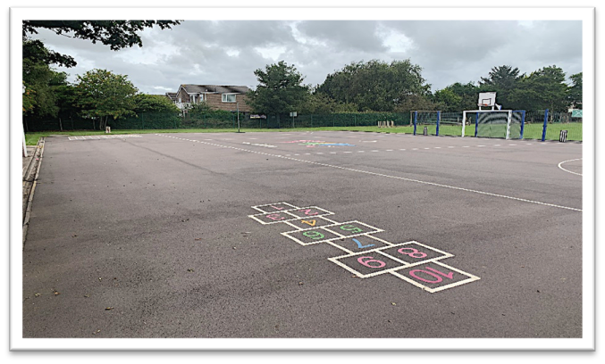
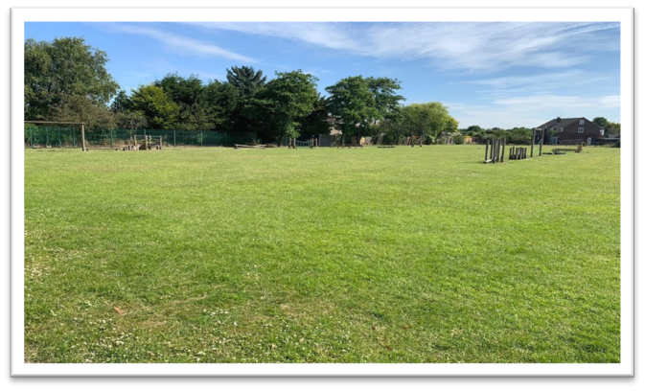
Break times & Snacks:
The children will spend break times on the Key Stage 1 playground and the KS2 playground/ field for lunch, (weather depending) pictured below.
Children are encouraged to bring a healthy snack and a bottle of water (ideally reusable) to school. As we promote healthy schools, children only eat healthy snacks at morning break-time and not chocolate-based snacks, crisps or similar. Fruit, yogurt, dried fruits and other healthy snacks only are permitted. Please ensure that grapes are cut in half.

Slide 6
Leave of Absence:
Children are in school for 190 days. This means there are 175 days for holidays etc. The school no longer has holiday forms in operation. Only applications for exceptional leave should be given to the school.
Any child whose absence has been unauthorised for longer than 4.5 days may result in a fine for the parents. This is the Department for Education's policy which the school must adhere to. Ofsted will also ensure the school complies with this.

Slide 7
Attendance:
Attendance of 95% for the year equals 10 days that your child has been
absent, that is 2 full school weeks of your child’s learning missed for that year.
Attendance of 90% for the year equals 19 days that absent, that is almost 4 school weeks missed. | your | child | has | been
Attendance of 85% for the year equals 29 days that absent per, that is almost 6 school weeks missed. | your | child | has | been
Punctuality matters:
Being frequently late for school adds up to lost learning:
Arriving 5 minutes late every day adds up to over 3 days lost each year;
Arriving 15 minutes late every day adds up to 2 weeks absence a year;
Arriving 30 minutes late every adds up to 19 days absence a year.

Slide 8
Uniform
All children should wear the correct school uniform. This includes the school’s
indoor and outdoor PE kit. All uniform should be labelled.
Please note, as per policy: children must wear a charcoal grey jumper/cardigan and the school’s charcoal jogging suit with school logo that can only be purchased from Whittakers, Southport or from Team TSP’s pre-loved uniform shop. Wearing school uniform forms part of the school’s safeguarding procedures so it is important that all our families abide to this.
Parents should always consult with school if a modification to the school’s
uniform is required for their child’s needs.
For further information regarding the school’s uniform,
please read this policy

Slide 9
Uniform
Children in Year 2 should only bring to school:
A small packed lunch bag (if not having school dinners) ;
School PE kit bag when attending an extracurricular club;
School book bag on their reading day, to transport books to and from school.
On occasions, where children may need to bring a larger bag to school, parents should provide school with the reason for this. Due to the limited locker space, large bags are not to be brought to school on a daily basis.
For further information regarding the school’s uniform,
please read this policy.

Slide 10
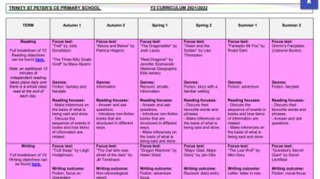
Curriculum
The Year 2 curriculum map, which outlines all the units taught across the each
subject and their main objectives, can be found by clicking here.*
*Please note that amendments may be made throughout the year.

Slide 11
PE
All children will access two hours of allocated PE time per week.
On the two days allocated for your child’s PE lessons, your child is to come
to school wearing their outdoor PE kit.
If a child is unable to take part in a PE lesson, an email should be sent from the
parent/guardian to the child’s class teacher.
Parents should always consult with school if a modification to the school’s uniform
is required for their child’s needs.
For further information, please read this policy.

Slide 12
PE Lessons – Autumn Term
The children will have their first PE lesson of the week on Monday afternoon.
The children will have their second PE lesson of the week on Thursday morning.
Please ensure your child comes to school each Monday and Thursday
wearing their full outdoor PE kit.

Slide 13
PE Kits
Children should come to school wearing their PE Kit on their designated PE days and wear their winter uniform for Autumn Term 2 (after the October half term) and Spring Term 1 (before February half term).
For further information, please read this policy.

Slide 14
Reading
As part of the children’s Read Write Inc. reading sessions, the children in Year 2 will read daily to an adult. During these sessions, adults will support them with their phonetical awareness and decoding skills. Each week, the book the child has read in class during these sessions will be sent home to develop their fluency. These books are matched to their phonetical ability. This means that, all being well, your child is able to read the book sent home with confidence. In addition to this, they will also receive an extra ‘Book Bag Book’ which they will not have read that week, this book will be the same level as their reading book.
However, once your child reaches the end of the Read Write Inc. scheme, they will be assessed on the Oxford Reading Tree and books matching their ability will be sent home accordingly.
Please record in your child’s Reading Record Book if they have read at home. The book is for
parent use only. All children’s reading books should be brought to school on your child’s
designated reading day.

Slide 15
Additional Home Learning
If you are looking for additional work for your child to complete over the summer holidays Miss Law’s virtual classroom has been uploaded to the blog. You will be able to use this image to quickly access the websites we use by clicking on the various objects.

Slide 16
Additional Home Learning
Regular practice of number bonds and counting forwards and backwards to/across 100 will benefit and support your child’s mathematical knowledge and understanding.
Within the curriculum, there is an increased emphasis on place value understanding before moving onto more complex written methods. Therefore, children have a better conceptual understanding of number and can more competently link to real-life problem solving.
By the end of Year 2 National Curriculum expectations are that children can count in 2s, 5s
and 10s.
Please also remember to check the ‘Learning at Home’ section of the school website as there are many other useful websites and tutorials available that
are appropriate for each key stage.

Slide 17


Behaviour and Anti Bullying Posters
These posters have been created by the pupils for the pupils. These posters are in line with the school’s values and are displayed and referred to throughout the school.

Slide 18



Slide 19
Contacting the Class Teacher
During the school year you may need to contact the class teacher. You can do this by:
Email y2@tsp.sefton.school;
Telephone call;
Pre-arranged appointment only.
Please kindly note, the teacher will check the class inbox each school morning at
8.30 am. A member of staff will endeavour to respond within 48 hours.
If there is a matter of urgency, please contact the school office as normal. Class teachers are available to meet with parents by appointment only
between the hours of 8.15 am and 4.30 pm at a mutually convenient
and agreed time .The School Communication Policy can be found here.

Slide 20
Contacting the SENDCo
If you would like to contact Mrs Martin with a SEN related query or concern, you can contact her on the SENDCo account: SENDCO@tsp.sefton.school
Contacting the School Office
During the school year you may need to contact the school office. You can do this by:
- Email - admin@tsp.sefton.school
- Telephone – 01704 876391

Slide 21
Home School Agreement
The Home School Agreement for September 2024 can be found here, which explains:
the school’s aims;
the school’s responsibilities towards its pupils;
the responsibility of each pupil’s parents;
what the school expects of its pupils.
This simple agreement between the school, parent and pupil outlines effective ways in which we can agree to work together to foster and maintain respectful and proactive relationships as your child moves through school.

Slide 22
Safeguarding
If you have a safeguarding concern, you can contact Mrs Pringle or a member of the Safeguarding Team: Mrs Martin (Deputy HT) or Mrs S Bevin and Mrs J Molloy (Early Year Leads/Senior Teachers).
Alternatively you can make a direct referral to Sefton Council by calling 0345 1400845 (8am - 6pm) or by contacting the emergency duty team on 0151 934 355 for urgent advice outside of office hours. Further information can be found here on the school website.

Slide 23
Weekly Updates
Every Friday, class teachers update their class blog with highlights from the
learning week.
Weekly class blogs will also provide a brief overview of Maths and English learning from that week as well as the content due to be covered the following week. This is to further support with home learning opportunities.
We also use Twitter to celebrate learning. Please follow your child’s class for
updates:
@Year2TSP

