Slide 1
‘Successful Start’ 2023
Transition Guide

Slide 2
A Successful Start
To help you to support your child in having a smooth transition into Year 5 in September, we feel that the following information will assist you.
Please also note that a wealth of information, such as school policies, can be found on the school’s website.

Slide 3
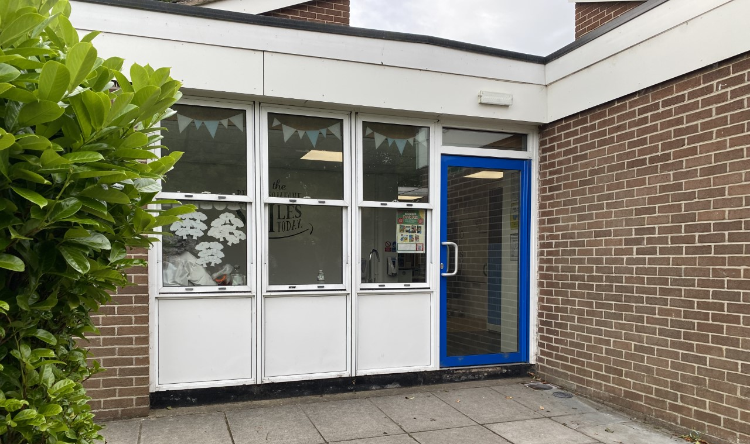
The School Day:
In September, school will start promptly each morning at 8.50 am. However, the Year 4 classroom - situated next door to Year 3 classroom - will be open from 8.40 am.
During this time, children in Year 4 will complete ‘4-a-day’ calculations
which impacts positively on children’s arithmetic skills. Therefore, it is
advised that children are in school promptly.

Slide 4
The School Day:
The school day will finish at 3:05pm and children should be collected promptly from outside the Year 4 classroom at this time, unless they are attending Clubhouse or an extracurricular club.
If your child has any alternative collection arrangements, please inform Miss Mcvey via the Y4 email account: y4@tsp.sefton.school

Slide 5
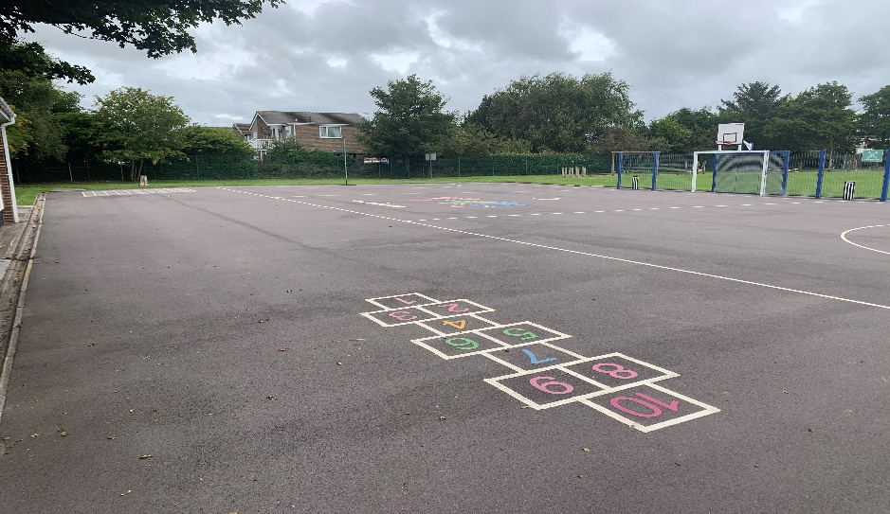
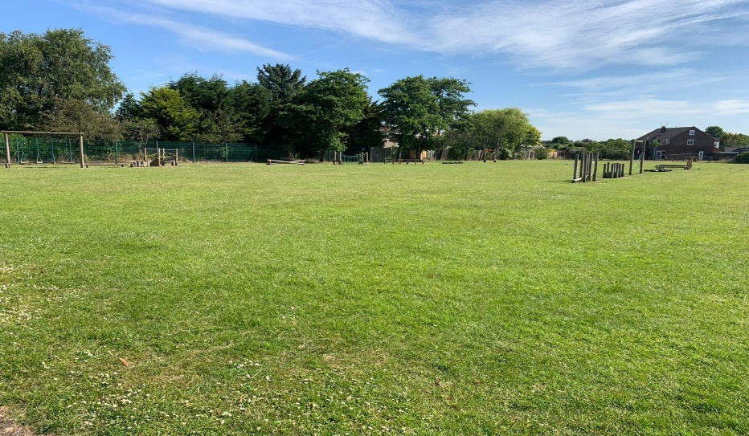
Break times & Snacks:
The children will spend break times and lunch times on the Key Stage 2 playground and field (weather depending) pictured below.
Children are encouraged to bring a healthy snack and a bottle of
water (ideally reusable) to school. As we promote healthy schools,
children only eat healthy snacks at morning break-time and not
chocolate based snacks, crisps or similar. Fruit, yogurt, dried fruits
and other healthy snacks only are permitted.

Slide 6
Mobile Phones:
The use of mobile phones in school is strongly discouraged, as is the use of any other devices that allow for private communication, such as Smartphone watches. The school cannot take responsibility for loss or damage to such devices.
However, it is recognised that some pupils do require such devices for their journeys to and from school. Therefore, a letter with further information will be sent to all families shortly.
If you give permission for your child to bring their phone or Smartphone watch into school - once you have read the terms of agreement – you will need
to inform Miss McVey via the Y4 email address: y4@tsp.sefton.school

Slide 7
Leave of Absence:
Children are in school for 190 days. This means there are 175 days for holidays etc. The school no longer has holiday forms in operation. Only applications for exceptional leave should be given to the school.
Any child whose absence has been unauthorised for longer than 4.5 days may result in a fine for the parents. This is the Department for Education's policy which the school must adhere to. Ofsted will also ensure the school complies with this.

Slide 8
Attendance:
Attendance of 95% for the year equals 10 days that your child has been absent, that is 2 full school weeks of your child’s learning missed for that year.
Attendance of 90% for the year equals 19 days that your child has been absent, that is almost 4 school weeks missed.
Attendance of 85% for the year equals 29 days that your child has been absent per, that is almost 6 school weeks missed.
Punctuality matters:
Being frequently late for school adds up to lost learning:
Arriving 5 minutes late every day adds up to over 3 days lost each year;
Arriving 15 minutes late every day adds up to 2 weeks absence a year;
Arriving 30 minutes late every adds up to 19 days absence a year.

Slide 9
Uniform
All children should wear the correct school uniform. This includes the school’s indoor and outdoor PE kit. All uniform should be labelled.
Please note, as per policy: children must wear a charcoal grey jumper/cardigan and the school’s charcoal jogging suit with school logo that can only be purchased from Whittakers, Southport. This forms part of the school’s safeguarding procedures so it is important that all our families abide to this.
Parents should always consult with school if a modification to the school’s uniform is required for their child’s needs.
For further information regarding the school’s uniform,
please read this policy.

Slide 10
Uniform
Children in Year 4 should only bring to school:
A small packed lunch bag ;
School PE kit bag when attending an extracurricular club.
On occasions, where children may need to bring a larger bag to school, parents should provide school with the reason for this. Due to the cloakroom/locker area, large bags are not to be brought to school on a daily basis.
For further information regarding the school’s uniform,
please read this policy.

Slide 11
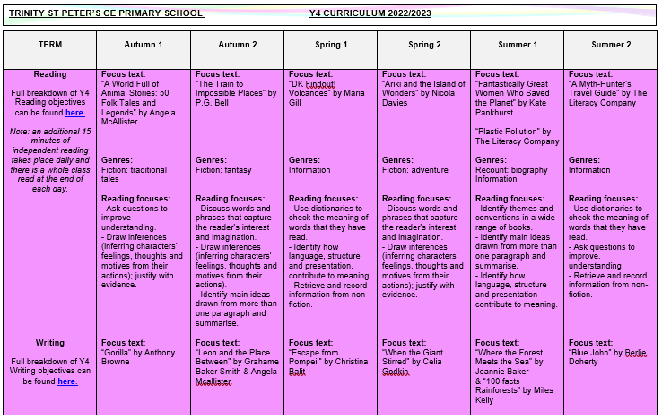
Curriculum
The Year 4 curriculum map, which outlines all the units taught across the each subject and their main objectives, can be found by clicking here.*
*Please note that amendments may be made throughout the year.

Slide 12
PE
All children will access two hours of allocated PE time per week.
On the two days allocated for your child’s PE lessons, your child is to come to school wearing their outdoor PE kit.
If a child is unable to take part in a PE lesson, an email should be sent from the parent/guardian to the child’s class teacher.
Parents should always consult with school if a modification to the school’s uniform is required for their child’s needs.
For further information, please read this policy.

Slide 13
PE Lessons – Autumn Term
During the autumn term, the Year 4 pupils will attend swimming sessions at Formby Pool on Wednesdays. Swimming lessons will commence the second week back to school. A letter will be sent in the new academic year to confirm swimming arrangements.
For swimming lessons, Formby Pool and Sefton Aquatics Team have specific rules regarding swimwear for school swimming lessons as detailed below:
• All children must wear a swimming cap.
• Boys must wear tight fitting swimming trunks/shorts - no baggy shorts.
• Girls must wear a one-piece appropriate swimming costume.
• No earrings or jewellery.
• Children will need a towel.

Slide 14
PE Kits
Children should come to school wearing their PE Kit on their designated PE days and wear their Winter Uniform for Spring Term 1 (before February half term).
The designated PE days for Year 4 are Tuesday (School PE) and Wednesday (Swimming).
For further information, please read this policy.

Slide 15
Music Provision
Children in Year 4 receive recorder lessons from a Sefton Music Service tutor, as part of the school’s Music provision. These sessions take place every Monday afternoon.
The children should have the opportunity to take their instruments home after their lesson but must ensure that they are returned to school the following Monday.
It is responsibility of the child/guardian to keep the instruments in full working order and any issues should be reported to the child’s class teacher.

Slide 16
Homework
Your child will receive spellings to learn each week on Google Classroom. These are taken from the National Curriculum and will be set every Friday and tested the following Thursday.

Slide 17
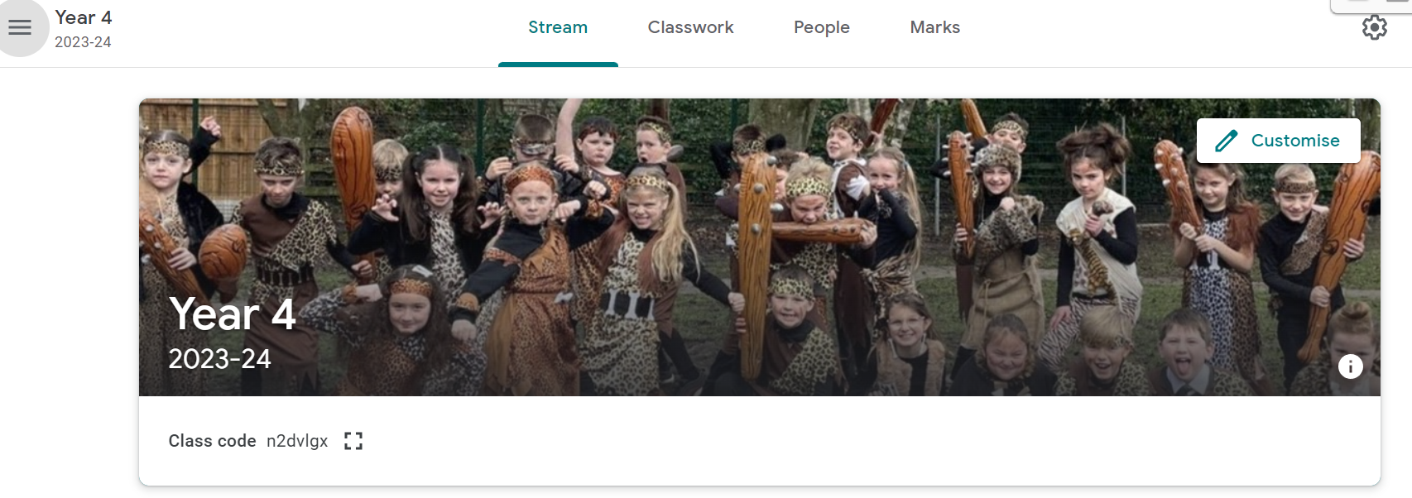
Additional Home Learning
Your child will have signed in to their new, virtual classroom on Google Classroom following their transition session with Miss Mcvey.
If your child wishes to do any additional work over the summer holidays, they will be able to access all their login details for the various sites they can use to support their independent learning (e.g. Times Table Rockstars, Sumdog, Epic etc.) via their Google Classroom.

Slide 18
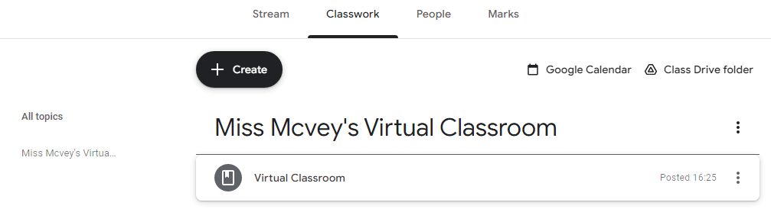
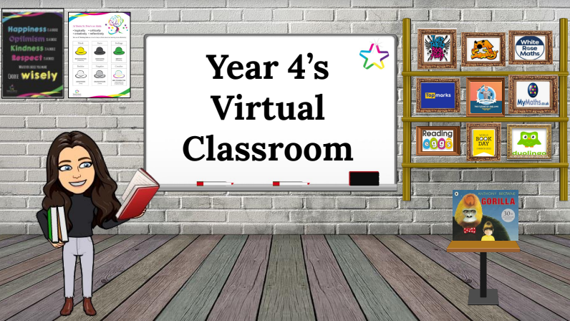
Additional Home Learning
Under the ‘Classwork’ tab on Google Classroom, you will also notice that there is also a section entitled ‘Miss Mcvey’s Virtual Classroom’. Your child will be able to use this image within Google Classroom to quickly access the various websites we use by clicking on the various objects.

Slide 19
Additional Home Learning
Regular practice of times tables and related number facts will benefit and support your child’s mathematical knowledge and understanding.
By Year 4, national curriculum expectations are that children should know ALL multiplication tables (and related division facts) up to 12 x 12 with fluent recall.
The ‘Times Tables Rock Stars’ and ‘Sumdog’ apps/websites are particularly effective tools to cement these essential number facts. Your child has individual login details for these websites which are available via Google Classroom.
Please also remember to check the ‘Learning at Home’ section of the
school website as there are many other useful websites and
tutorials available that are appropriate for each key stage.

Slide 20



Additional Home Learning
For additional materials to support your child throughout Year 4, we would recommend the CGP workbooks, which can offer further help for general revision in Maths, SPaG and Reading, as well as specific, targeted areas in these subjects.

Slide 21
Reading
In Year 4, all children will be given the opportunity to read daily in class, using a book either from the school reading scheme or the class library. There will also be a class text, which will be read by Miss Mcvey, and standalone Reading lessons will also be taught during each half-term.
Sharing and reading books with your child is one of the most important activities you can do at home:
An extra 10 minutes, five times per week equals 1800 minutes of reading throughout the school year.
20 minutes of reading per day exposes readers to 1.8 million words per year.
On the ‘Learning at Home’ section of the school website, a recommended
reading list titled ‘100 Books to Read in Year 3 & 4’ and
‘100 Books to Read in Year 5 & 6’ is provided.
Should parents want to share any information about their child's
reading at home, they can email the class teacher via the class
account.

Slide 22
Behaviour and Anti Bullying Posters
These posters have been created by the pupils for the pupils. These posters are in line with the school’s values and are displayed and referred to throughout the school.

Slide 24
Contacting the Class Teacher
During the school year you may need to contact the class teacher.
You can do this by:
- Email y4@tsp.sefton.school;
Telephone call;
Pre-arranged appointment only.
Please kindly note, the teacher will check the class inbox each school morning at 8.30 am. A member of staff will endeavour to respond within 48 hours.
If there is a matter of urgency, please contact the school office as normal.
Class teachers are available to meet with parents by appointment only
between the hours of 8.15 am and 4.30 pm at a mutually convenient
and agreed time. The School Communication Policy can be found here.

Slide 25
Contacting the SENDCo
If you would like to contact Mrs Martin with a SEN related query or concern, you can contact her on the SENDCo account: SENDCO@tsp.sefton.school
Contacting the School Office
During the school year you may need to contact the school office.
You can do this by:
- Email - admin@tsp.sefton.school
Telephone – 01704 876391

Slide 26
Safeguarding
If you have a safeguarding concern, you can contact Mrs Pringle or a member of the Safeguarding Team: Mrs Martin (Deputy HT) or Mrs S Bevin and Mrs J Molloy (Early Year Leads/Senior Teachers).
Alternatively you can make a direct referral to Sefton Council by calling 0345 1400845 (8am - 6pm) or by contacting the emergency duty team on 0151 934 355 for urgent advice outside of office hours. Further information can be found here on the school website.

Slide 27
Home School Agreement
The Home School Agreement for September 2023 can be found here, which explains:
the school’s aims;
the school’s responsibilities towards its pupils;
the responsibility of each pupil’s parents;
what the school expects of its pupils.
This simple agreement between the school, parent and pupil outlines effective ways in which we can agree to work together to foster and maintain respectful and proactive relationships as your child moves through school.

Slide 28
Weekly Updates
Every Friday, class teachers update their class blog with highlights from the learning week.
Weekly class blogs will also provide a brief overview of Maths and English learning from that week as well as the content due to be covered the following week. This is to further support with home learning opportunities.
We also use Twitter to celebrate learning. Please follow your child’s class for updates:
@Year4TSP

