Slide 1
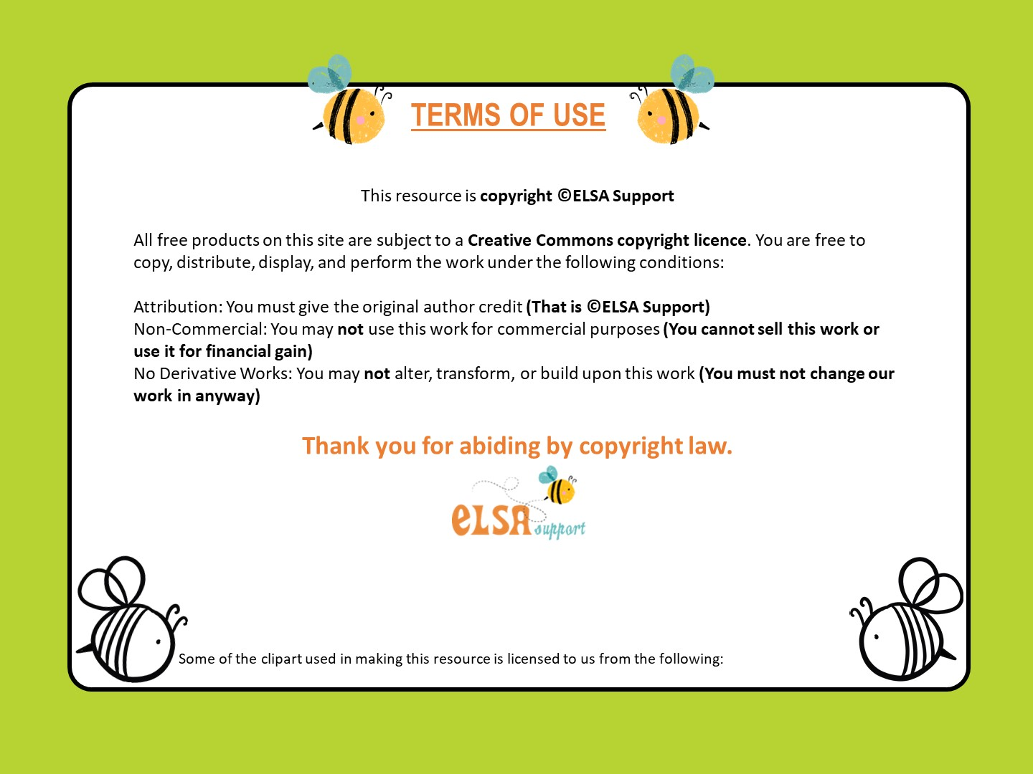

www.elsa-support.co.uk

Slide 2
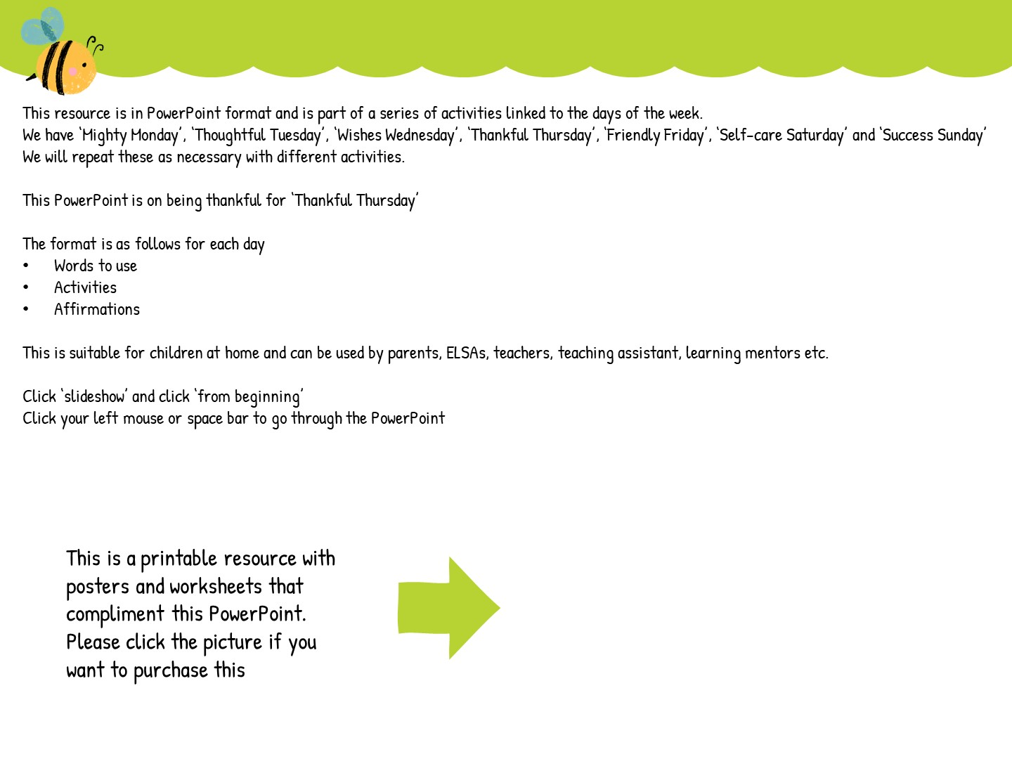
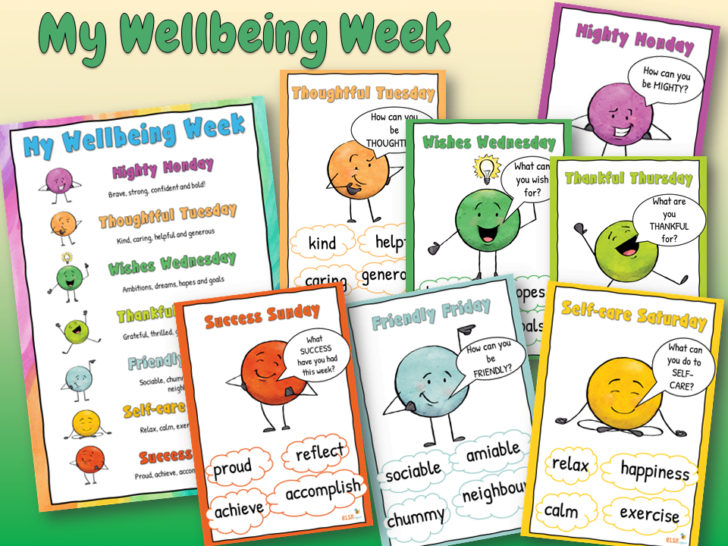

Slide 3


Slide 4


Slide 5

glad
thrilled
pleased
grateful
Can you think of a time when you were thankful?

Slide 6
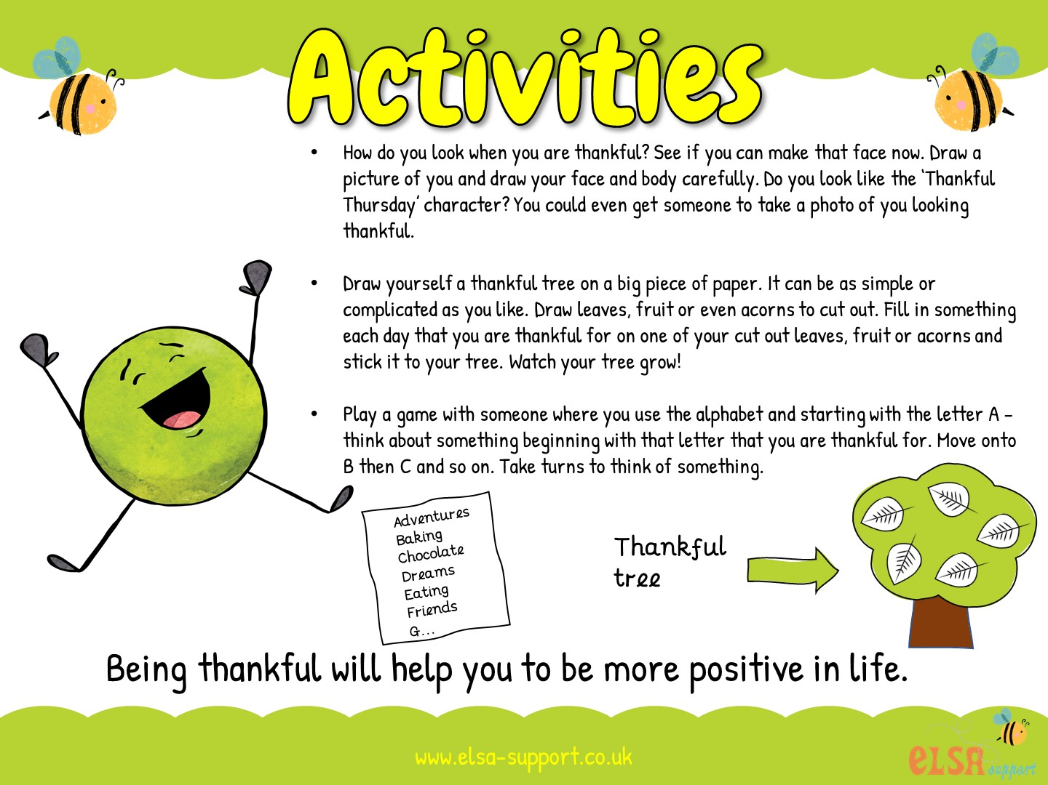

Slide 7


Slide 8


