Slide 1
Your writing task is to complete a first person setting description using DADWAVERS, describing the picture in the centre (on page 3). You need to imagine that you are describing exactly what you can see, what you can hear, what you can smell, feel and maybe even taste.
Remember this is a description about a moment in time, this is not a story and should not have any action other than what you can see in front of you. You can choose whether to write this in the past or present tense.
DAWAVERS are sentence starters. On the next slide I have put some examples about a different picture so you can remind yourself what each stands for.
Write your sentences (you can write more than one for each if you like) and then use your creativity to reorder them and make an exciting descriptive paragraph.

Slide 2
Description: Tall, ancient trees stood still in uniformed lines, a broken limestone path on the ground between them formed a bridge across the rotting and decaying leaves that had fallen during the winter.
Action: A light broke the gloom, illuminating the forest around it, disturbed bats flew skittishly from their roosts and irritable owls hooted their displeasure.
Dialogue: "Hello?" he called.
Where: In the distance through the trees, the weary traveller could see an old cabin which had previously gone unnoticed in the darkness.
Adverb: Nervously, the young lad put on a brave face and clenching the straps on his rucksack, so tightly his knuckles whitened, made his way along the path through the trees to the cabin.
Verb: Creeping through the black trees a mist wrapped everything in silence.
Estimation of time: For a few moments, the wanderer watched the trees surrounding him for life- of which there was none.
Rhetorical Question: Would he survive this adventure?
Simile: The mist enveloped him like a shroud making it almost impossible to see the cabin in the gloom, but the light shone from the porch like a lighthouse in a storm.

Slide 3
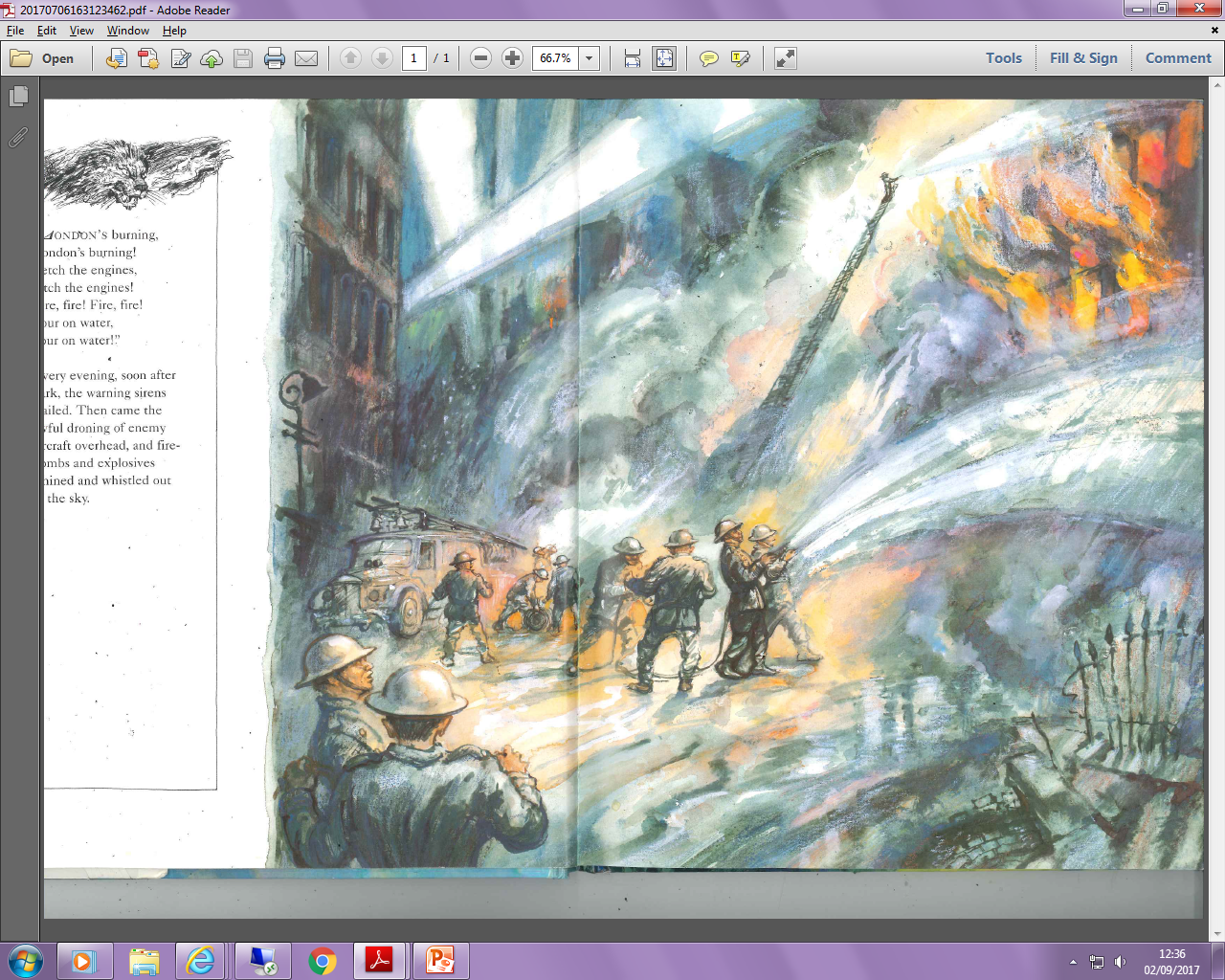
DADWAVERS | Description
Action | Dialogue
Where | Adverb
Verb | Estimation of Time
Rhetorical Questions | Simile or Metaphor

