Slide 1

DiveRsity, PSHE & RSE Workshop For parents and carers
Prospect Vale Primary School
Wednesday 25.05.2022 & Wednesday 20.06.2022
3:30pm

Slide 2
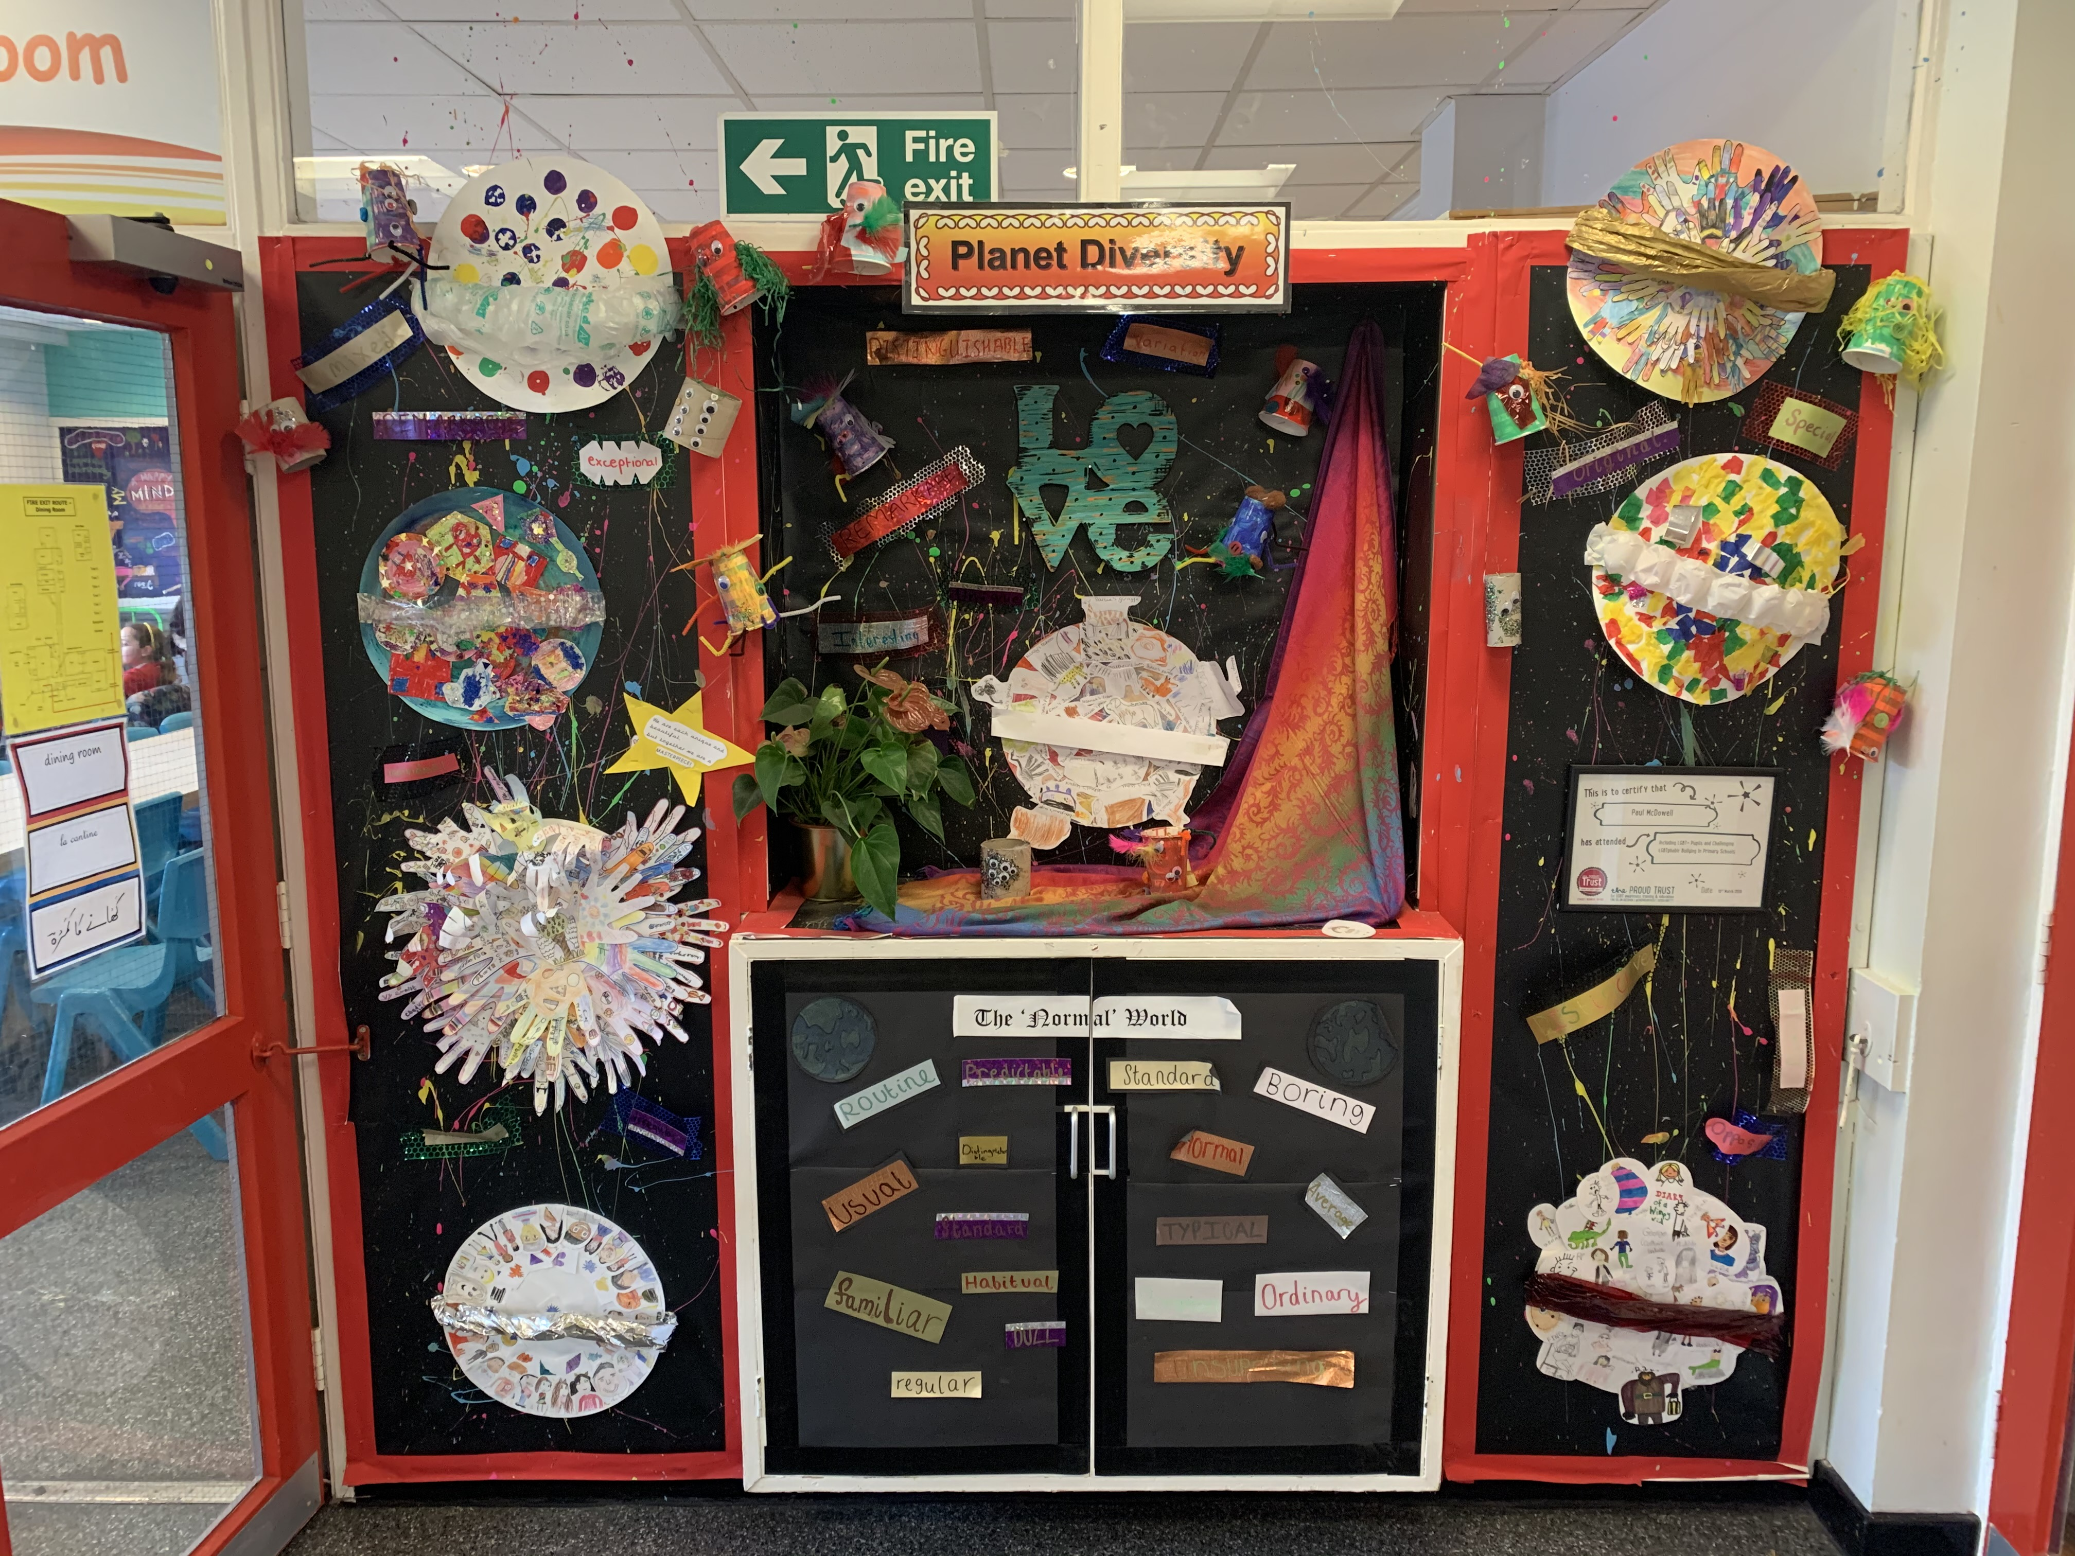
What is Diversity?
Celebrating diversity is a fundamental factor in the ethos at prospect Vale
What your children know about diversity
how Diversity is taught at Prospect Vale
THe impact Diversity has on our curriculum

Slide 3
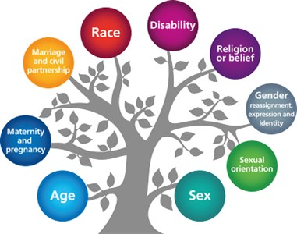
DIVERSITY:
“ A range of different things”
Simplest form – differences, encompassing a range of topics
How do we celebrate Diversity here at PV?
how does learning about Diversity enrich our curriculum?
How DOES diversity challenge our thinking every day?
How does diversity link in to our PSHE curriculum and RSE?

Slide 4
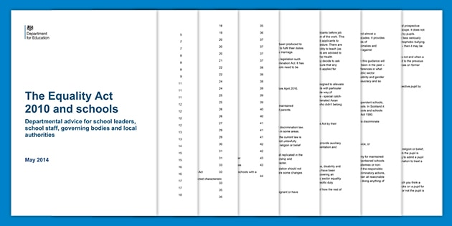
Diversity:
Why is learning about diversity important?
In addition to our ethos and what we believe is right,
we are also legally required to do so!
Ofsted guidance, when inspecting Protected Characteristics in school are looking for schools who:
eliminate discrimination, harassment, victimisation and any other conduct that is prohibited by or under the Equality Act 2010
advance equality of opportunity between persons who share a relevant protected characteristic and persons who do not share it
foster good relations between persons who share a relevant protected characteristic and persons who do not share it
It is important to have a shared vision, with all parts of society working together to support our families and community by giving our pupils the best possible start.
In school we work towards a common goal of the young people in our care having a strong sense of belonging, and the supportive relationships, strong ambitions, and good opportunities they need to realise their potential.
We believe that our uniqueness is what makes each and every one of us special and that diversity in ALL its strands should be celebrated and valued.

Slide 5
Helpful documents and information:
https://www.gov.uk/government/publications/relationships-education-rse-and-pshe
Relationships education, RSE & PSHE (including guides for parents and FAQ document)
https://www.gov.uk/guidance/equality-act-2010-guidance
Equality act 2010 guidance
https://www.gov.uk/government/publications/keeping-children-safe-in-education--2
Keeping children safe in education document – Updated guidance for September 2022
https://no-outsiders.com/
School takes part in the ‘NO OUTSIDERS’ programme and Andrew Moffat, the founder of this charity, has visited our school and worked with the children from Reception to Y6, helping children celebrate diversity in all forms
Diversity strands and support for families
document available on the school website. Go to the ‘our curriculum’ tab, under diversity
This document also highlights charities that school have previously supported, including Mermaids, the charity we are raising funds for this half term

Slide 6
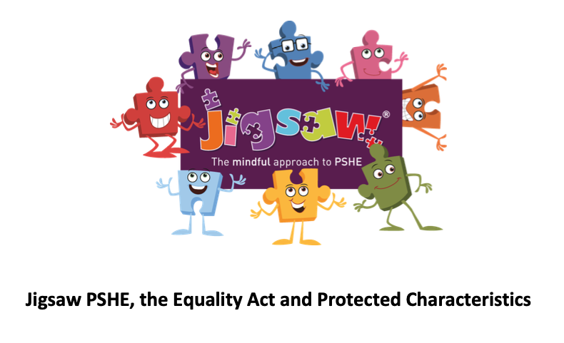
Diversity, PSHE and RSE – making the link
Protected characteristics from the Equality Act:
Age, disability, gender, gender reassignment, marriage and civil partnership, pregnancy and maternity, race, religion or belief and sexual orientation.
All of the above protected characteristics are acknowledged, discussed and celebrated through everyday learning within our curriculum but can also be looked at more in depth through our Jigsaw PHSE scheme of work.
These protected characteristics are the strands of diversity we learn about and celebrate through many aspects of our curriculum but particularly when focussing on relationships – the statutory part of RSE in primary schools
Prospect Vale are committed to safeguarding the mental health and well-being of our school community:
Following Mental Health First Aid and Safeguarding training for staff, there is some startling data out there, making what we do more important than ever!
Data for depression, anxiety, self harm and suicide are upwardly trending in young people, particularly in BAME and LGBT+ groups.

Slide 7
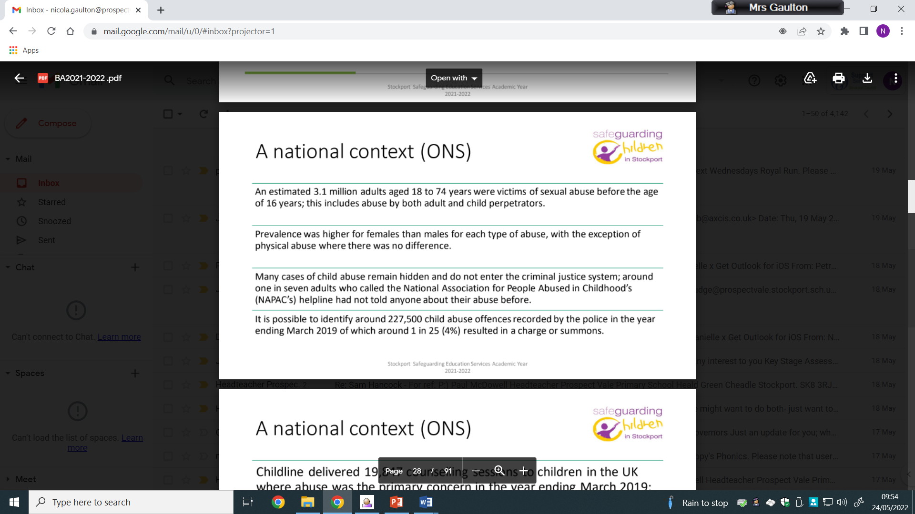
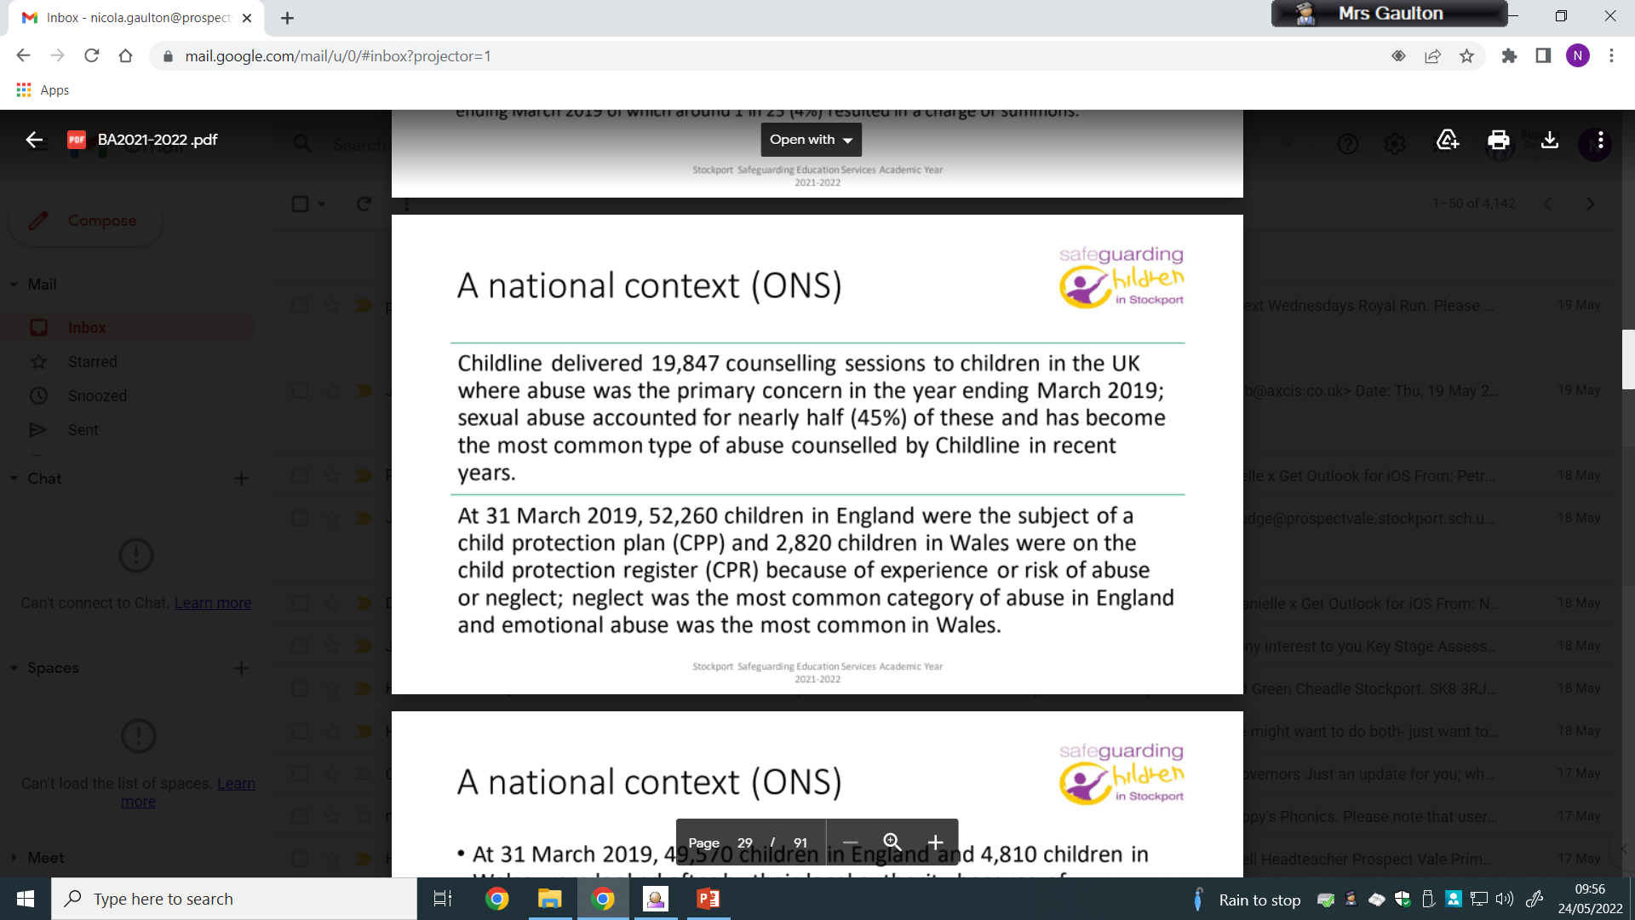
Data shared with whole staff team at recent Safeguarding training from the LA:

Slide 8
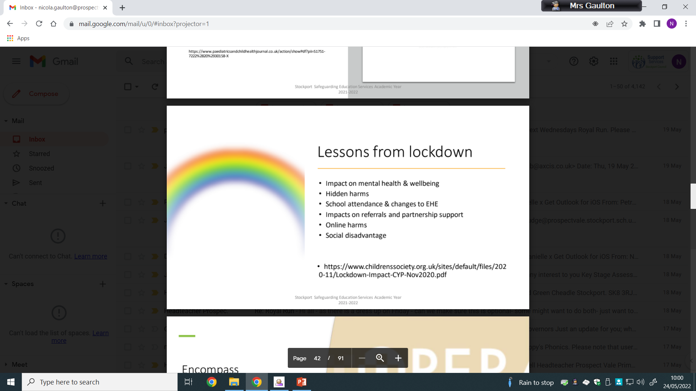
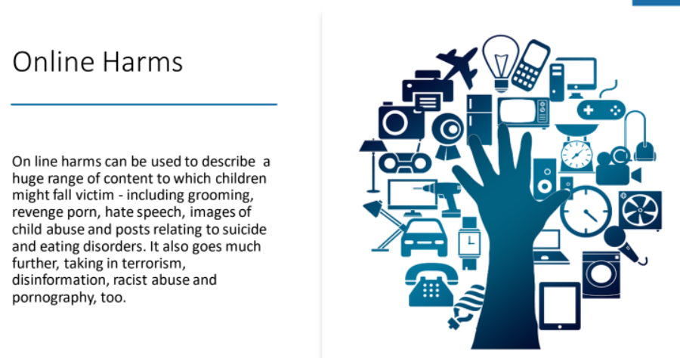
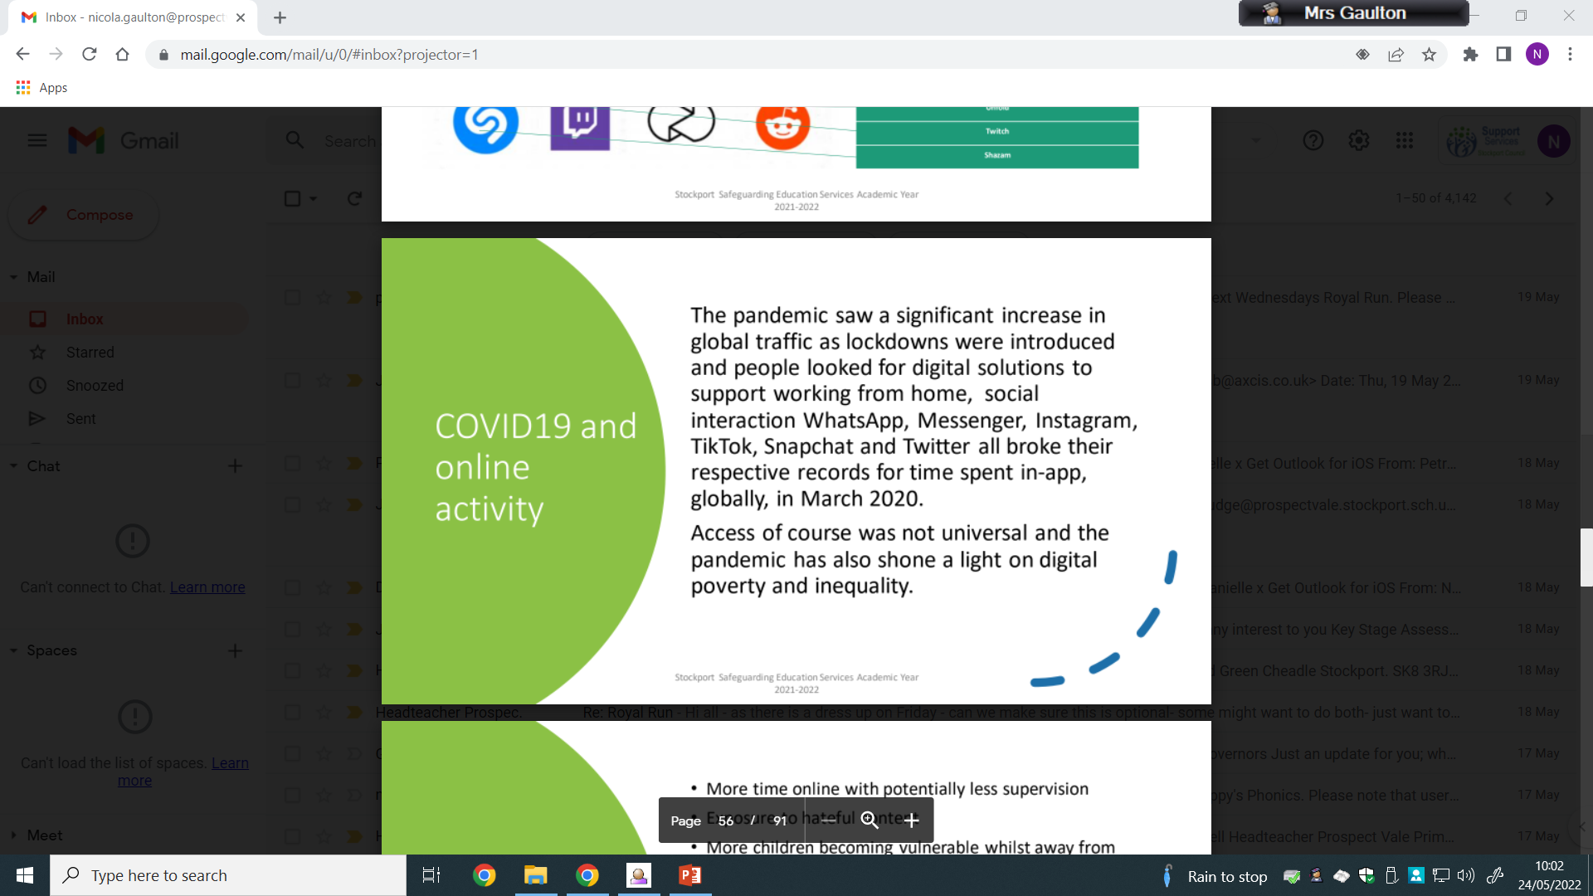

Slide 9
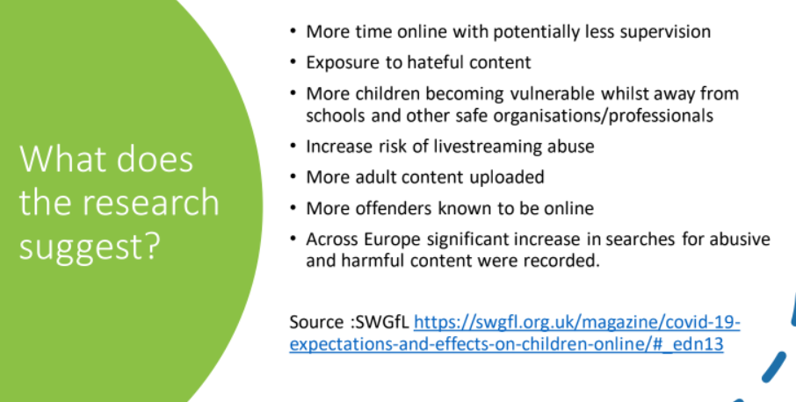
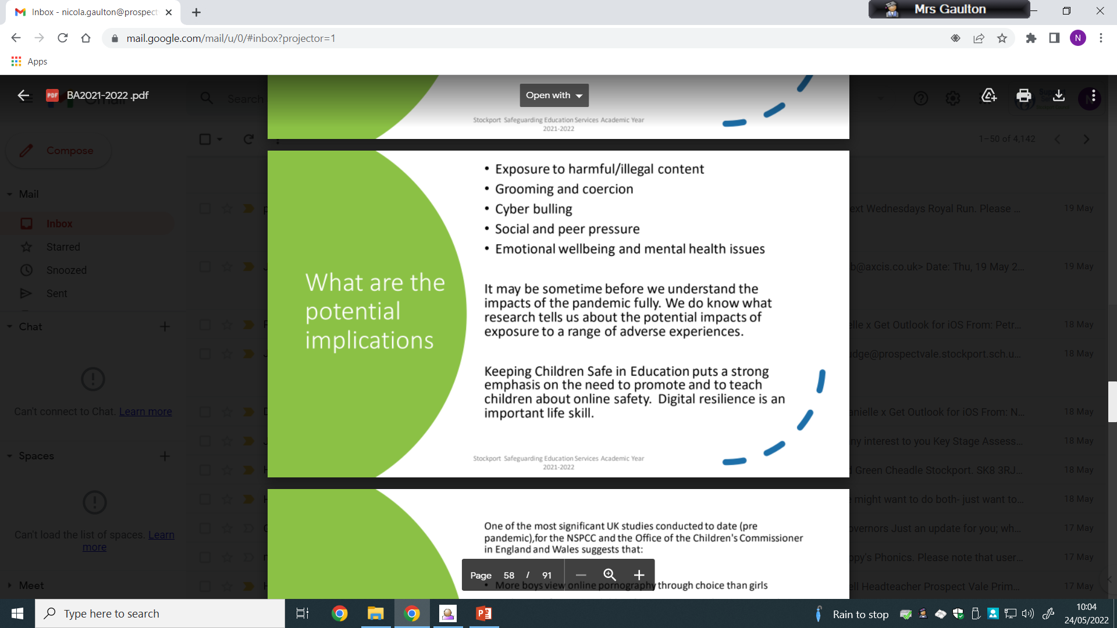
Diversity, PSHE and RSE
– safeguarding

Slide 10
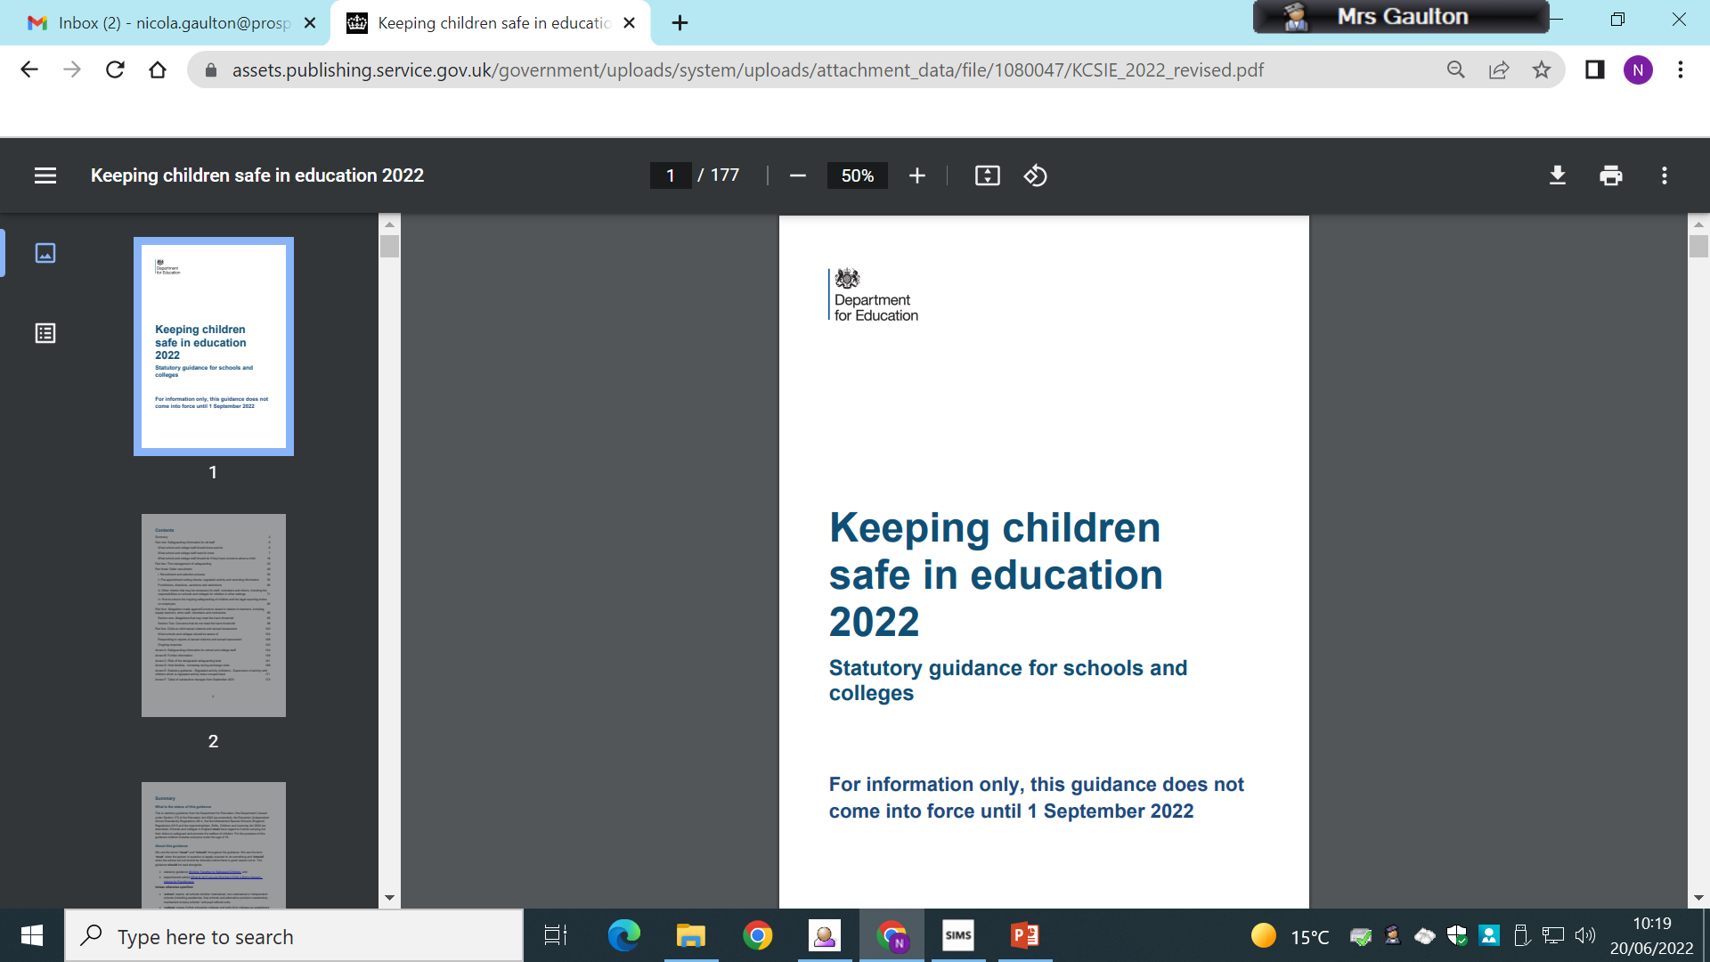
Diversity, PSHE and RSE
– safeguarding updates for Sep 2022
According to the Equality Act, schools and colleges must not unlawfully discriminate against pupils because of their sex, race, disability, religion or belief, gender reassignment, pregnancy and maternity, or sexual orientation (protected characteristics)
Whilst all of the above protections are important, in the context of safeguarding, this guidance, and the legal duties placed on schools and colleges in relation to safeguarding and promoting the welfare of children, governing bodies and proprietors should carefully consider how they are supporting their pupils and students with regard to particular protected characteristics - including disability, sex, sexual orientation, gender reassignment and race.

Slide 11

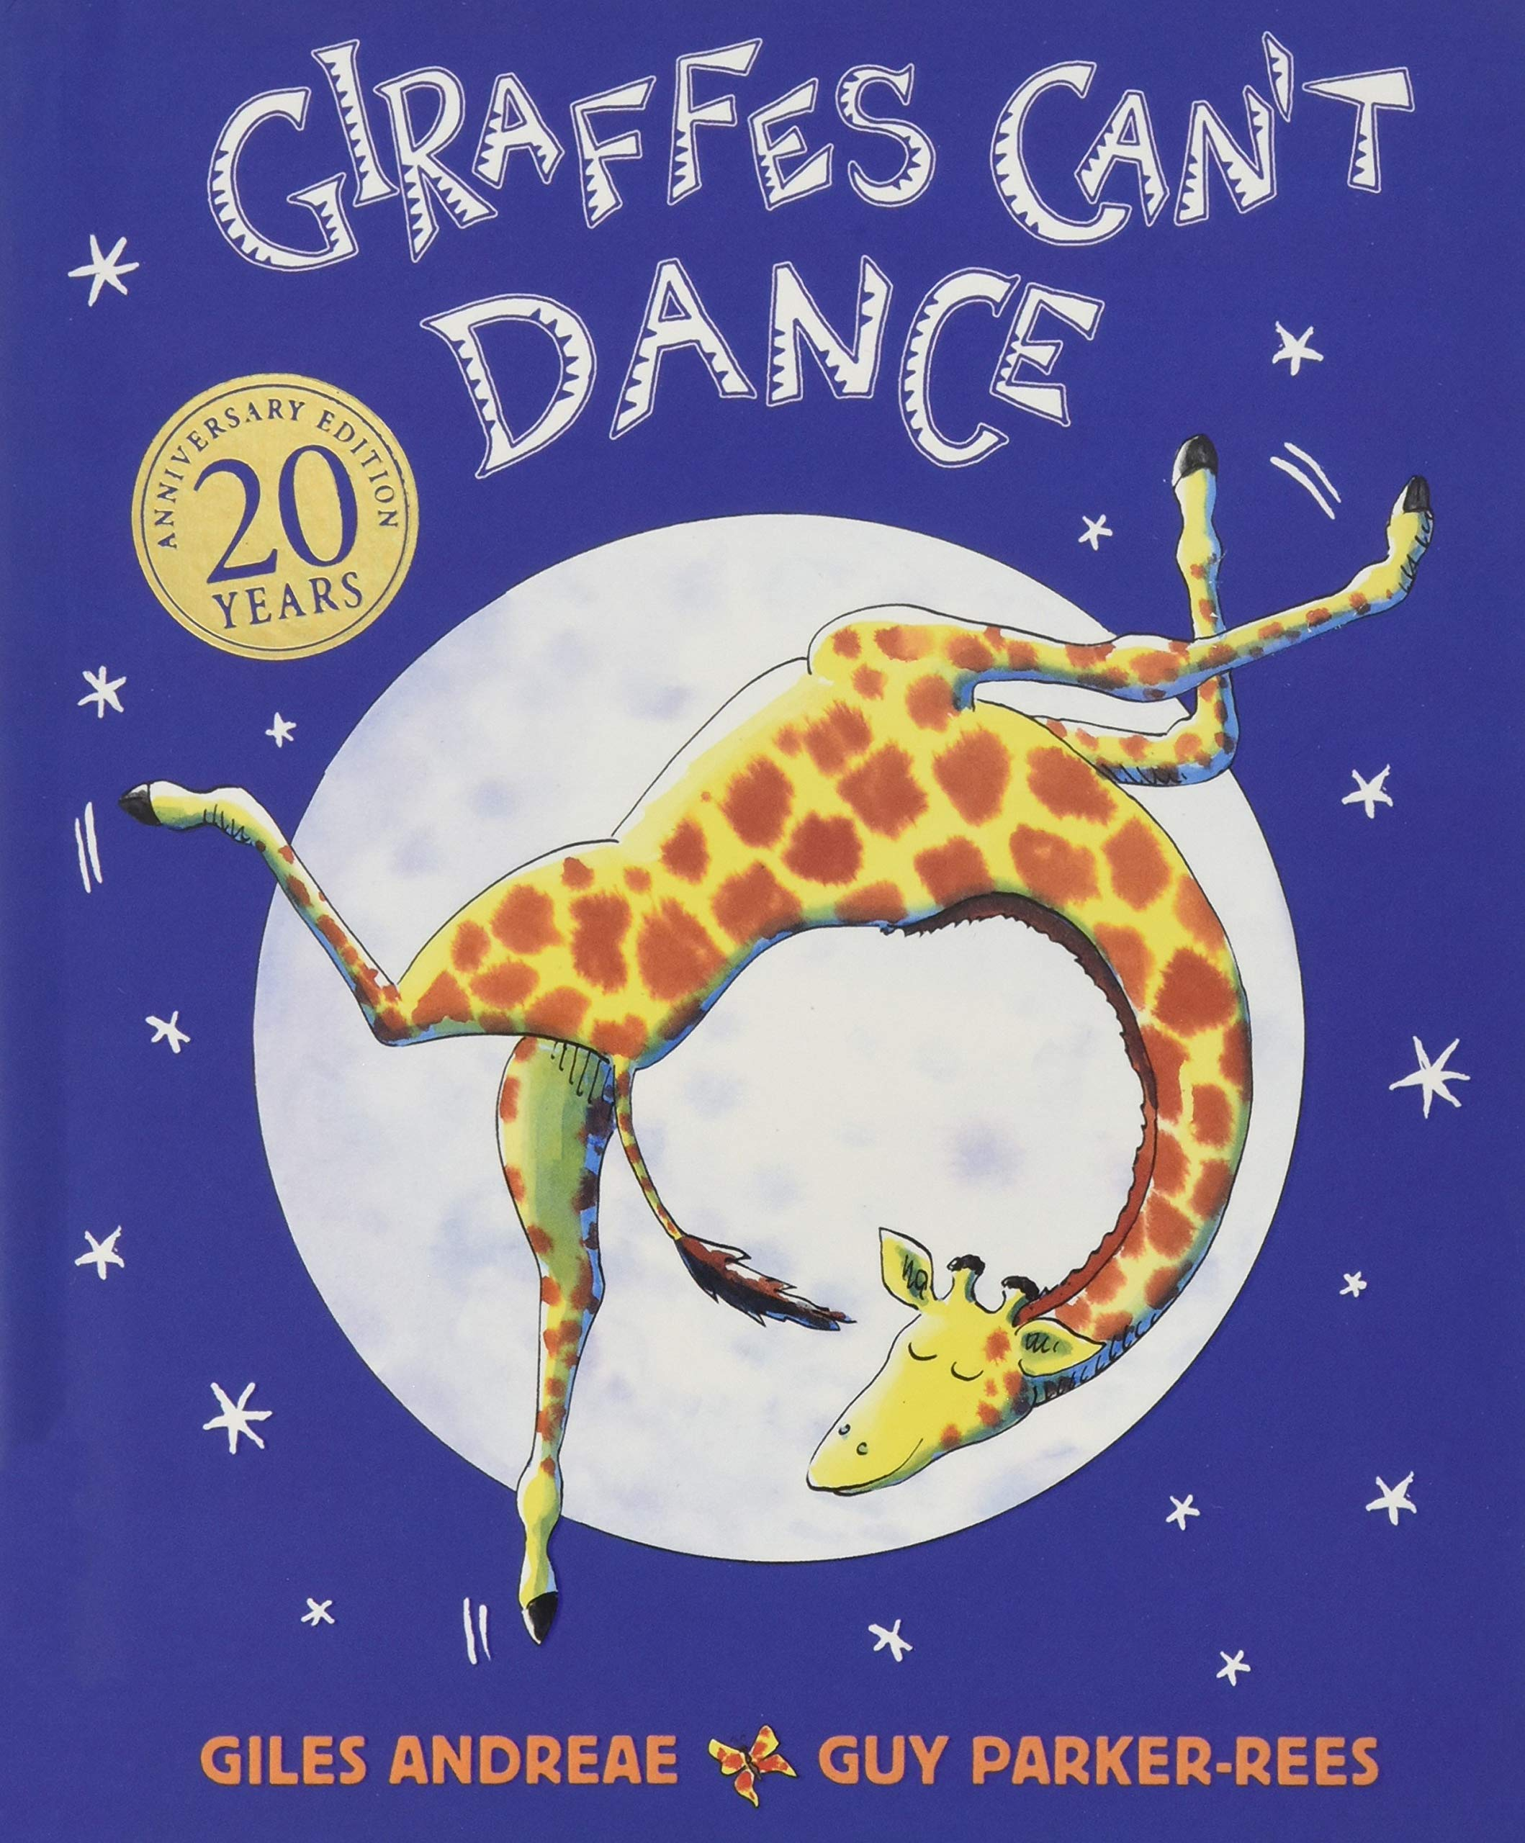



IT’s all about conversation!
It’s all
about conversation!
We talk. We encourage the children to talk.
We ask questions. We answer questions.
We encourage the children to do the same.
Interact
Learn about difference – through fiction and real life
Challenge stereotypes
Empathise
Celebrate
BE KIND!

Slide 12
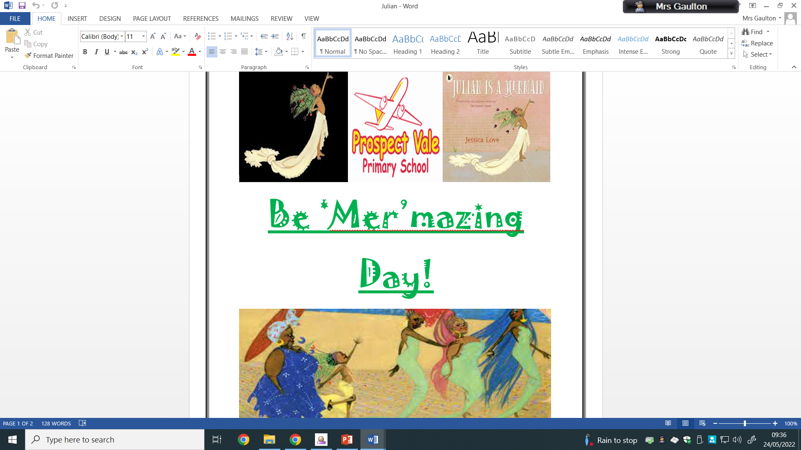
Be ‘Mer’mazing!
Friday 27.05.2022
Celebrated the individuality of all children in school
Reinforced our school ethos – It’s GREAT to be unique, it’s GREAT to be YOU!
Text used as a stimulus for addressing the use of pronouns and using more gender neutral language
Assemblies prior to the day (Y1-Y6) raised discussions in all age groups around gender stereotypes – colours, toys, games, sports & professions
Reasoning behind it - Keeping Children Safe in Education document (Revised in May 2022) highlights the rise in cases of child on child abuse. This can lead to reluctant attendance in schools amongst other issues – we would be NEGLECTFUL if we didn't address these issues in school and would not be fulfilling our statutory duty of care to all children.

Slide 13


Diversity, PSHE,
RSE and inclusion go hand in hand!
a diverse school is one in which a variety of people from numerous different backgrounds work and learn.
An inclusive school is one in which policies and behaviours recognise and celebrate those differences, with everyone having the same access to opportunities.
“To embrace the challenges of creating a happy and successful adult life, children and young people need knowledge that will help them make informed decisions about their own well-being, health and relationships. This knowledge can be put into practice when making decisions around facing risk, challenges and complexities within modern society. ” (PV PSHE & RSE POLICY, 2021)
We give our pupils the opportunity to access age-appropriate information, supported by a nationally acknowledged and approved scheme of work for PSHE and RSE, all outlined in our policy.

Slide 14

Questions, concerns and ideas …
It’s over to you!
If there is anything you’d like us to consider while supporting your children on their pastoral and emotional journey at Prospect Vale, please do let us know. Thank you.

