Slide 1


Computing
Online Safety
Year One
Computing | Year 6 | Online Safety | Secure Websites | Lesson 2

Slide 3
Aim
I can identify secure websites by identifying privacy seals of approval.
Success Criteria
I can look in the address bar of a website so check for security.
I can identify the lock symbol in an address bar.
I can find a link to a privacy policy.
I can understand why I should ask an adult if I am unsure.
I can identify warning signs that a website might not be secure.

Slide 4
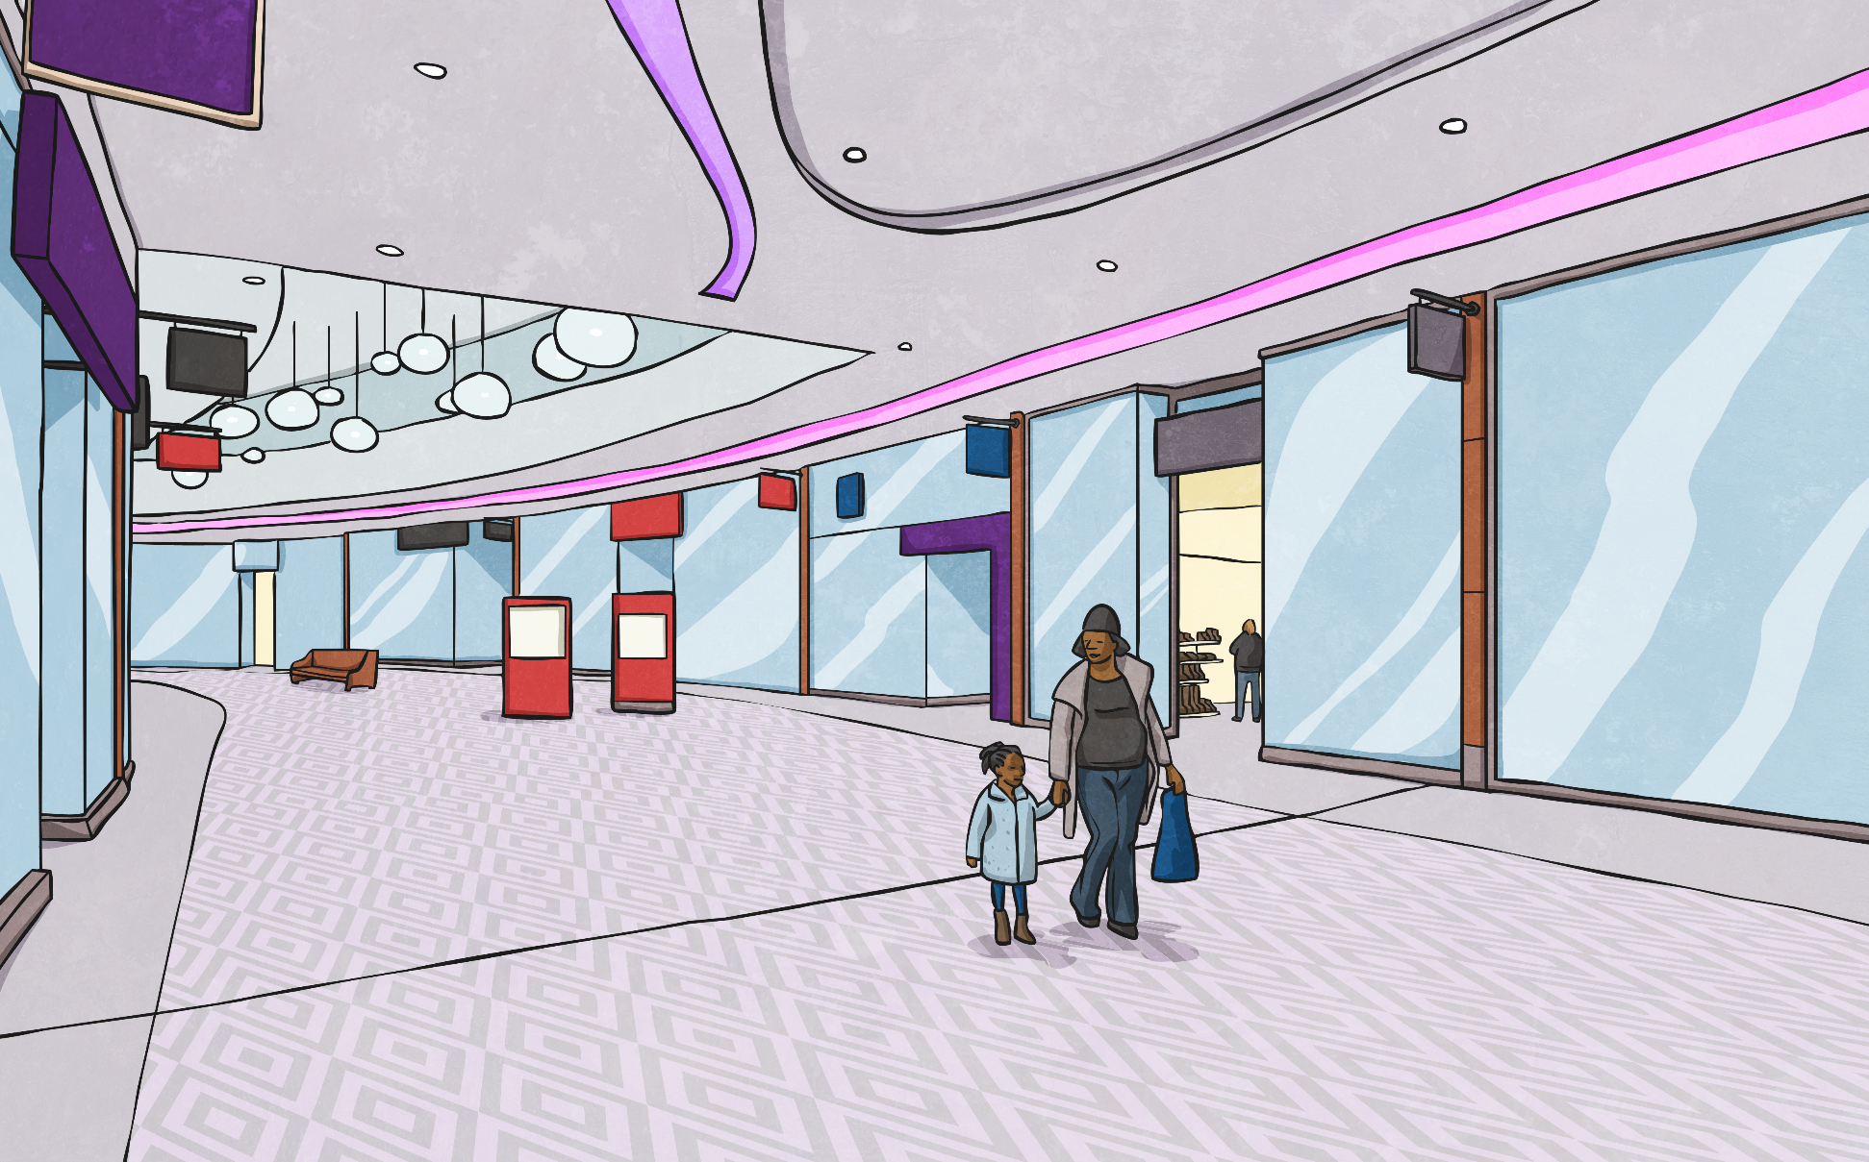

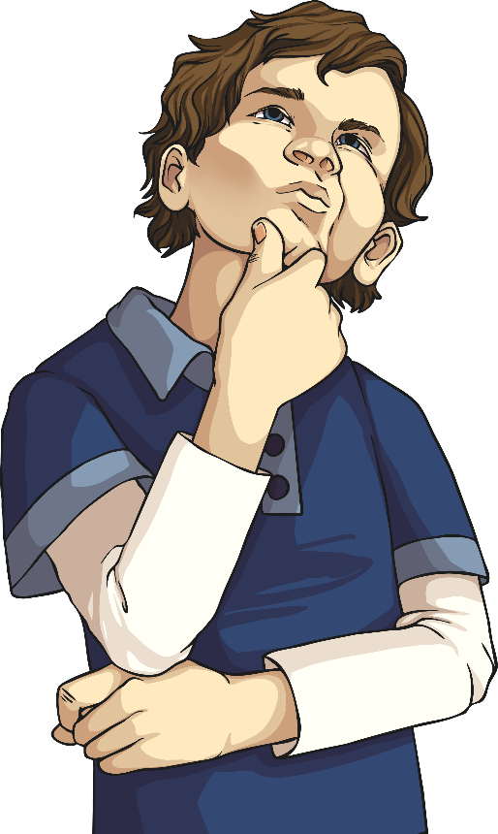
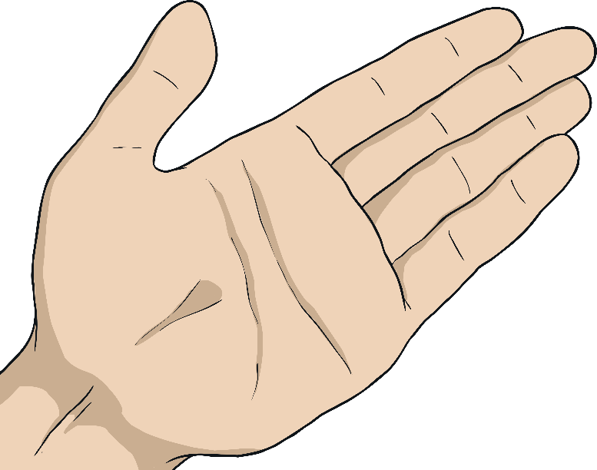

Tell Me About Yourself
If someone you didn’t know asked you these questions before you bought something or used something, would you just answer?
What’s your full address?
What’s your date of birth?
Can I have your parent’s bank details?
What’s your phone number and email address?

Slide 5

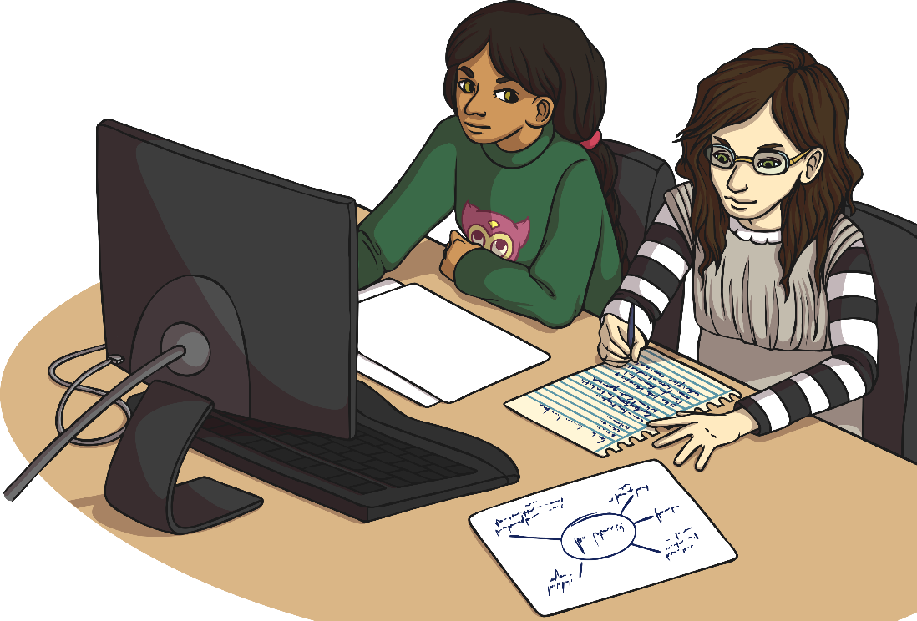
What Do You Do Online?
In a group, brainstorm the different types of websites you access. Put them under these headings:
Some websites might fit under more than one category.
By Myself
With an Adult
at Home
At School
Social Media
Video Streaming
Online Games
Homework Research
Shopping
Homework Research
Research
Design Websites

Slide 6
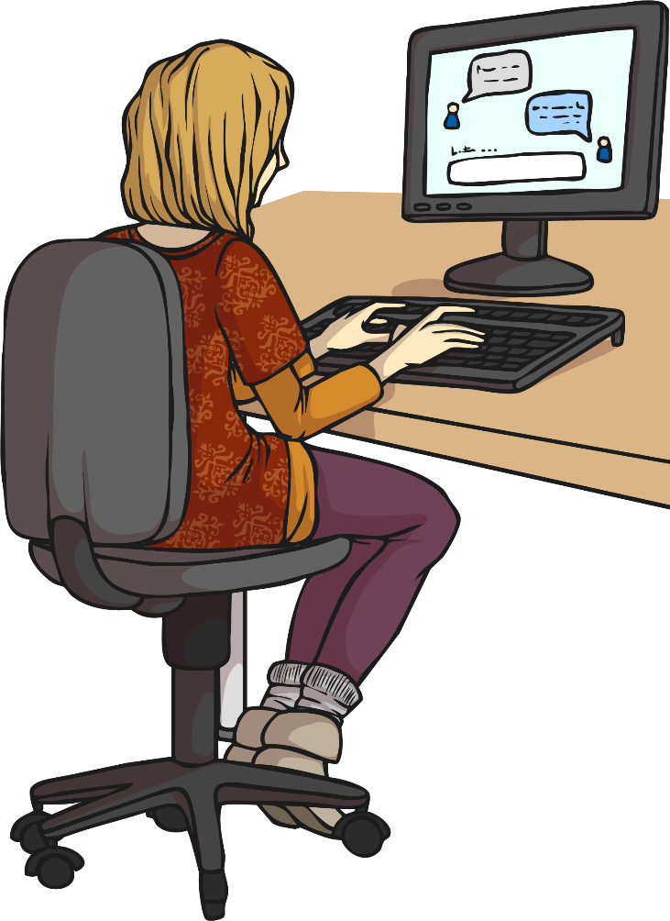
What Are You Telling People Online?
Think about the websites you have just listed. What kind of information do you give to them when you sign up or need to access them?
Social Media?
Online Shopping?
Gaming?
Research?
Full Name?
Address?
Birthday?
An adult’s bank details?
School?
Email address?
Phone Number?
How do you know the site you are putting your details into is safe, even if you’re with an adult?
What could happen if you gave those details to an unsecure or even fraudulent website?

Slide 7
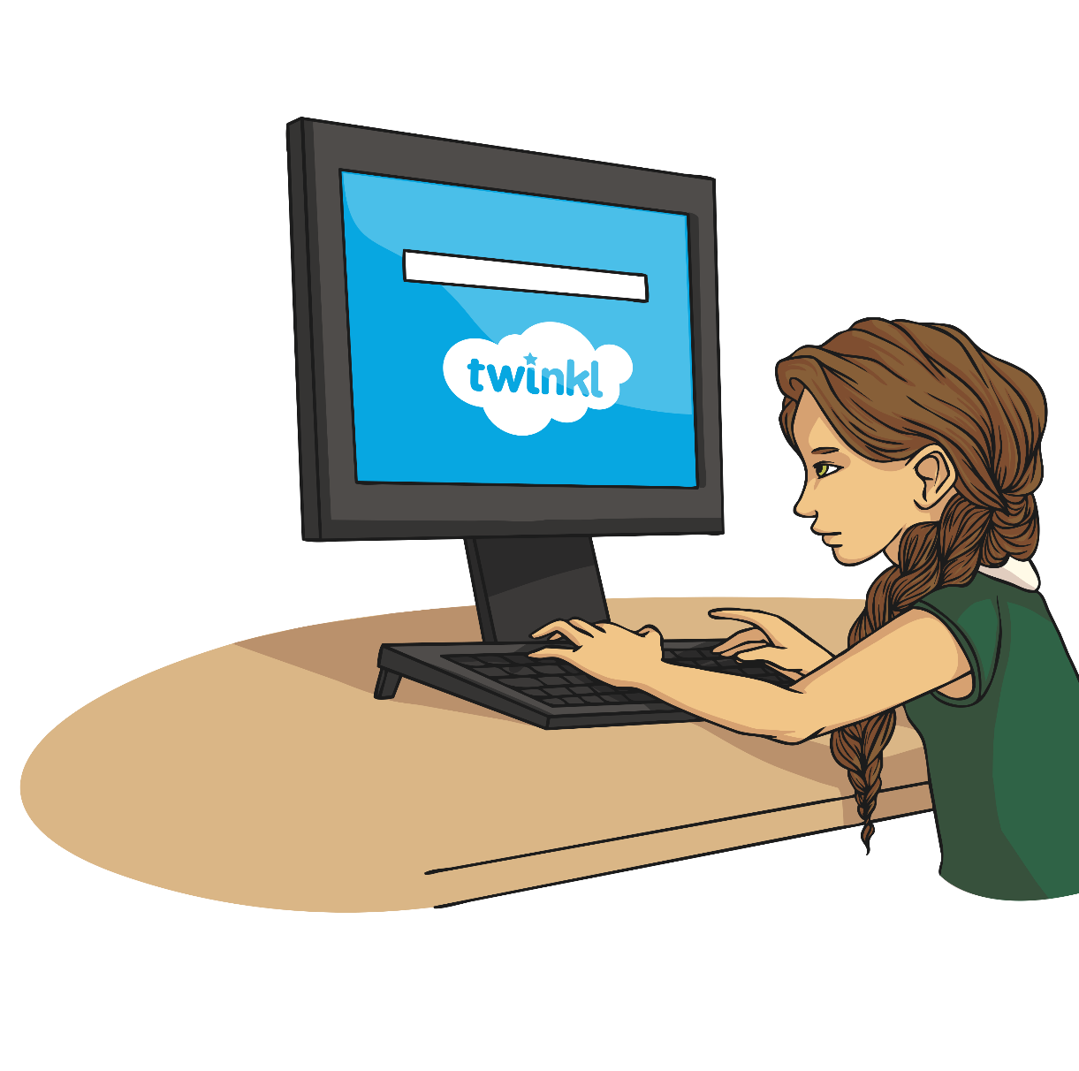
How Can You Tell a Site
Is Secure?
If a site is secure it means that any information you put into it is safe: it can’t be seen by anyone else.
There are some simple clues you can look for to tell you a website is safe:

Slide 8

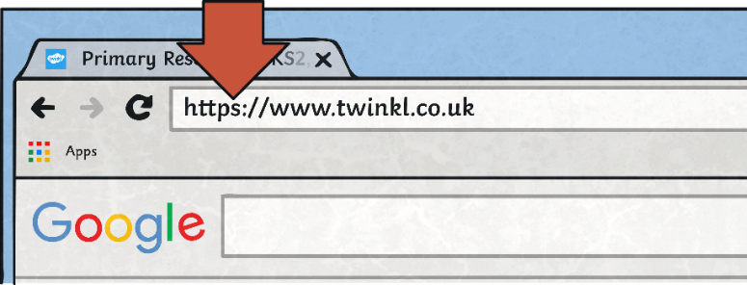
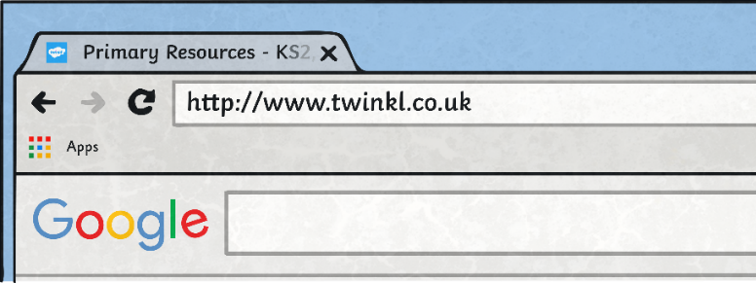
How Can You Tell a Site
Is Secure?
Look at the address bar. Does it read ‘http’ or ‘https’ at the beginning? The ‘s’ stands for secure!
Secured
Unsecured

Slide 9
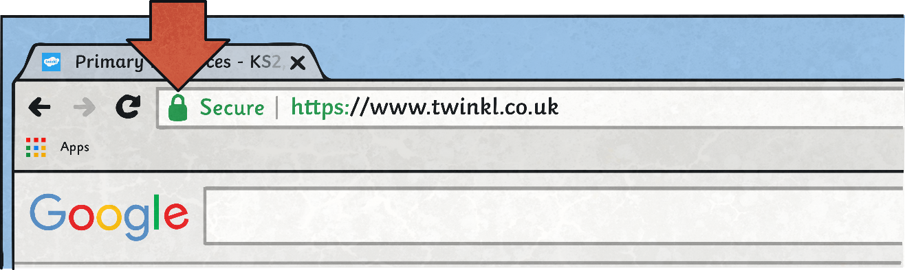
How Can You Tell a Site
Is Secure?
Look in the address bar. Some browsers will show a padlock symbol to show that the site is secure.
The address bar may show up as green for a secure site too.

Slide 10

How Can You Tell a Site
Is Secure?
There are also many logos used to show that a site is secure, ask an adult if you’re not sure which logos are real.
But remember, anyone can copy and paste a logo to make it look like the real thing!

Slide 11
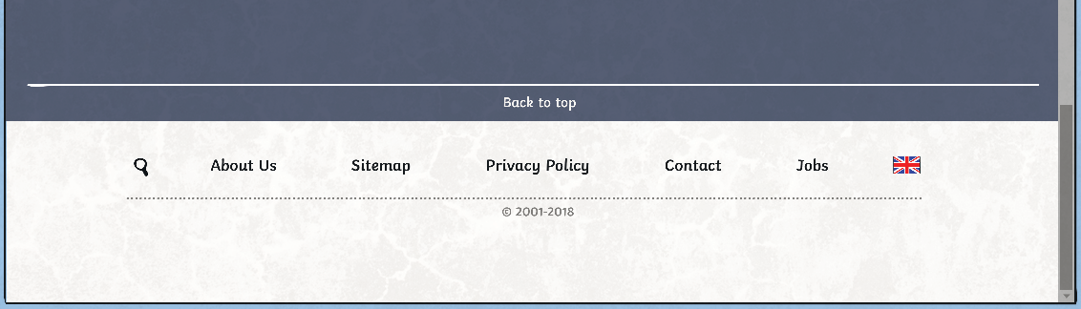
How Can You Tell a Site
Is Secure?
Lots of websites will have a privacy policy.
You will usually find these at the bottom of a website, they are legal documents which tell you exactly how your information is used.
If you are ever worried about that a site might not be secure, an adult could help you find out by looking at this document.

Slide 12
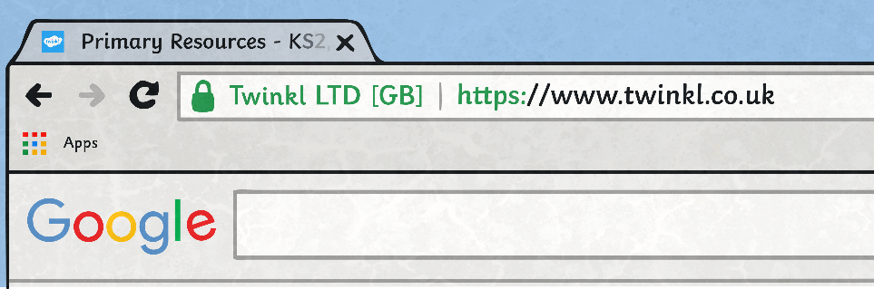
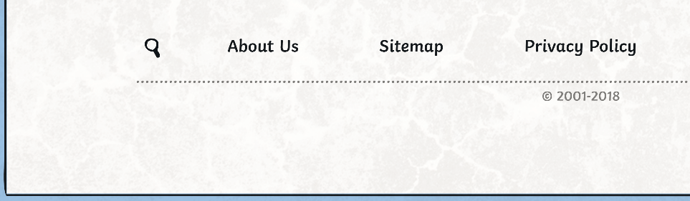

How Can You Tell a Site
Is Secure?
What are the clues on this webpage, that tell you it is safe to put your details in?
Padlock icon
https address
Secure logo

Slide 13

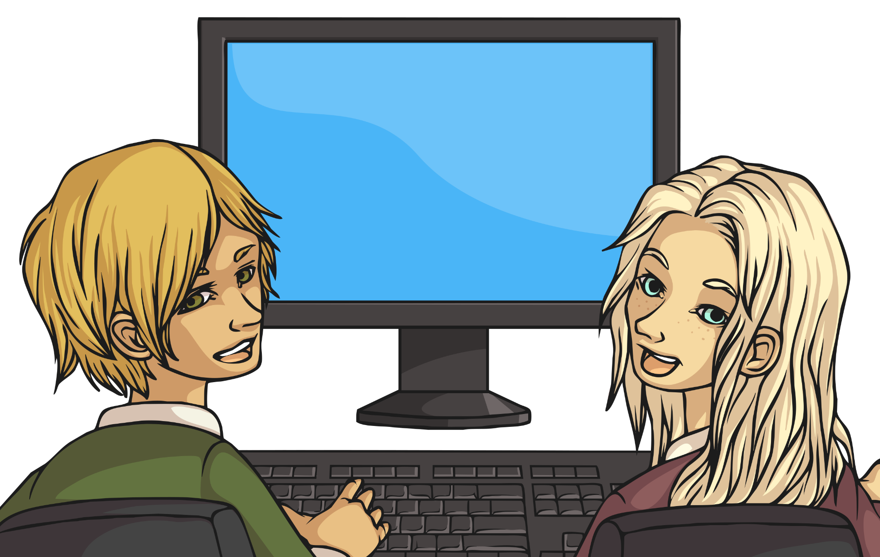


Am I Safe?
Look at the websites given to you. Look around the pages and see what clues you can find that might suggest a site is secure.
Make notes with your partner to feedback to the rest of the class.

Slide 14
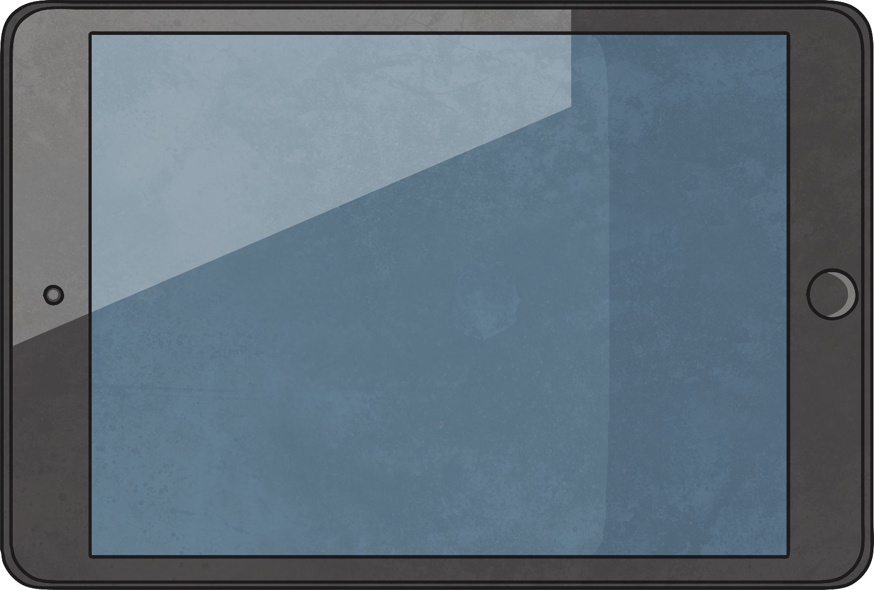

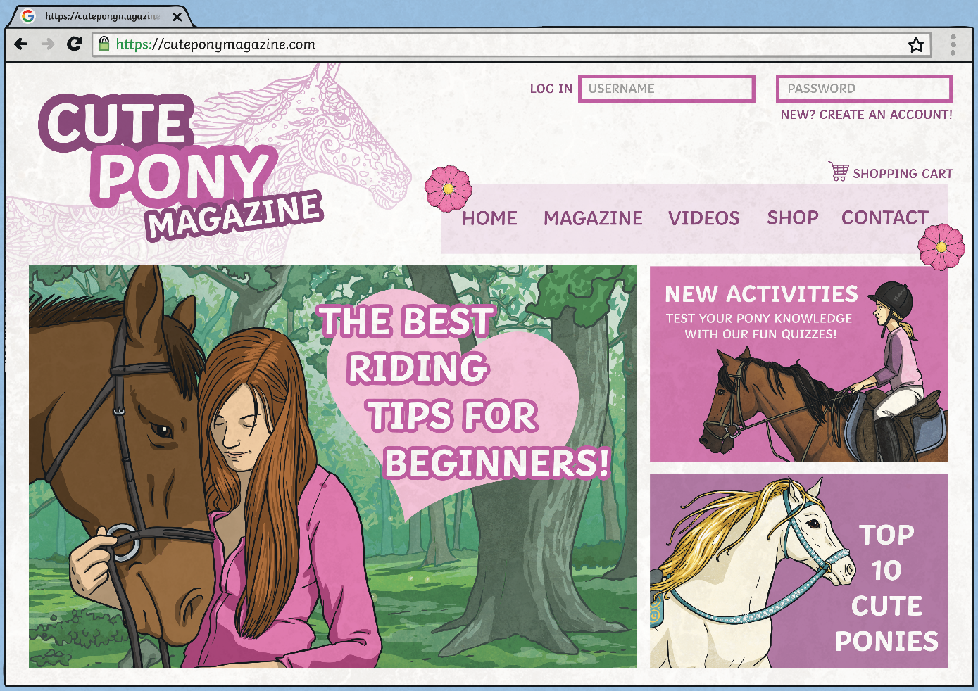
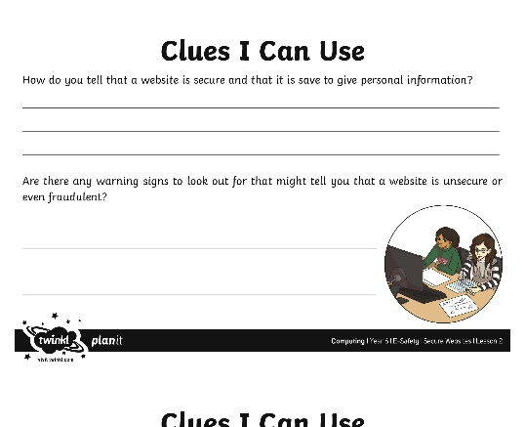
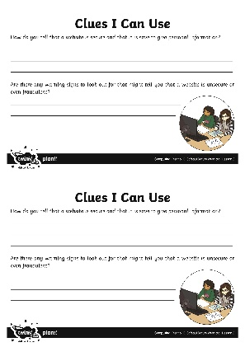

Clues I Can Use
Use the Clues I Can Use sheet to write down any tips for spotting secure and unsecure sites.
Now you can use this sheet as a reminder in the future if you’re not sure!

Slide 15

Aim
I can identify secure websites by identifying privacy seals of approval.
Success Criteria
I can look in the address bar of a website so check for security.
I can identify the lock symbol in an address bar.
I can find a link to a privacy policy.
I can understand why I should ask an adult if I am unsure.
I can identify warning signs that a website might not be secure.

