Slide 1
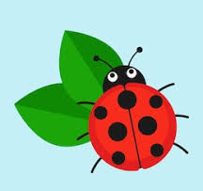
Ladybirds Home Learning
Week 4 – w/c 25th January

Slide 2
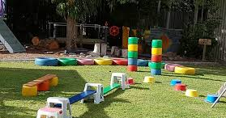
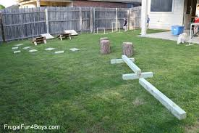
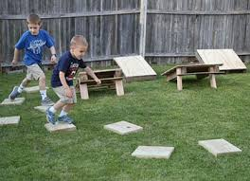
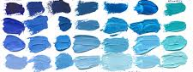
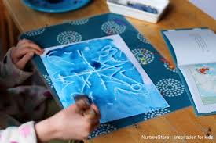
Monday 25th January
Literacy – Listen to Mrs Taylor reading a poem about winter. Talk about all of the different things that happen in winter, what do you enjoy? Our daily phonics will be on the link below. Please focus on set 1 sounds.
https://www.youtube.com/watch?v=uYAxX2WO9jk
Learning through play – an opportunity for children to choose something that they would like to play with. Last week we made snow machines, perhaps you could make a machine that makes some of your favourite things this week?
Outdoors – make an obstacle course using things you find in the garden or around your house. Can you move over the different obstacles? You could try and move through the obstacle course in an interesting way. Perhaps jumping, skipping, or even backwards!
Maths – join in with our Maths Moment video. Using a basket of clothes, can you sort them into winter and summer clothes. How many of each are there? Write the number. Maximum of 6 each. You could use the cut and stick activity on our class gallery.
Art – Colour mixing, using blue, white, black paint. Can you use the paints to make different shades of blue, and paint a wintery snowflake picture?
Story – choose a story from the books you have at home. Enjoy listening to the story you choose, talk about the pictures, and explain which part is your favourite and why.

Slide 3
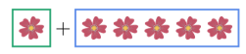
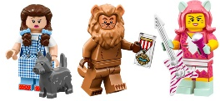
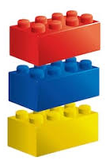
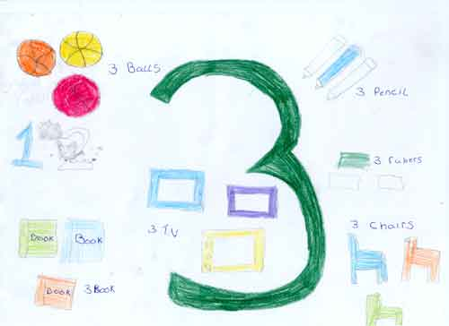
Tuesday 26th January
Literacy – Draw some pictures with a winter theme. We will use these later in the week to go with our own winter poems. Our daily phonics will be on the link below. Please focus on set 1 sounds.
https://www.youtube.com/watch?v=uYAxX2WO9jk
Learning through play – an opportunity for children to choose something that they would like to play with, and to follow their own interests and imagination to create models, art work, stories and songs.
Outdoors – use the super movers videos on our class gallery to remind you of the different super movers moves (bee, caterpillar and anemone), then see if you can have a go at the moves yourself. You can make up your own movements to the tracks too. You could record a short video and send it via email so that we can watch your super mover moves!
Maths – join in with our Maths Moment video. Can you find lots of different ways to represent the number 6? You could spot the numeral 6 around your house or out and about, then collect lots of things which you can use to show 6. For example; 4 buttons and 2 counters, 6 cars, make the numeral 6 using playdough, counting out 6 of lots of different objects.
Investigate – freeze water in rubber gloves or in different containers. What does it look like and feel like? What happens when you pour salt on the ice?
Singing – sing some of your favourite songs with a grown up at home. You might remember some of the songs from our singing bag.
You could make a number poster like this.

Slide 4



Wednesday 27th January
Literacy – You could read some of the winter poems saved on our class gallery. Talk to your grown up’s about the poems, and about what you can see outside when it is winter. Our daily phonics will be on the link below. Please focus on set 1 sounds.
https://www.youtube.com/watch?v=uYAxX2WO9jk
Learning through play – an opportunity for children to choose something that they would like to play with, and to follow their own interests and imagination to create models, art work, stories and songs.
Outdoors – enjoy finding different ways of balancing and moving outside. We are focusing on changing speed and direction when running or moving quickly around the space. You could play the traffic light game, ask your grown up to shout out one of the traffic light colours. Green means go, amber means move in slow motion, and red means freeze!
Maths – choose a number card from your home learning pack, and ask someone in your house to challenge you to ‘act out the number’ using different movements (hopping, skipping, jumping, clapping, tapping, stamping etc.) Don’t forget that you can challenge your family too!
P.E – Play ‘Freeze Tag’ with your family in the garden or the park. One person needs to be the ‘Ice Dragon’ (or something similar and equally as exciting!), who chases and tags the other people in the game. If the Ice Dragon catches you, you need to freeze like a snowflake. One of the other players can come and melt the snowflake and free you by touching your shoulder. Take it in turns to be the Ice Dragon and the snowflakes.
Story – Choose a story from the Cbeebies story time website (link below). Tell a grown up something that happened in the story.
https://www.bbc.co.uk/cbeebies/stories

Slide 5
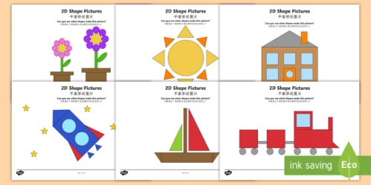
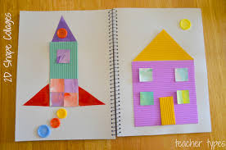
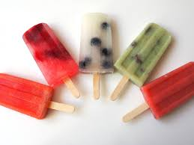
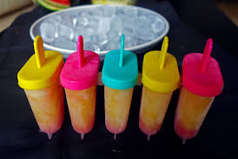
Thursday 28th January
Literacy – Create your own ‘Winter is…’ poem like the one Mrs Taylor read in our video. Don’t forget to send your poems into school so that we can read them to your friends in the classroom! Our daily phonics will be on the link below. Please focus on set 1 sounds.
https://www.youtube.com/watch?v=uYAxX2WO9jk
Learning through play – an opportunity for children to choose something that they would like to play with, and to follow their own interests and imagination to create models, art work, stories and songs.
Outdoors – practise jumping, skipping, hopping, running in and out of objects, and balancing. Can you hold a balance for 5 seconds? Challenge yourself and see how many hops, skips or jumps you can do in 30 seconds.
Maths – Cut out some different sized 2D shapes (circle, triangle, square, rectangle) from coloured card or paper. Can you create your own picture using the 2D shapes? Ask your grown up to write down your explanation about what your picture is. You could take a photo and send this into school.
Investigate – Make ice lollies, and choose your own flavours. You could use a lolly mould or a plastic cup and a lollipop stick. Here is a link to some ice lolly recipes you could try at home. Enjoy!
https://www.bbcgoodfood.com/recipes/collection/ice-lolly-recipes
Singing – sing some of your favourite songs with a grown up at home. You might remember some of the songs from our singing bag.

Slide 6

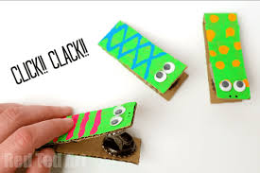
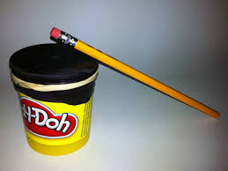
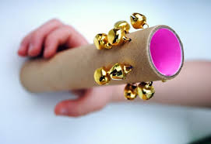
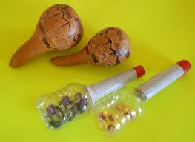
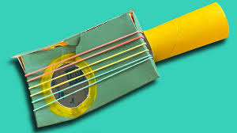
Friday 29th January
Literacy – Please keep practising writing the letters in your name. Don’t forget that you could make the letters out of playdough, draw them in a tray of sand, write them on the driveway with chalk, or paint them too. Our daily phonics will be on the link below. Please focus on set 1 sounds.
https://www.youtube.com/watch?v=uYAxX2WO9jk
Learning through play – an opportunity for children to choose something that they would like to play with, and to follow their own interests and imagination to create models, art work, stories and songs.
Outdoors – Go for a walk with your family. Talk about your favourite things from our home learning this week. Why did you like it? What was their favourite thing that they did this week?
Maths – practise counting forwards from 0-10. Can you count backwards like you are blasting off to space? When you are really confident counting forwards and backwards, try starting and ending at different numbers. For example; start at 3 and end at 9. This will help you build lots of fluency with your counting.
Art – make your own musical instrument using things you find at home. Can you listen to some staccato music and make spiky, quick, frosty noises using your instruments?
Story – Can you retell the stories ‘The Snowflake Mistake’ and ‘Lost and Found’? You could draw pictures or make props to help you too. You could even get a grown up to record you telling the story and send the video into school.

