Slide 1
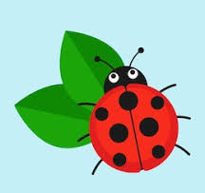
Ladybirds Home Learning
Week 1 – 6th, 7th and 8th January

Slide 2
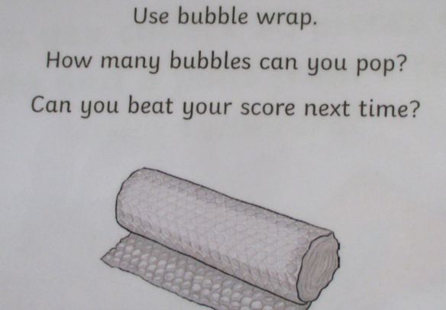
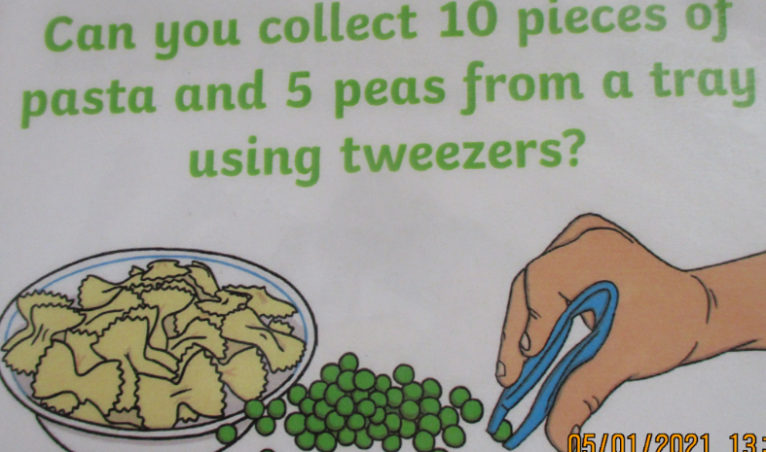
Wednesday 6th Jan
Literacy – Can you make marks using the things you find at home? You could use your finger in a plate of flour, draw using chalk outside on the floor, or glitter in a tray. Our daily phonics will be on the link below. Please focus on set 1 sounds.
https://www.youtube.com/watch?v=B6ltPCRM93E
Learning through play – an opportunity for children to choose something that they would like to play with. You could have a go at the fine motor activities below.
Outdoors – Practise skills like skipping, hopping, jumping, running and balancing. We are going to be developing these skills during our Supermovers sessions next week.
Maths – join in with our Maths Moment video. Can you use pasta shapes and spaghetti to make different patterns? You could count out the correct number of pasta shells and match them to a number that your grown up writes for you.
P.E – join in with our dough disco songs using this link. You could use a recipe and make your own playdough if you don’t have any at home. https://www.youtube.com/watch?v=o9D5lfqZF3o
Story – Listen to our story ‘Meg’s Eggs’ online using the link below. Talk about what happens in the story, and about the pictures. What is your favourite part of the story? Why?
https://www.youtube.com/watch?v=FWQOM4C_vI0

Slide 3
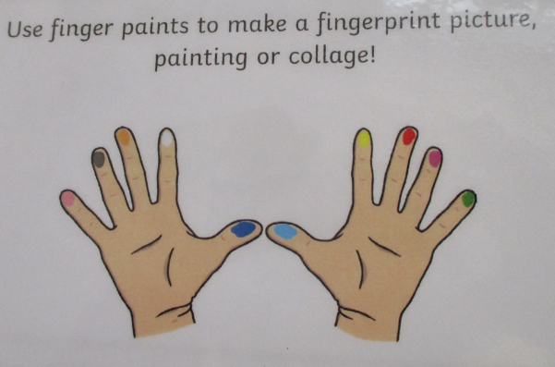
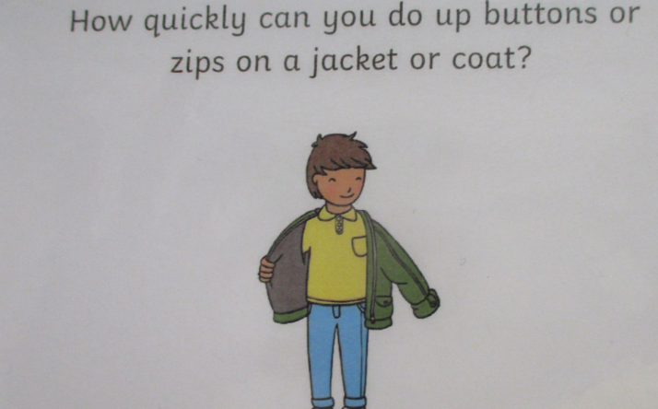
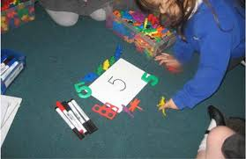
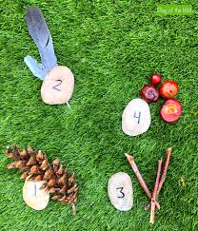
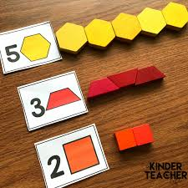
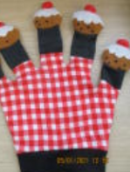
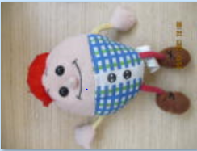
Thursday 7th Jan
Literacy – practice writing the letters in your name. Ask grown up to write it first for you to copy, then have a go yourself! Our daily phonics will be on the link below. Please focus on set 1 sounds. https://www.youtube.com/watch?v=B6ltPCRM93E
Learning through play – an opportunity for children to choose something that they would like to play with. You could have a go at the fine motor activities below.
Outdoors – Practise skills like skipping, hopping, jumping, running and balancing. We are going to be developing these skills during our Supermovers sessions next week.
Maths – join in with our Maths Moment video. Can you choose a number and find different ways to show it using the things you find in your house. Here are some examples;
Investigate – look outside and talk about the things that you can see. What do the trees look like in winter? What is the weather like?
Singing – sing some of your favourite songs with a grown up at home. You might remember some of the songs from our singing bag.

Slide 4
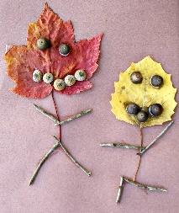
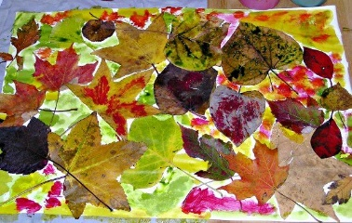
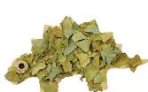
Friday 8th Jan
Literacy – practice writing the letters in your name. Ask grown up to write it first for you to copy, then have a go yourself! Our daily phonics will be on the link below. Please focus on set 1 sounds.
https://www.youtube.com/watch?v=B6ltPCRM93E
Learning through play – an opportunity for children to choose something that they would like to play with. It could be linked to a book, for example ‘Harry and his bucketful of dinosaurs’ where children could create their own dinosaur world using Lego, blocks, painting, drawing etc. The possibilities are endless!
Outdoors – collect interesting natural materials from the garden or an outside space near your home. Talk about the things that you find with your family. Carry them carefully, you’ll need them for our art work later on!
Maths – join in with our Maths Moment video, then play the dice game (video explanation online)
Art – create a picture using the natural materials that you collected when you went outside. Snap a picture and send it into school. Here are some examples;
Story – Listen to our story ‘Harry and his bucketful of dinosaurs’ online using the link below. Talk about what happens in the story, and about the pictures. What is your favourite part of the story? Why?
https://www.youtube.com/watch?v=uWoopkMgLqM

