Slide 1
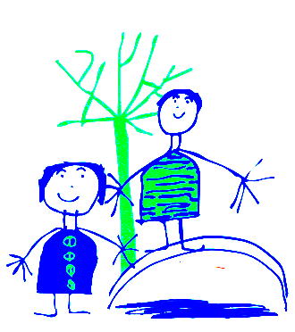
Dobcroft Infant School Foundation Stage
(FS2)

Slide 2
Welcome to Dobcroft Infant School.
Mrs Burgan and Mrs Jaram,
Mrs Pemberton and Mrs Chaudhry
Mrs Carl and Mrs Rowlands
Foundation Stage Two

Slide 3
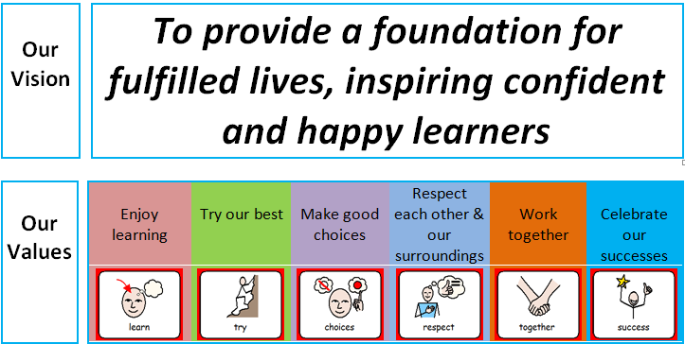
Our school Vision

Slide 4
Purpose
Share what learning in FS2 looks like (routines and timetable).
Introduce you to the Early Years curriculum and terminology.
Welcome Meeting Pack:
Wow Sheet, Home Learning Letter, Knowledge organiser.
Early Literacy Skills booklet, letter formation sheet, tricky word sheet, phonics games
Numberline, Hundred square, target book

Slide 5
Classroom Routines
Door open at 8:50am and are locked at 9.00am. Registration starts at 9.00am.
After this time you must go to the main entrance. Please do not open the door for parents after 9.00 am.
Children say goodbye to their parents outside the classroom and then come into school and hang up their coats by themselves.
They then:
Put water bottle on the table in classroom.
Sit on the carpet quietly with a book or look at the pictures on the active board screen.
We then get ready to take our register.

Slide 6
Planning and Preparation Time
On a Wednesday morning the teachers have planning and preparation time (PPA) so you may see another teacher at this time.
PE takes place on a Wednesday morning each week. Please make sure the children have a names PE kit in school.
Soccer Eds – Thursday.

Slide 7
General Issues
If your child is absent from school please telephone the school office and explain why.
If your child arrives at school after 9.00am they will be marked as late and you will need to go to the school office.
School finishes at 3.25pm please can you be on time to collect your child. Children not collected will wait by Mrs Rowland’s office. Sheffield Council Policy: child uncollected after 3:40pm will be taken to a safe waiting place outside the office
Children who have been sick need to stay away from school for 24 hours after the last bout of sickness. For diarrhoea it is 48 hours after the last episode.
For Covid symptoms please follow the latest government guidance.
Please remember to “take a peek once a week” and check for worms and nits.
We encourage children to be independent . Please encourage your child to tell a member of staff if they have wet or soiled or hurt themselves.
Please make sure your child has their blue book bag in school every day. Letters from school will generally go out via e-mail on a Friday.
Please ensure all items of clothing are clearly labelled and your child knows where the label can be found.
Please do not let your child play with the resources set out in our outside classroom areas (outside each classroom door).

Slide 8
Library
School will provide a red library book bag. Please bring it to school on your child’s library day.
Library sessions will start after half term.

Slide 9
Talking to your child’s teacher
Any worries or issues please do not hesitate to speak to a member of staff. Mornings are often very busy, so please either wait until the end of the day, send your class teacher an email, or pop to the office to arrange a convenient time to meet with the teacher.
School protocol is that, where possible, teachers will respond by return or email, but please allow up to a week for a response.

Slide 10
The Early Learning Goals.
The Foundation Stage covers the education for children from birth to the end of the “Reception Year”.
The Foundation Stage is split into 7 areas of learning.
Each area of learning is broken down into a series of “aspects of learning” and then “Early Learning Goals” for the children to work through and achieve.

Slide 11
How do the Children Learn?
Children will have focus teaching time each day to develop all areas of learning.
The learning will be delivered as part of a “class”, a small group and as an individual.
The children will learn through structured play activities inside and outside.
Children will have opportunities to explore and experience the learning activities independently in the classroom.
The teachers work with every child either one to one or in small groups each day, along with hearing each child read once a week. These activities are tailored to the child’s next steps in learning.

Slide 12
Early Days in School
To begin with, learning focusses on PSED (Personal, Social and Emotional Development) and the children’s emotional wellbeing.
Learning the names of their friends and the adults who look after them is key, alongside learning where everything lives in the classroom, how to share and play together, and how to tidy up!
We are currently assessing all the children RBA to see where they are working and what their next steps are.

Slide 13
Parent Information
At the beginning of each term we will send home a “Knowledge Organiser” letter to inform you of what the children will be learning in school.
Individual meetings for parents and carers in November and March.
In July you will receive your child’s school report.

