Slide 1
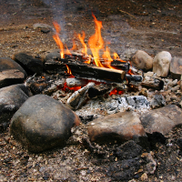
How to be safe near a bonfire.

Slide 2
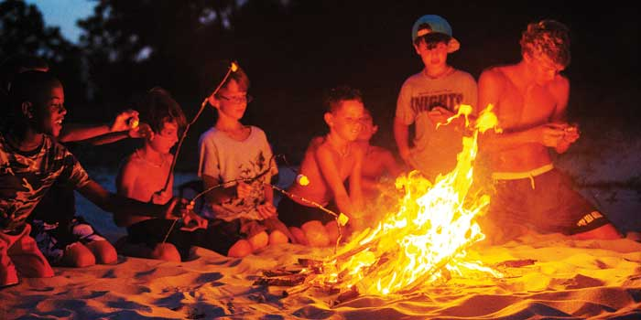
Bonfires are exciting and so much fun. But they can be very dangerous and they can hurt you if you are not very careful.
We are going to learn the bonfire rules…

Slide 3
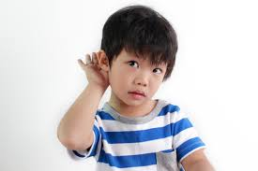
Listen carefully to the grown ups ALL THE TIME so that they can keep you safe.

Slide 4
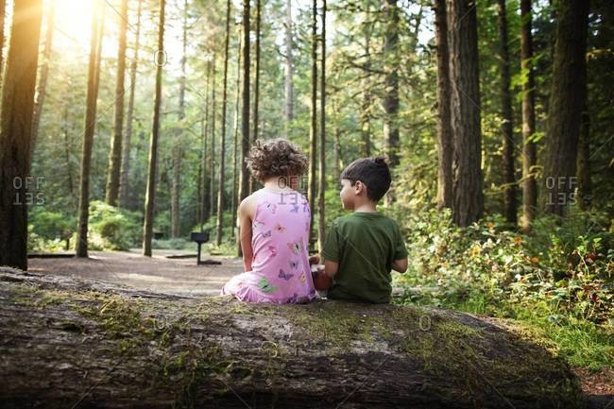
Sit next to a friend and stay sitting down sensibly on your log at all times.

Slide 5
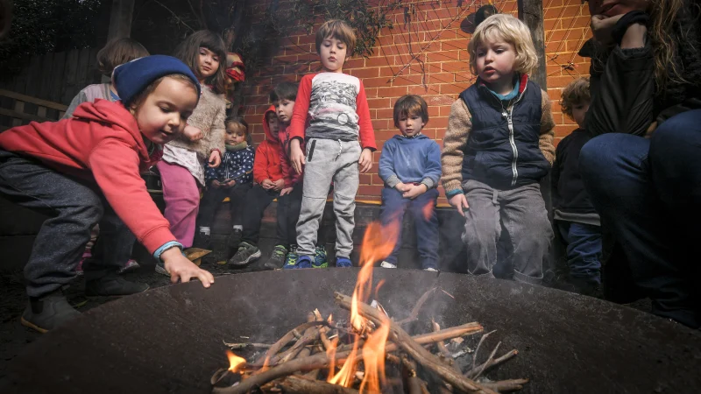
Do not touch the fire pit!

Slide 6
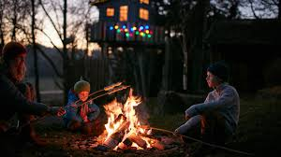
Cook your marshmallow on a long stick over the flames.
Do not put it into the fire.

Slide 7
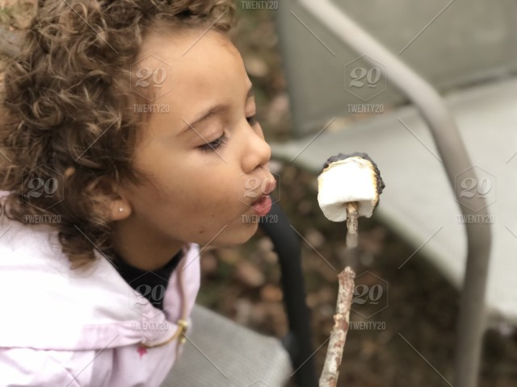
Blow on your marshmallow 10 times to cool it down!

Slide 8
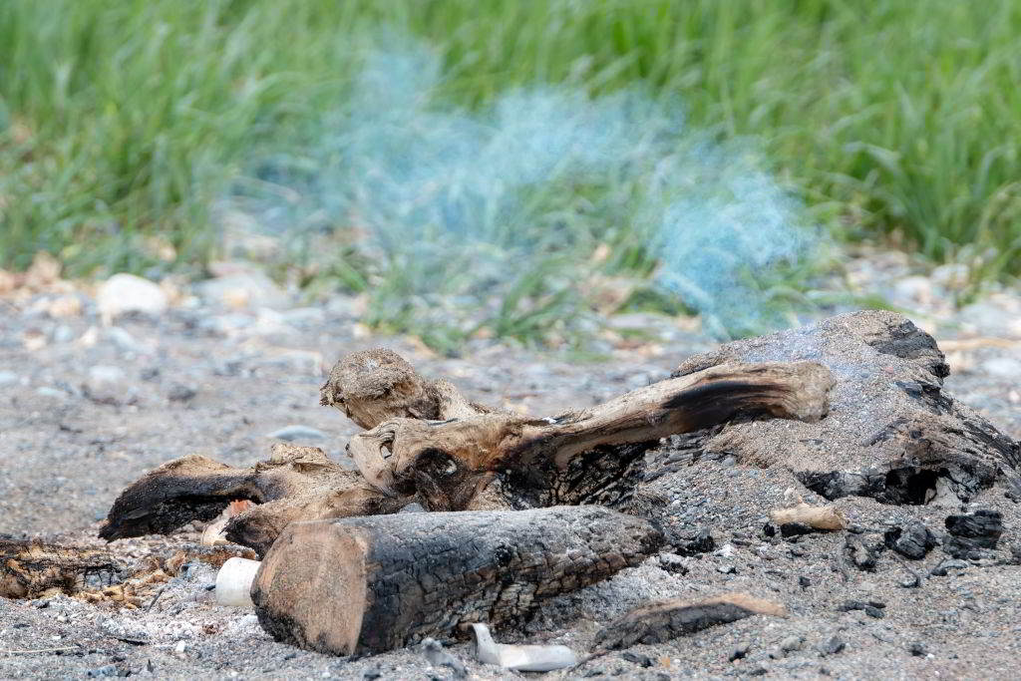
Put out the fire!

Slide 9

The Bonfire Rules
Listen.
Sit on the log.
Do not touch the fire.
Blow on your marshmallow.
Put out the fire.

