Slide 1




Year 1 Curriculum Meeting
Hedgehogs – Miss Sutherland
Squirrels – Mrs Waters and Mrs Holmes
Foxes – Miss Shaw

Slide 2






Our Vision
Our Vision
For you to be fulfilled, happy and confident learners
Our Values
Enjoy learning
Try our best
Make good choices
Respect each other & our surroundings
Work together
Celebrate our successes

Slide 3
Purpose
What learning in year 1 looks like.
Curriculum
Assessments
How you can help your child at home.
How to keep in touch.

Slide 4
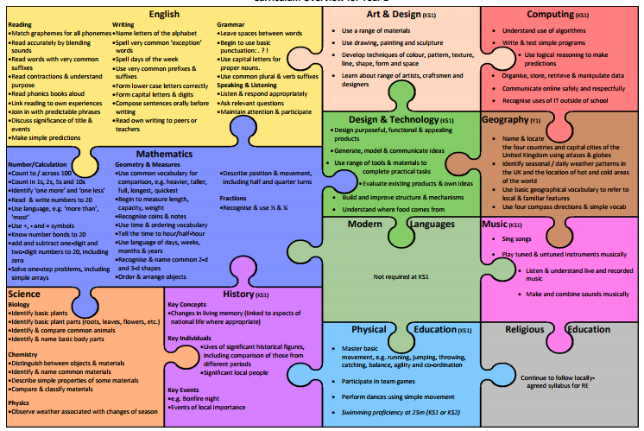
What we cover in year 1

Slide 5



Curriculum
Y1 Themes
Into the Woods
Geography focus: human and physical geography. Geographical skills and fieldwork.
Science focus: seasonal changes for autumn.
History focus: changes in our local area.
Ice and Fire
History Focus: significant events beyond living memory.
Roars, Paws and Claws
Science focus:
Animals, plants and living things
Areas of learning
Maths
English – writing, reading and phonics, spelling
Science
PE
Art
Music
Design Technology
Computing
History
Geography
P4C
PSHE
RE
Metacognition
Learning Attributes
Resourceful, Reciprocal, Risk-Taking, Resilient, Reflective

Slide 6
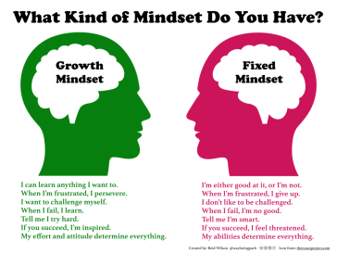
Mastery curriculum
Mastery
Based around broadening a child’s understanding of a text and language and show a deep understanding through applying their learning.
What will this look like across the year?
Skills and knowledge will be built up throughout the year so children will be apply to apply their learning to a wide variety of contexts.
Mathematics Mastery
Teaching the year 1 maths curriculum in depth not breadth.
Whole class taught together with scaffolding and resources for additional support. Children keeping up not catching up.
Use of quick intervention for children who require additional support.
Mastery English
Immersive teaching style focusing on one text at a time.
What does this look like in the classroom?
All literacy lessons being based around one text with children learning SPaG skills and building up to longer writes.

Slide 7
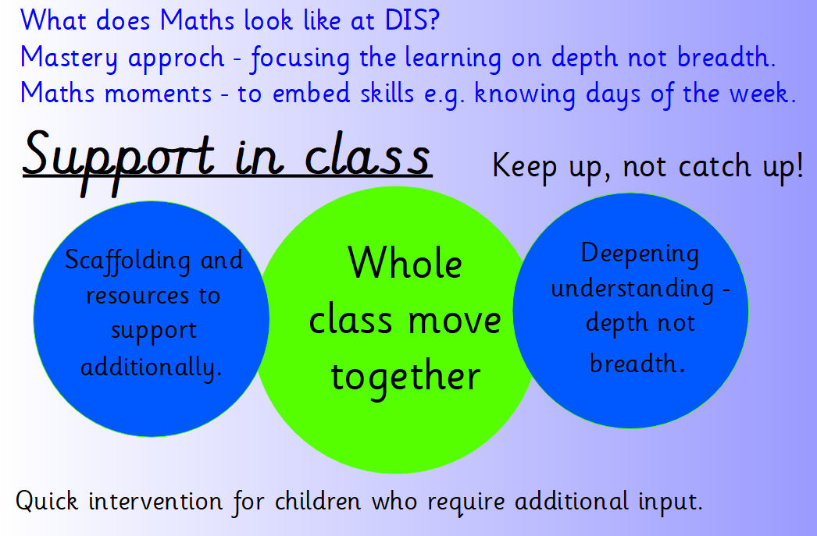
Maths in Year 1

Slide 8
Maths in Year 1
Count forwards and backwards in 1s within 100 starting at any number.
Count forwards and backwards in 2s, 5s and 10s.
Know 1 more and 1 less than a given number up to 100.
To understand place value of a number within 100 – how many tens and ones.
To fluently recall number bonds to 10 and 20.
To fluently add and subtract numbers within 10 understanding the relationship of parts and wholes.
Add and subtract numbers within 100 using concrete resources and pictures.
Fluently recall the related addition and subtraction facts up to 20.
2-digit add and subtract 1-digit not crossing 10s
e.g. 36 + 3 = 75 - 2 =
Understand mathematical symbols + - and =
Use the language of comparisons (greater than / less than).
Measure weight, length and capacity.
Recognise and describe simple 2D and 3D shapes.
Tell the time (half past, o'clock).
Recognise half, quarter and whole of amounts, shapes and number (1/2).

Slide 9
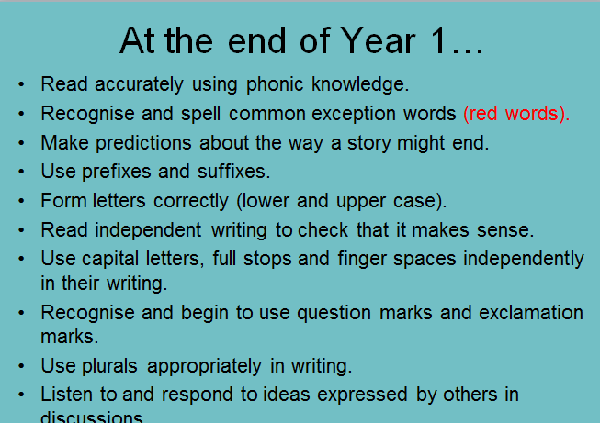
Literacy

Slide 10
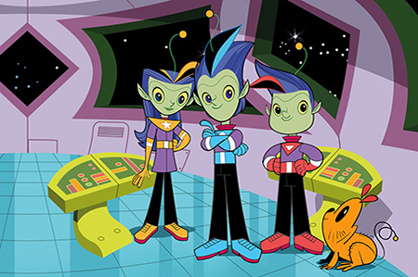
Spelling
Welcome to the spelling zone
We expect all children to be able to spell the year 1 common exception words and make phonetically plausible attempts at spelling words.
What this looks like in school?
Morning Activities. Application of spellings in writing. Words mats to support spelling. Homework to practise. Develop knowledge of spelling strategies

Slide 11
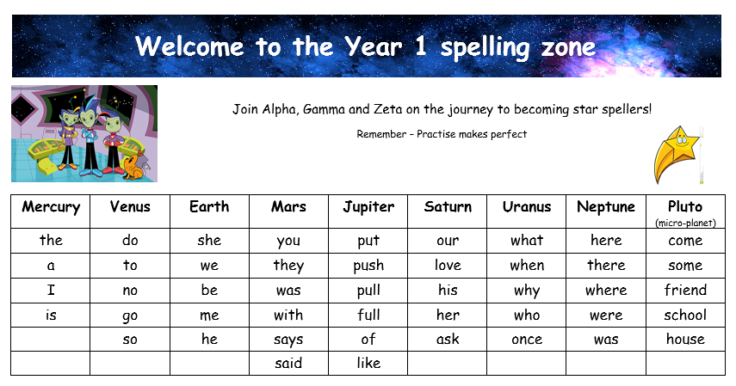
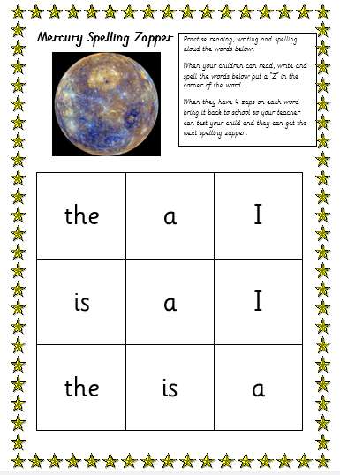
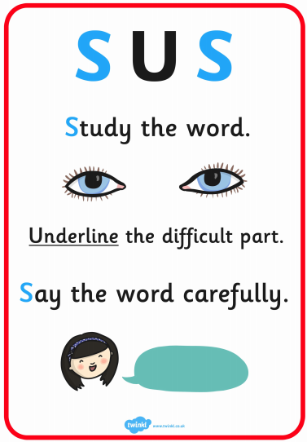
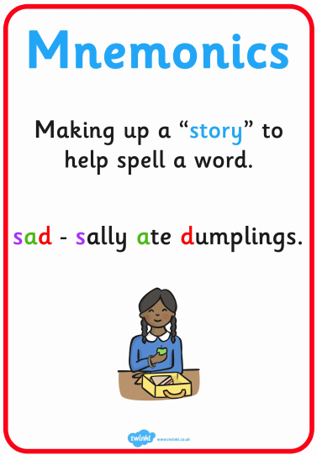

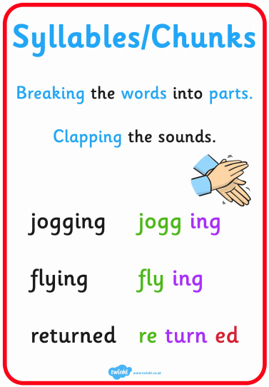
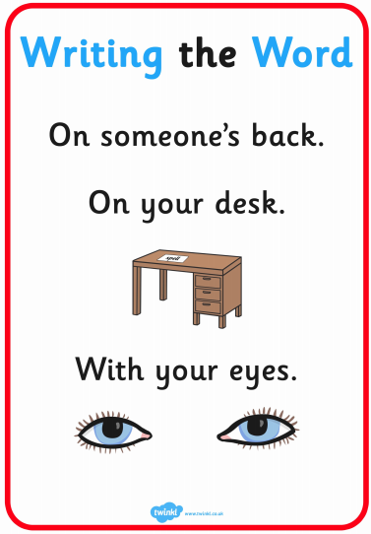
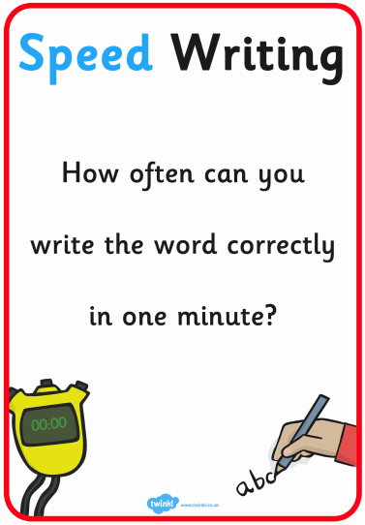

Slide 12
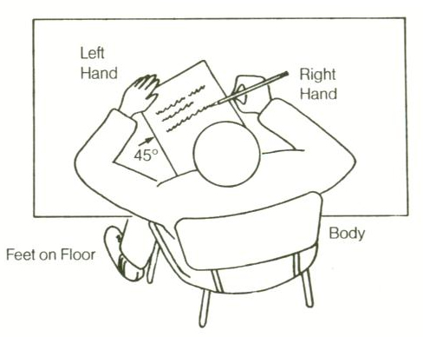
Handwriting
What do we expect?
All lower case letters formed correctly
• Write capital letters taller than lower case letters.
• Write on the lines.
• Write descenders under the line all the same length
(f, g, j, p, q, y)
• Write ascenders taller than other lower case letters and make them all the same height (b, d, h, k, l, t)
Support in school – handwriting lines, specific sessions within school. Links to games on the class blogs.
Notes:
Lindy

Slide 13
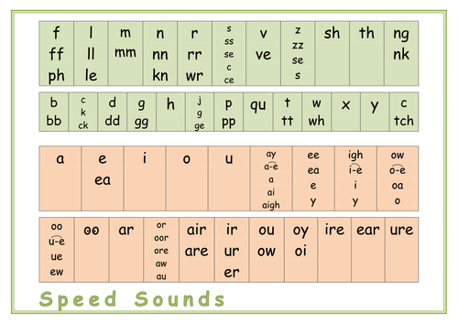
Reading
A school adult will read a colour book with your child once a week and write a comment in their reading diary. Your child will bring a new book home on a Friday to read. Please return this to school on a Tuesday so we can quarantine the books.
We teach reading and phonics through the Read, Write, Inc (RWI). This is taught in class 5 days a week for half an hour. You child will focus on a set of sounds each half term, which will be stuck into their reading diary.

Slide 14
How to help at home.
Maths - Say the mathematical names for things. We use vocabulary such as 'calculations' and 'equations' in our maths learning. The children love to know what the 'proper' words are and what they mean. Many of our children can now use words such as these in their maths conversations. Practise the ‘learn it’s on the homework – these will include counting in 2s, 5s and 10s, learning number bonds to 10 and to 20 as well as looking at practising telling the time to o’clock and half past. Reading at home daily - this can be shared reading, reading to your child, discussing books and hearing your child read. Please also practise the phonic sounds your child is learning at home – these can be found in their reading diary. Encourage your children to answer questions and have conversations using full sentences as this builds up their ability to reason and explain themselves. Writing in homework books - to be given out half termly and to be handed in at the end of a half term. This has been given out already, and will include maths, spelling and wider curriculum activities.

Slide 15
How to help at home
Here are some websites you may enjoy exploring at home. Purple Mash Bug Club Obb and Bob; phonics play online BBC bitesize BBC bitesize; small town superhereos Charanga Top marks website; maths games

Slide 16

Y1 Assessments
It is a government initiative that every child will complete the end of y1 phonics screen. This requires them to read 40 words – some real and some ‘alien’ or nonsense words. It is helpful if you practise some of these at home.
These assessments will take place in the summer term.
They will be administered and marked by the class teacher and will take place in a quiet room on a 1:1 basis. We do lots in school to prepare the children.
Benchmarking – done when children are reading their current book band with good fluency and pace. Children will also need to show a clear understanding of the book they’re reading being able to answer questions and summarise what they have read. Children may stay on a book band for longer as they move through the colours.
Maths and English are assessed based on the work they produce throughout the year by the class teacher. We use the national curriculum to assess whether children are working towards the expected standard, working at the expected standard or working at greater depth.

Slide 17

Communication
Talking with us: Due to social distancing rules please try to keep in touch with us via email as much as possible.
Personal emails
Friday e-letters
Occasional paper letters
Class notice boards
Texts
Ask Me board on window
Class Blog
Twitter
Parent Consultations: Nov, March
Report and results of phonics assessment and reading, writing and maths data.
sutherlande@dobcroft-inf.sheffield.sch.uk - Hedgehogs
holmesk@dobcroft-inf.sheffield.sch.uk
watersc@dobcroft-inf.sheffield.sch.uk
Squirrels
shawg@dobcroft-inf.sheffield.sch.uk-
Foxes

Slide 18
Thank you for listening and we look forward to working with you in the coming year.

