Slide 1

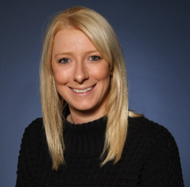
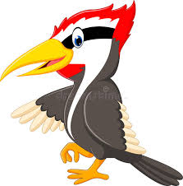
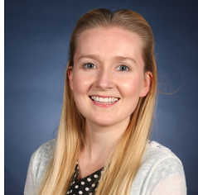

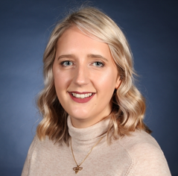
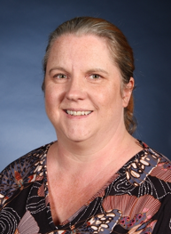
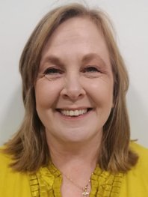
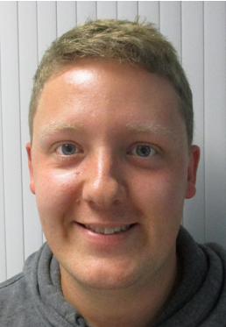

Welcome to Year 2
Kingfishers – Miss Tinker and Miss Marlow
Woodpeckers – Miss Mather
Eagles – Miss Hughes and Miss Sweet
TAs
Mrs Peersman
Mrs Briggs
Mr Ogden

Slide 2






Our School Vision
Our Vision
For you to be fulfilled, happy and confident learners
Our Values
Enjoy learning
Try our best
Make good choices
Respect each other & our surroundings
Work together
Celebrate our successes

Slide 3
Routines
Independent Punctual Entry Woodpeckers 8.45, Kingfishers 8.50, Eagles 8.55
Children will be expected to independently hang their coat up and put their book bag and water bottle away.
Children will then be asked to complete a morning work task which will be displayed on the interactive whiteboard.
Please encourage your child to enter the classroom independently, each class has an adult who will be there to help settle the class in the morning.
Home Time Woodpeckers 3.15, Kingfishers 3.20, Eagles 3.25
Attending DASH: we have lists if your child attends DASH.
Any different arrangements: If your child is going home with an adult they do not usually go home with then please inform an adult on the door.
Sheffield Council Policy: child uncollected after 3:40pm will be taken to a safe waiting place outside the office.

Slide 4
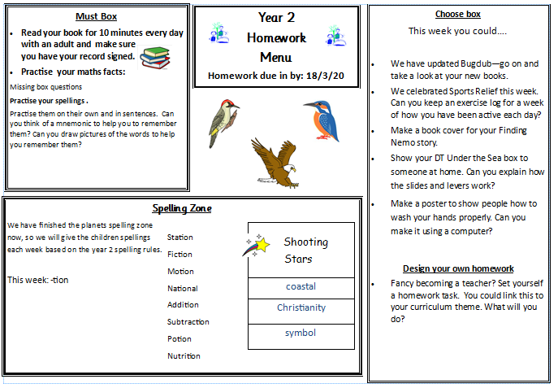
Homework
Homework is on a weekly basis: It is uploaded to each class blog on a Friday and will be expected in on Wednesday.
(please see class teacher if paper copy is required.)
The children will be familiar with the format from Year 1
Format of the homework
Non-negotiables:
Reading, Spelling Zone and maths ‘Learn its’
Choose from:
Often topic based.
Practical: walks, discussions
Research: library, internet, class blog, bug club, purple mash
Recording: drawings, posters, PowerPoints, photos, writing, email

Slide 5
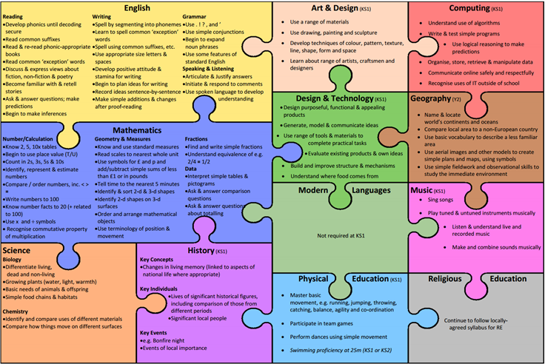
What we cover in Year 2
This is the national curriculum jigsaw for Year 2. Copies will be available to download from the class blogs.

Slide 6
How we cover curriculum at Dobcroft Infant School
Year 2 Themes
Around the World (Autumn term)
Geography focus:
around the world, landmarks, continents and oceans
History focus:
Travel through Time
Victorians (Including a Victorian day!)
Science Focus:
Living Things and habitats around the world
Materials
Under The Sea (Spring term)
History Focus:
Sheffield Floods
Science Focus:
animals including humans
Food Glorious Food (summer term)
History focus:
How food is manufactured
Science focus:
Healthy eating and food
Areas of learning
Maths
English – writing, reading (including phonics), grammar and spelling
Science
PE
Art
Music
Design Technology
Computing
History
Geography
P4C (Philosophy for children)
SEAL
Massage
RE
Metacognition
Healthy Minds
Wellbeing
Wellbeing of children
Health and wellbeing has been a part of our curriculum for many years. With recent events (Covid-19) we will have an increased focus on this.
We will be talking to the children about how to recognise their emotions/worries and how to deal with these.
Children will be taught many techniques relating to these emotions. We will have ‘worry boxes’ so children can share these emotions with adults and individual advice given. We will work with you to ensure information is passed on.
The Wellbeing of our children and to you as parents is paramount to us as a school! We are here to help.

Slide 7
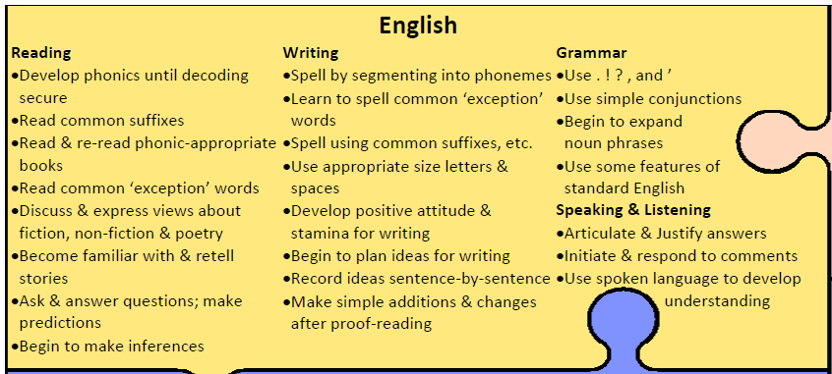
What we cover in Year 2 - English

Slide 8
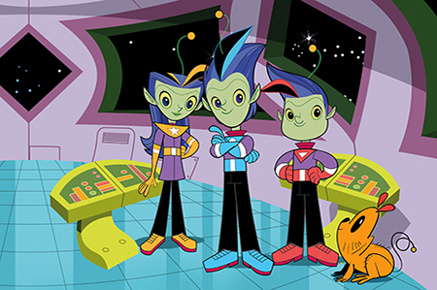
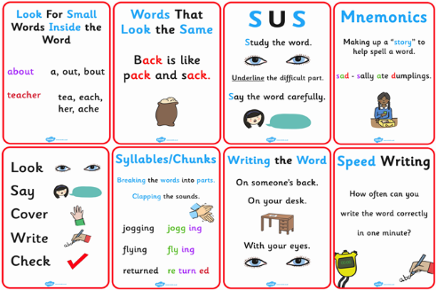
Spelling
Welcome to the spelling zone
We expect all children to be able to spell the Year 2 common exception words and the spelling rules for Year 2 by the end of the year.
Copies of these words are on the class blogs.
What this looks like in school?
Morning Activities.
Spelling zappers. (Similar to Year 1)
Direct teaching of spelling rules.
Application of spellings in writing.
Words mats to support spelling.
Homework to practise.
Develop knowledge of spelling strategies (See picture to support you with these strategies)

Slide 9
Writing for Purpose
As well as the technical elements children need to include in their writing, there has been a shift in focus back onto creativity and writing for an audience.
Children will read and write a variety of genres throughout Year 2, and there is a greater emphasis on the links between using what they have read and language from books to inform their writing.
Therefore allowing children to creative write is a useful process and will also increase their stamina for writing. This will also be included in homework.

Slide 10
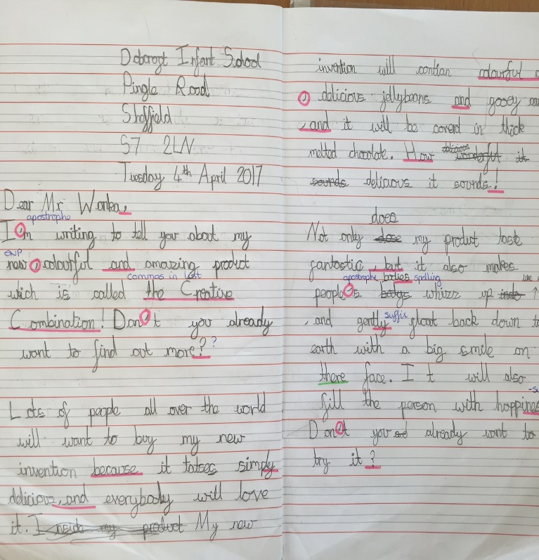
Handwriting
What do we expect?
All lower and upper case letters formed correctly.
Join lower case letters and leave capital letters un-joined.
• Write capital letters taller than lower case letters.
• Write on the lines.
• Write descenders under the line all the same length
(f, g, j, p, q, y)
• Write ascenders taller than other lower case letters and make them all the same height (b, d, h, k, l, t)
Support in school – handwriting lines, specific sessions within school.
Support at home – Handwriting booklets will be in the home learning books.
Notes:
Lindy

Slide 11
Reading
What does it look like in school?
Morning reading each Tuesday
Guided reading sessions 3 x week.
Read Write Inc lessons for those who require support with phonics.
In addition to this each child will be read with individually by a school adult every fortnight. (Comments supporting with next steps will be in reading diaries)
We work on developing the following reading skills;
Decoding individual words and sounds – sounding out loud and then in their head to build pace and fluency.
Comprehension – answering retrieval and inference questions using evidence from the book and their wider knowledge.
Style of reading – using intonation and expression to reflect how characters are feeling and also to appropriately read punctuation.
Discuss the type of book they are reading (fiction / non-fiction / traditional tale)
Assessment:
We will benchmark children to move up to their next reading colour when we feel they are ready. As they move through the book bands they may spend longer on them as they will be developing their comprehension and reading style (for example reading with expression) .

Slide 12
Reading Expectations
Year 2 reading expectations.
Fluent reading – 90 words per minute
Automatic decoding when reading
Able to answer find and retrieval and inference questions.
Please read with your child as often as you can at home. You will have information on how to support your child with their reading in their reading diaries (This is located in the front of their diaries and teachers will add individual comments.) Please record when you read with them.
Coloured Books
End of year expectation – gold/white books.
As the children move through the bandings, the books become longer, more difficult and require a greater depth of comprehension. Children require much more reading stamina when they move up through the reading bands. Don’t worry if your child stays on one colour band for a longer period of time, they are likely building on their reading stamina!

Slide 13
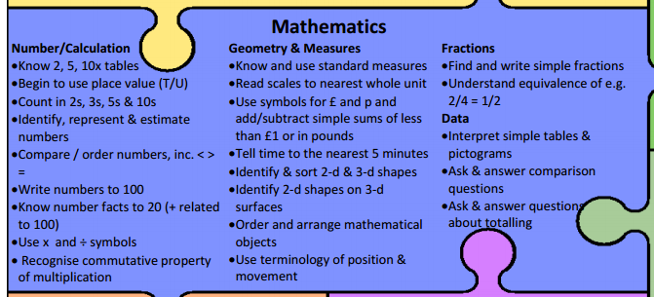
What we cover in Year 2 - Maths

Slide 14
How to help at home
Say the mathematical names for things. We use vocabulary such as 'calculations' and 'equations' in our maths learning. The children love to know what the 'proper' words are and what they mean. Many of our children can now use words such as these in their maths conversations. Practise ‘learn its’ at home. These will be on the homework menu every week and don’t need to be recorded. e.g. - multiplications walking to school Expose children to telling the time and making amounts of money as much as possible! Assessment in Maths Support with techniques will be available on the class blog. Very fluid assessment: we constantly assess children during lessons and we're scaffolding/extending children all of the time. Children self-assess all of the time. They say when they find things easy/difficult and move through the different levels of scaffolding appropriately. End of unit assessments or skill practise: children have a go at different questions relating to skills covered so far. End of year assessment: teacher assessment 1 test on calculation and 1 test on reasoning.

Slide 15
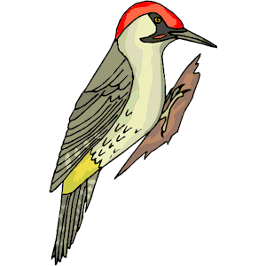

Year 2 Assessments
(This may depend on routines in place due to Covid - 19. We will keep you as updated as we can)
It is a government initiative that every child will complete an end of KS1 assessment in maths, SPaG (Spelling, Punctuation and Grammar) and reading. Writing will be assessed by the child’s class teacher.
These assessments will take place in the summer term.
They will be administered and marked by the class teacher and will take place in the child’s classroom. Some children may complete the assessments in small groups or individually.
Although these assessments will be marked by class teachers they will be moderated within the year team.
These tests are part of our end of year assessments and will have no more emphasis for the children than their usual work expectations.

Slide 16

Teaching Assessment Framework (TAF)
As well as the end of Key Stage 1 assessments, your child will be assessed against the TAF– a set of expectations released by the government.
This allows us to teacher assess where each child is, which will be the final assessment of your child.
You will be given a copy of the TAF at the autumn parents evening (Covid-19 dependent), however if you would like to look at them before there is a copy on the class blogs.
Used for Reading, Writing (SPaG) and Maths.
Split each subject into:
  Pre-Key Stage Standard
  Working towards the expected standard
  Working at the expected standard
  Working at greater depth

Slide 17

Phonics
As the phonic assessment was unable to take place in June due to Covid 19, the government have rearranged the phonic assessment to take place in December 2020.

Slide 18

Communication
Talking with us: If urgent, in the morning, otherwise after school, by phone or at an arranged time.
Personal emails – See below
Friday e-letters
Occasional paper letters
Texts
Class notice boards – Located on classroom windows
Ask Me board on window (These are on each class window and get updated regularly with our learning and upcoming events)
Class website page
Parent Consultations: Nov, March (Covid 19 dependent)
Report and results of KS1 Assessments
tinkerc@dobcroft-inf.sheffield.sch.uk - Kingfishers
matherk@dobcroft-inf.sheffield.sch.uk – Woodpeckers
hughesc@dobcroft-inf.sheffield.sch.uk- Eagles

Slide 19
Thank you and we look forward to working with you in the coming year.
If you have any questions please email your new class teacher.

