Slide 1
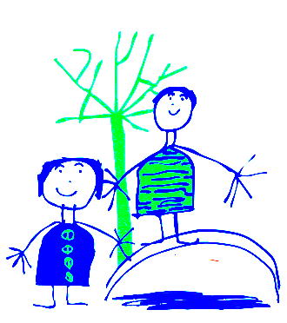
Dobcroft Infant School Foundation Stage
(FS2)

Slide 2
Welcome to Dobcroft Infant School.
Mrs Featherstone, Mrs Pemberton, Miss Chaudhry
Foundation Stage Two

Slide 3
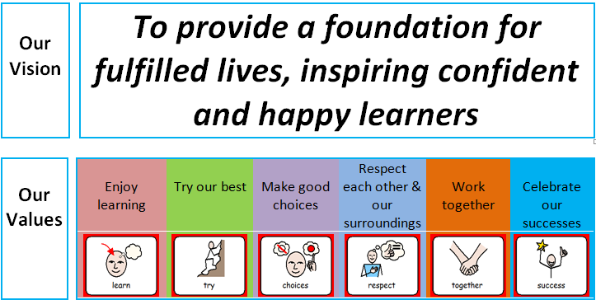
Our school Vision

Slide 4
Purpose
To introduce you to the team.
Share what learning in FS2 looks like (routines and timetable).
Introduce you to the Early Years curriculum and terminology.

Slide 5
Classroom Routines
(This may depend on routines in place due to Co-vid 19. We will keep you as updated as we can)
Doors open at 8.45 am, you can leave your child from 8.50am. Door are locked at 9.00am ~ please use main entrance (office) after this time. Registration starts at 9.00am.
After this time you must go to the main entrance. Please do not open the door for parents after 9.00 am.
Please do not bring prams into the classroom.
Please could parents come into the classroom and wait for their child to hang their coats etc.
Children hang up coats.
Put water bottle on the table in classroom.
Change book in book bag and put bag in the box/drawer (books to be given out this week).
Put picture on the rocket.
Sit on the carpet quietly with a book or look at the pictures on the active board screen.
Parents are welcome to look at the pictures too and then leave when their child is settled.
Please leave by the cloakroom door and make sure the door is closed.

Slide 6
Planning and Preparation Time
On a Thursday morning the teachers have planning and preparation time (PPA) so you may see other familiar adults at this time.
Mrs Rowlands – Rabbits
Mrs Rhodes – Mice
Mrs Simpson - Badgers

Slide 7
General Issues
If your child is absent from school please telephone the school office and explain why.
If your child arrives at school after 9.00am they will be marked as late and you will need to go to the school office.
School finishes at 3.25pm please can you be on time to collect your child. Children not collected will wait by Mrs Rowland’s office. Sheffield Council Policy: child uncollected after 3:40pm will be taken to a safe waiting place outside the office
Children who have been sick need to stay away from school for 24 hours after the last bout of sickness. For diarrhoea it is 48 hours after the last episode.
For Covid symptoms please follow the latest government guidance.
Please remember to “take a peek once a week” and check for worms and nits.
We encourage children to be independent . Please encourage your child to tell a member of staff if they have wet or soiled themselves.
Please make sure your child has their blue book bag in school every day. Letters from school will generally go out via e-mail on a Friday.
Please ensure all items of clothing are clearly labelled and your child knows where the label can be found.
Please do not let your child play with the resources set out in our outside classroom areas (outside each classroom door).

Slide 8
PE and Library
Please make sure your child has a PE kit in school every day (jade T shirt and dark shorts). We send the PE kits home every half term so you can wash them.
Children with long hair should have it tied back on PE days.
Jewellery should not be worn in school. If your child has recently had their ears pierced they must cover their earrings with plasters. (please bring from home)
School will provide a red library book bag. Please bring it to school on your child’s library day.

Slide 9
Helping in School
Parents are always very welcome to come into school and help. Please sign up with your child’s teacher if you are able to help (after this meeting). No younger siblings please!
Due to current circumstances this might need to be reviewed.
Any worries or issues please do not hesitate to speak to a member of staff. Mornings are often very busy, so please either wait until the end of the day, send your class teacher an email, or pop to the office to arrange a convenient time to meet with the teacher.

Slide 10
The Early Learning Goals.
The Foundation Stage covers the education for children from birth to the end of the “Reception Year”.
The Foundation Stage is split into 7 areas of learning.
Each area of learning is broken down into a series of “aspects of learning” and then “Early Learning Goals” for the children to work through and achieve.

Slide 11
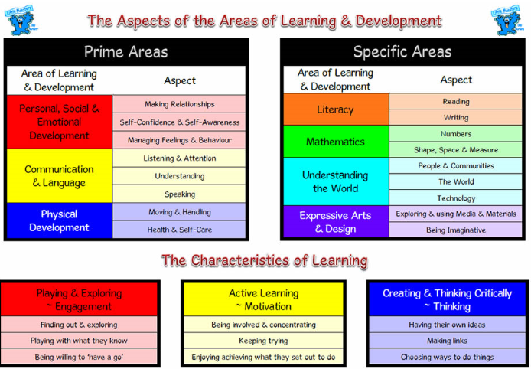

Slide 12
How do the Children Learn?
Children will have focus teaching time each day to develop all areas of learning.
The learning will be delivered as part of a “class”, a small group and as an individual.
The children will learn through structured play activities inside and outside.
Children will have opportunities to explore and experience the learning activities independently in the classroom.

Slide 13
SEAL
This stands for Social, Emotional Aspects of Learning. In Autumn, we place the most emphasis on this area of learning and help the children to be happy and settled in their new classes.
Each half term the children work on a different SEAL theme which covers our personal, social and emotional curriculum (PSHE).
Term One ~ New Beginnings
Getting On and Falling Out
Term Two~ Going for Goals
It’s Good to be Me
Term Three ~ Relationships
Changes
Sometimes, we may ask you to bring in some photos from home for the children to share in school.

Slide 14
Family Seal Activities
This half term, we are asking you to complete an activity with your child where you will be talking about different things you and your child have enjoyed over the course of a week. Parents can scribe for their children and email back to your class teacher.

Slide 15
WALT
WALT ~ We Are Learning To
Your children will see this picture in school and is used to introduce the learning objective they will be working on.

Slide 16
Eco School
ECO CODE
At Dobcroft Infant School we are committed to:
Reduce, recycle and reuse.
Appreciate and value our environment and community.
Build awareness of the choices we make and their impact globally.
We have a “ Eco Team” in school with representatives from each class. These will be chosen after the Christmas holidays.

Slide 17
Parent Information
At the beginning of each term we will send home a “Knowledge Organiser” letter to inform you of what the children will be learning in school.
Individual meetings for parents and carers in November and March.
In July you will receive your child’s school report.

Slide 18
Other Areas of Learning
A separate meeting or power point
(depending on the covid situation) will be posted in October to give more details about how we teach literacy, phonics and numeracy.
At the parents evenings in November.
We will talk to you more about your individual child and what their next steps of learning are.

Slide 19
PSA
The parent association (FODS) runs various events through out the year which are promoted in a termly newsletter.
If you are able to help at any of the events or would like more information then please email
enquiries@dobcroft-inf.sheffield.sch.uk

Slide 20
Thank you for coming!

