Slide 1






Our Vision
Our Vision
For you to be fulfilled, happy and confident learners
Our Values
Enjoy learning
Try our best
Make good choices
Respect each other & our surroundings
Work together
Celebrate our successes

Slide 2




.
Welcome to Year 1
2020 - 21
Ellie Sutherland - Hedgehogs
Colette Waters and Kat Holmes - Squirrels
Gabby Shaw - Foxes

Slide 3

Purpose
To introduce you to the team.
Share what learning in year 1 looks like (routines and timetable).
Our Curriculum.
How we assess children in year 1.
How you can help your child prepare for year 1.

Slide 4
Routines
Independent Punctual Entry 8:45 -9:00 (Register at 9:00)
(This may depend on routines in place due to Co-vid 19. We will keep you as updated as we can)
Children will be expected to independently hang their coat up and put their book bag and water bottle away. Children can change their coloured reading book if necessary,
Children will then be asked to complete a morning work task which will be displayed on the interactive whiteboard.
Please encourage your child to enter the classroom independently, each class has a TA who will be there to help settle the class in the morning.
Home Time 3:30
Clubs and DASH: we have lists if your child attends either.
Any different arrangements: If your child is going home with an adult they do not usually go home with then you must write on the going home board near the classroom entrance when dropping your child off in the morning. Please update when necessary.
Sheffield Council Policy: child uncollected after 3:40pm will be taken to a safe waiting place outside the office.

Slide 5
Homework
Half Termly: Each half term we will set a home learning task. You will have the whole of the half term to complete the home learning. It will be due in on the last Monday of each half term. The homework will be supplied in a homework book and a copy will also be available on each class blog should you misplace it.
Format – homework menu (see next slide for example)
Non-negotiables: Activities you must do with your child as often as possible. These will include;
Reading, Spelling Zone (common exception word zappers) and ‘Learn its’ (maths facts)
Choose box:
Often topic based activities that you can choose to complete or not complete.
Examples: walks, discussions, research, drawings, posters, powerpoints, photos and writing.

Slide 6
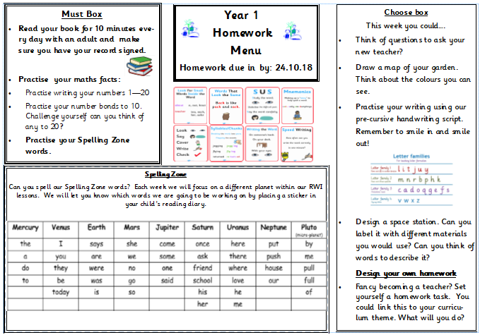
Homework Menu Example

Slide 7
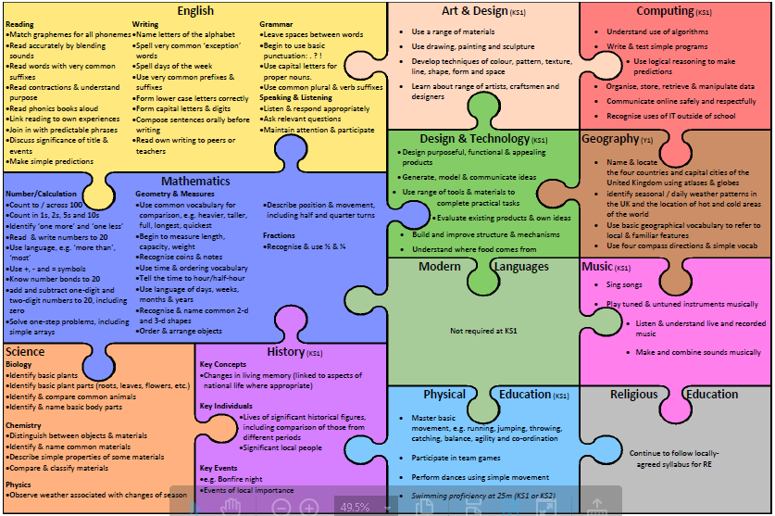
Curriculum Overview for Y1

Slide 8



Curriculum
Learning Qualities
We encourage the children to develop these skills to support their learning. We call them the 5 ‘R’s;
Resourceful, resilient, risk-taking, reciprocal, reflective
Y1 Themes
Into the Woods:
Geography Focus:
Geographical skills and fieldwork, locational knowledge of the UK and surrounding seas. Physical features of Geography
Fire and Ice
History focus:
Significant historical events beyond living memory (stay tuned to find out what they are!).
Animals
Science focus:
Animals including humans and plants and living things.
Areas of learning
Maths
English
Science
PE
Art
Design Technology
Computing
History
Geography
P4C
PSHE
Massage
RE
Metacognition – tying shoe laces
Music

Slide 9

Reading
In year 1 children have four shared reading sessions each week through our Read Write Inc program where they will work on developing their knowledge of phonics and sounds.
In addition to this each child will be read with individually by a school adult every fortnight.
We work on developing the following reading skills;
Decoding individual words and sounds – sounding out loud and then in their head to build pace and fluency.
Comprehension – answering find and retrieval and inference questions using evidence from the book and their wider knowledge.
Style of reading – using intonation and expression to reflect how characters are feeling and also to appropriately read punctuation.
Discuss the type of book they are reading (fiction / non-fiction / traditional tale)
Assessment:
We will benchmark children to move up to their next reading colour when we feel they are ready. As they move through the book bands they may spend longer on them as they will be developing their comprehension and reading style.

Slide 10
Reading at home
Reading at home ;
We recommend daily home supported reading – please record in diary
If there is no comment in the Diary for a fortnight, we will ask the office to text a reminder. With some children returning to school we have noticed that many of them have made great strides with their reading book band colours however many still require support with their phonics, learning new sounds, spotting sounds in their reading and writing sounds. Please watch the Ruth Miskin phonics lessons on you tube to help support your child with this.
Support for you:
Phonics - At the start of each half term you will find a note from your child’s RWI teacher (this may be different to their class teacher) which will tell you what sounds they will be learning and working on that half term.
Please use this to spot the sounds when you are reading with your child. You can also use these sounds to make up your own real and alien (nonsense) words.
Reading colour – there are tips on how to support your child’s reading on the colour book band label in their reading diary (changed when they move colour).
When reading at home help your child by encouraging them to sound out unfamiliar words (either out loud or in their head), look for clues in the pictures, consider what would make sense and break longer words down into syllables (beats).
You can also ask your children to summarise what they have read and talk about the significance of the book title and language used by the author to develop their vocabulary and comprehension skills.

Slide 11
Following the global pandemic and unprecedented times that we have all experience we appreciate and understand that you may feel nervous about any gaps in learning that your child may have. Please feel reassured that as a staff team we will be working closely together with each other, with you and with the FS team to support all children, to build on their strengths as learners and support any areas where they require further development.
To support your child and their transition to year 1 we will place some home learning booklets on their current class blogs (Badgers, Rabbits and Mice) that you can complete over the summer if you wish to however this is not compulsory. These will be uploaded in the week beginning 13th July and will aim to consolidate the learning from FS.
Activities will include;
Getting your child ready for Year 1
English
Letter formation; to print correctly with letters sitting on the line.
Spelling zone words for year 1(common exception words)
Summer diary
Phonic sound mats to support reading and writing.
Watch Ruth Miskin Phonics lessons on you tube.
Maths
Number formation booklet
Addition and subtraction booklet

Slide 12

Communication
We believe that teachers and parents should work in partnership together. It is crucial that we communicate and work together effectively to meet the needs of all children with school.
Given the current situation, how we work together may be different from usual and may change throughout the year, but we really value your work with us.
Talking with us; for right now the best way to communicate with us is via email which are available on the year 1 blogs. If you have something really urgent to discuss with your class teacher arranging a meeting (this may be zoom) via email would be best.
Work emails, checked once a week
Friday e-letters from office
Occasional paper letters
Class notice boards – general information you need to know
Texts
Ask Me board on window – updated weekly with learning we have been doing.
Class Blog – updated at least once a half term.
The following are subject to Government guidelines:
Class assemblies – Spring term
Curriculum Meeting – Autumn 1
Parent Consultations: Nov, March

Slide 13

Additional Information
Knowledge organisers – at the start of each half term we will release a knowledge organiser which will contain an overview of what we will be learning that half term and key language the children will need to know.
Reading, Bug Club – as well as the school reading books each child will also have access to bug club. A great reading tool which helps to build comprehension as well as decoding tools. This will be updated in a timely fashion when your child moves to a new book band colour.
Purple Mash – an online resource website that you can use from home. From time to time we may also set home learning on this. If your child’s log in changes we will inform you.
Homework – each half term. Keep your eyes out for the homework book.
Educational visits – these are subject to government guidelines. We will keep you informed throughout the year.
Parents coming in- we love having parents in to help and share their expertise, however at the moment this is not possible. We will keep you informed on this matter.

Slide 14
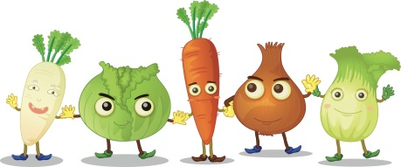



Bits and Pieces!
Healthy School Practise:
NO chocolate, nuts or sweets in lunchboxes
Provide a water bottle with fresh water each day.
Birthdays
We celebrate birthdays in class by giving a card and singing and ask you not to send in birthday treats.
We do not give out birthday invitations at school.
Toys
Keep toys at home as they can get broken or lost.
Show and Tell
At the moment we cannot do show and tell as children cannot bring things from home. As soon as this changes we will do show and tell again and we will let you know.
Uniform and belongings
Uniform and belongings MUST be clearly labelled with your child’s name.
This includes their DIS PE kit with shoes which must be in school.
Please ensure that your child in dressed and prepared appropriately for the weather as we do outdoor learning each day e.g. suncream / wellies / coats.

Slide 15
Thank you for your time and support. We look forward to working with you in the coming year.

