Slide 2
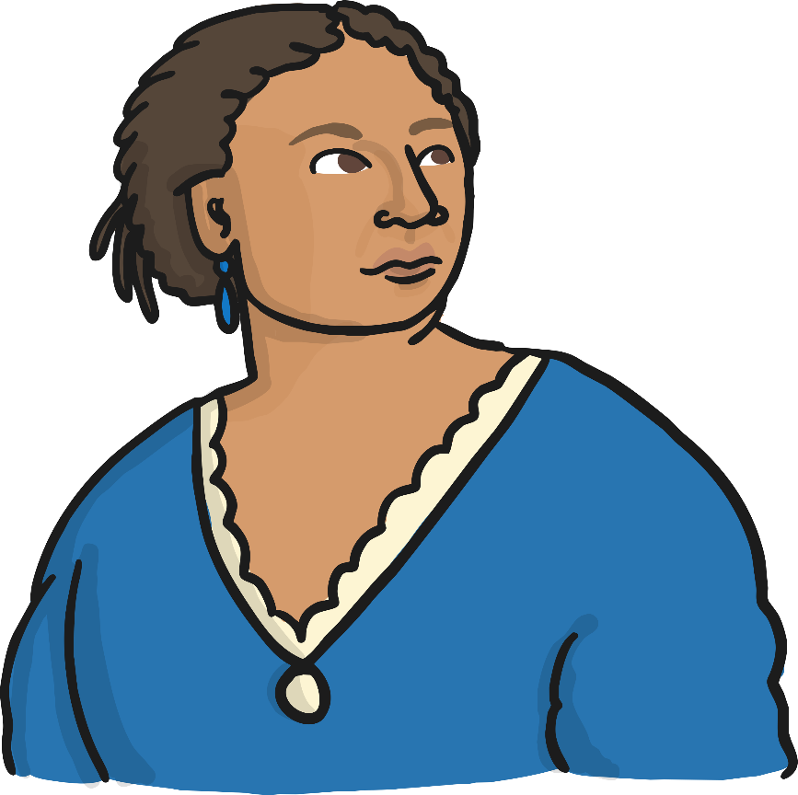
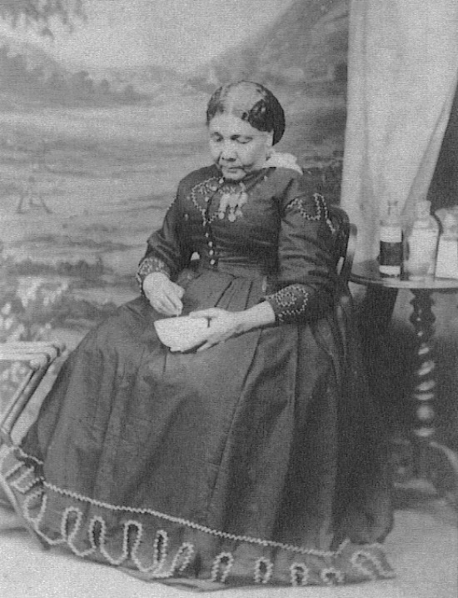
Who Was Mary Seacole?
Mary Seacole is remembered for her role in helping wounded soldiers in the Crimean War.
Mary, who was mixed race, also fought against being treated differently because of the colour of her skin.

Slide 3
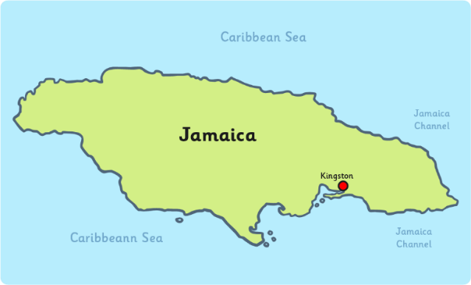
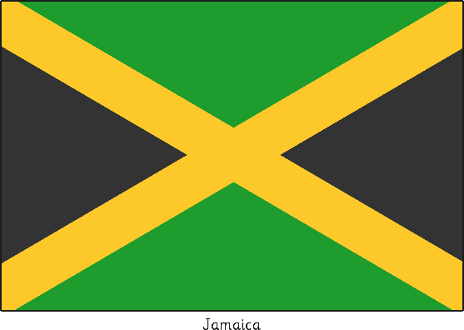
The Life of Mary Seacole
Mary was born in Kingston,
Jamaica on 23rd November 1805.
Her father was a Scottish soldier
and her mother was a Jamaican ‘doctress’ or healer, who used a variety of herbal remedies that came from African and Caribbean culture.
Mary’s mother ran a boarding house for injured soldiers and it is here Mary learnt her nursing skills.
On 10th November 1836, Mary married Edwin Seacole in Kingston. Sadly, he died 8 years later.

Slide 4
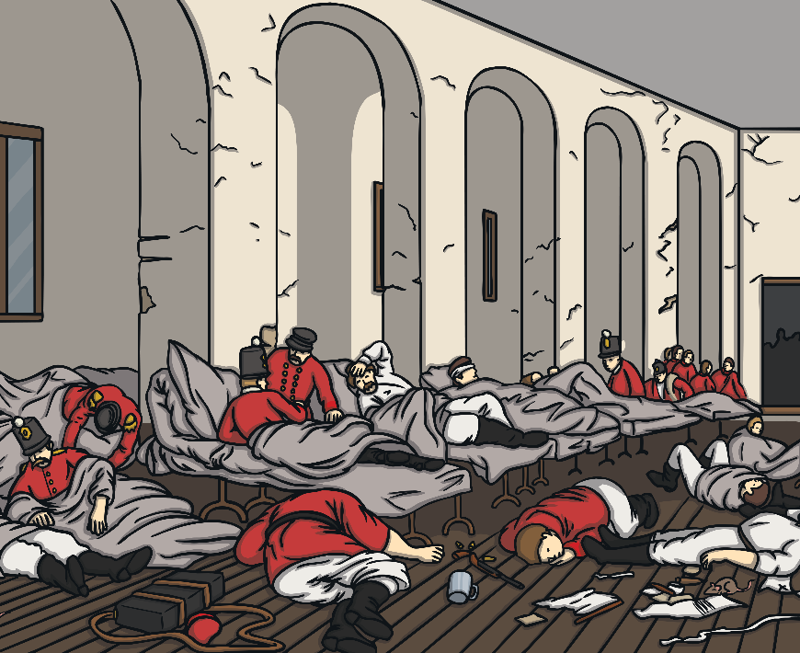
The Crimean War
The Crimean War began on 16th October 1853 and lasted for 3 years.
Mary wanted to help treat the
wounded soldiers there but was turned away due to the colour of her skin.
She saved up her own money to be able to travel there and opened her ‘British Hotel’ - a hospital for the soldiers injured in the war.
Mary also travelled to where the fighting was happening to treat soldiers under fire.

Slide 5
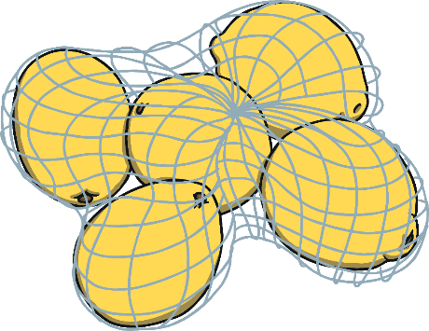
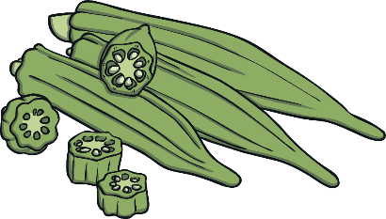

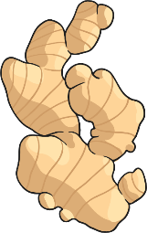
Mary’s Herbal Remedies
Mary used herbal remedies she had learnt from her mother to treat the soldiers.
She would often grind them in a pestle and mortar, mix them in a bowl or heat them over a fire.
    Some of the ingredients she used included:
    Aloe Vera – mixed to help heal cuts and wounds.
    Lemongrass – boiled to help a fever.
    Ginger – ground to help diarrhoea.
    Lemons – mixed to help coughs.
    Okra – chopped to help heal boils.
Some countries still use these remedies, or ones inspired by them, today.

Slide 6
After the War
Mary returned to Britain after the war but she was in poor health and had no home.
Many people had heard about her good work and raised money to help her.
Mary was awarded military medals for her service during the war.
In 1857, a book about her life was published. It was the first autobiography to be written by a black woman in Britain.
Mary died on 14th May 1881, aged 76, at her home in Paddington, London.
Her work was sadly forgotten until around 100 years after her death, when a group of Jamaican nurses wanted to know more about her and started making her name famous again.

Slide 7
Task 1
Your task is to put together a fact file on Mary Seacole using the fact file frame on your worksheet.
What to include:
Sub-headings
Information about the British Hotel in Crimean War.
Bullet points
Fact file
What she is famous for
Facts about her life
Labelled pictures

Slide 8
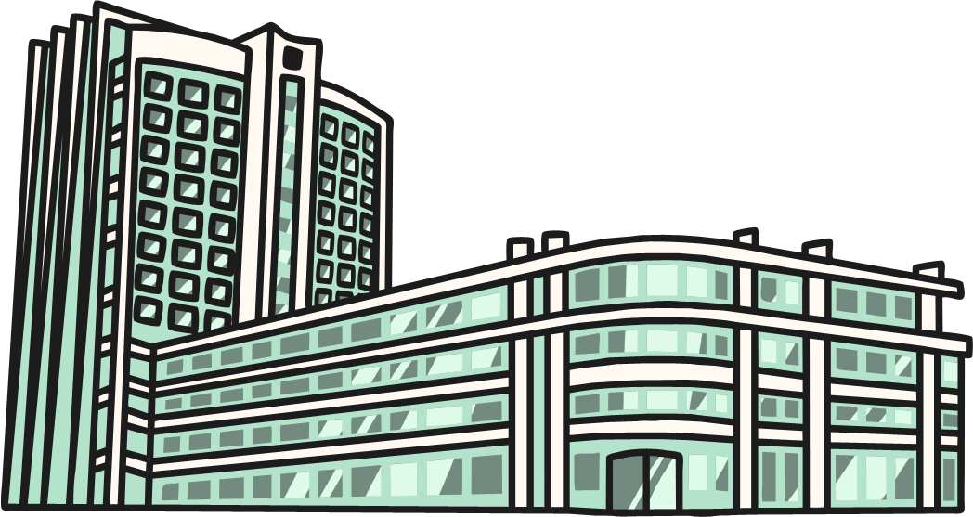
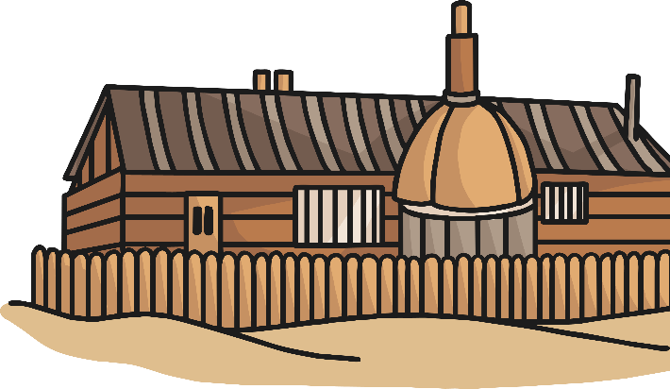
Task 2
Complete the worksheet comparing hospitals in the past with hospitals today.

Slide 9
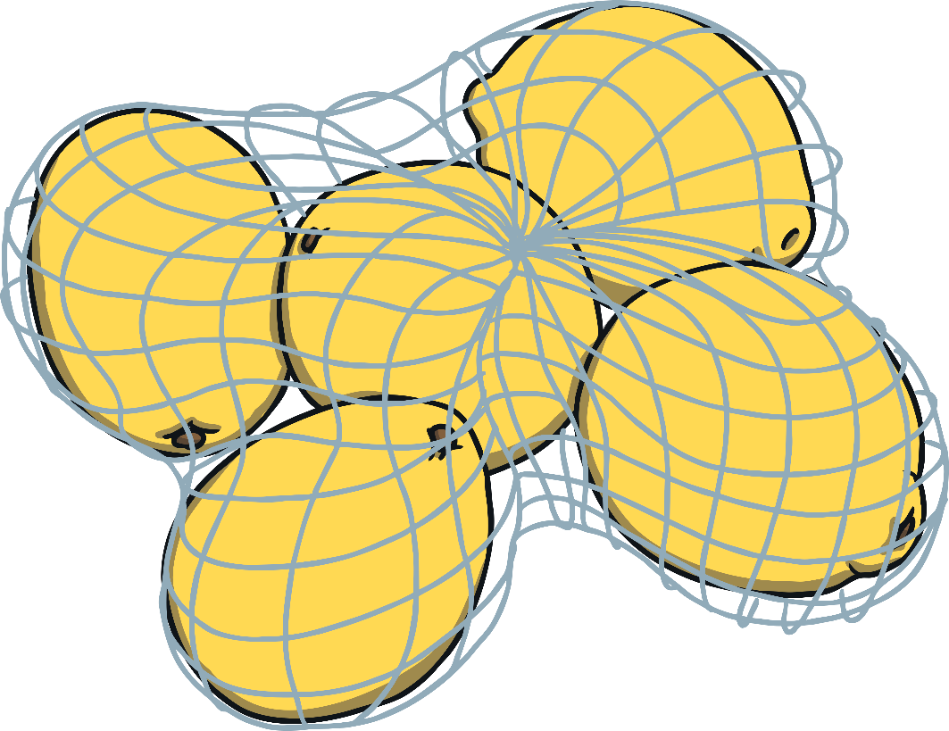


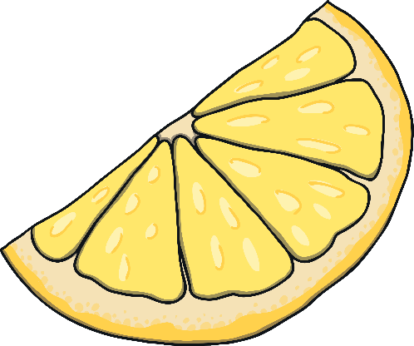
Task 3
Complete the worksheets giving information about some of Mary’s herbal remedies.

Slide 10
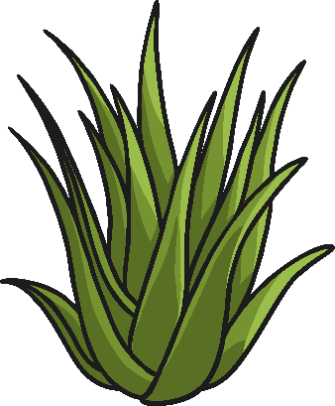

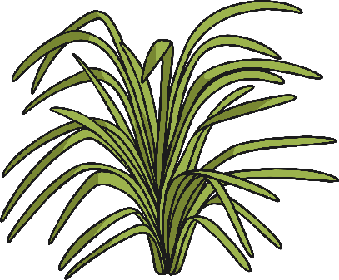


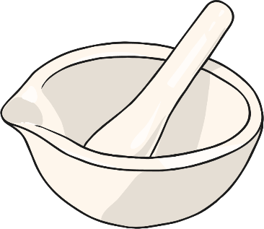
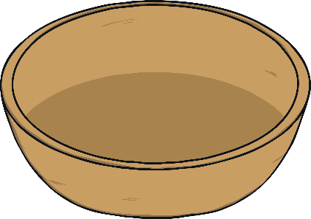
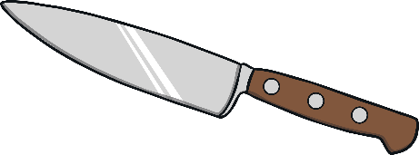
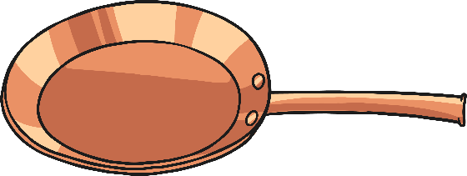
Plenary
Can you match the plant used to make one of Mary’s herbal remedies with the equipment she would have need to use?

