Slide 1
Phonics Screening Test Meeting
https://www.loom.com/share/4a395c43a41a4ff49da669fdb17bc589
Notes:
Welcome to a brief taster of our whole school synthetic phonics literacy programme – Read Write Inc!
Please insert own notes for introduction/welcome.

Slide 2
Year Phonics
Welcome Year One Parents and Carers.
Thank you for coming to our meeting!

Slide 3
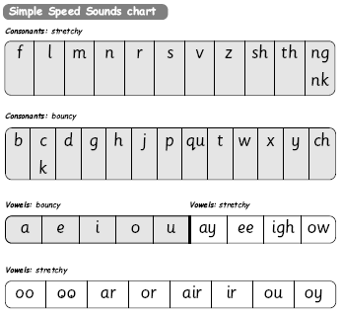
Letter and grapheme recognition
Notes:
Go through these sounds quickly with parents using My Turn/Your Turn.
Stress you must not use letter names at this stage – just pure sounds.
Emphasise getting rid of ‘ugh’ to help blending. Parents usually love this bit! Make it fun! Set 1 then long vowels in Set 2.
Explain that when the children are taught the sounds they use the cards and a multi-sensory approach – hold up the cards.
Describe how we use the pictures, rhymes and actions to help us to remember and recognise the grapheme on sight and therefore are more likely to blend when reading.
We call the digraphs “special friends”

Slide 4
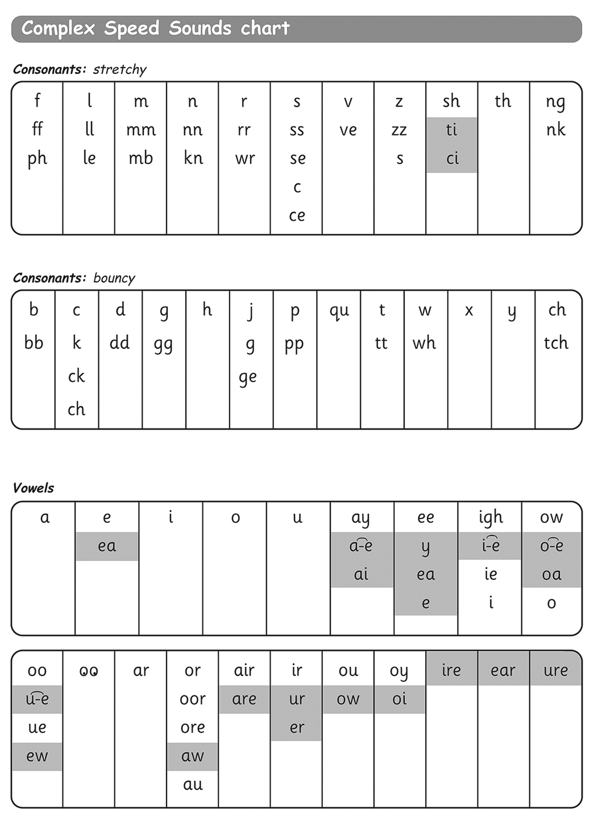
Letter and grapheme recognition
Notes:
Explain again the sound boxes and say this chart show the many different graphemes for the same sounds! No other language has as many to learn! Pink graphemes are Set 3 – explain they only learn these once they know all of Set 1 & 2 effortlessly – systematic and structured!

Slide 5
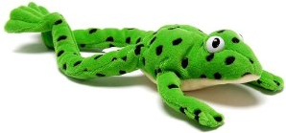
You can have fun with Fred Talk.
“What a tidy r-oo-m!”
“Where’s your c-oa-t?”
“Time for b-e-d!”
Notes:
Give a couple of examples e.g. Where is your c_oa_t? Time for b_e_d! Make sure your child can tell you what the word is.
Use only single syllable words (no Fred Talking multi-syllabic words) and only the last word in a sentence or it gets very silly! E.g. P_u_t o_n y_our b_l_ue c_oa_t (you’ll never get out!).
Explain that we use fred talk/fred fingers to help us decode unfamiliar words by looking for the special friends first, then fred talk to sound out, then finish by saying the word.

Slide 6
Move on to Fred in your head
As your child becomes more confident, they can start to Fred in their head to improve fluency and hence comprehension.
Notes:
They need to be reading at 60 wpm (one a second) to have the desired comprehension levels. Model how we do fred in your head at school with both real and fake words.

Slide 7
Phonics Screening Test
In June all Year One children will be expected to undertake a phonics check. The aim is to check that a child is making progress and working at the age related expectation in phonics.
Notes:
Explain to parents that they have been invited as we have identified their child as needing some additional support to pass the test.

Slide 8












Phonics Screening Test
Notes:
Explain that there are 40 words in the test and children must get about 32 ish (depending on what the government sets as the pass mark). There are a mixture of real and fake words and the test is conducted by the class teacher in a low key way.
Ch can use their fred fingers/fred talk to decode but must say the word as their final answer.

Slide 9
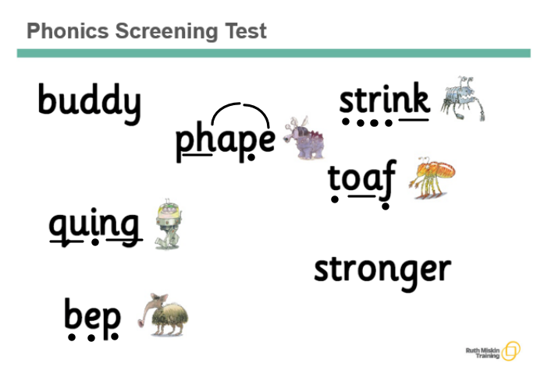
Phonics Screening Test
Notes:
Explain that there are 40 words in the test and children must get about 32 ish (depending on what the government sets as the pass mark). There are a mixture of real and fake words and the test is conducted by the class teacher in a low key way.
Ch can use their fred fingers/fred talk to decode but must say the word as their final answer.

Slide 10
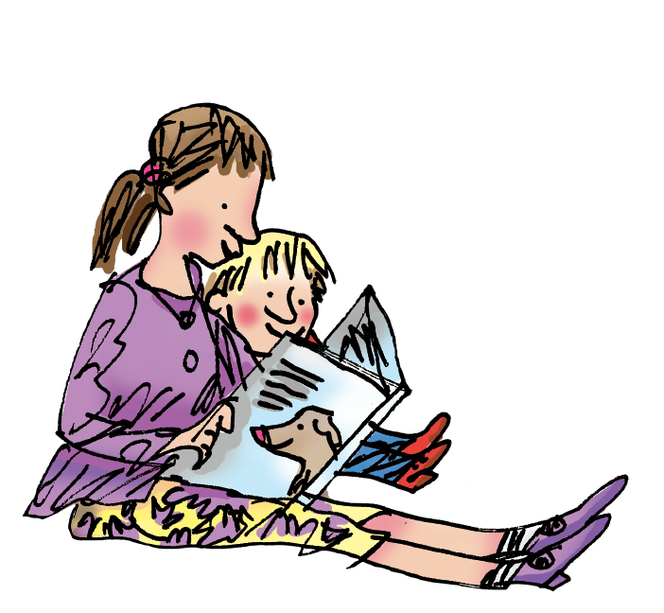
How to help your child at home…
Notes:
Explain that we will be sending home a sheet including lots of fun games and links to useful websites to play with your children.

Slide 11
You can read stories with your child. Relentlessly.
Read favourite stories over and over again, encouraging them to use Fred talk/Fred in your head/flash card fast.
We have put a past test on the website for you to download to try at home.
Read some stories at a higher level than they can read themselves.
Have a look at our games to try at home and useful website links.

Slide 12
Thank you for coming to our Phonic meeting – it is important to note the children are very used to doing their phonic sounds checks and should not be feeling worried or stressed about the Phonic Screening.
Notes:
Packs will be labelled with child’s name so we know who has got one and who needs to be given one by class teacher.

