Slide 1
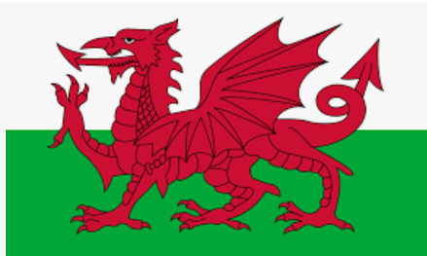
The reason the red dragon of the Welsh flag is not represented in the Union flag is because when the flag was created, Wales had already entered into a union with England. This union was formed as early as the 13th century and Wales was considered a principality. This means that Wales was ruled from England.
Wales

Slide 2

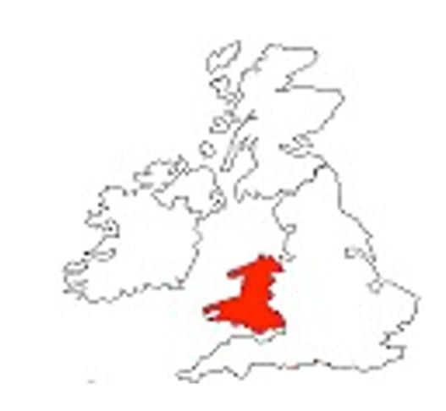
Wales is to the west of England and has lots of mountains.

Slide 3
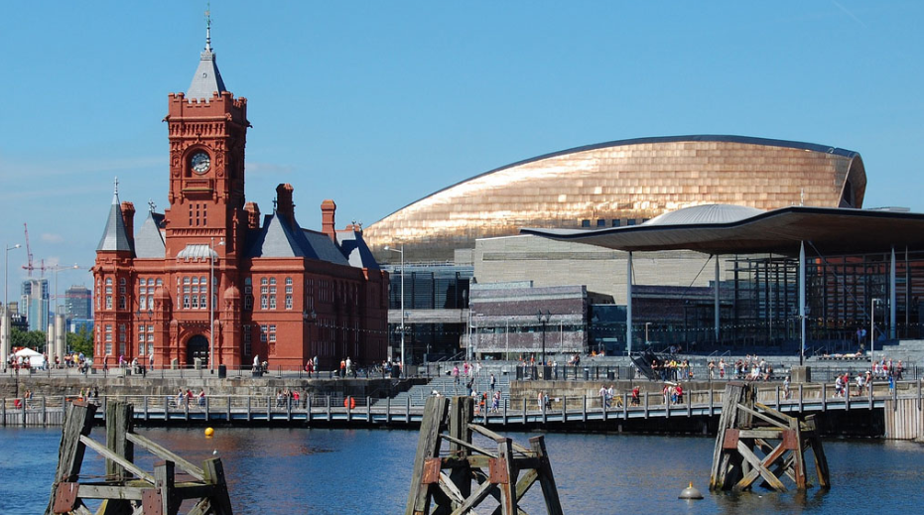
The capital city of Wales is Cardiff.

Slide 4
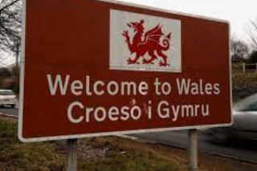
Wales is the only country in the United Kingdom where most of its people speak a language other than English- Welsh.

Slide 5

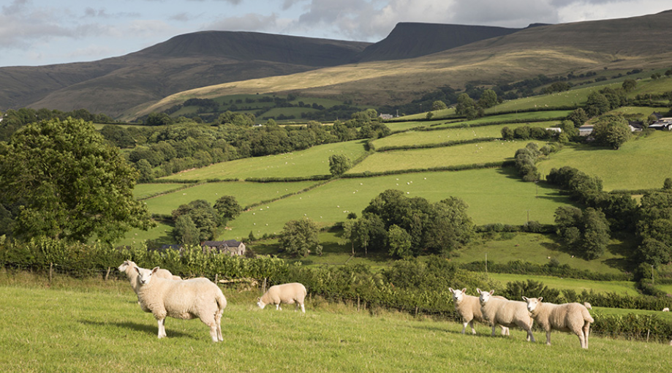
Wales is famous for its beautiful green countryside (and it has a lot of sheep!)

Slide 6
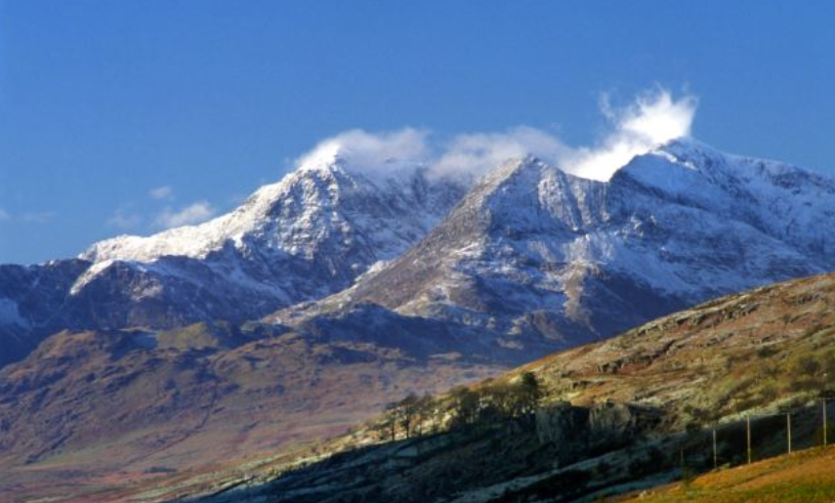
Mount Snowden is the highest mountain in Wales.

Slide 7
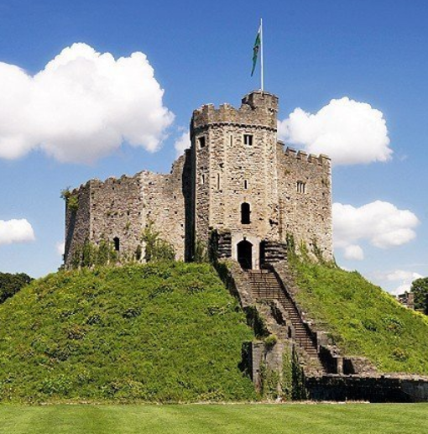
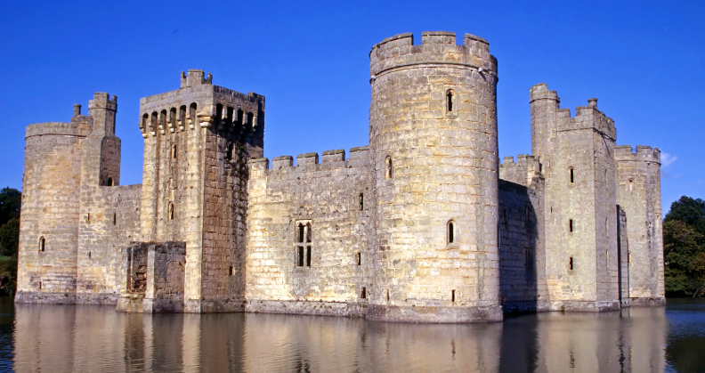
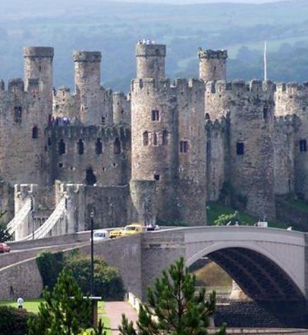
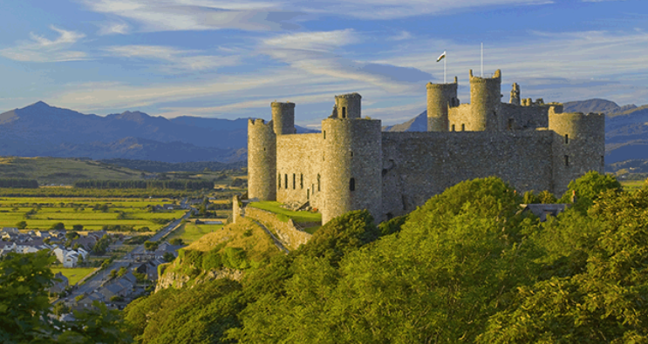
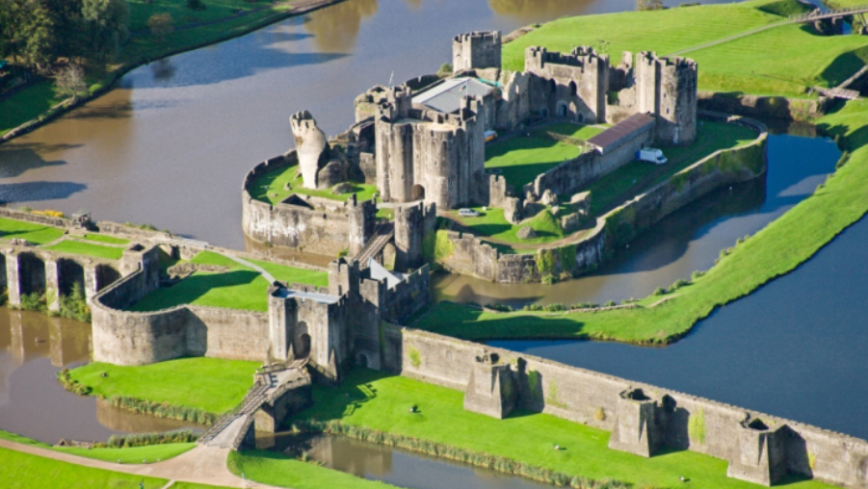
Wales is often called 'the land of castles' – there are 427 of them. If you visit Wales you’re almost certain to see one.

