Slide 1
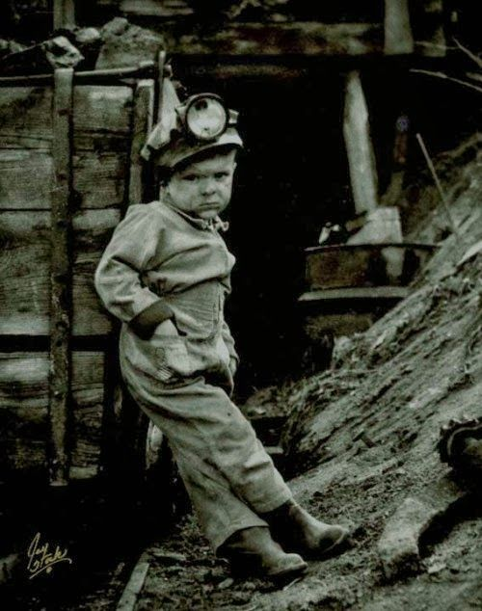
Wales was famous for coal for a very long time.
Most coal used to come out of the ground in Wales.
This photo was taken a long time ago when children didn’t go to school. They had jobs!
This little boy is 7.
In the past some children used to work in the coal mines with their fathers.
It was very dangerous and hard work.

Slide 2
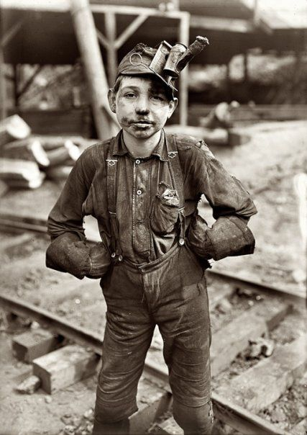
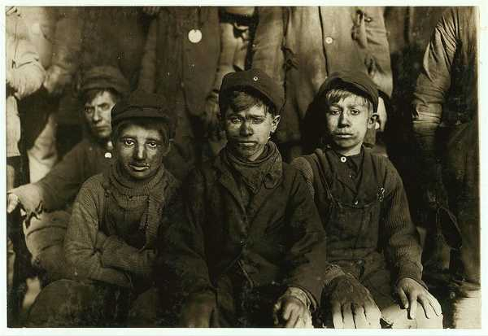
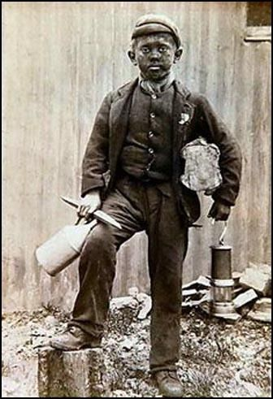
These boys didn’t go to school, but they did have to work underground all day. It was very dirty! But it wasn’t cold.
In those days they didn’t have showers, but would have a bath once a week. Can you imagine the colour of the bath water?

Slide 3
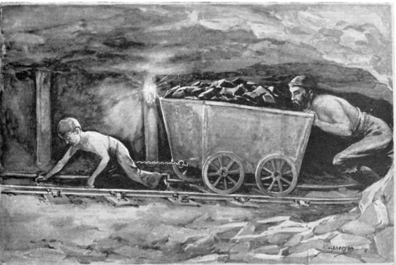
A very long time ago, children used to have to pull the carts with coal. Can you imagine how heavy this cart would be and how strong you would need to be?
Ponies replaced children and they were not allowed to do such difficult work.

Slide 4
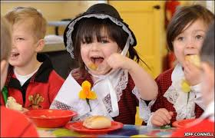
Children in Wales don’t go down mines any more. They go to school, just like you and they don’t have jobs!

