Slide 1
UNICEF/Helin

Slide 2
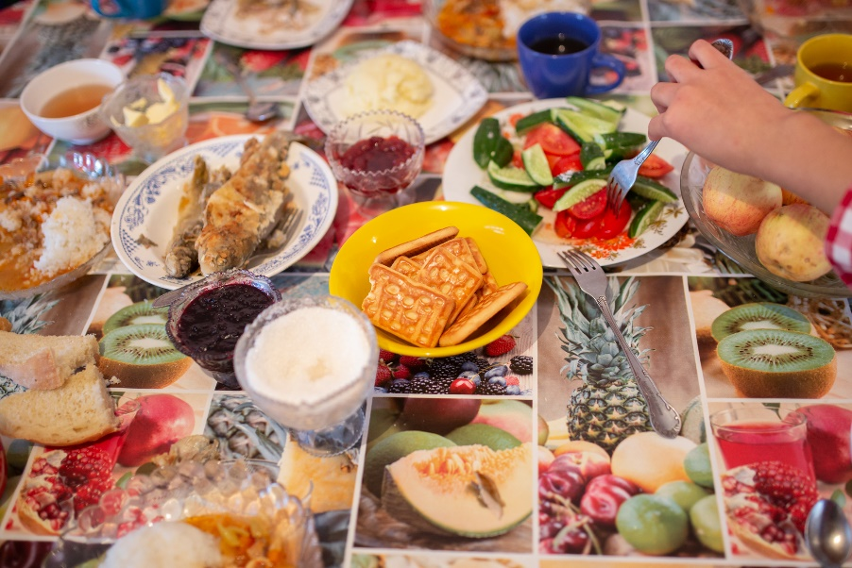

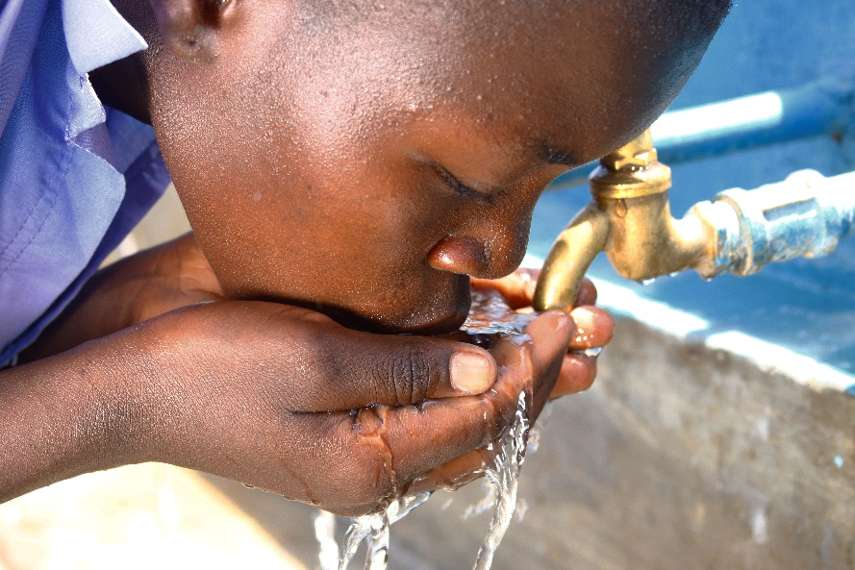
Guess the Article
These pictures provide a clue to this week’s article.
How do these pictures help you? Can you guess how they are linked together?
Write down your thoughts or discuss with someone in your house.
UNICEF/Zhanibekov
Wikimedia Commons
UNICEF/Adriko

Slide 3
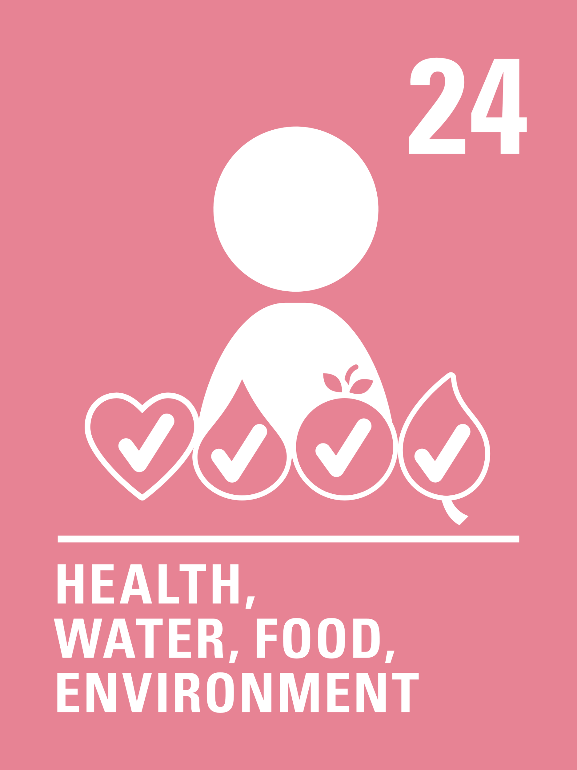
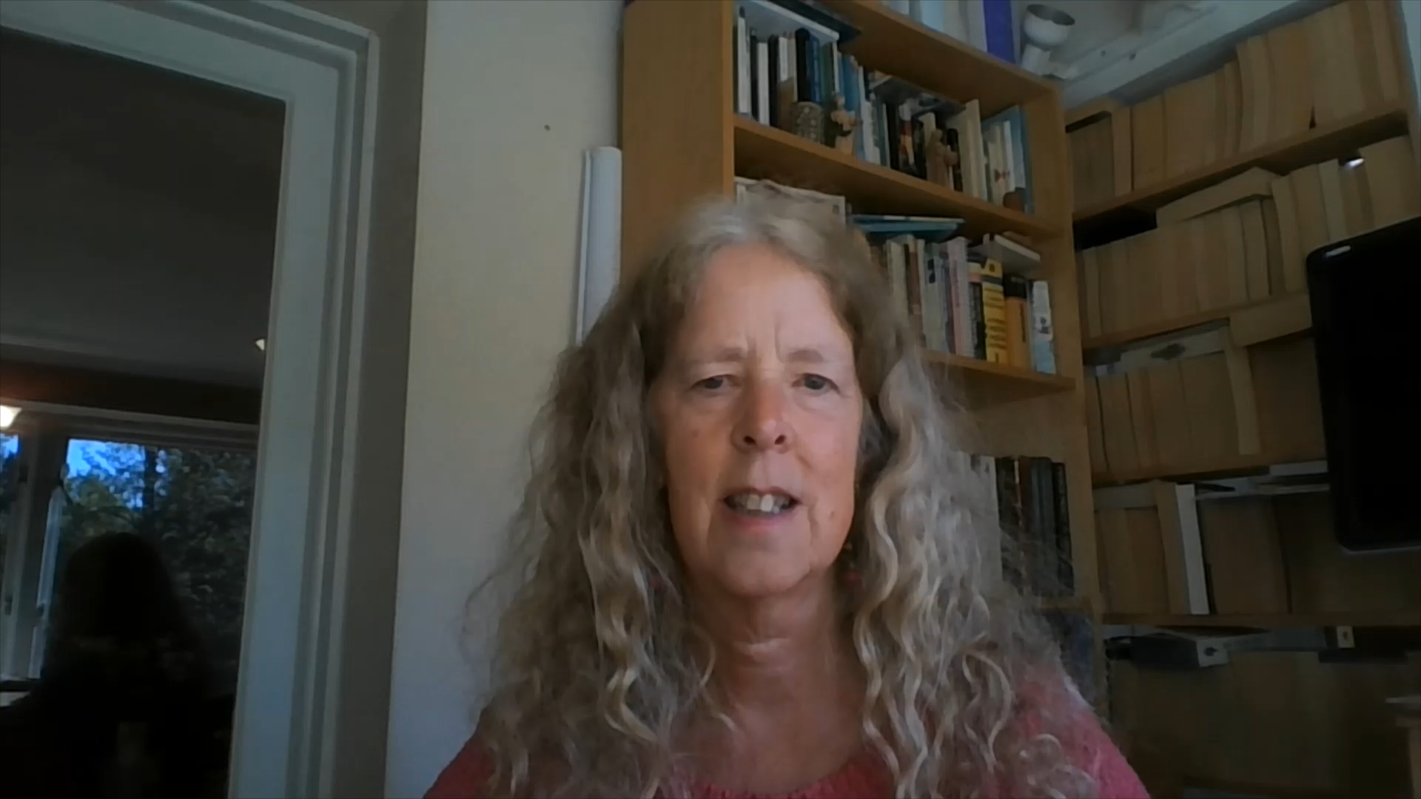
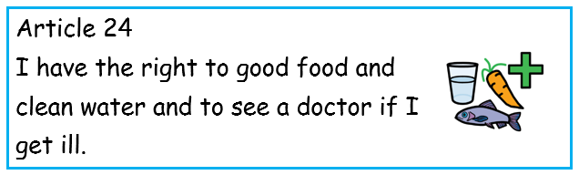
Introducing… Article 24
Frances introduces Article 24 – Health Care
Article 24 – Health Care - ensures that every child has the right to the best possible health.
Governments must provide good quality health care, clean water, nutritious food, and a clean environment and education on health and well-being so that children can stay healthy.
Richer countries must help poorer countries achieve this.

Slide 4
What do you need to be healthy?
How many ideas can you think of to help you be healthy?
Write them down and then compare your answers with the next slide.

Slide 5
How many of these did you get?
Enough Sleep – at least 8 hours
Nutritious Food – fruit and vegetables
Water – at least a litre a day
Good hygiene – keeping clean, particularly your hands
Exercise
A clean environment
Feeling safe, secure and respected
Health care - To see a doctor or a nurse when you need to and to be vaccinated against diseases

Slide 6




Activity time
Draw or list people who can help you stay healthy and safe. What are their jobs?
Make a list with words or pictures of as many kinds of exercise you can think of.
All these activities are related to…
Set up an obstacle course and challenge someone in your house to have a go.
Read Coronavirus: a book for children and talk about what you are doing as a family to keep healthy during this time.
You don’t need to do every single activity but if you have time you can do more than one.
Primary

Slide 7


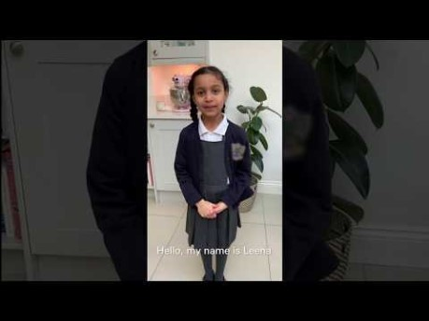

Activity Time
The new hospitals being built are called Nightingales. Who are they named after and what did this person do to enable the right to good quality healthcare?
Have you taught your family to wash their hands carefully? Watch this video on YouTube.
Could you create your own video linked to Article 24?
Invent a recipe for a healthy snack that you could make for your family.
Choose 10 items of food from your kitchen, can you sort them into healthy/not so healthy?
Primary

Slide 8



Activity time
Virtually get together with your friends to challenge each other to get fit, or try an online workout video.
Keep a food, drink and exercise diary for a week. Are you keeping yourself healthy?
These activities will help you understand how..
…can relate to your life. You don’t need to do every activity, just do as many as you can.
Create a dance video and safely share with your friends and family on social media.
Design a poster showing all the ways that you and your family can support your right to article 24.
Secondary

Slide 9

Reflection
Spend a few minutes thinking about these questions.
What do you do in your own life to respect your right and other people’s right to be healthy?
How does the woman pictured opposite help us to access health and health services?
How can we show our appreciation and why is this important?
Have you taken part in ‘Clap for Carers’? What else could you do to show you care? For example you could put a poster on your window or send a picture or a card to say thank you to hospital, local GP or care home.
Write down your answers or talk to people in your home.
Wikimedia Commons

Slide 10
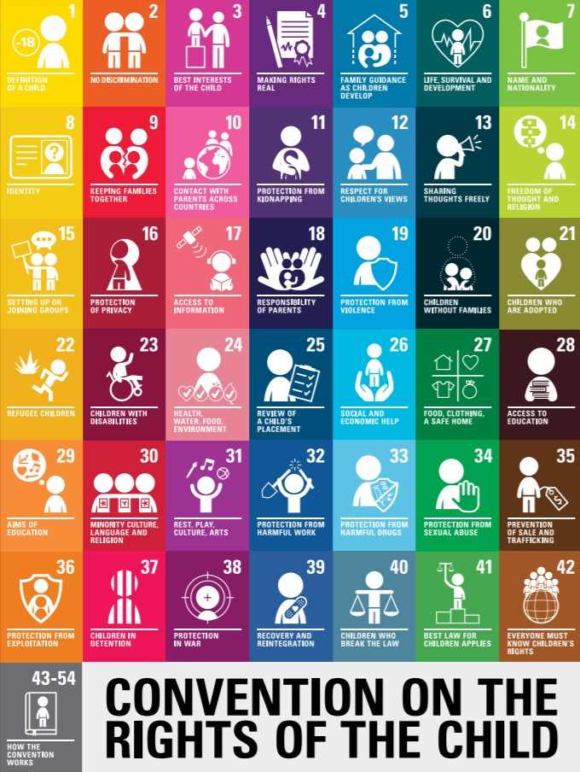
extension
Rights are indivisible and all equally important. Are there are other rights that are being supported or limited by social distancing?
How do we balance our right to article 24 with these other rights?
You can read the whole Convention here.

