Slide 1
Phonics Screening Test Meeting
Celina
Notes:
Welcome to a brief taster of our whole school synthetic phonics literacy programme – Read Write Inc!
Please insert own notes for introduction/welcome.

Slide 2
Year Phonics
Welcome Year One Parents and Carers.
Agenda
Provide information on the phonics screening assessment.

Slide 3
Phonics Screening Test
Celina
In June all Year One children will be expected to undertake a phonics check. The aim is to check that a child is making progress and working at the age related expectation in phonics.
Notes:
Explain to parents that they have been invited as we have identified their child as needing some additional support to pass the test.

Slide 4












Phonics Screening Test
Celina
Notes:
Explain that there are 40 words in the test and children must get about 32 ish (depending on what the government sets as the pass mark). There are a mixture of real and fake words and the test is conducted by the class teacher in a low key way.
Ch can use their fred fingers/fred talk to decode but must say the word as their final answer.

Slide 5
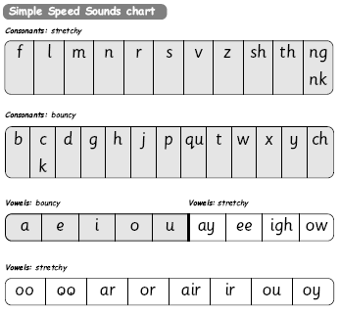
Ellie
Letter and grapheme recognition
Notes:
Go through these sounds quickly with parents using My Turn/Your Turn.
Stress you must not use letter names at this stage – just pure sounds.
Emphasise getting rid of ‘ugh’ to help blending. Parents usually love this bit! Make it fun! Set 1 then long vowels in Set 2.
Explain that when the children are taught the sounds they use the cards and a multi-sensory approach – hold up the cards.
Describe how we use the pictures, rhymes and actions to help us to remember and recognise the grapheme on sight and therefore are more likely to blend when reading.
We call the digraphs “special friends”

Slide 6
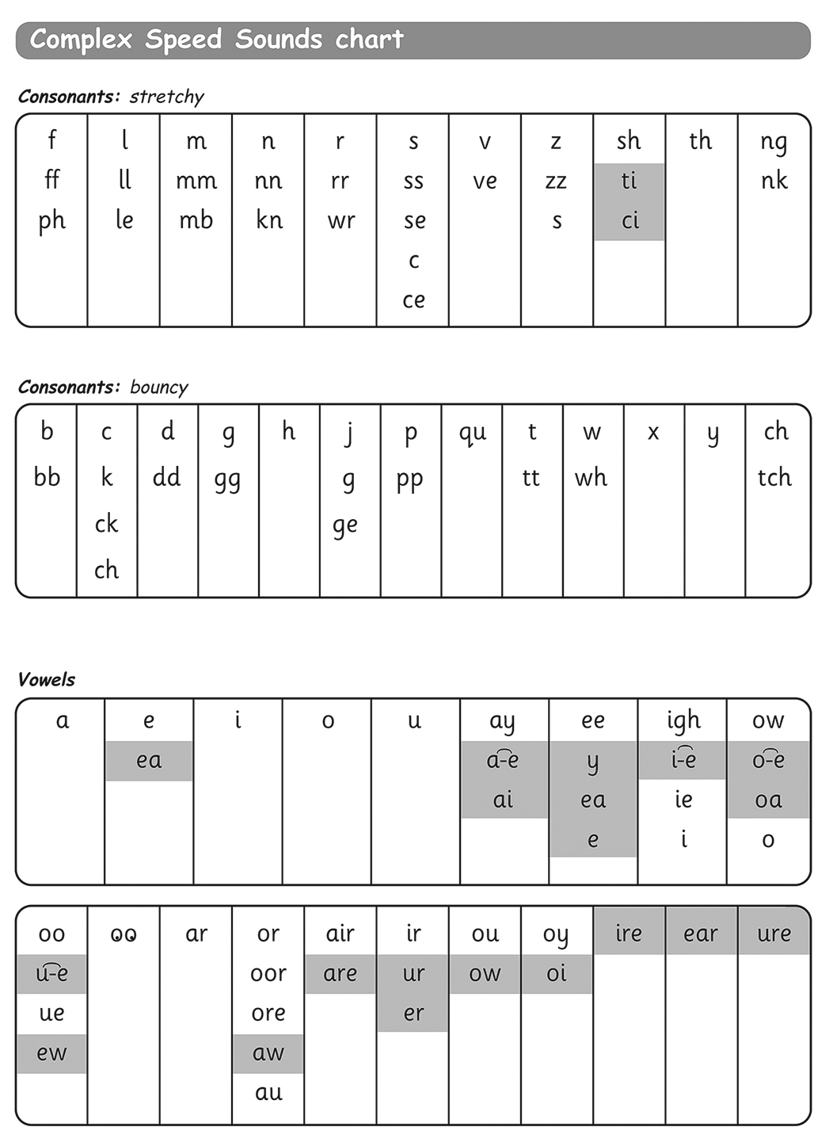
Letter and grapheme recognition
Ellie
Notes:
Explain again the sound boxes and say this chart show the many different graphemes for the same sounds! No other language has as many to learn! Pink graphemes are Set 3 – explain they only learn these once they know all of Set 1 & 2 effortlessly – systematic and structured!

Slide 7

How to help your child at home…
Ellie
Notes:
Explain that we will be sending home a sheet including lots of fun games and links to useful websites to play with your children.

Slide 8
You can read stories with your child. Relentlessly.
Ellie
Read favourite stories over and over again, encouraging them to use dots and dashes and sound out words.
s h i p
Have a look at our games to try at home and useful website links.

Slide 9
Celina
Thank you for coming to our Phonic meeting – it is important to note the children are very used to doing their phonic sounds checks and should not be feeling worried or stressed about the Phonic Screening.
Notes:
Packs will be labelled with child’s name so we know who has got one and who needs to be given one by class teacher.

