Slide 1
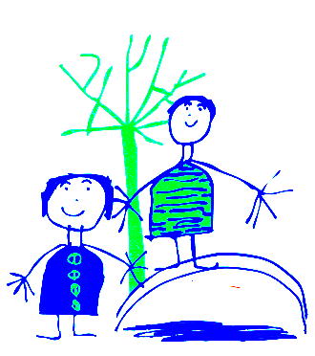
Dobcroft Pre School Foundation Stage One.

Slide 2
Welcome to Dobcroft Infant School.
Mrs Singh, Mrs Burgan, Mrs Pinder, Mrs Blackburn
Foundation Stage One

Slide 3
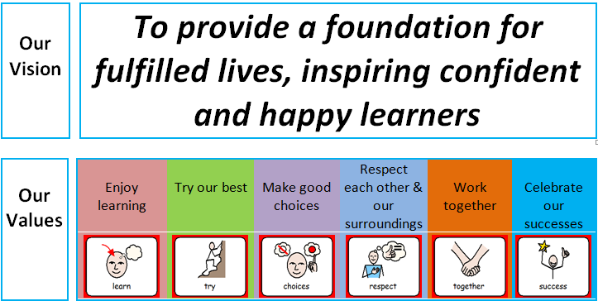

Slide 4
Classroom Routines
Doors open at 9.00 am
Meet/drop off at the Hub on a Wednesday lunchtime, classroom all other times. If it’s not raining we’ll meet you at the gate.
Children hang up coats, put water bottle in tray and choose their lunch.
During the week we aim to have:
1. Circle times where we sing songs, enjoy a story or share news
2. Supermovers
3. Maths moments
4. Phonics
5. Focused teacher led learning opportunities that cover all areas of learning
6. Snack time
7. Inside and outside free flow
8. SEAL
9. PE

Slide 5
General Info
If your child is absent from school please telephone the school office and explain why.
Children who have been sick need to stay away from school for 24 hours after the last bout of sickness.
For diarrhoea it is 48 hours after the last episode.
Please remember to “take a peek once a week” and check for worms and nits.

Slide 6
General Info
Please do not bring prams into the classroom.
We encourage children to be independent . Please encourage your child to tell a member of staff if they have wet or soiled themselves.
Please ensure all items of clothing are clearly labelled and your child knows where the label can be found.
Parents evening will be during the week commencing the 11th November.

Slide 7
The Early Learning Goals.
The Foundation Stage covers the education for children from birth to the end of the “Reception Year”.
The Foundation Stage is split into 7 areas of learning.
Each area of learning is broken down into a series of “aspects of learning” and then “Early Learning Goals” for the children to work through and achieve.

Slide 8
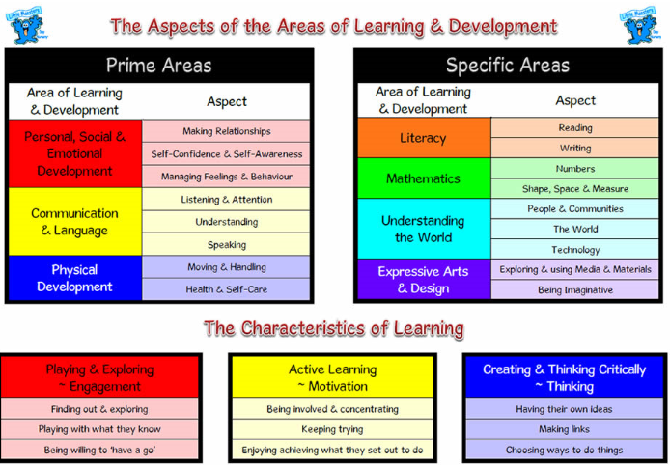

Slide 9
How do the Children Learn?
The children will learn through child initiated and teacher-led play activities inside and outside – Time to Talk
Children will have focus teaching time each day to develop all areas of learning.
The learning will be delivered as part of a “class”, a small group and as an individual.
Children will have opportunities to explore and experience the learning activities independently.

Slide 10
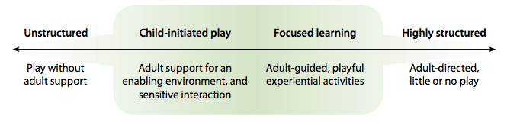
Teaching & Play
Get the balance right
how
what
Areas of learning
Characteristics of effective learning
Notes:
When children explore and share their ideas with others they try to solve problems and develop their thinking together – constructing their own learning. Sustained shared thinking involves the adult being aware of the children’s interest and understandings and the adult and children working together to develop an idea or skill.
Seeing teaching as many different ways in which adults, consciously or otherwise, help children to learn.
A learner who is frequently assessed in only content and knowledge could lead to a closed mind set and have limited cognitive self regulation ie if there is too much teacher led activities then the children wait to be told what to do rather than having autonomy and independence….becoming a learner for school.
A learner who has good characteristics of effective learning is a good cognitive self regulator, frequently involved in sustained shared thinking and mastery learning…becoming a thinker and learner for life, a life long learner.

Slide 11

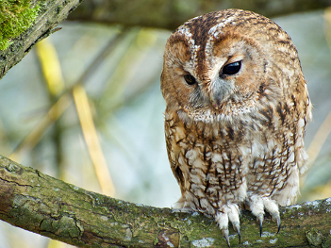
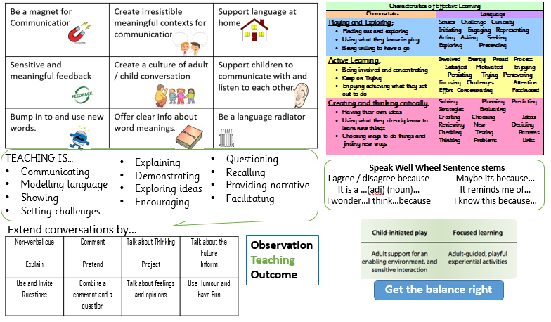
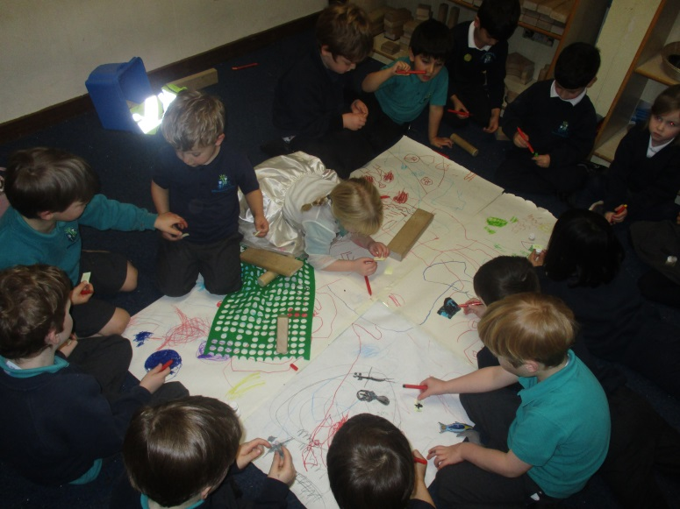
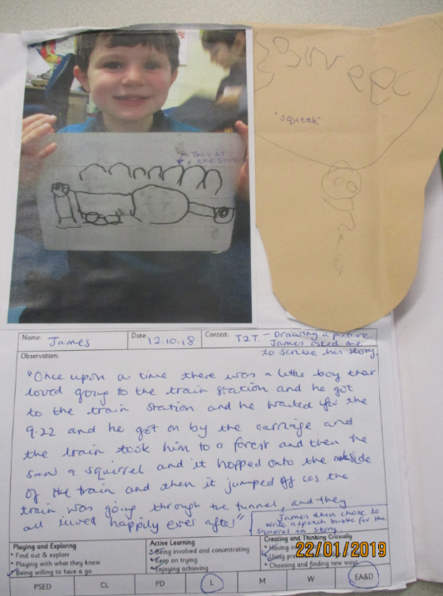
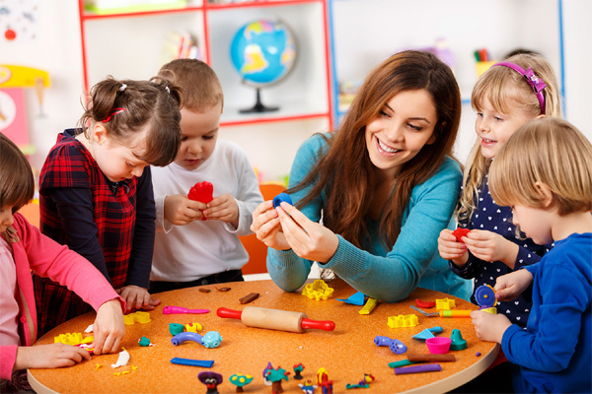
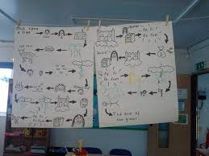
What T2T looks like everyday
Cathy Ring research
OWLing
Dedicated time
In the moment
Pie Corbett
Helicopter stories
Notes:
First hour of everyday is spent doing time to talk. We do the register, possibly a quick input of a new continuous provision activity (often as a result of T2T the pervious day) then we have T2T for approximately one hour.
Owling: Anna Ephgrave says: wait, wait, wonder. This piece of advice is everywhere, just voiced in slightly different ways but they all have a common theme. Respect the children, value them and what they have to say and then provide them with interesting opportunities that will help them extend their learning.
Target key children who you know need in their language or confidence to speak.
Give examples of Annabelle R and WT
What I’ve come to realise is that it’s not just about the language development and the talk….its also about the TIME. When children feel valued because we as practitioners have given the time to build meaningful relationships with the children, they will be more confident and happy, in turn be their best version if themselves. Therefore, time is of equal (if not more) importance to talk.

Slide 12
SEAL
Social, Emotional Aspects of Learning.
Each half term the children work on a different SEAL theme.
Term One ~ New Beginnings
Getting On and Falling Out
Term Two~ Going for Goals
It’s Good to be Me
Term Three ~ Relationships
Changes

Slide 13
New Beginnings
I know I belong to Ladybirds.
I know the names of the people in Ladybirds.
I like belonging to Ladybirds.
I can talk about things in my life.

Slide 14


Slide 15
Thank you for attending this meeting. Please write on a post it what you found useful or any suggestions.
Good Bye.

