Slide 1
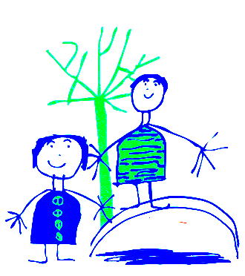
Dobcroft Infant School Foundation Stage
(FS2)
Please pick up your pack from the table as you come in and find a seat.

Slide 2
Welcome to Dobcroft Infant School.
Mrs Cooke, Mrs Pemberton, Mrs Perkins
Foundation Stage Two
Check packs

Slide 3
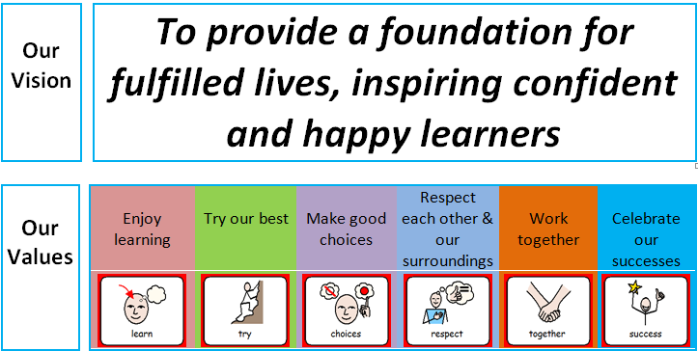
Nicola

Slide 4
Classroom Routines
Doors open at 8.45 am, you can leave your child from 8.50am. Door are locked at 9.00am ~ please use main entrance (office) after this time. Registration starts at 9.00am.
After this time you must go to the main entrance. Please do not open the door for parents after 9.00 am.
Please do not bring prams into the classroom.
Please could parents come into the classroom and wait for their child to hang their coats etc.
Children hang up coats.
Put water bottle on the table in classroom.
Change book in book bag and put bag in the box/drawer (books to be given out this week).
Put picture on the rocket.
Sit on the carpet quietly with a book or look at the pictures on the active board screen.
Parents are welcome to look at the pictures too and then leave when their child is settled.
Please leave by the cloakroom door and make sure the door is closed.
Mathilde

Slide 5
Planning and Preparation Time
On a Thursday morning the teachers have planning and preparation time (PPA) so you may see other familiar adults at this time.
Mrs Rowlands – Rabbits
Mrs Rhodes – Mice
Mrs Simpson - Badgers
Beth

Slide 6
General Issues
If your child is absent from school please telephone the school office and explain why.
If your child arrives at school after 9.00am they will be marked as late and you will need to go to the school office.
School finishes at 3.25pm please can you be on time to collect your child. Children not collected will wait by Mrs Rowland’s office.
Children who have been sick need to stay away from school for 24 hours after the last bout of sickness.
For diarrhoea it is 48 hours after the last episode.
Please remember to “take a peek once a week” and check for worms and nits.
We encourage children to be independent . Please encourage your child to tell a member of staff if they have wet or soiled themselves.
Please make sure your child has their blue book bag in school every day. Letters from school will generally go out via e-mail on a Friday.
Please ensure all items of clothing are clearly labelled and your child knows where the label can be found.
Please do not let your child play with the resources set out in our outside classroom areas (outside each classroom door).
Nicola

Slide 7
PE and Library
Please make sure your child has a PE kit in school every day (jade T shirt and dark shorts). We send the PE kits home every half term so you can wash them.
Children with long hair should have it tied back on PE days.
Jewellery should not be worn in school. If your child has recently had their ears pierced they must cover their earrings with plasters. (please bring from home)
School will provide a red library book bag. Please bring it to school on your child’s library day.
Mathilde

Slide 8
Helping in School
Parents are always very welcome to come into school and help. Please sign up with your child’s teacher if you are able to help (after this meeting). No younger siblings please!
Any worries or issues please do not hesitate to speak to a member of staff. Mornings are often very busy, so please either wait until the end of the day, send your class teacher an email, or pop to the office to arrange a convenient time to meet with the teacher.
Beth

Slide 9
The Early Learning Goals.
The Foundation Stage covers the education for children from birth to the end of the “Reception Year”.
The Foundation Stage is split into 7 areas of learning.
Each area of learning is broken down into a series of “aspects of learning” and then “Early Learning Goals” for the children to work through and achieve.
Beth

Slide 10
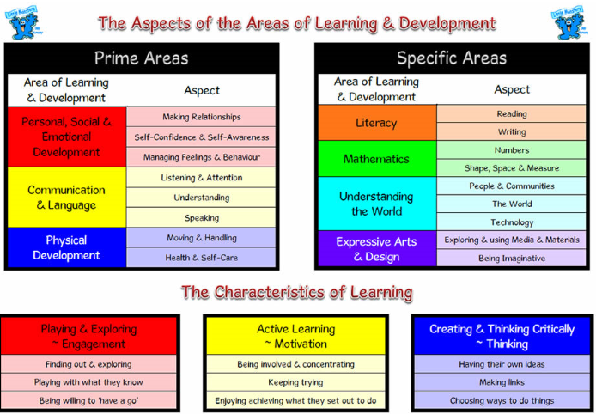
Beth

Slide 11
How do the Children Learn?
Children will have focus teaching time each day to develop all areas of learning.
The learning will be delivered as part of a “class”, a small group and as an individual.
The children will learn through structured play activities inside and outside.
Children will have opportunities to explore and experience the learning activities independently.
Nicola

Slide 12
SEAL
Social, Emotional Aspects of Learning.
Each half term the children work on a different SEAL theme.
Term One ~ New Beginnings
Getting On and Falling Out
Term Two~ Going for Goals
It’s Good to be Me
Term Three ~ Relationships
Changes
Mathilde

Slide 13
Family Seal Activities
Each half term a letter explaining the current SEAL theme is sent home .
Each half term there is also a “family activity” for you to complete with your child at home ~ “My Week”. Please send it back to school once you have completed it. These may be displayed in class.
Mathilde

Slide 14
WALT
WALT ~ We are learning to
Nicola

Slide 15
Eco School
ECO CODE
At Dobcroft Infant School we are committed to:
Reduce, recycle and reuse.
Appreciate and value our environment and community.
Build awareness of the choices we make and their impact globally.
We have a “ Eco Team” in school with representatives from each class. These will be chosen after the Christmas holidays.
Beth

Slide 16




We will use performance tag colours to help us to express how we feel about our learning
Nicola

Slide 17
TASC
Beth

Slide 18

The Gingerbread Man
The children talked with a talking partner about their ideas.
The children thought about what they already knew about Gingerbread Men.
Beth

Slide 19

Generate
Bridges
Butterflies
Flies
Aeroplanes
Submarines
Waterproof wet suit
Tunnels
Hot air balloons
Frog
Beth

Slide 20
Which is the best idea?
The children selected the method of crossing the river they wanted to make and created a design sheet.
Beth

Slide 21
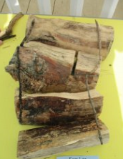
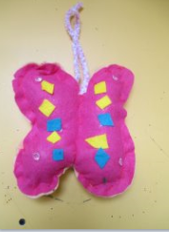
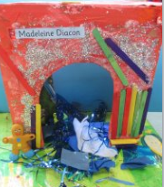
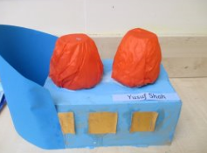

Let’s Do it!
Beth

Slide 22

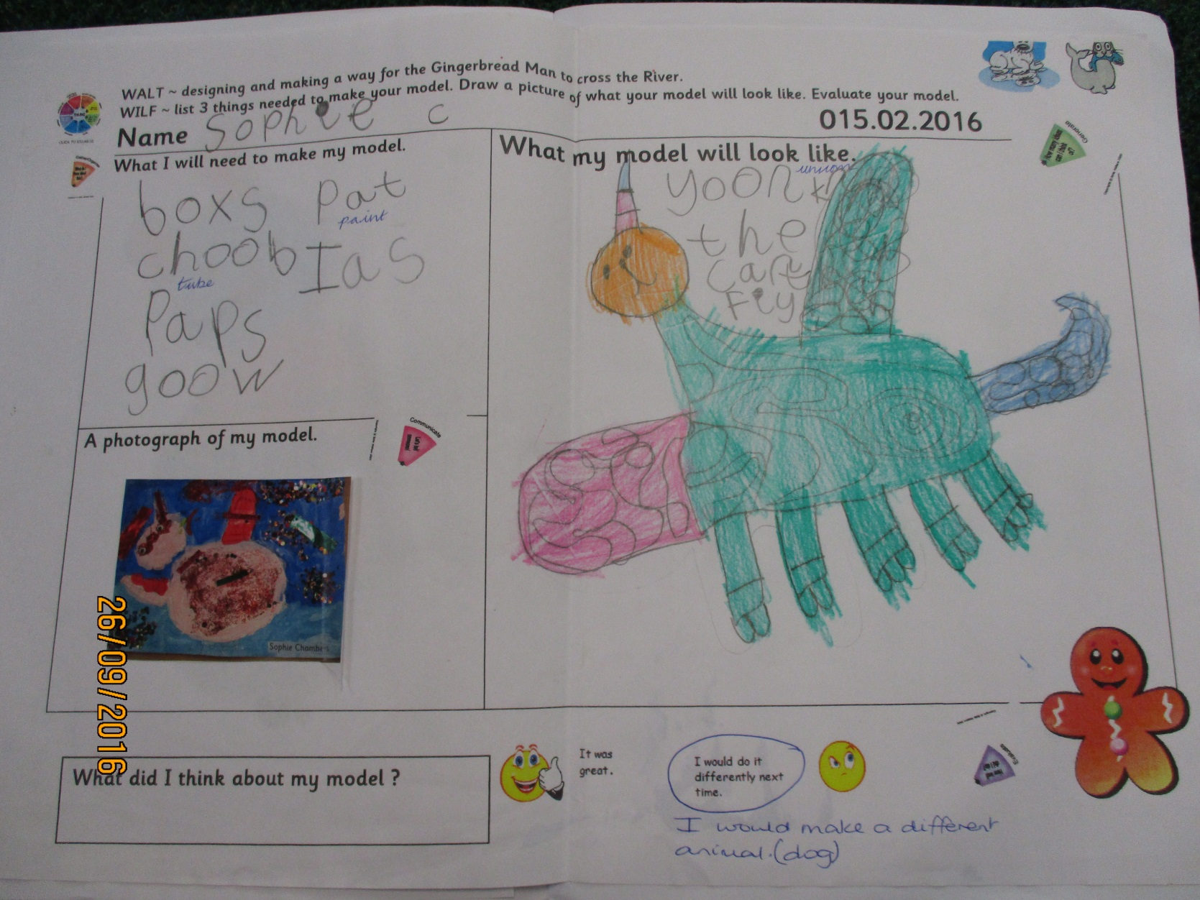
How well did I do?
Beth

Slide 23
Parent Information
At the beginning of each term we will send home a “Curriculum News” letter to inform you of what the children will be learning in school.
Individual meetings for parents and carers in November and March.
In July you will receive your child’s school report.
Mathilde

Slide 24
Other Areas of Learning
The meeting on Thursday 3rd October will give more details about how we teach literacy, phonics and numeracy.
At the parents evenings in November.
(during the week beginning 11th November) We will talk to you more about your individual child and what their next steps of learning are.
Nicola

Slide 25
Dobcroft Infant Website
Each class has a class page ~ it can be accessed via the school website.
Mathilde

Slide 26
PSA
The parent association (FODS) runs various events through out the year which are promoted in a termly newsletter.
If you are able to help at any of the events or would like more information then please email
enquiries@dobcroft-inf.sheffield.sch.uk
Beth

Slide 27
Thank you for coming!
Teachers are available for questions and for you to sign up to help in class.

