Slide 1



Getting ready for Year 2
Kingfishers – Miss Charles (Mrs Machin)
Woodpeckers – Mrs Holmes and Miss Shaw
Eagles – Miss Hughes

Slide 2






Our Vision
Our Vision
For you to be fulfilled, happy and confident learners
Our Values
Enjoy learning
Try our best
Make good choices
Respect each other & our surroundings
Work together
Celebrate our successes

Slide 3
Purpose
To introduce you to the team
What learning in year 2 looks like (routines and timetable)
Curriculum
Assessments
How you can help your child prepare for year 2

Slide 4
How we work as a team to provide consistency
Y2 team curriculum planning
Same expectations
assessments
moderated by Y2team
PPA Time: will expand upon the extended curriculum delivered in class.

Slide 5
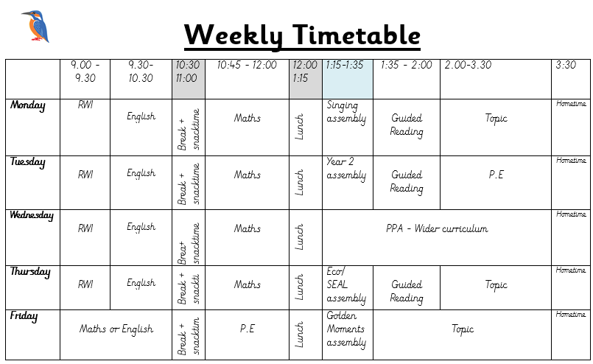
Example year 2 timetable

Slide 6
Routines
Independent, punctual entry 8:45 -9:00
Coat and book bag away, water bottle , change reading book, Complete morning work displayed on the interactive whiteboard
Please write on the class going home board if your child is going home with a different adult to usual
Register: 9:00
Home Time 3:30
Clubs and DASH: we have lists
Pre- arranged play date with another child: adult must write on the going home board
Parent late (after 3:40): safe waiting place outside Mrs Rowland’s office
Parent collecting younger sibling: Y2 children may walk to their sibling’s class if we have signed written permission from the parent.

Slide 7

Homework
Weekly: out on Friday, in on Wednesday on the website instead of paper copy. (please see class teacher if paper copy is required.)
Format – homework menu
Non-negotiables:
Reading, Spelling Zone and ‘Learn its’
Choose from:
Often topic based.
Practical: walks, discussions
Research: library, internet, class blog
Recording: drawings, posters, powerpoints, photos, writing, email
Look out for the Homework Book.
Inside, is our handwriting script, teacher’s email and our class blog address

Slide 8
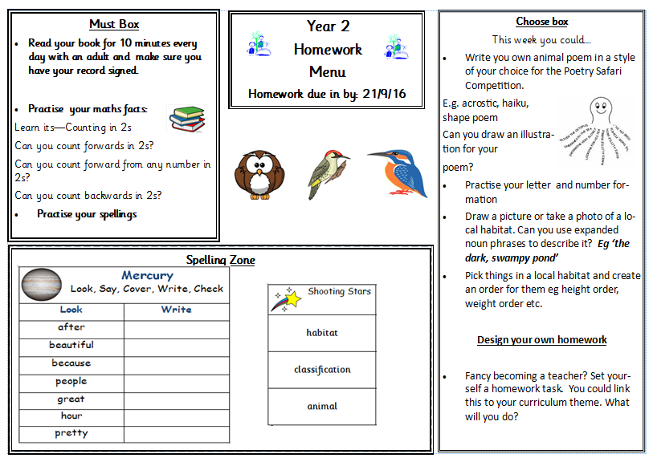
Homework Menu

Slide 9
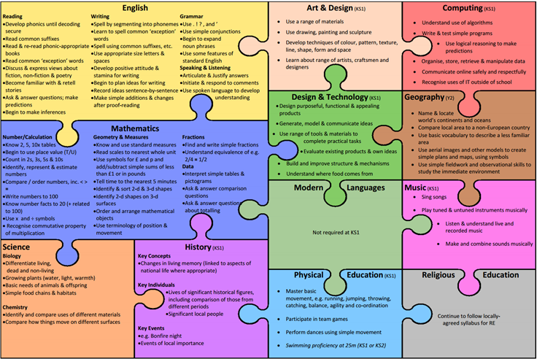
What we cover in year 2

Slide 10



Curriculum
Areas of learning
Maths
English – writing, reading and phonics
Science
PE
Art
Music (violins)
Design Technology
Computing
History
Geography
P4C
SEAL
Massage
RE
Metacognition
Whole School Themes
Around the World
Geography and History focus:
Under the Sea
History Focus:
Local heroes
Art Focus:
Andy Warhol, Pop art
Food, glorious food
Science focus:
Animals, plants and living things
How To Learn
Resourceful, Reciprocal, Risk-Taking, Resilient, Reflective

Slide 11
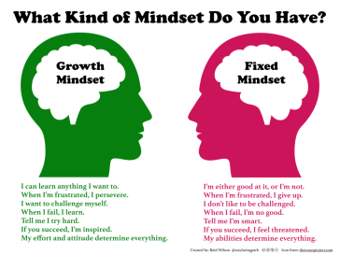
Mastery curriculum
Mastery
Based around broadening a child’s understanding of a text and language and show a deep understanding through applying their learning.
What will this look like across the year?
Skills and knowledge will be built up throughout the year so children will be apply to apply their learning to a wide variety of contexts.
Mastery English
Immersive teaching style focusing on one text at a time.
What does this look like in the classroom?
Text – Genre – SPAG feature – Reading Comprehension – Application
Mathematics Mastery
Extension of how the children have been learning in year 1.
Depth not breadth.
We will give you more information at the curriculum meeting in the autumn term.

Slide 12

Y2 Assessments
It is a government initiative that every child will complete an end of KS1 assessment in maths, SPaG and reading. Writing will be assessed be the child’s class teacher.
These assessments will take place in the summer term.
They will be administered and marked by the class teacher and will take place in the child’s classroom. Some children may complete the assessments in small groups or individually.
Although these assessments will be marked by class teachers they will be moderated within the year team.
These tests are part of our end of year assessments and will have no more emphasis for the children than their usual work expectations.

Slide 13

Teaching Assessment Framework (TAF)
As well as the end of Key Stage 1 assessments, your child will be assessed against the TAF– a set of expectations released by the government.
This allows us to teacher assess where each child is, which will be the final assessment of your child.
You will be given a copy of the TAF at the autumn parents evening, however if you would like to look at them before there is a copy on our website.
Used for Reading, Writing (SPaG) and Maths.
Split each subject into:
  Pre-key stage standards
  Working towards the expected standard
  Working at the expected standard
  Working at greater depth

Slide 14

Getting your child ready for Year 2

Slide 15
After feedback from parents this year, we realise 6 weeks is a long period for children to go without continued learning. Therefore we have provided some selected activities that you could do over their summer which will consolidate the learning that your child has done in year 1, ready to build on for year 2.
As an eco school, we have placed all of these resources on your current class’s website page. Please do let your new class teacher know if you require a paper copy.
These include:
Getting your child ready for Year 2
English
Handwriting paper
Spelling zone words for year 1 and 2
Reading and SPaG booklet
Maths
Addition and subtraction booklet
Multiplication and division booklet
Fractions booklet
Your child will receive a holiday homework menu as part of transition. These activities will be on there as well as some activities based on foundation subjects.

Slide 16

Communication
Talking with us: Make an appointment after school, by phone, email or at an arranged time
Personal emails
Friday e-letters
Occasional paper letters
Class notice boards
Texts
Ask Me board on window
Class Blog
Class assembly (Aut 2)
Curriculum Meeting (Aut 1)
Parent Consultations: Nov, March
Report and results of KS1 Assessments (Summer term)
machina@dobcroft-inf.sheffield.sch.uk - Kingfishers
holmesk@dobcroft-inf.sheffield.sch.uk
shawg@dobcroft-inf.Sheffield.sch.uk – Woodpeckers
hughesc@dobcroft-inf.sheffield.sch.uk- Eagles

Slide 17
Thank you for listening and we look forward to working with you in the coming year.

