Slide 1
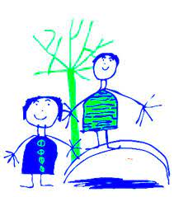
Phonics Screening Test
Parent Meeting AUT 2021
Dobcroft Infant School

Slide 2
Agenda
Provide information on the phonics screening assessment which takes place in school.
What the test will look like.
How to help at home.

Slide 3
At the end of November all Year Two children across the country will be expected to undertake a phonics check.
The Governments aim is to check that a child is making progress and working at the age related expectation in phonics.
It is important that children build their phonics knowledge not only for the test, but also as the development of phonics supports fluency in reading and writing as the children progress.
This is usually done at the end of Year 1 but was postponed due to Covid-19.

Slide 4
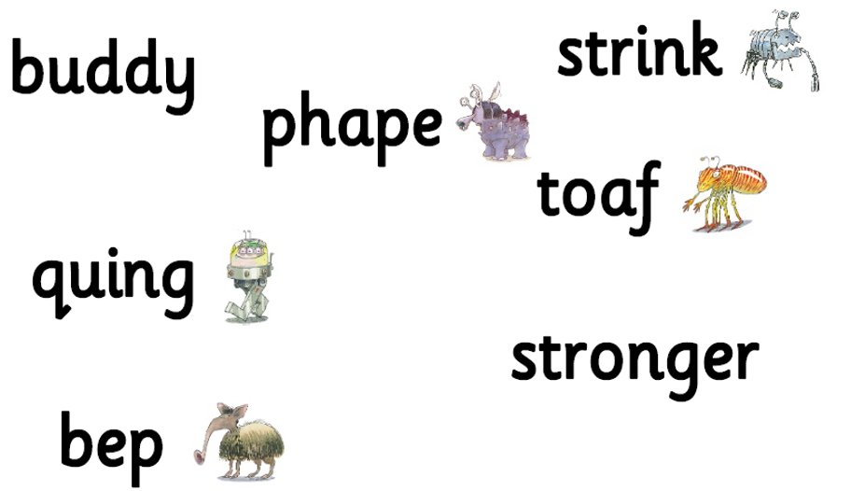
What does the test involve?
The test comprises of 40 words for the children to read (They usually have to be able to read 32 words or more to be able to pass).
All of the words are phonetically decodable ( able to be broken up, sounded out and blended back together).
Some of the words will be real life words and some will be alien words ( made up). The alien words have a picture of an alien next to them for reference.

Slide 5
What does the test involve?
The test takes place 1:1 with the child’s teacher.
It takes place in a quiet but familiar place like the classroom or breakout room.
It is made as informal as possible and low key for the children.
The children have done lots of practices in the same format so should be very familiar and unfazed by the test!
    There is no need to panic!
You will receive a letter with your child’s result once the government has published the pass rate (This will hopefully be before Christmas but might be after).

Slide 6
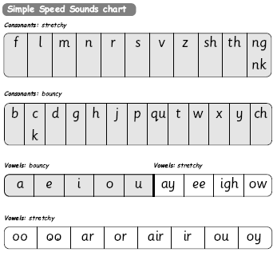
What sounds will be included in the test?
Use the sound names not the letter names!
Children are taught all of these sounds with a variety of methods over a long period of time for retention.
Children use pictures, rhymes and actions to help them remember and recognise the grapheme (written sound) on sight, therefore more likely to blend when reading.

Slide 7
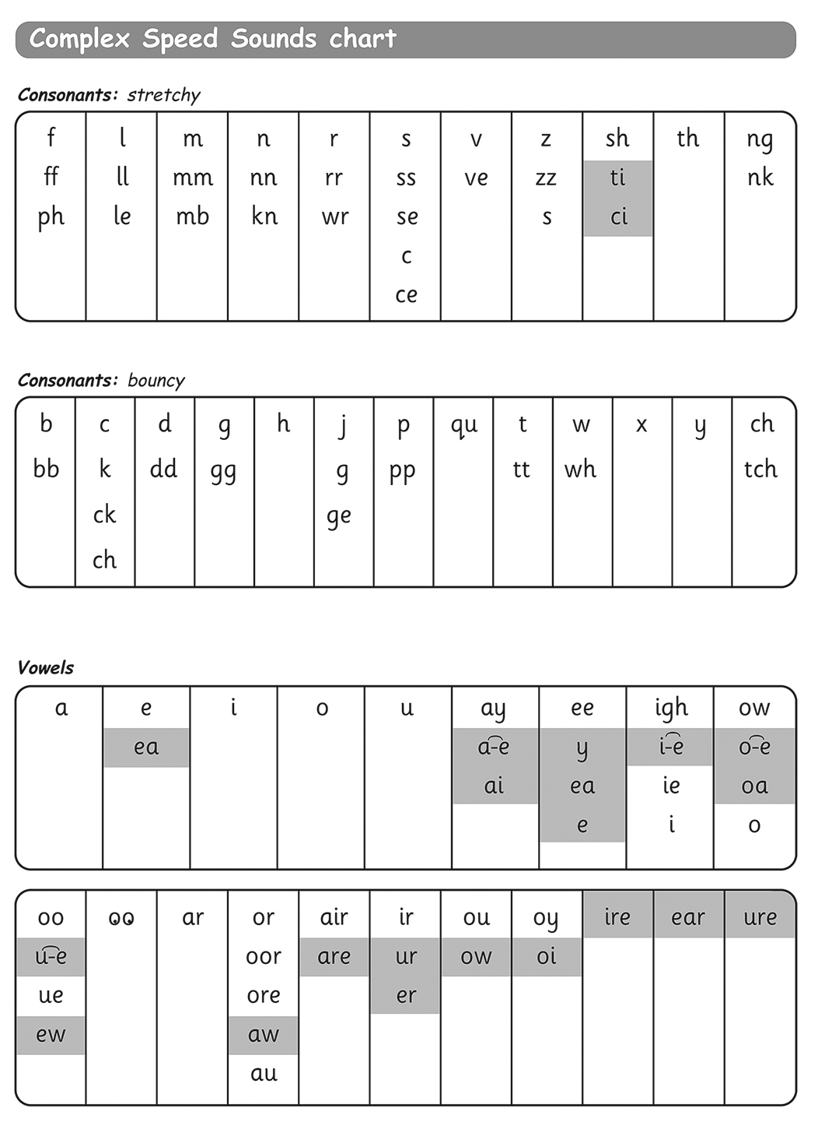
What sounds will be included in the test?
This chart shows the different graphemes for the same sound. “Same sound, different spelling!”
The highlighted sounds are set 3 sounds. They learn these after the others (set 1 and 2) so that they can use them effortlessly, systematically and with structure.

Slide 8
How to help at home
Your child’s teacher will be sending home some useful information, fun games to play and links to useful websites to use with your children.
Read stories with your child- relentlessly!! Read favourite stories over and over again, encouraging them to use dots and dashes and sound out words (your child should know how to use dots and dashes through their RWI lessons).
s h i p
Use the speed sound charts on this power point to play ‘My Turn Your Turn’ to ensure your child knows all of the sounds.

Slide 9



Thank you for taking the time to read the information about the phonics screening check 2021.
If there are any questions in regards to the information in this power point or phonics related questions in general, please contact your child’s class teacher via their email.
Look out for the resources the teachers will provide after half term!
tinkerc@dobcroft-inf.sheffield.sch.uk
matherk@dobcroft-inf.sheffield.sch.uk
hughesc@dobcroft-inf.sheffield.sch.uk

