Slide 1



Year 2 Curriculum Meeting
Kingfishers – Miss Charles and Mrs Perkins
Woodpeckers – Mrs Holmes
Eagles – Miss Hughes

Slide 2






Our Vision
Our Vision
For you to be fulfilled, happy and confident learners
Our Values
Enjoy learning
Try our best
Make good choices
Respect each other & our surroundings
Work together
Celebrate our successes

Slide 3
Purpose
What learning in year 2 looks like (routines and timetable)
Curriculum
Assessments
How you can help your child at home

Slide 4
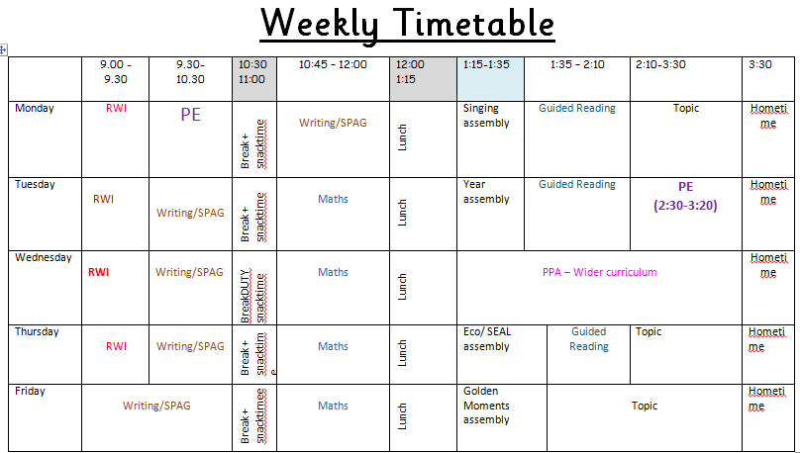
Example year 2 timetable

Slide 5
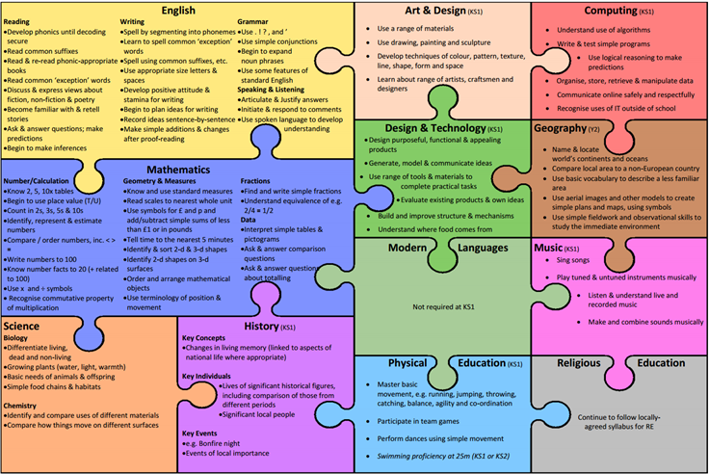
What we cover in year 2

Slide 6



Curriculum
Whole School Themes
Space
History focus:
History of space travel, Helen Sharman
Science Focus:
Planets, how materials change
Geography focus:
around the world, aerial maps - landmarks and vocab
Heroes
History Focus:
Local heroes
Art Focus:
Andy Warhol, Pop art
Food and growth
Science focus:
Animals, plants and living things
Areas of learning
Maths
English – writing, reading and phonics, spelling
Science
PE
Art
Music (violins)
Design Technology
Computing
History
Geography
P4C
SEAL
Massage
RE
Metacognition
How To Learn
Resourceful, Reciprocal, Risk-Taking, Resilient, Reflective

Slide 7

Mastery curriculum
Mastery
New curriculum = New thinking
Based around broadening a child’s understanding of a text and language and show a deep understanding through applying their learning.
What will this look like across the year?
Skills and knowledge will be built up throughout the year so children will be apply to apply their learning to a wide variety of contexts.
Mastery English
Immersive teaching style focusing on one text at a time.
What does this look like in the classroom?
Text – Genre – SPAG feature – Reading Comprehension – Application
Mathematics Mastery
Extension of how the children have been learning in year 1.
Depth not breadth.

Slide 8
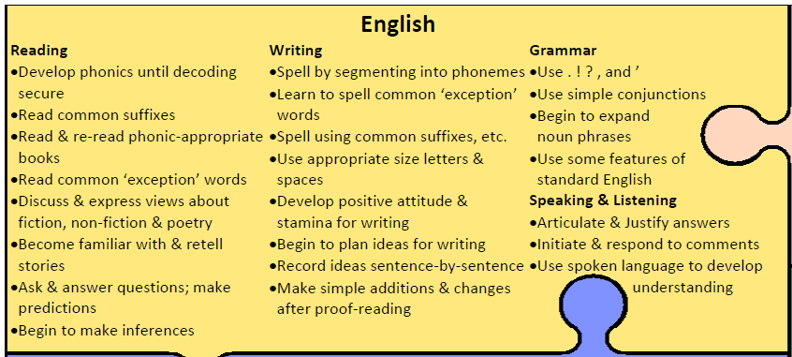
What we cover in year 2

Slide 9
punctuation
grammar
spelling
handwriting
Mastery
Reading
Notes:
Jenny

Slide 10
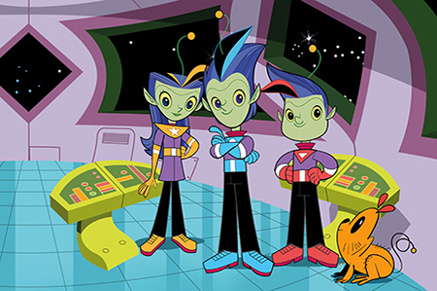
Spelling
Welcome to the spelling zone
We expect all children to be able to spell the year 2 common exception words and the spelling rules for year 2.
Copies on the website.
What this looks like in school?
Morning Activities. Application of spellings in writing. Words mats to support spelling. Homework to practise. Develop knowledge of spelling strategies

Slide 11
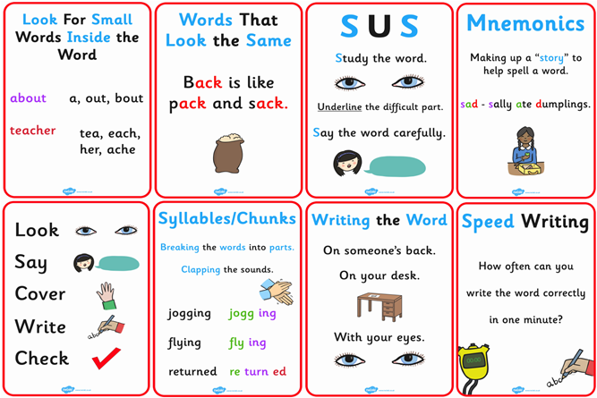
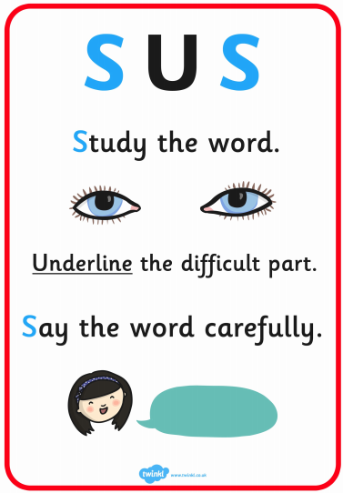
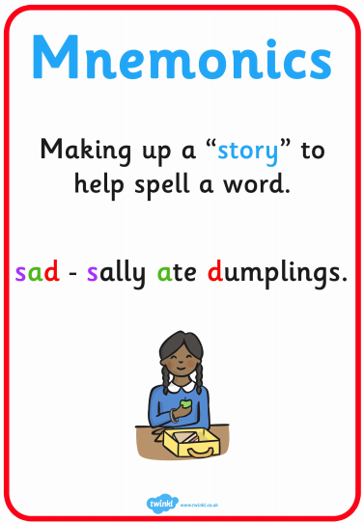

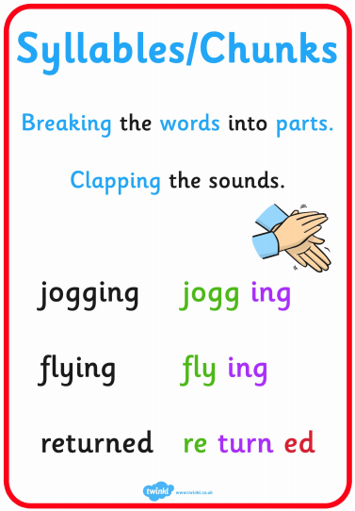
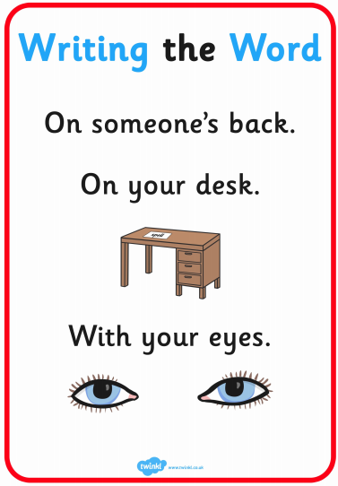
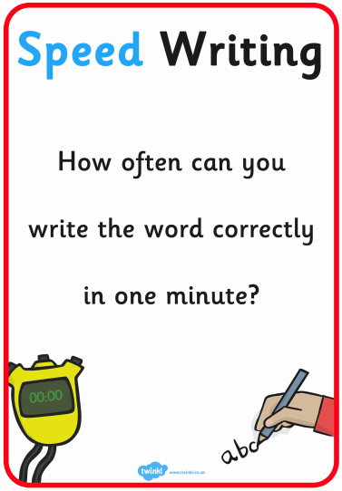

Slide 12

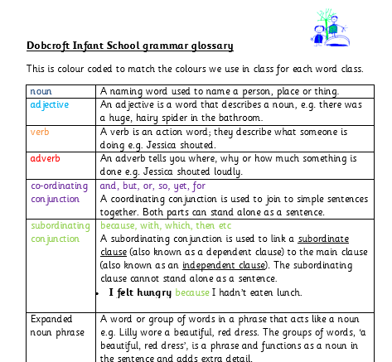
Grammar
Children use the correct terminology during English mastery lessons.
Here is your cheat sheet for those awkward moments when your child asks you “Does a complex sentence use a co-ordinating or subordinating conjunction?”
Copies available on the website.

Slide 13
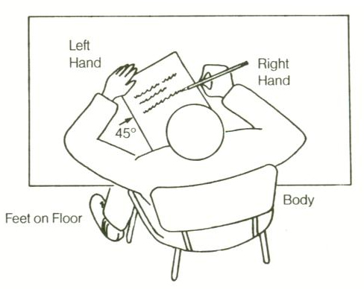
Handwriting
What do we expect?
All lower case letters formed correctly
Join lower case letters and leave capital letters unjoined.
• Write capital letters taller than lower case letters.
• Write on the lines.
• Write descenders under the line all the same length
(f, g, j, p, q, y)
• Write ascenders taller than other lower case letters and make them all the same height (b, d, h, k, l, t)
Support in school – handwriting lines, specific sessions within school. Links to games on the class blogs.
Notes:
Lindy

Slide 14
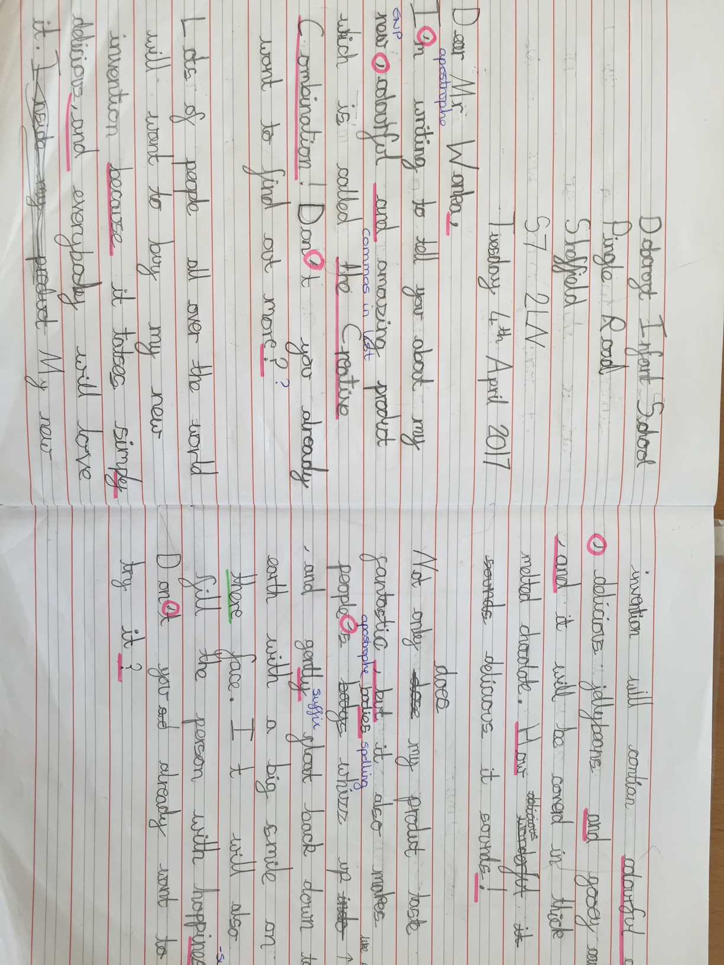
WAGOLL
- expectations

Slide 15
Reading
What does it look like in school?
Guided reading sessions 3 x week. Half termly assessment. All teachers responsible.
Guided reading sessions will be linked to the English class text.
Phonics screening (repeat)

Slide 16
Reading Expectations
Fluent reading – 90 words per minute
Automatic decoding when reading
Able to answer find and retrieval and inference questions.
Please read with your child as often as you can at home. You will have information on how to support your child with their reading in their reading diaries. Please record when you read with them.
Coloured Books
End of year expectation – gold/white books.
As the children move through the bandings, the books become longer, more difficult and require a greater depth of comprehension. Children require much more reading stamina when they move up through the reading bands. Don’t worry if your child stays on one colour band for a longer period of time, they are likely building on their reading stamina!

Slide 17
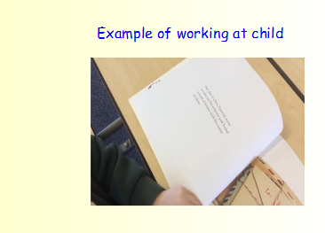
WAGOLL

Slide 18
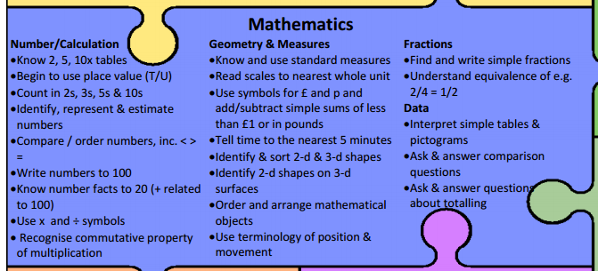

Slide 19
By the end of Year 2... Partition 2-digit numbers into tens and ones. Add two 2-digit numbers within 100. Use estimation to check their answers. Mentally subtract a 2-digit number from a 2-digit number. Recognise the inverse relationships (+ -) Solve missing number problems Recall multiplication and division facts: 2, 5, 10 Identify 1/2, 1/4, 1/3, 2/4, 3/4 Use different coins to make the same amount. Read scales in divisions of 1s, 2s, 5s and 10s. Read the time on the clock to the nearest 15 minutes. Describe properties of 2D and 3D shapes.

Slide 20
This term in maths Partitioning 2 digit numbers into tens and ones Representing numbers using different pictorials Start introducing the four calculation methods. These methods might be different to what you are familiar with, so we will share these at the November parents’ evenings. Ordering numbers to 100 in increasing in decreasing sequences Comparing numbers to 100 using greater than and less than symbols ( < > ) Deepening challenges Children will apply these skills into different contexts such as missing box problems, word problems, ‘find all the possibilities’, two step problems and ‘spot and correct the error’ problems.

Slide 21
How to help at home
Say the mathematical names for things. We use vocabulary such as 'calculations' and 'equations' in our maths learning. The children love to know what the 'proper' words are and what they mean. Many of our children can now use words such as these in their maths conversations. Practise ‘learn its’ at home. These will be on the homework menu every week and don’t need to be recorded. I.E multiplications walking to school Expose children to telling the time as much as possible!

Slide 22
Assessment in maths
- Very fluid assessment: we constantly assess children during lessons and we're scaffolding/extending children all of the time. - Children self-assess all of the time. They say when they find things easy/difficult and move through the different levels of scaffolding appropriately. End of unit assessments or skill practise: children have a go at different questions relating to skills covered so far. End of year assessment: teacher assessment 1 test on calculation and 1 test on reasoning.

Slide 23

Y2 Assessments
It is a government initiative that every child will complete an end of KS1 assessment in maths, SPaG and reading. Writing will be assessed be the child’s class teacher.
These assessments will take place in the summer term.
They will be administered and marked by the class teacher and will take place in the child’s classroom. Some children may complete the assessments in small groups or individually.
Although these assessments will be marked by class teachers they will be moderated within the year team.
These tests are part of our end of year assessments and will have no more emphasis for the children than their usual work expectations.

Slide 24

Interim Standards
As well as the end of Key Stage 1 assessments, your child will be assessed against the interim standards – a set of expectations released by the government.
This allows us to teacher assess where each child is, which will be the final assessment of your child.
You will be given a copy of the interim standards at the autumn parents evening, however if you would like to look at them before there is a copy on our website.
Used for Reading, Writing (SPaG) and Maths.
Split each subject into:
  Working towards the expected standard
  Working at the expected standard
  Working at greater depth

Slide 25

Communication
Talking with us: If urgent, in the morning,
otherwise after school, by phone or at an arranged time
Personal emails
Friday e-letters
Occasional paper letters
Class notice boards
Texts
Ask Me board on window
Class Blog
Class assembly
Curriculum Workshops
Parent Consultations: Nov, March
Report and results of KS1 Assessments
charlesa@dobcroft-inf.sheffield.sch.uk - Kingfishers
holmesk@dobcroft-inf.sheffield.sch.uk – Woodpeckers
hughesc@dobcroft-inf.sheffield.sch.uk- Eagles

Slide 26
Thank you for listening and we look forward to working with you in the coming year.

