Slide 1
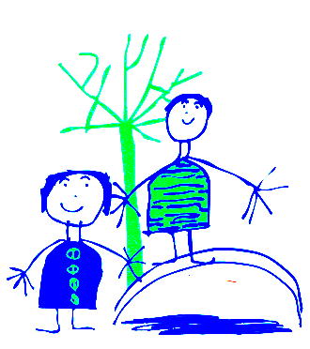
Dobcroft Infant School Foundation Stage
(FS2)

Slide 2
Welcome to Dobcroft Infant School.
Mrs Burgan, Mrs Cooke, Miss Marsden, and Mrs Taylor
Foundation Stage Two

Slide 3
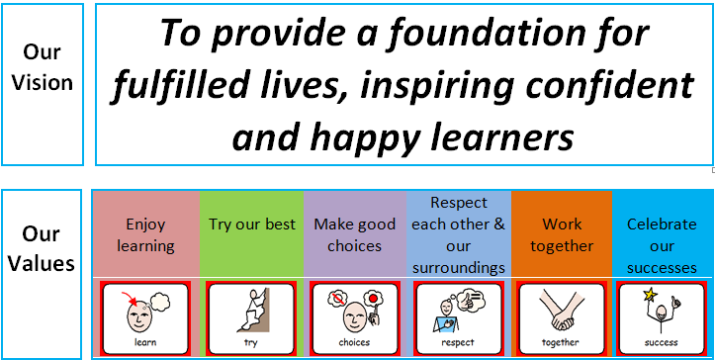
Our school Vision

Slide 4
Classroom Routines
(This may depend on routines in place due to Co-vid 19. We will keep you as updated as we can)
Drop off for FS2 children is 8.55am, collection is at 3.25pm.
Doors are locked at 9.00am ~ please use main entrance (office) after this time. Registration starts at 9.00am.
After this time you must go to the main entrance. Please do not open the door for parents after 9.00 am.
Children say goodbye to their parents outside the classroom and then come into school and hang up their coats by themselves.
They then:
Put water bottle on the table in classroom.
Self Registration: put their picture on the rocket or practise writing their name.
Sit on the carpet quietly with a book or look at the pictures on the active board screen.
We then get ready to take our register.

Slide 5
Planning and Preparation Time
One morning a week the teachers have planning and preparation time (PPA) so you may see Mrs Rowlands, Mrs Rhodes or Mrs Simpson at this time.
The PPA times are subject to change.

Slide 6
General Issues
If your child is absent from school please telephone the school office and explain why.
If your child arrives at school after 9.00am they will be marked as late and you will need to go to the school office.
School finishes at 3.25pm please can you be on time to collect your child. Children not collected will wait by Mrs Rowland’s office. Sheffield Council Policy: child uncollected after 3:40pm will be taken to a safe waiting place outside the office
Children who have been sick need to stay away from school for 24 hours after the last bout of sickness. For diarrhoea it is 48 hours after the last episode.
For Covid symptoms please follow the latest government guidance.
Please remember to “take a peek once a week” and check for worms and nits.
We encourage children to be independent . Please encourage your child to tell a member of staff if they have wet or, soiled or hurt themselves.
Please make sure your child has their blue book bag in school every day. Teachers will read with your child once per week and record this in their reading diary. Letters from school will generally go out via e-mail on a Friday.
Please ensure all items of clothing are clearly labelled and your child knows where the label can be found.
Please do not let your child play with the resources set out in our outside classroom areas (outside each classroom door).

Slide 7
PE and Library
Much of our physical learning is done as part of our outdoor learning.
We also have formal PE lessons in the hall on Wednesdays, where we will wear our PE kits (Black or navy shorts or leggings, jade school PE t-shirt)
School will provide a red library book bag. Please bring it to school on your child’s library day (TBC in the Autumn term)

Slide 8
Talking to your child’s teacher
Any worries or issues? Please do not hesitate to speak to a member of staff. Mornings are often very busy, so please either wait until the end of the day, send your class teacher an email, or pop to the office to arrange a convenient time to meet with the teacher.
Due to social distancing, the teachers will have to meet you outside when all other children have gone.
School protocol is that, where possible, teachers will respond to your email within one week.

Slide 9
The Early Learning Goals.
The Foundation Stage covers the education for children from birth to the end of the “Reception Year” as you will have seen in the letter given out at home visits.
The Foundation Stage is split into 7 areas of learning.
Each area of learning is broken down into a series of “aspects of learning” and then “Early Learning Goals” for the children to work through and achieve.

Slide 10
The Curriculum
In Reception we follow the Foundation Stage Profile, which is a curriculum for the early years. Children’s learning will continue from their learning in nursery, and will prepare them for their life in wider school. The emphasis is on building their independence and we develop their maths, reading and writing skills through discussion, drawing, reading stories and exploring the world around them. Details of a curriculum meeting for parents to follow.

Slide 11
How do the Children Learn?
Children will have focus teaching time each day to develop all areas of learning.
The learning will be delivered as part of a “class”, a small group and as an individual.
The children will learn through structured play activities inside and outside.
Children will have opportunities to explore and experience the learning activities independently in the classroom.
Staff work with every child in a literacy activity, a maths task, and a creative activity, along with hearing each child read once a week. These activities are tailored to the child’s next steps in learning.

Slide 12
Early Days in School
To begin with the learning focusses on PSED (Personal, Social and Emotional Development) and the children’s emotional wellbeing.
Learning the names of their friends and the adults who look after them is key, alongside learning where everything lives in the classroom, how to share and play together, and how to tidy up!

Slide 13
Family Seal Activities
This half term, we will be talking about our families, and will be asking you to complete an activity with your child where you will be talking about different things you and your child have enjoyed over the course of a week. Parents can scribe for their children, or the children could draw a picture for each activity.
Details to follow in the Autumn term.

Slide 14
WALT
WALT ~ We Are Learning To
Your children will see this picture in school and is used to introduce the learning objective they will be working on.

Slide 15
Eco School
ECO CODE
At Dobcroft Infant School we are committed to:
Reduce, recycle and reuse.
Appreciate and value our environment and community.
Build awareness of the choices we make and their impact globally.
We have a “ Eco Team” in school with representatives from each class. These will be chosen after the Christmas holidays.

Slide 16
Parent Information
At the beginning of each term we will send home a “Knowledge Organiser” letter to inform you of what the children will be learning in school.
Individual meetings for parents and carers in November and March. These will be done online this year.
In July you will receive your child’s school report.

Slide 17
Other Areas of Learning
A separate meeting or power point
(depending on the current government covid guidelines) will be posted in October to give more details about how we teach literacy, phonics and numeracy.
At the parents evenings in November we will talk to you more about your individual child and how they have settled into school. The meetings in March will be about individual progress and next steps for learning.

Slide 18
PSA
The parent association (FODS) runs various events through out the year which are promoted in a termly newsletter.
If you are able to help at any of the events or would like more information then please email
enquiries@dobcroft-inf.sheffield.sch.uk

Slide 19
Thank you for reading!

