Slide 1
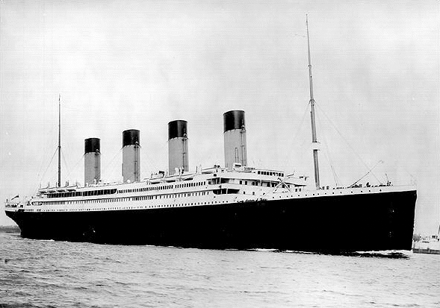
The Titanic

Slide 2
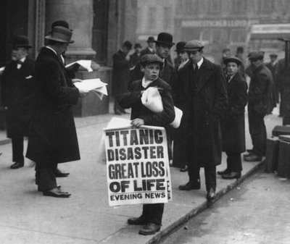
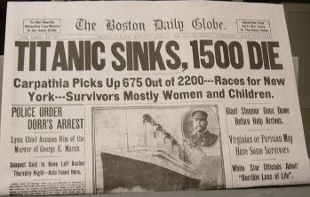
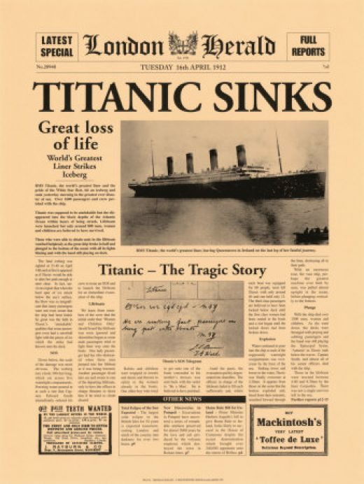
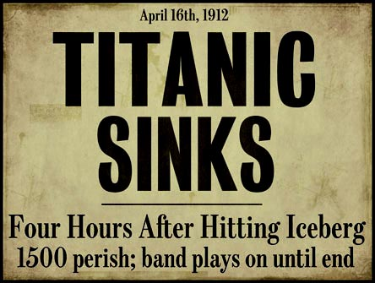
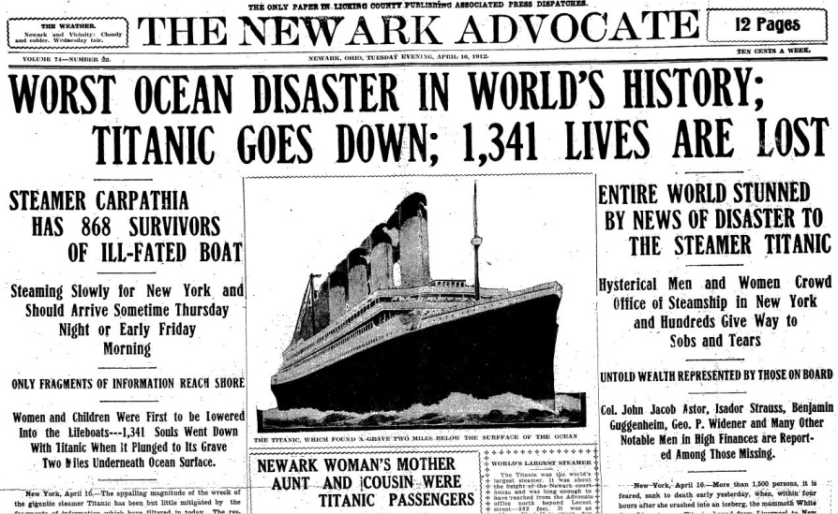

Slide 3
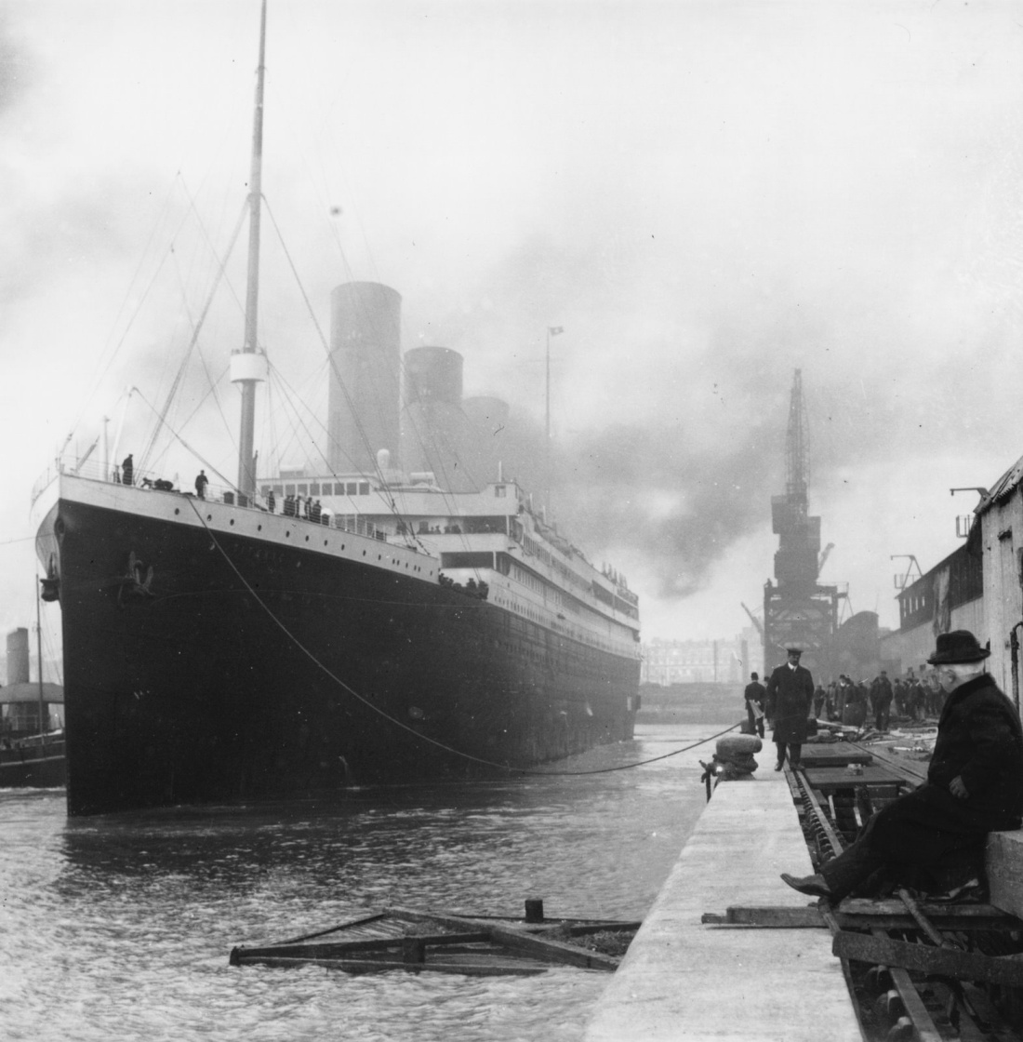
The Titanic was the biggest ship in the world. Some people thought she was the best ship ever built. She was said to be too strong to sink. She was unsinkable – or so they believed!!

Slide 4
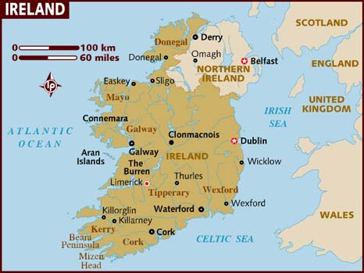
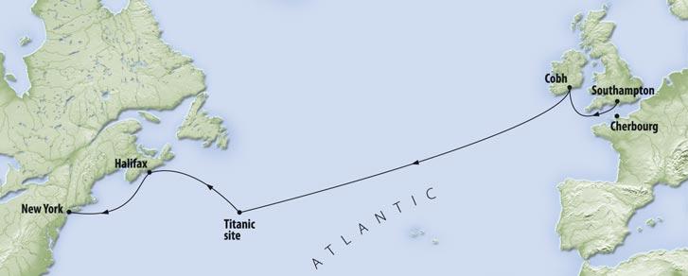
The Titanic was built in Belfast by the White Star Line Shipping Company.
Queenstown was in County Cork. It is now called Cobh.
It set sail from Southampton in England on the 10th April 1912. More passengers boarded the ship in France and Queenstown in Ireland. It was on its way to New York.

Slide 5
The journey

Slide 6
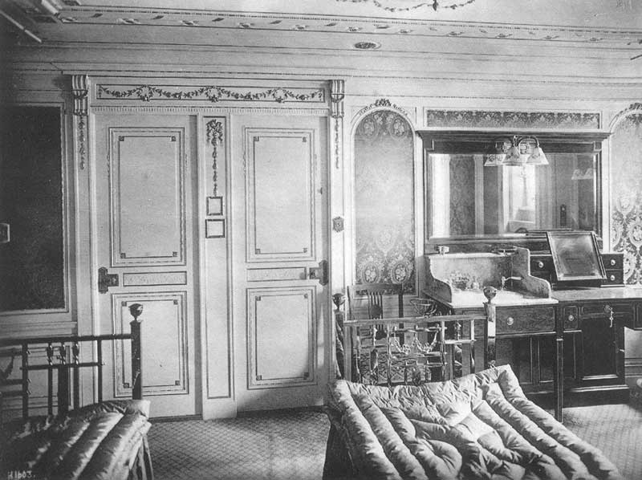
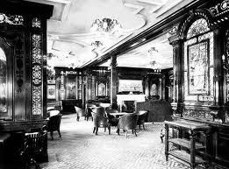
When the passengers began their journey to New York City, it was like a wonderful party on board. Everybody was having loads of fun. They thought they were making history – they were!
The Titanic was a floating palace. She was one of the first ships with a pool and she had beautiful gold chandeliers. Because of this many very wealthy people travelled on board the Titanic. They stayed in the upper deck, which was called The First Class. While the poorer passengers and the crew stayed below deck in Third Class.

Slide 7
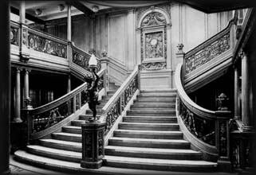
The Grand Staircase

Slide 8
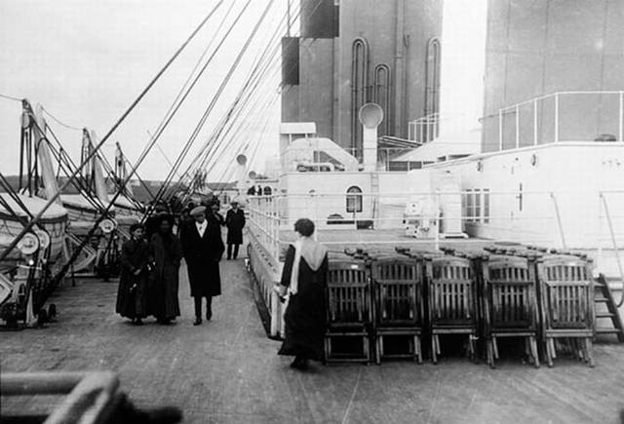
When it set sail across the Atlantic Ocean, it had 2,224 passengers on board. It only had 16 lifeboats which could only hold 1,708 people. The White Star Line knew they should have had more lifeboats but they didn’t want the decks to look to cluttered and spoil the look of the ship.

Slide 9
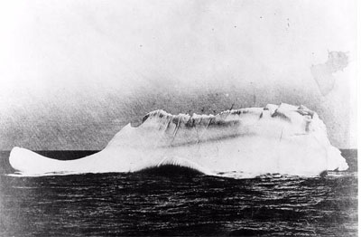
By the 14th of April, Titanic was in the middle of the Atlantic Ocean. The weather was clear. That night, the stars glistened against the cold, dark sky.
Shortly before midnight, a sailor spotted something out in front of the ship. He couldn’t really see it but he knew it could only be one thing – an iceberg!
An Iceberg is a huge piece of floating ice. It is much bigger beneath the water than it is on top. It can really damage a ship if it crashes into it.

Slide 10
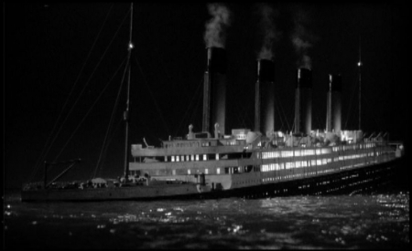
It was too late for the Titanic to turn away and it hit the iceberg. The iceberg ripped a huge hole in the side of the ship and the lower parts of the ship began to fill with icy water.
The nose of the Titanic began to disappear beneath the water. The stern, or the back of the ship began to rise high into the air. In a few hours the ship would sink. The crew set of flares to let other ships know that it needed help.

Slide 11
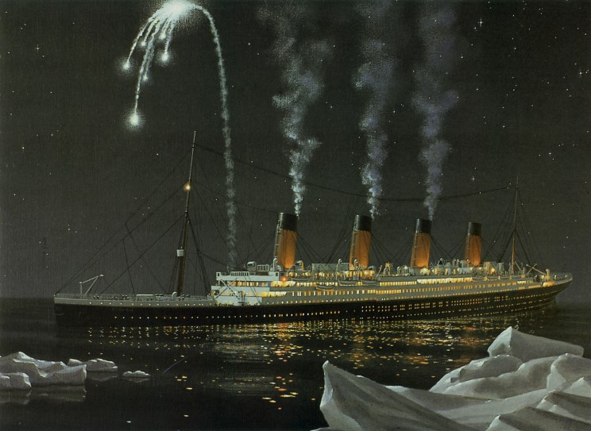
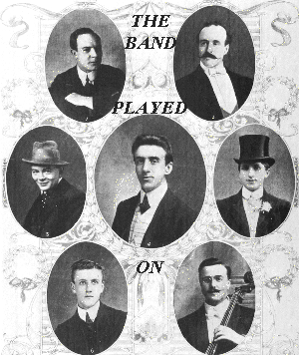
Sailors on other ships saw the flares but thought they were fireworks set off during a party on the ship so they sailed on by.
The Titanic crew began trying to save people. Some had come out on deck when the ship hit the iceberg, but many were still below deck. They didn’t think there was anything to worry about.
The band began to play music to calm the passengers.

Slide 12
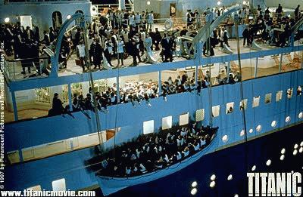
The sailors began to put people in the lifeboats. Women and children went first. But there was not enough lifeboats for everybody on board. Also, in the panic of the sinking, some lifeboats were lowered into the water with empty seats.
By the time all the lifeboats had been lowered, there were still 1,500 people on board.

Slide 13
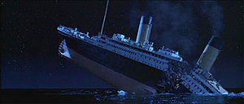
By 2.00 a.m. the passengers still on the sinking ship heard a terrible sound. The Titanic was ripping apart!
People started to jump off the ship into the icy water. The Titanic had disappeared beneath the Atlantic Ocean by 2.20 a.m. on the 15th of April 1912.

Slide 14
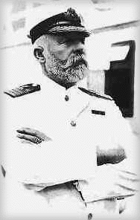
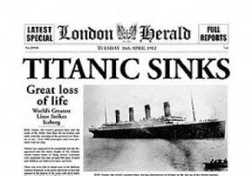
The Titanic sank 2 miles to the bottom of the Atlantic Ocean. Most of it’s passengers and crew died. Captain Smith went down with his ship.
The people who were in the lifeboats were rescued by another ship called the Carpathia.
Nobody knew where in the Atlantic Ocean the Titanic was. It was not found until 71 years after it sank.

Slide 15
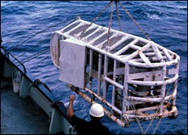
A BOY'S DREAM
As a kid, scientist Robert Ballard was interested in shipwrecks. He especially loved reading about theTitanic. "My lifelong dream," he says, "was to find this great ship."
Ballard became an ocean explorer when he grew up. He visited underwater mountains in the middle of the Atlantic. He found giant worms that live in the Pacific. And he never forgot his boyhood dream—to find the Titanic.
The task seemed impossible. Some people said The Titanic had been crushed. Others thought she had broken into little pieces. Everyone agreed the ship was far too deep to reach.
But Ballard was determined. He took ships to where The Titanic had sunk. They used special tools to look around the ocean floor. For weeks, they found nothing.
Then they sent down an underwater craft called Argo. Its cameras took videos of the ocean floor and sent them up to the ships.

Slide 16
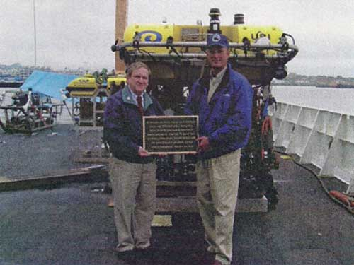
FOUND IT!
Argo searched for several days. Still nothing. Ballard was sure he had failed. Shortly after midnight on September 1, he decided to get some sleep. He really needed it.
Barely an hour later, someone woke him up. Metal objects were showing up on the video screen. These things could only have come from a boat. Soon the team spotted a huge ship engine. They had found the Titanic!
Over the next few days, Argo circled the wreck. Ballard almost couldn't believe what he saw. Titanic's bow, or front, was stuck in mud. Yet the ship still looked huge.
Ballard also found many sad reminders of theTitanic's passengers. He saw beds, suitcases, cups, and countless shoes. It was almost like visiting a sunken museum.
Before leaving, Ballard wanted to honor the tragic ship. He left a plaque to remember the people who had died. Aside from that, he left everything exactly the way he found it.

Slide 17
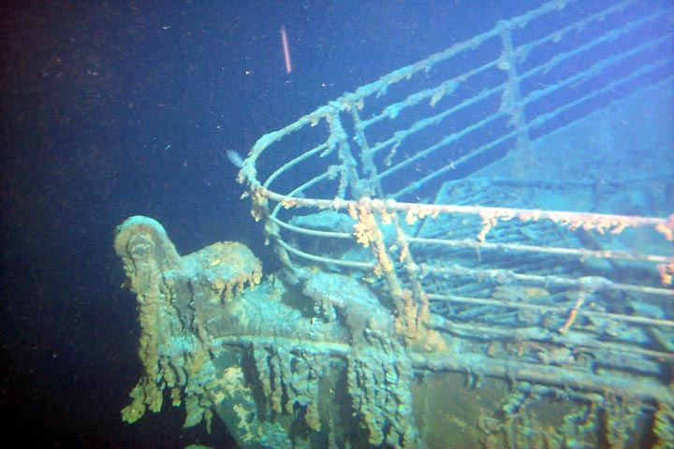
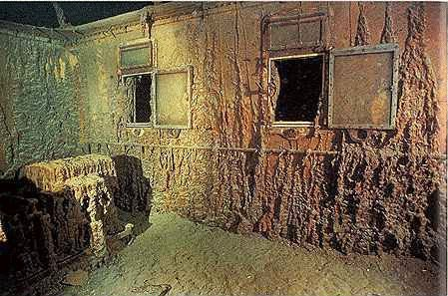
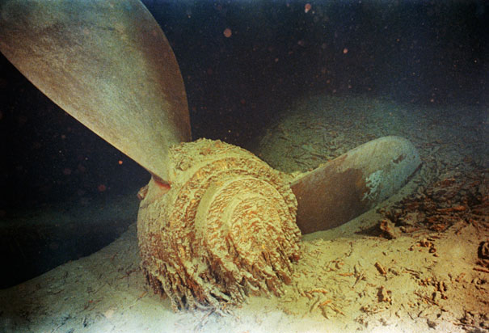
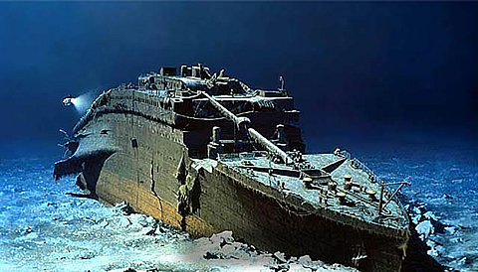

Slide 18
