Slide 1
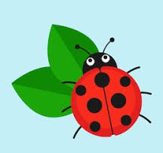
Ladybirds Home Learning
Week 2 – w/c 1st March 2021

Slide 2
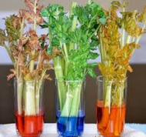
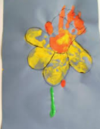
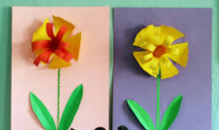
Monday 1st March
Literacy – Listen to Mrs Cooke reading ‘The Runaway Pea’ again on our class gallery. Can you think of another adventure that the pea could go on? Talk to an adult about where he might go next. You could ask them to write down your adventure and send it into school. Can you draw pictures to go with your story?
Learning through play – an opportunity for children to choose something that they would like to play with..
Science – Look at a piece of celery, what can you see? Is there a leaf and root?
Place a stem of celery in water, red and blue food colouring.
Talk about what they think will happen and why?
Maths – join in with our maths moments video. Have a look inside and outside, can you find any flowers ? Draw the flowers and count how many petals each has. Which has the most, least, smallest, biggest petals?
Outdoors- Go for a walk outside. Can you spot or hear wildlife. Draw a picture when you get home.
Nature- Watch garden tails, which animals can you spot? What sounds did you hear? https://www.bbc.co.uk/iplayer/episode/m000s6hw/garden-tales-series-1-7-graces-grand-cafe
Art – Draw or paint daffodils for St David’s day.

Slide 3
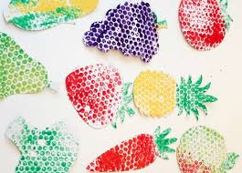
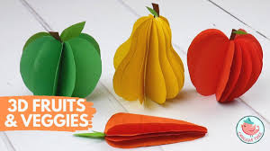
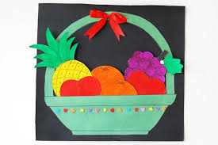
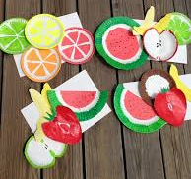
Tuesday 2nd March
Literacy – Mrs Pinder has recorded a new phonics video for you to join in with. Can you spot our new sounds in the stories that you read? You could practise writing the new sounds too, and think of words which begin with each sound.
Learning through play – an opportunity for children to choose something that they would like to play with. You could make your own fruit and vegetable shop, drawing pictures of different things to sell, or making them using materials you have at home.
Outdoors – Can you spot the signs of spring? Take photographs of what you can see. Then share them with a friend or family member. Play the cbeebies springo game.
Maths – join in with our maths moments video. Talk about your daily routine. What happens first in the day? What do you do next? Use language like next, then, after that, and last to talk about the things that happen in your day.
Art & story- draw a picture of your favourite character or front cover of your favoutite book. Make it big and bright and put it in your window for others to see.
Story – choose a story and share it with someone in your family. Can you point to the title of the book? What do we call the person who wrote the book? Can you find the author’s name on the front cover?

Slide 4


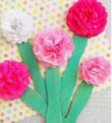
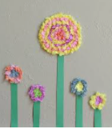
Wednesday 3rd March
Literacy – we are going to make a diary for planting seeds. Yesterday we planted some seeds. Can you draw a picture of what they look like? How do you think that they will change over time?
Learning through play – an opportunity for children to choose something that they would like to play with. You could build a model, play a game, make up a song or dance, or play outside in the garden.
Outdoors – Have a look at the clouds, what are the different things you can see?
Maths – join in with our maths moments video. Practise subitising (looking at a set of objects and knowing how many there are without counting) at home. You could join in with the subitise rap online using the link below.
https://www.youtube.com/watch?v=6yyz_OycV4A
Art – Watch Miss Bell make tissue paper flowers,
create your own picture.
Singing – sing some of your favourite songs with a grown up at home. You might remember some of the songs from our singing bag too.

Slide 5


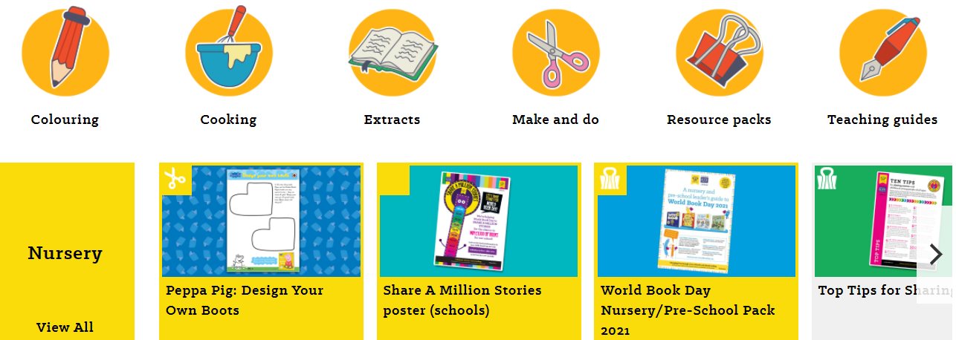
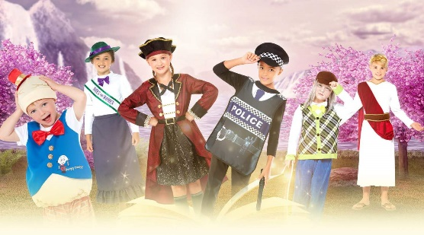
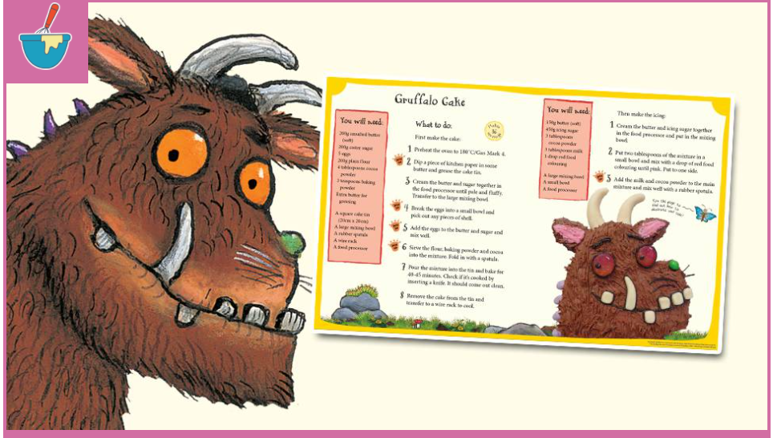

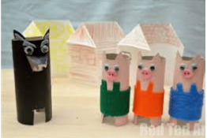
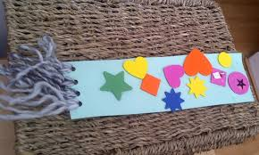
Thursday 4th March
Today is World Book Day!
You could dress up as your favourite book character, or get crafty and make a costume yourself! If you do choose to dress up, please remember to send us a photo for our home learning board at school.
1.30am Live Register and book day assembly with Mrs Harrison.
Visit https://www.worldbookday.com/resources/ and select the Nursery tab. The site has lots of lovely ideas and activities that you can have a go at whilst at home, such as ‘Share a Story Live (10.30am on https://www.worldbookday.com/event/words-pictures-bring-reading-to-life/), colouring, singing and spot the difference.
You could also, draw a picture of characters from your favourite book, act out a story using props found at home, or make Gruffalo cake using the recipe online. You could make a book mark, or finger puppets to use when retelling your favourite story. We can’t wait to see what you get up to at home when we see you on our live registers this week! Remember to look for book characters in windows when you go for a walk.

Slide 6
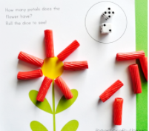
Friday 5th March
Literacy – Draw a picture of yourself and tell your adult something you would like us to know about you since we’ve seen you or something that you are looking forward to.
Learning through play – an opportunity for children to choose something that they would like to play with.
Cooking – have a go at Mrs Shepherd’s cooking challenge.
Details of this can be found on our class gallery page.
Maths – Roll the dice and choose the right number of petals (pasta or paper),
repeat and then count the total numbers of petals.
Mindfulness – watch the ‘Mindfulness with Harry’ video on our class gallery page and join in with the actions and activities. What makes you feel relaxed and happy?
Pre-school- join us for fun outdoors at pre-school.

