Slide 1
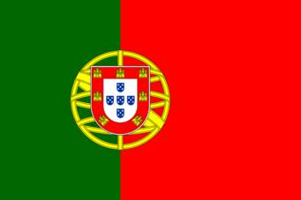
Portugal
By Kate Edwards

Slide 2
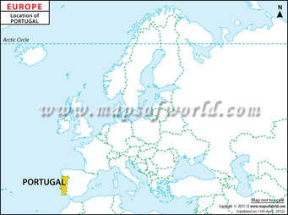
Where is Portugal?
Portugal is in the west of Europe.

Slide 3
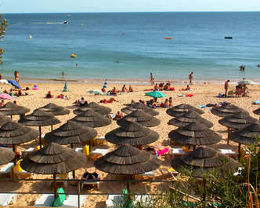
Portugal’s Population
Portugal has a population of 10,000,000 people. Lisbon ( the capital of Portugal), has a population of over 545,200 people.

Slide 4
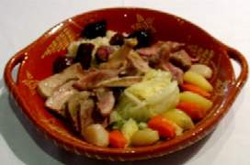
Portugal’s food
Some of the Portuguese food includes :
Cozido is made from a hotpot of beef,
potatoes, sausages, vegetables and rice.
Caldo Verde is made from potatoes, kale.
Feijoada contains beans, beef and pork.
Rojoes is a portuguese meat stew.

Slide 5
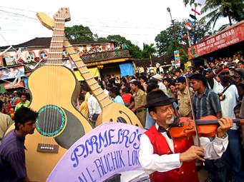
Thank you for listening .

