Slide 1
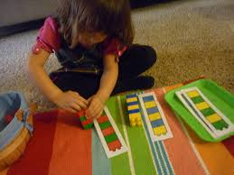
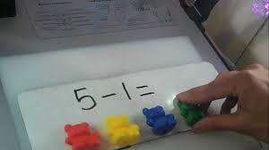
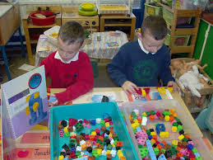
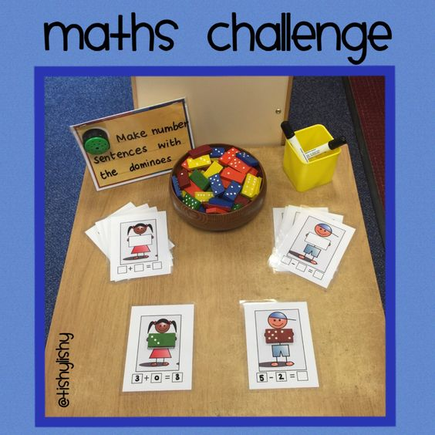
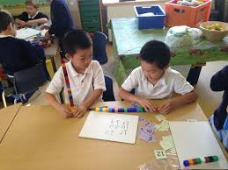
Maths in Year One

Slide 2

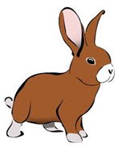


Welcome to Year 1
Claire Hughes and Laura McFarlane – Hedgehogs
Beth Dray – Rabbits
Lois Fairclough and Colette Waters-Squirrels
Celina Tinker - Foxes

Slide 3






Our Vision
Our Vision
For you to be fulfilled, happy and confident learners
Our Values
Enjoy learning
Try our best
Make good choices
Respect each other & our surroundings
Work together
Celebrate our successes

Slide 4
By the end of Year 1... - Count to and across 10. - Count in 1s, 2s, 5s and 10s. - Know 1 more and 1 less than a given number. - Add and subtract with numbers to 20. - Use + - and = - Use the language of comparisons (more/fewer). - Measure weight, length and capacity. - Recognise and describe simple 2D and 3D shapes. - Tell the time (half past, o'clock). - Recognise half, quarter and whole.

Slide 5
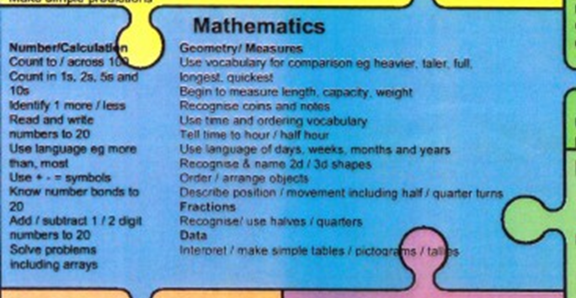
These are available at the back of the hall.

Slide 6
Maths Mastery
Introduced in Sheffield schools as part of their Mastery curriculum.
An exciting opportunity to be involved in a new way of teaching.
Year 2 are starting to use some of the features of Maths Mastery.
Introduced at Dobcroft in Year 1 and Foundation Stage.
Depth not breadth.

Slide 7
Maths Moments!
Children learn songs and rhymes to involve them in maths learning.
'Days of the Week' to the Addams Family song.
Finish the Pattern
How many more to make 10?
8
Months of the year, weather, season.
Ordinal numbers.
4

Slide 8
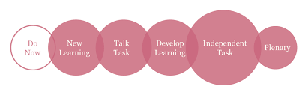
6 Part Lesson
New Learning New skill introduced to all of the children in a whole class carpet session. Vocabulary and sentences modelled by teacher and TA.
Develo[p Learning Back to the carpet to develop and deepen understanding. Introduce deepening task.
Plenary All children on the carpet to talk about things we found easy/difficult, consolidate skills learned.
Do Now A short task where children practise skills from a previous session. Often as a morning job. Not always as part of the maths lesson.
Talk Task Gives children the chance to practise the modelled vocabulary and new skill in partners.
Independent Task Children practise the new skills learned on a task sheet or practically using resources.

Slide 9
Support in class
Keep up, not catch up!
Scaffolding and resources to support additionally.
Whole class move together
Deepening understanding - depth not breadth.
Same day/next day intervention for children who require additional input.

Slide 10
Assessment
- Very fluid assessment: we constantly assess children during lessons and we're scaffolding/extending children all of the time. - Children self-assess all of the time. They say when they find things easy/difficult and move through the different tasks appropriately. - End of unit assessments: children have a go at different questions relating to skills covered. Children are grouped to support learning through same day interventions. This 'gap filling' gives children the best chance to 'keep up, not catch up'.

Slide 11
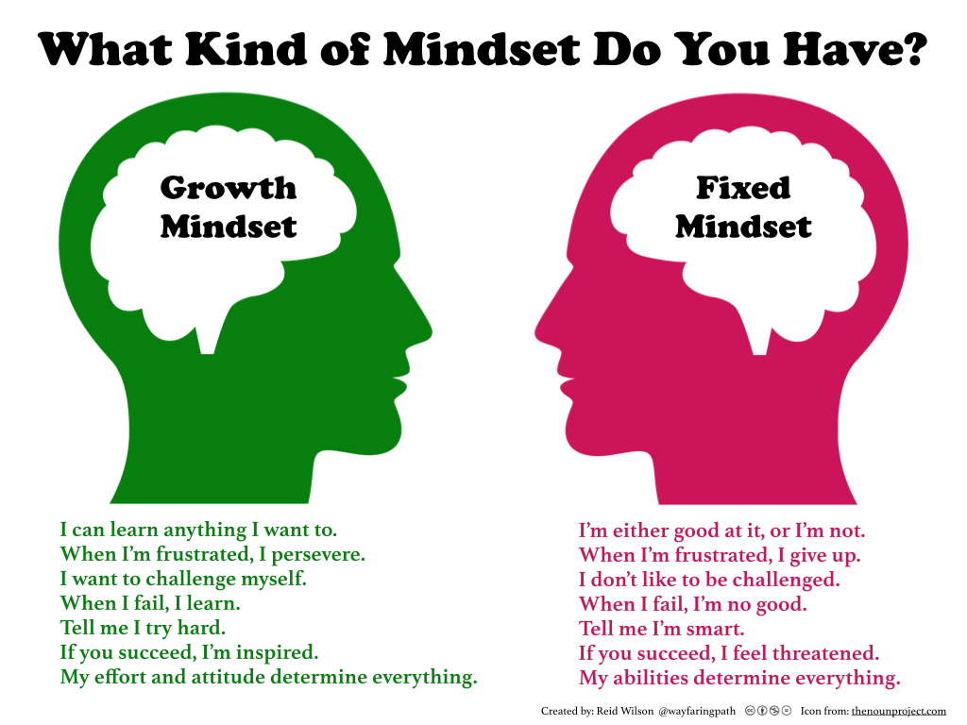
Hollywood Hates Math https://www.youtube.com/watch?v=3uYBoWH3nFk
It has become acceptable in society to be 'bad at maths'. Children are exposed to these messages constantly, and we need to actively find ways to encourage a positive, growth mindset to maths.
“In a growth mindset, people believe that their most basic abilities can be developed through dedication and hard work—brains and talent are just the starting point. This view creates a love of learning and a resilience that is essential for great accomplishment”. Carol Dweck

Slide 12
How to help at home
Say the mathematical names for things. We use vocabulary such as 'calculations' and 'equations' in our maths learning. The children love to know what the 'proper' words are and what they mean. Many of our children can now use words such as these in their maths conversations.
We have put together a few ideas of how to help your children with maths at home. We are always looking for new ways to engage children, so if you have an idea which isn't listed please let us know so that we can add it on and try it out too!

Slide 13
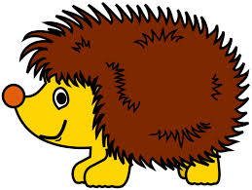



Thank you for coming tonight, we hope that the meeting has been useful.
We have laid out some of the resources on the tables that we use to support maths.
Thank you for your continued support,
The Year One Team

