Slide 1




Welcome to Year 2
2016-17
Miss Sutherland
Mrs Holmes
Miss Charles
Notes:
AC

Slide 2
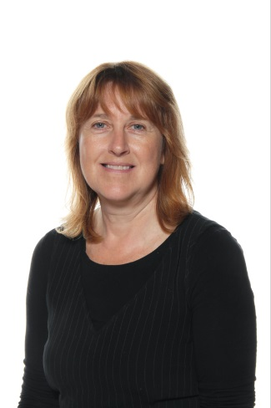
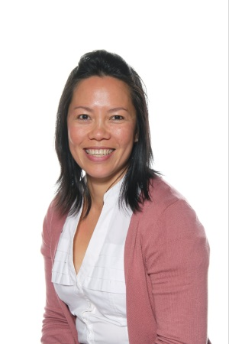
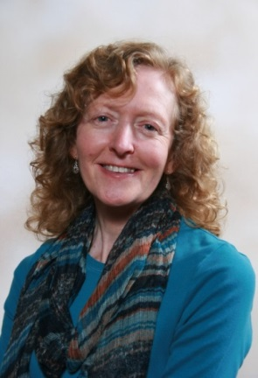
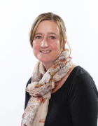
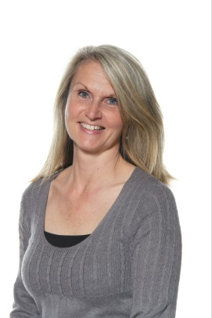
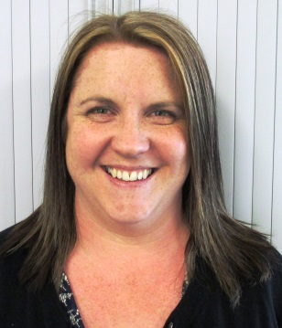
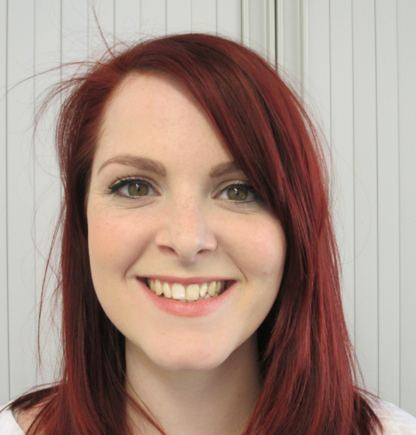
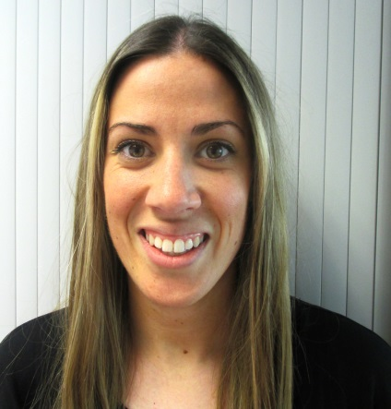
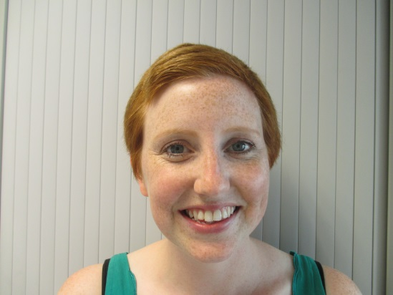
Teaching Staff Y2
Mrs Kilcoyne Mrs Rhodes Mrs Simpson Mrs Greatorex Mrs Godwin Mrs Peersman
Mrs Holmes
Miss Sutherland
Miss Charles
Notes:
AC

Slide 3
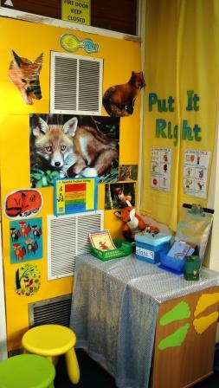
Y2 team curriculum planning
Same expectations
assessments
moderated by Y2team
PPA Time: will cover the extended curriculum including -Strands in Music, Eco and Sustainability, SEAL and P4C
Notes:
AC

Slide 4



Curriculum
Whole School Themes
Houses and Homes
Science focus:
Animals and Habitats
History focus:
The Victorians
Heroes
History focus:
Significant individuals in the past and present
Geography focus:
Modern day local heroes
Food and Growth
Science focus:
Plants and living things
Areas of learning
Maths
English – writing, reading and phonics
Science
PE
Art
Music (violins)
Design Technology
Computing
History
Geography
P4C
SEAL
Massage
RE
How To Learn
Resourceful, Reciprocal, Risk-Taking, Resilient, Reflective
Notes:
AC

Slide 5




PPA
Preparation, Planning, Assessment
Y2 Team Tuesday Afternoons alternate weeks
Classes taught pre-planned curriculum
SMS Violin
Music
Eco and Sustainability
Geography
SEAL
P4C
Notes:
KH

Slide 6
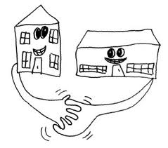
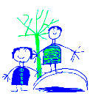
Working together
Termly Curriculum News (emailed)
New blog and website in development
Parent Workshops English Mastery (22nd September 7pm) Maths (3rd October 7pm),
Reading (children change books independently). RWI Teacher will listen to your child every week. There will be a comment in your child’s diary from an adult every two weeks.
Spelling Zone – your child will bring a small set of spellings home to learn and to practise applying their knowledge in different ways. More information to follow.
Maths moments –’Learn its’ Different maths facts to learn at home e.g. multiplications, doubling and halving facts, number bonds.
Educational visits
Parents coming in to share expertise. Please let us know.
Notes:
JG

Slide 7

Communication
Talking with us: If urgent, in the morning,
otherwise after school, by phone or at an arranged time
Personal emails
Friday e-letters
Occasional paper letters
Class notice boards
Texts
Ask Me board on window
Class Blog
Class assembly
Curriculum Workshops
Parent Consultations: Nov, March
Report and results of KS1 Assessments
sutherlande@dobcroft-inf.sheffield.sch.uk
charlesa@dobcroft-inf.sheffield.sch.uk
lawk@dobcroft-inf.sheffield.sch.uk
Notes:
JR

Slide 8
Helping In School
HELP US!
Induction and Confidentiality
Library volunteer
Working with individuals / groups
Running weekly library session
Supporting us on visits
Preparing resources
Speak to your individual class teacher at the end
of our information evening.
Notes:
KH

Slide 9
Routines
Independent, punctual entry 8:45 -9:00
Coat and book bag away, water bottle , change reading book, Complete morning work displayed on the interactive whiteboard
Please write on the class going home board if your child is going home with a different adult to usual
Register: 9:00
Home Time 3:30
Clubs and DASH: we have lists
Pre- arranged play date with another child: adult must write on the going home board
Parent late (after 3:40): safe waiting place outside Mrs Rowland’s office
Parent collecting younger sibling: Y2 children may walk to their sibling’s class if we have signed written permission from the parent.
Notes:
ES

Slide 10

Homework
Weekly: out on Friday, in on Wednesday
Format – homework menu
Non-negotiables:
Reading, Spelling Zone and ‘Learn its’
Choose from:
Practical: walks, discussions
Research: library, internet, class blog
Recording: drawings, posters, powerpoints, photos, writing, email
Look out for the Homework Book.
Inside, is our handwriting script, teacher’s email and our class blog address
Notes:
CH

Slide 11

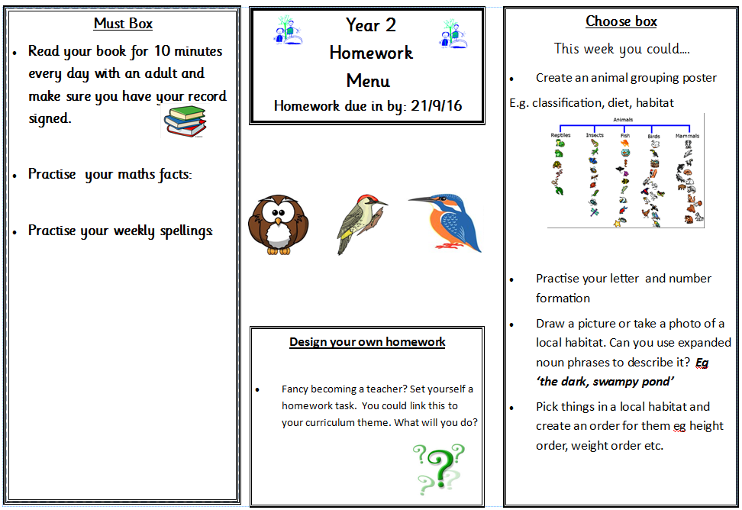
Homework Menu
Notes:
CH

Slide 12
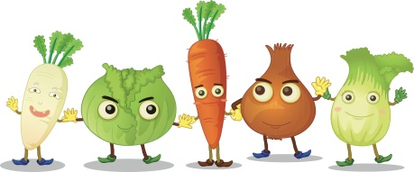

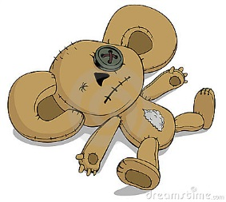

Bits and Pieces!
Healthy School Practice:
Avoid chocolate, nuts and sweets in lunchboxes
Provide a water bottle
Provide shorts, T-shirt and shoes for PE
Birthdays
We celebrate birthdays in class by giving a card and singing and ask you not to send in birthday treats.
We do not give out birthday invitations at school however your child can put them individual children’s drawers.
Toys
Keep toys at home as they can get broken or lost.
Uniform and belongings
Clearly label each item of clothing including PE kits with your child’s name. All tops, jumpers, cardigans and dresses must have the Dobcroft badge sewn on.
Notes:
JR

Slide 13

Y2 Assessments
It is a government initiative that every child will complete an end of KS1 assessment in maths, SPaG and reading. Writing will be assessed be the child’s class teacher.
These assessments will take place in the summer term.
They will be administered and marked by the class teacher and will take place in the child’s classroom. Some children may complete the assessments in small groups or individually.
Although these assessments will be marked by class teachers they will be moderated within the year team.
These tests are part of our end of year assessments and will have no more emphasis for the children than their usual work expectations.
Notes:
JR

Slide 14
Thank you for listening and we look forward to working with you in the coming year.
Notes:
JR

