Slide 1




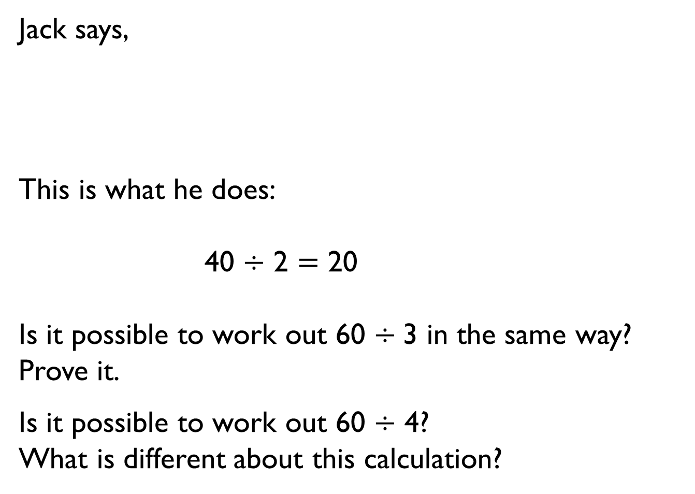
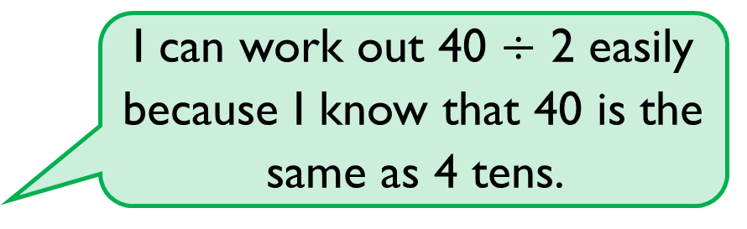
Jack says,
This is what he does:
40 $÷$ 2 $=$ 20
Is it possible to work out 60 $÷$3 in the same way?
Prove it.
Is it possible to work out 60 $÷$ 4?
What is different about this calculation?
I can work out 40 $÷$ 2 easily because I know that 40 is the same as 4 tens.

Slide 2

Alex has 20 sweets and shares them between 5 friends.
Tommy has 20 sweets and shares them between 10 friends.
Whose friends will receive the most sweets?
How do you know?

Slide 3
You have 30 counters.
How many different ways can you put them into equal groups?
Write down all the possible ways.

Slide 4

Amir has some counters.
He makes 5 equal groups.
The amount he started with
is greater than 10 but less
than 35
How many counters could he have started with?
How many will be in each group?

Slide 5
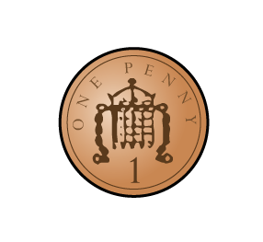

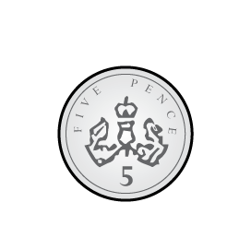
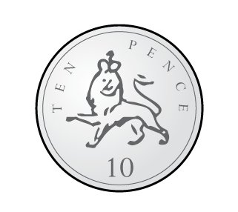
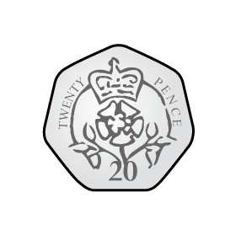
I have 24 p.
I divide it equally between 2 friends.
How much will they get each?
I have 24 p in 2 p coins.
How many 2 p coins do I have?
Consider the two questions above.
What is the same and what is different?

Slide 6
Tommy and Annie have some counters.
Tommy shares his counters into 2 equal groups.
He has 15 in each group.
Annie groups her counters in twos.
She has 19 groups.
Who has more counters and by how many?
How did you work it out?

Slide 7



Ron has shared some grapes equally between two friends.
Each friend receives fewer than 50 grapes.
Complete the sentences to describe the number of grapes Ron started with.
He must have started with…
He could have started with…
He can’t have started with…

Slide 8










True or false?
12 is an odd number.
Prove your answer using concrete, pictorial and abstract representations.
Explain each approach.

Slide 9


Tommy says that when he adds two odd numbers together, his total will be even.
Is he correct?
Convince me.
What else can you find out?

Slide 10

Whitney says,
What could Whitney’s numbers be?
Is this the only possible answer?
Which numbers would not be possible?
Explain your answers.
I have added two one-digit numbers. My answer divides into 2 equal groups.

Slide 11


A party bag contains 5 sweets.
A jar contains 5 party bags.
Ron has 75 sweets.
How many party bags will he need?
How many jars will he need?

Slide 12
Use the number cards to make multiplication and division sentences.
How many can you make?
2
20
5
10
4

Slide 13
Mrs Owen has some sweets.
She shares them equally between 10 tables.
How many sweets could each table have?
Find as many ways as you can.
What do you notice about your answers?

Slide 14
True or false?
Dividing by 10 is the same as dividing by 5 then dividing by 2

Slide 15



Cakes are sold in boxes of 10
Jack and Alex are trying to pack these cakes into boxes.
Who is correct? Explain how you know.
There are 5 groups of 10
There are 6 groups of 10
Jack
Alex

