Slide 1


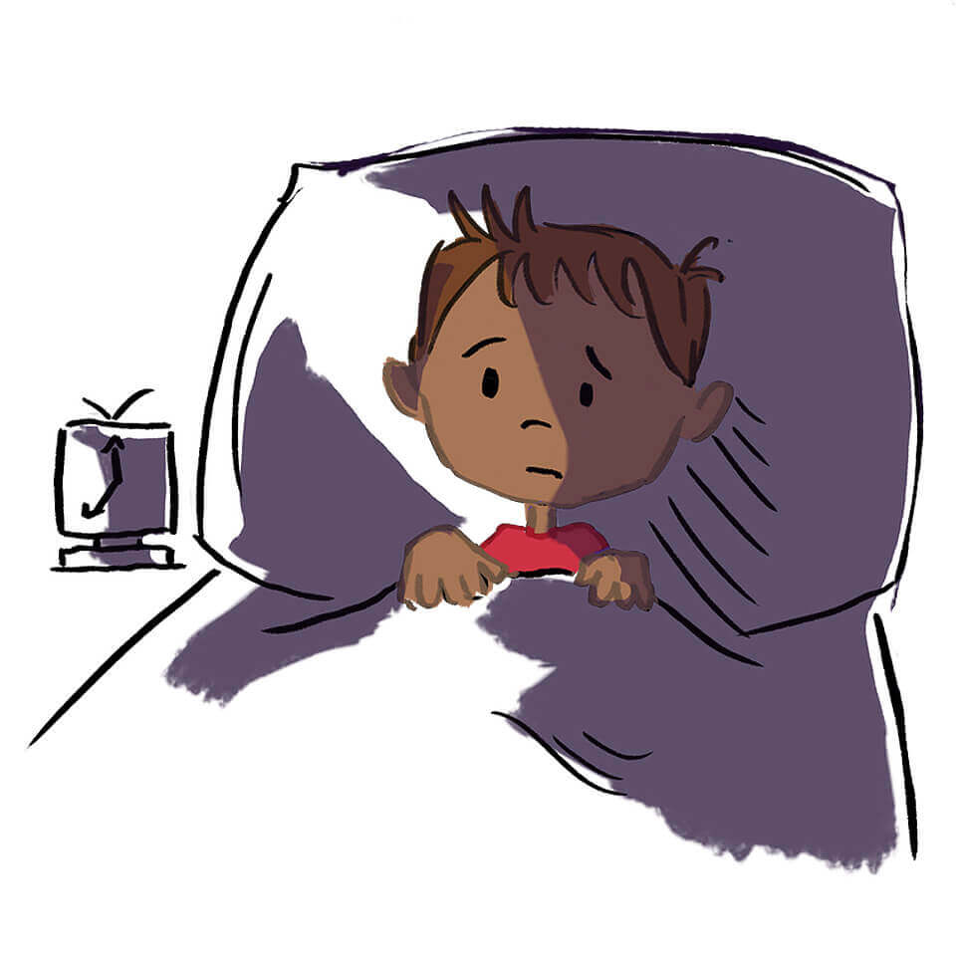

Improving Your Child’s Sleep
Mental Health Support Team

Slide 2

Session outline
Consider consequences of a lack of sleep.
To understand the science behind sleep.
To understand the factors that may promote sleep in children.
To understand how to create a sleep plan for your child.
Notes:
Sleep hygiene is the behavioural and environmental factors that are necessary for a quality night time sleep and full day time alertness

Slide 3
Session outline
Consider consequences of a lack of sleep.
To understand the science behind sleep.
To understand the factors that may promote sleep in children.
To understand how to create a sleep plan for your child.
Notes:
Sleep hygiene is the behavioural and environmental factors that are necessary for a quality night time sleep and full day time alertness

Slide 4

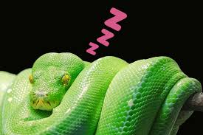
Fun facts about sleep
Otters hold hands when they are asleep to stop them from floating away.
Python needs up to 19 hours of sleep a day

Slide 5

Fun facts about sleep
Mariah Carey claims she needs 15 hours of sleep in order to perform.

Slide 6

Fun facts about sleep
Athletes and sports team hire sleep specialists to help with their performance. Even Rotherham football club has their own ‘sleep geek’.
Sleep geek
Notes:
This is James Wilson who has been hired by Rotherham united to ensure the team get the best sleep possible as a good nights slee has such a big impact on our ability to achieve- including in football.
James looks at temperature of the rooms they footballers are in and even encourages taking something that was been washed at home to an away game to keep in the hotel to make it more homely and encourage sleep.
James even looks at how the rest of the footballers family sleeps including their kids- as we know when a child doesn't sleep it has an impact on the whole family.

Slide 7

Sleeplessness in Children
Children's sleep problems are very common.
At some stage about 50% of children have a sleep problem considered to be significant by their parents.
About 4% of children have a formal sleep disorder diagnosis.
Children with a chronic physical illness like asthma or have a learning disability are those who are particularly prone to problems with sleep.
Notes:
When chronic, sleep difficulties can have effects on cognitive development, mood regulation, attention, behaviour and quality of life, not only of the child but the entire family.
There are a huge number of sleep issues and often more than one contributing factor. Common difficulties that families face are around: • Common difficulties that young people face with sleep include: • Finding it difficult to fall asleep at the start of the night • Frequent waking • Difficulty waking in the morning • Feeling tired during the daytime • Anxiety around sleep issue

Slide 8
Sheffield Healthy Minds sleep data
In Sheffield between October 2017 and April 2020, 15,875 primary students (across 84 schools) and 9,374 secondary school students (across 17 schools) completed an online questionnaire.
Results:
37% of primary school children and 32% of secondary school children reported that sleep difficulties were the biggest problem for them.
Notes:
We all have our own individual relationship with sleep. Sometimes our sleep will be affected by who is in the same house as us.
Our sleep can change and be affected by different things life- routine change or job change etc.

Slide 9
Possible effects of poor sleep
For the Parent:
Mental Health (e.g. stress and anxiety)
Poor health
Headaches
Poor parent-child relationship
For the Child:
Hyperactivity
Poor memory and cognitive ability (concentration)
Lowers immune system
Weight/growth issues
Ability to meet their full potential
Hormonal problems
Behavioural problems
Notes:
It should be noted that these difficulties that are caused by a lack of sleep are often temporary. Once sleep is improved, the problems often resolve themselves.
Irritability
Low mood
Arguments
Lack of concentration
Impaired cognitive functioning
Anxiety
Bad memory
Making mistakes
Lack of concentration
Lower attainment
Impacts on relationship
Research links obesity with lack of sleep
May eat more or lose their appetite
Sleep impacts several areas of our lives and development
Physical health conditions – destroys immune system, sugar levels, can block arteries
Mental health conditions – contributes to all major psychiatric conditions including depression, anxiety. Can also cause anxiety about how much you are sleeping
Concentration, learning – one hour less sleep over 3 nights can significantly reduce performance – 2 years of academic if continued.

Slide 10
“If you could manufacture a pill that could improve your cognitive function, that improved your emotional regulation, that stopped you reaching for the biscuit tin in the afternoon, you’d be a millionaire. That is what sleep can help you with. It’s free and available to us all.”
Catherine Hill, Consultant Paediatrician, Southampton Children’s Hospital
Notes:
Pupils who get the right amount of sleep are more likely to:
Be mentally alert and concentrate
Their brain functions better
The senses are sharpened
They can learn to their full potential
They are able to emotionally regulate themselves better and remain calmer
Sleep helps pupil’s bodies to develop by:
Sleep supports their immune system
Releases hormones that aid growth and helps tissues repair

Slide 11
How much sleep does a child need?
Age | Average number of hours needed at night | Average number of hours needed during day
12 months | 11 ½ | 2 ½
2 Years | 11 ¾ | 1 ¼
3 Years | 11 | 1
4 Years | 11 ½ | -
5 Years | 11 | -
6 Years | 10 ¾ | -
7 Years | 10 ½ | -
8 Years | 10 ¼ | -
9 Years | 10 | -
10 Years | 9 ¾ | -
Notes:
Most children between the ages of 5 and 12 get about 9.5 hours of sleep a night, however, the exact amount of sleep we need is individual to the child. Here is the general guidance on how much sleep is recommended depending on age:
Eg Your 9yr old needs 10hours sleep.
Therefore if they need to be up for school at 7am, they need to be asleep for 9pm.
This means that the sleep routine should have started before 8pm.

Slide 12
Age | Average number of hours needed at night | Average number of hours needed during day
11 Years | 9 ½ | -
12 Years | 9 ½ | -
13 Years | 9 ¼ | -
14 Years | 9 | -
15 Years | 8 ¾ | -
16 Years | 8 ½ | -
This information is a guide- we are all individual with the amount of sleep we need and children are the same. If you are unsure how much sleep you child needs a sleep diary can be useful.
Notes:
Research suggests that teenagers' body clocks are different to Adults and Children's. Meaning that teenagers are programmed to stay up later and struggle to get up in the morning. Because of this and the fact that teenagers still need to get up early to go to school most days, often they are not getting the 8-10 hours recommended for their age.

Slide 13
Session outline
Consider consequences of a lack of sleep.
To understand the science behind sleep.
To understand the factors that may promote sleep in children.
To understand how to create a sleep plan for your child.
Notes:
Sleep hygiene is the behavioural and environmental factors that are necessary for a quality night time sleep and full day time alertness

Slide 14
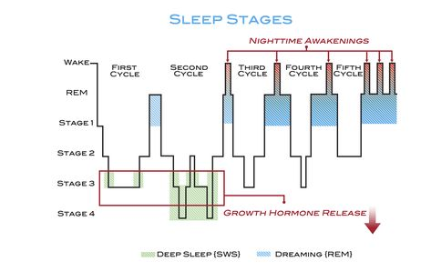
Stage 1 (N1)
A very light sleep where your child will be easily woken. If parents tip-toe out of their child’s room and they wake up it is because they were in a light sleep.
Stage 2 (N2)
Still a light sleep but the body is preparing for the deep sleep that is about to come. The child will be more relaxed. Now is a good time to sneak out of their room!
Stage 3 (N3)
This is a very deep sleep. The body needs this sleep so that repair can take place. The child is difficult to wake at this stage.
REM sleep
Increased heart rate and brain activity. Stage of sleep where we dream
Notes:
When we sleep we go through different levels of sleep. We also sleep in cycles- moving through these sleep stages. It is important that when we sleep we go through these stages as each stage has it’s own benefit to keeping us healthy and at our best the next day.
Stage 1: light sleep
Drifting in and out of sleep.
Easy to wake.
Stage 2:
Eye movements stop and brain activity slows down
Stage 3 and 4: deep sleep
No eye movement or muscle activity. Very difficult to wake someone.
REM Sleep
Increased heart rate and brain activity. This is the stage in which we dream. If woken during this stage people often remember their dreams.
Sleep cycle consists of Stage 1, 2, 3 and REM sleep
We get our deep sleep towards the beginning of the night, and lighter sleep in the early hours of the morning.
The amount of REM and non-REM sleep in a cycle changes throughout the night. Children have a lot of deep non-REM sleep in the first few hours after they fall asleep. That’s why children sleep so soundly in the first few hours after they’ve gone to bed and aren’t disturbed by anything. As the night goes on, children have more REM sleep and light non-REM sleep. This means they wake up much easier in the second half of the night.

Slide 15
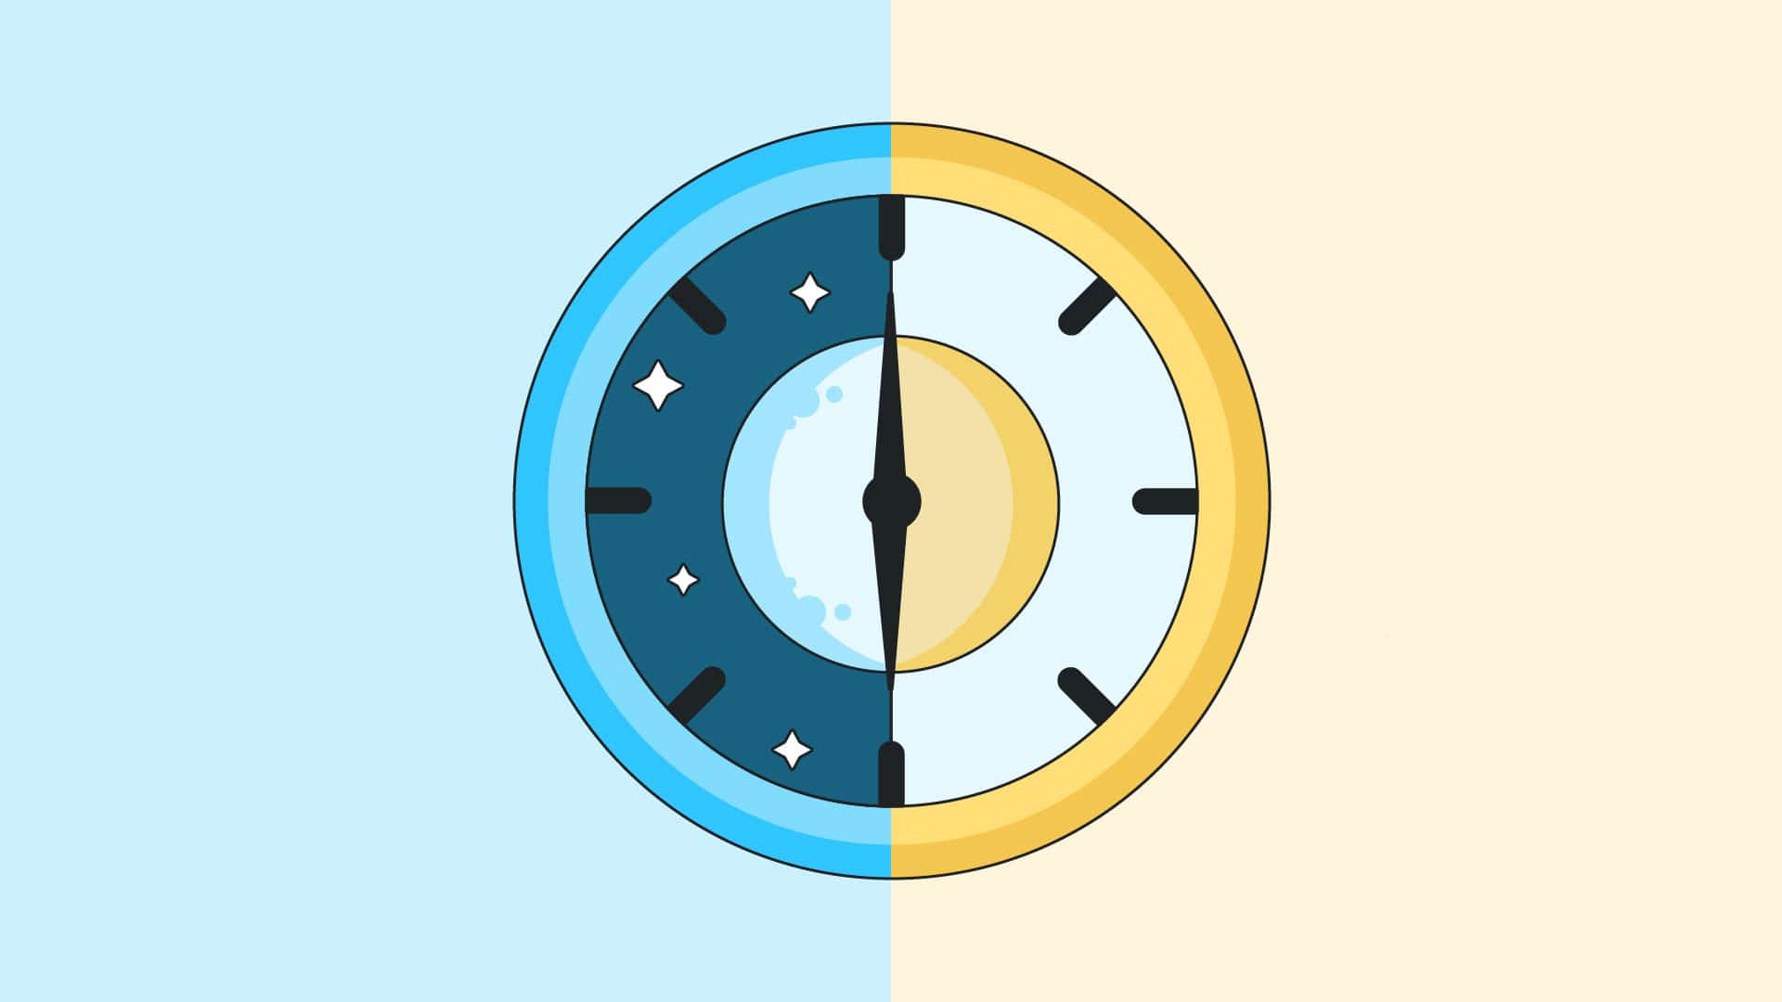
Sleep Regulation
Regulation of sleep and wakefulness:
Sleep Drive
Circadian Rhythms
Melatonin
Notes:
Sleep Drive - One process involves the normal accumulation of sleep debt as the day goes on (the more time that passes after an individual wakes up for the day the greater the sleep debt). This process is called the “sleep drive.”
Stated simply, the longer the time that has elapsed since an individual has last slept, the stronger the sleep drive becomes, and the easier it will be to fall asleep. In some ways the sleep drive is similar to hunger, and napping to snacking. Appetite may be ruined by snacking close to meal-time.
Circadian Rhythm - Your circadian rhythm is thought of as your internal body clock – it tells us when to be awake and when to be asleep. This internal clock moves between cycles of sleepiness and more awake periods at regular intervals throughout the 24 hour day.
Our circadian rhythm is helped along by changes from daylight to darkness and vice versa. When it is dark outside out bodies produce melatonin to help us sleep (called hormone of darkness).
Our circadian rhythm works best when we have regular sleep habits, like going to bed at night and waking up in the morning around the same time (including weekends). When things get in the way, like jet lag or a sleepless night, our rhythms can be disrupted and in turn make it harder to pay attention the next day.
Studies have shown that your natural circadian rhythm is 24hours and 7 mins – so sleep time will drift by 7 mins every day – emphasises importance of routine.
Bedtimes and wake up times can easily slip during the school holidays so it is important to slowly change the routine back in time for school to start again so children can get the most out of their return to school.

Slide 16
So what does the science mean practically?
The science behind sleep can help us getting the most out of sleep!
A consistent environment will help us stay asleep.
Consistent bedtimes and wake times will help our body clocks know when to be sleepy.
A dark environment will help us become sleepy and sleep.
Notes:
Sleep stages mean that we are sometimes very close to waking up throughout the night.
In the early childhood years, sleep cycles get longer as children get older. In children aged three years, sleep cycles are about 60 minutes. At around five years old, sleep cycles have matured to the adult length of roughly 90 minutes. At the end of each cycle, we reach a point where we are partially awake. When this happens, if everything is as it was when we went to sleep it is likely we will continue to sleep. However, if anything has changed, like when a child’s environment has change by being moved from a car seat to bed, it is likely that we will wake up.

Slide 17
Session outline
Consider consequences of a lack of sleep.
To understand the science behind sleep.
To understand the factors that may promote sleep in children.
To understand how to create a sleep plan for your child.
Notes:
Sleep hygiene is the behavioural and environmental factors that are necessary for a quality night time sleep and full day time alertness

Slide 18

Overcoming common sleep issues for children and young people
Bedroom Routines
Hunger / Thirst
Bedroom Environment
Worrying / anxiety

Slide 19
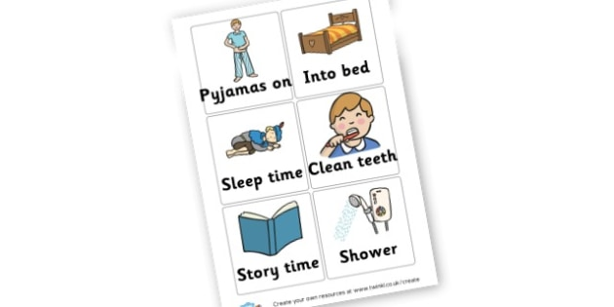
Overcoming Common Sleep Issues: Bedtime Routines
Can have great benefits once established
Be consistent
Be predictable
Plan them in advance
Notes:
Importance of Routines
Wind down time is really important for sleeping well
Routines are really important for setting up helpful sleep associations, and the hour before we go to bed is the most important hour for setting up high quality sleep.
Can have great benefits once established - When everyone in the house is exhausted because one child isn’t sleeping- it can be really tempting to choose the easy option-let them fall asleep on the sofa or in you bed and move them later. Try to avoid this- investing in a good predictable bedtime routine will be worth it in the end.
• A regular routine in the evening will help to support a young person’s circadian rhythm – studies have shown that the circadian rhythm will naturally shift by 7 mins every day so maintaining regular sleep wake time is important, even at weekends to prevent this movement in our circadian rhythm and keep regular sleep cycle
• A routine can help your mind and body prepare for sleep, increasing melatonin production.
Be Consistent - When beginning a bedtime routine it is important to use it daily until it is well established – yes, even at weekends!! It is important that the bedtime routine is used consistently by everyone caring for the children around bedtime. Plan for same bed time and wake up time – even if it means they get less sleep overall.
Bedtime should be predictable and follow the same routine each day, such as bath then brush teeth before a story and bed. Children find routines comforting and safe – they know what to expect and what is expected of them.
Plan them in advance – make child aware of what their routine is going to look like. Some children may like the routine displayed in a poster.. Involve them in creating it, making it look nice. plan other activities such as meals in so that they happen around the same time.

Slide 20
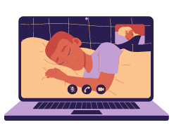
What does a good routine look like?
Needs to start one hour before bed
No screen time
Dim lighting in the hour before bed
Light bed time snacks
Relaxing Activities
Bath / shower
Quick and boring good night / check ins
Notes:
Aim to reduce hyperarousal before bed.
Sleep diaries with naps, sleep and wake times might be useful to track patterns of difficulties if sleep seems inconsistent.
Evidence that a warm bath helps increase melatonin production
One hour before bed - Work out what your child’s average time is to fall asleep and start the routine one hour before. However, if your child is never sleepy at the planned bedtime, try a temporary delay of bedtime by 15-30 minutes until they are sleepy. This should mean that they fall asleep quickly when they get into bed. This bedtime can then gradually become earlier until the original bedtime time is reached.
• Avoid screen activities as these are a light source and will keep your child awake. The blue light suppresses the production of the hormone, melatonin, which makes them feel sleepy. This includes TVs, phones and gaming devices. Might be tempted to use nightmode – try and avoid this too.
• Dim the lights to increase that melatonin production
• Consider a bath, this raises body temperature which will then gradually decrease aiding feelings of sleepiness. However if a bath is something that excites your child and makes them hyper aroused, may not be the best thing to do.
• Plan in a supper time snack of sleepy food – avoid sugar like biscuits or hot chocolates. The best snacks to aid sleep are things like low sugar cereal with milk, yoghurt or cheese and crackers. Will talk more about this later.
Plan relaxing activities like listening to calming music, craft type activities. Story time is also an effective way to calm down, spend quality time together and promote learning. Or Activities that use fine motor skills like colouring or drawing, jigsaws. Avoid homework. Mindfulness activities can be helpful. Could begin a journal, writing down one positive thing that has happened each day. Do the same thing at the same time every night. Might be tempted to get child to exercise before bed to tire them out - Regular exercise during the day often helps with sleep, but not too close to bed.
Quick and boring check ins throughout the night if you need to check on your child. The purpose of these checks is to make your child feel safe, try to avoid conversations or games that may be more interesting than being asleep. When putting them to sleep, do the same thing every night… tuck them in, kiss them on the head, tell them good night and you will see them in the morning. Exit swiftly.
Sleep diaries can help us understand is anything is happening in the day or leading up to bedtime that is effecting children's sleep.

Slide 21
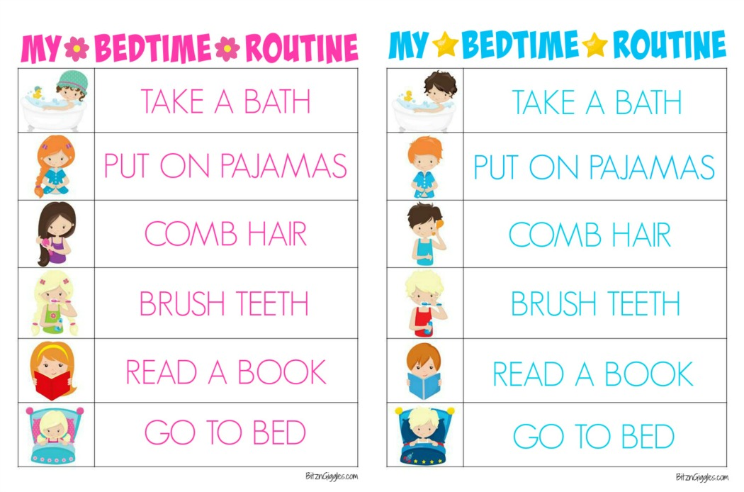
Bedtime routine Example
  It should be simple, easy to understand and achievable.
  7.00pm No screens, dim the lights, light snack
  7.10pm Colouring in or jewellery making in kitchen
  7.30pm Bath
  7.50pm Book in bed
  8.00pm Lights out
Notes:
Starts 1 hour before bed
In bed ten mins before lights out

Slide 22

Bedtime routines and weekends/holidays
  Bedtimes should be as consistent throughout the week as possible- including at weekends.
  During the school holidays bedtimes can slip- top tip around this is to make sure that you bring back the bedtime to where they need to be before school restarts.

Slide 23

Overcoming Common Sleep Issues:
Hunger / Thirst
Hunger or thirst can stop us from getting sleep-as can being too full!
It is important to make sure your child is hydrated throughout the day to ensure they are not thirsty at night.
Equally some food should be avoided before bed as they can affect our sleep:
Avoiding caffeine in drinks and snacks (like cola and chocolate)
Avoid sugary snacks
Notes:
What we eat during the day impacts on sleep during the night. Avoid sugary snacks and anything containing caffeine.
Thirst- being dehydrated before bed can lead to leg cramps and less quality sleep. However, having lots of water before bed can lead to multiple bathroom trips- the key is to make sure your child has enough water throughout the day to keep them hydrated.
· Avoiding caffeine in drinks and snacks (like cola and chocolate) in the evening as they can keep children awake. Caffeine can also make sleep shallow and make children wake up throughout the night.

Slide 24

Sleepy snacks
Below is a list of foods that research has found to help us sleep:
Almonds
Bananas
Dairy
Oatmeal
Cherries
Cereal
It’s a myth that cheese will give you nightmares and keep you awake.
Notes:
Almonds: Contain magnesium which promote both sleep and muscle relaxation. They also help to keep blood sugar levels stable overnight.
Bananas: Are an excellent source of magnesium and potassium. They also contain tryptophan (an amino acid) that helps us to sleep.
Dairy: Also contain tryptophan helping us to nod of more easily. Calcium is effective in stress reduction. E.g. yoghurt
Oatmeal: Makes an excellent supper time choice, it’s cheap and easy to prepare and has sleep inducing qualities. It is rich in calcium, magnesium, phosphorus silicon and potassium, all of which help to promote better sleep.
Cherries: Have been found to naturally boost melatonin production and has been proven to aid sleep.
Cereal: Contains complex carbohydrates which increase the availability of tryptophan in the bloodstream. Avoid sugar-coated cereals as these may induce a sugar rush.

Slide 25
Overcoming Common Sleep Issues:
A sleep-friendly bedroom environment
A sleep friendly bedroom will be:
A bed that is just for sleeping (not for laptops or gaming)
Limit electronics
Dark
Quiet
Tidy
Temperature
Free of distractions
Comfortable – bedding, ventilation, decoration
Notes:
Try and make their bed a space just for sleeping. Free of distractions. Avoid homework, playing games or talking on the phone to happen on the bed. This will help train the body to associate the bed with sleep. If their bedroom is also a play area, could this be sectioned off?
· Research shows that children with a TV in their room sleep less. If there is a TV in your child’s room, make sure it’s turned off when it’s time to sleep. Try to keep your child’s bedroom a screen-free zone and avoid screens for an hour before bedtime. Encourage tablets and phones to charge in a different room overnight. To avoid children checking on them throughout the night.
· The ideal sleep friendly bedroom is dark, quiet and tidy to encourage a safe and calm environment to sleep in. Light helps us know when to sleep and when to be awake. Bedrooms should be dark when it is bedtime. Even the light from a TV or computer screen can make it harder to fall asleep. A nightlight is okay as long as it is dim and should also be left on all night. Any changes to the environment can mean the child wakes up during their sleep cycle and is unable to get back to sleep.
Dark, quiet and tidy - • Quiet – white noise can be helpful to mask out background noise but needs to be left on all night, some people like the whirring of a fan for example, others prefer ear plugs. Are there any noises that might scare your child? • Dark (or has consistent lighting levels if you prefer a nightlight on) - blackout blinds can help particularly in the summer months or some people prefer to use an eye mask. • Tidy-ish – clutter can cause your child to worry or think about things that we need to do. Look out for objects that could potentially be misinterpreted as scary e.g. dressing gown on back of door, could this look like a monster? Is there anything that could scare your child?
A room at the wrong temperature can shift your circadian rhythm, around 18 degrees is ideal. Temperatures over 24 degrees are likely to cause
restlessness, while a cold room will make it difficult to drop off. Check the temperature of your child’s room. - If you find you are warm, open the window to cool the room in the run up to bedtime. Think about what they are wearing and their bedding. Some fabrics can trap heat. Physical activity increases body temperature. This means you need to think about the timing of their exercise routine.
Free of distractions – ideally no phone at night-time, move revision away from the bed. If a young person watches the clock, turn the clock face away, checking the time can increase anxiety.
• Comfortable – think about the bed, pillows, bedding. Lay in your child’s bed – check if it is comfortable.
• Decorated in neutral colours – bright colours can be over stimulating whereas muted, calm shades have a more calming feel to them
• Well ventilated – opening the windows each day and letting some fresh air in can be helpful.

Slide 26
Overcoming Common Sleep Issues:
Worry and Anxiety
Often children can be kept awake at night due to worrying thoughts or not being able to relax. Parents can help with this by:
Being warm and empathetic
Try comforting objects
Massage / wrapping
Introduce worry time
Journaling
Relaxation techniques – loads on YouTube
Notes:
Make parents aware that this depends on age.
Anxiety impacts on sleep and sleep deprivation can increase anxiety levels, it is a complex relationship! Young people may become anxious about their sleep patterns which can make it even more difficult to fall to sleep. Might worry about the day ahead and how lack of sleep is going to negatively impact.
Warm and empathetic – Making time to share any worries or concerns they have is important Listen and take time to understand their worries. Acknowledge that you understand.
Comforting objects at bedtime can be reassuring to younger children to help them feel safe and secure in bed if they have trouble getting to sleep due to bad thoughts or worries.
Massage / wrapping - e.g – wrapping /holding in bath towel or blanket for nurture.
Introduce Worry time as a way to plan specific time into the day to discuss your child’s worries that may be keeping them up at night. Worry time is a good way to plan specific time into the day to discuss your child’s worries that may be keeping them up at night. You can plan in worry time once a day. If your child tries to talk about these worries throughout the day, try and remind them that they will have an opportunity to talk this with you at the time you agreed on. They could write down their thought and save it for later if they think they may forget. Try and do worry time well before bedtime so that the worries they have discussed aren’t fresh in their mind before they try to sleep.
Journaling – older children - They may find completing their journal a helpful way of documenting thoughts
Relaxation techniques can help a child relax before bed. Doing the same relaxing things in the same order and at the same time each night helps promote good sleep. Some good examples of relaxation techniques include:
* A warm (not hot) bath will help your child relax and get ready for sleep.
* Once they're in bed, encourage your child to read quietly or listen to some relaxing music, or read a story together.
* Breathing exercises are also useful. There are plenty of these online.
* Mindfulness – grounding in the moment Notice 5 things you can
See
Hear
Feel
Right now.
* Thinking of a beautiful calm place like a beach and describing what they imagine is a good relaxation technique.
Planning in relaxation time is important, their journal will help with this • Spending time considering what they find relaxing can be helpful and choosing some activities to try

Slide 27
What if my child won’t go to sleep without me?
Sometimes children can become dependant on a parent being there to get to sleep.
Try and reduce this in a step by step transition.
Bedtime should be boring and check-ins should be boring.
‘it is time for bed’ can help with boundaries, discouraging play.
Notes:
Changing things step by step…
Bedtime should be boring without check ins, but if you find you need to go in, this is how you can slowly reduce it.
Slow retreat- Parent/Carer remains inside the child’s bedroom on a chair / cushion (out of touching distance) until the child is asleep. Once settling with no intervention move the chair every 3 days.
Rapid return- Parent/Carer remains outside child’s bedroom and re-enters as soon as they get out of bed. Putting them back into bed, repeating the sleepy phrase before leaving again.

Slide 28
Session outline
Consider consequences of a lack of sleep.
To understand the science behind sleep.
To understand the factors that may promote sleep in children.
To understand how to create a sleep plan for your child.
Notes:
Sleep hygiene is the behavioural and environmental factors that are necessary for a quality night time sleep and full day time alertness

Slide 29
Creating your own Sleep Plan
How much sleep does your child need?
What time does your child need to wake up in a morning? Work backwards to determine the time that your child should be going to sleep.
Choose a strategy that will work for you and your family.
Consider if there are any other changes you would like to make e.g. introduction of nightlight / blackout curtains etc.
Decide when you will start using your plan.
Consider keeping a sleep diary to identify things that make it more difficult / easier for your child to get to sleep.

Slide 30
Sleep diaries can help
Notes:
https://sleepcouncil.org.uk/wp-content/uploads/Sleep-Council-Sleep-Diary-Interactive.pdf
Plenty online- can find one which suits you. Main thing to record what happens hour before bed, how much sleep they get and the mood when they wake up. This can help track anything that might be interrupting sleep and help us realise how much sleep our child needs to feel refreshed in the morning.

Slide 31

Things to remember….
Consistency throughout the week including weekends.
It can take several weeks for a child to learn a new routine and behaviour. It can be easy to fall into bad habits so the whole house sleep, but putting in the work around sleep routines will pay off.
Behaviour may become more difficult at first and there may be knock backs.
Keep positive and use lots of praise and encouragement.
Not all strategies will work for every child.

Slide 32
Seeking additional support
We would recommend seeking support from your GP if:
Your child has had sleep difficulties for a long period of time and you have tried strategies around sleep and they are not helping.
Your child's sleep is affecting their daily life in a way which makes if difficult for them to manage.
You are concerned about their daily wellbeing and health due to their sleep difficulties.

Slide 33

Questions or comments

