Slide 1
ANXIETY PARENT WORKSHOP
Mental Health Support Team

Slide 2
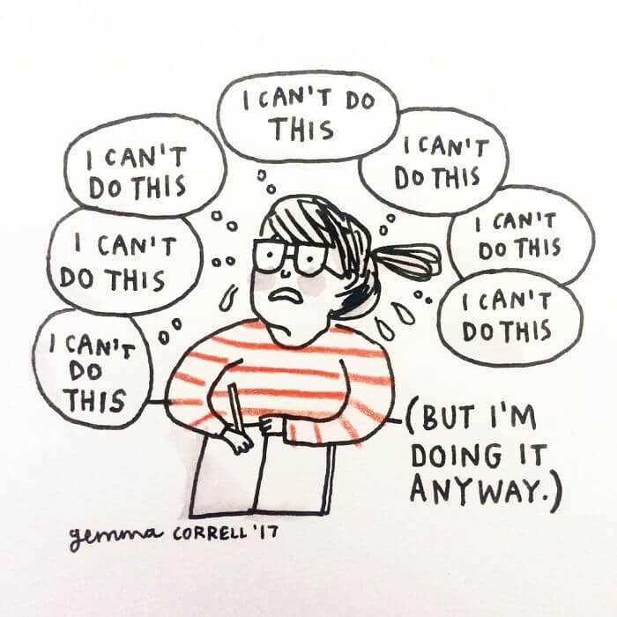
What is Anxiety?
Anxiety is a normal reaction we all experience
Part of our brain tells us to Fight, Flight or Freeze when faced with a threatening situation
Common situations can cause anxiety
There are several aspects of anxiety and it affects our: thoughts; feelings (both our emotions and feelings in our body); and behaviour.
When does anxiety become a problem?
Notes:
Anxiety is a normal, human feeling of fear or panic. When we become anxious, we typically expect something bad is going to happen.
Theory around anxiety explains that when we are faced with stressful or threatening situations our bodies automatic systems go off- this is a survival mechanism. As a response to the threat we go into fight, flight or freeze mode. This dates back to cavemen who would often be faced with life threatening situations and needed their instincts to kick in for survival. Common situations can cause us anxiety like exams.
Anxiety affects our body- through our ‘alarm system’ for example- when anxious our heart might beat fast to pump blood to our muscles to fight or run.
Anxiety also affects our thoughts- often people have ‘what if thoughts’, ‘what if I get shouted at’ ‘what if I get the question wrong’ often fearing the outcome.
Anxiety also affects our behaviours. Sometimes people have coping strategies that help them in the short term situation. For example, they might avoid the situation or ask for reassurance which will help them there and then. However, if they show these behaviours over a longer time they become unhelpful and in fact keep the anxiety cycle going.
Anxiety is common and helpful in situations where we are threatened. Anxiety is thought of as a problem when our fight/flight/freeze response is activated when there is no real danger and when this response starts to affect our day to day lives and functioning.

Slide 3
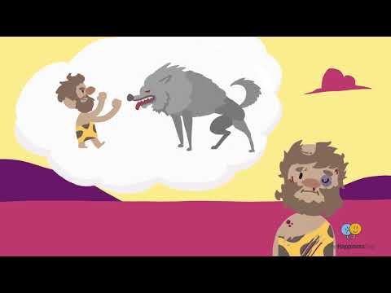
Fight Flight Freeze video
Notes:
http://www.youtube.com/watch?v=kv6HkipQcfA

Slide 4
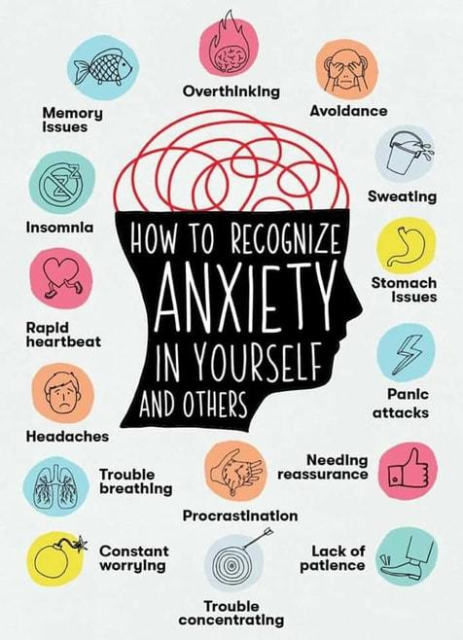
What might anxiety look like?
Notes:
Worries, fears and anxiety all involve an expectation that something bad is going to happen. This leads to a body reaction and us exhibiting specific behaviours.
Moody, irritable, angry
Feeling overwhelmed
Struggle to concentrate
Poor judgement
Seeing only the negative
Lashing out, feeling backed into a corner
Avoiding situations
Withdrawing from others
Loneliness and isolation
Memory problems
Trouble sleeping
low appetite
Cries often

Slide 5
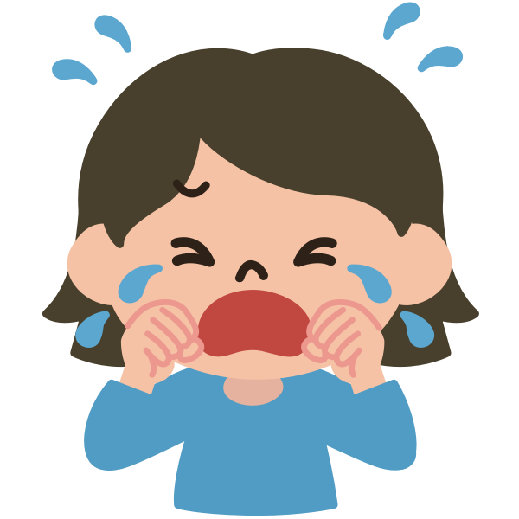
Discussion- how do you know when your child is feeling anxious?
Notes:
What behaviours/emotions do you see in your child when they are anxious?

Slide 6
What do children need to learn about anxiety?
If we face a situations that makes us anxious, the likelihood is that it will not end badly like we expect.
Even if the outcome isn’t ideal, we need to learn that we can handle problems.
Facing our fears and anxiety is the best way to stop anxiety from keeping going.
We can break this down into smaller steps if needed.

Slide 7
How can you help when your child is anxious?
Normalise feeling anxious. It is a common emotion.
Encourage being brave and having a go.
Support them in calming down if needed- breathing exercises are useful for this.
Use a worry tree.

Slide 8
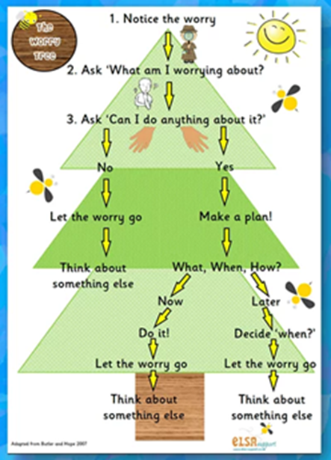
Supporting children with worry thoughts with worry thoughts
Notes:
Using a worry tree- example

Slide 9
How can you help when your child is anxious?
Support them to keep up with their general emotional wellbeing by:
Supporting sleep
Encouraging regular exercise
Stay connected with others
Do activities they enjoy
Keep a healthy diet
Provide structure where possible

Slide 10
Thinking about emotional wellbeing as a stress bucket
Everyone gets anxious in some situations like in exams. However, some people can become anxious more frequently.
Anxiety can also happen due to a build up of smaller stressful events/experiences.
The higher our stress, the more anxious we are likely to feel.

Slide 11
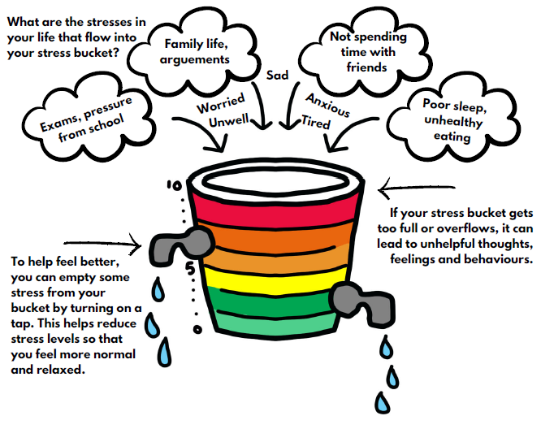
Stress bucket
Notes:
When considering our children’s or our own emotional wellbeing at home a helpful analogy to think about can be the stress bucket.
The stress bucket helps us to understand that over time our ‘bucket’ can get filled up with various things. It is also useful to think about how we can recognise if our stress bucket is filling up.
If our stress bucket gets too full or overflows it can lead to unhelpful thoughts, feelings and behaviours.
Sometimes we need to open the tap on the stress bucket and let some things out to make us feel calmer, safer and less anxious.

Slide 12
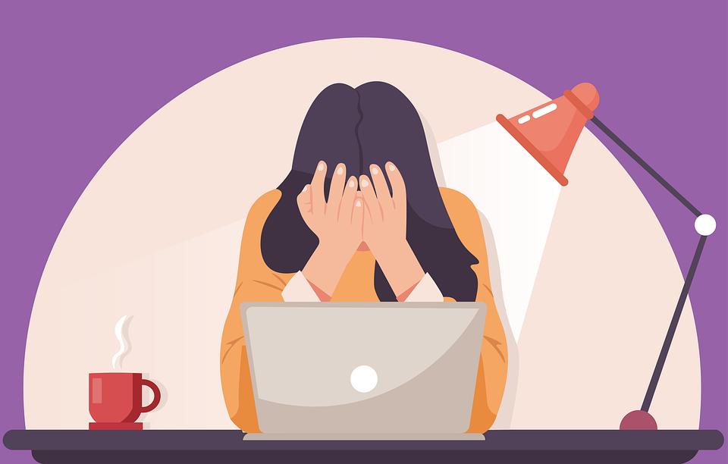
Discussion- what situations can fill up your child’s or your own stress bucket?
Notes:
What behaviours/emotions do you see in your child when they are anxious?

Slide 13
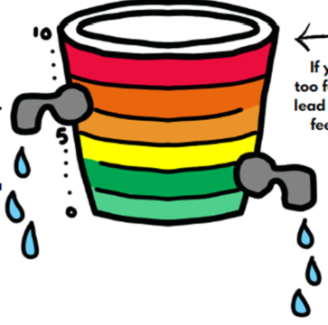
We need to do activities that open the taps of our stress/anxiety bucket. Allowing stress to reduced.
Notes:
Thinking about some of the stuff we just discussed what ‘taps’, ideas or strategies are going to be important for the individual you had in mind, to ensure that their stress bucket doesn’t over flow?
Some good activities to lower the level on our stress buckets include:
Self-care like a nice bath
Watch a film with the family
Listen to music
Go for a walk
Make healthy snacks
Have a good sleep routine

Slide 14

Discussion- what activities reduce your child's or your own stress?
Notes:
What behaviours/emotions do you see in your child when they are anxious?

Slide 15
Re-cap of strategies to support anxious children
Breathing techniques
Calming techniques
Use a worry tree
Structure (throughout the day and bedtime routine)
Doing things we enjoy more often
Exercise and keeping active
Relaxation techniques
Mindfulness activities
Talk to our friends and families
Keeping a healthy diet
Break down anxious activities into smaller steps
Plan in enjoyable/stress reducing activities throughout the week

Slide 16
Places to look for more info
Healthy Minds Sheffield –
https://www.sheffieldchildrens.nhs.uk/services/camhs/healthy-minds/
Young minds – https://youngminds.org.uk/find-help/for-parents/parents-survival-guide/
We heart CBT –
https://weheartcbt.com/for-parents
NHS website: https://www.nhs.uk/mental-health/children-and-young-adults/advice-for-parents/anxiety-in-children/
Epic friends: https://epicfriends.co.uk/issues/anxiety/

Slide 17

Questions?

