Slide 1
Parents’ Meeting
Introduction to Read Write Inc.

Slide 2
Reading changes everything
Teach a child to read and keep that child reading and we will change everything.
And I mean everything.
Jeanette Winterson
We want to help you understand how your child is learning to read with phonics – specifically ‘Read Write Inc.’ Phonics

Slide 3
Read Write Inc. Phonics
Children learning to read in FS – Y2
Taught in groups based on their stage of reading

Slide 4
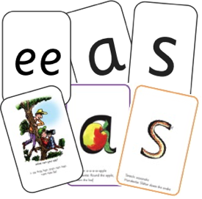
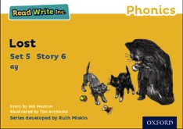


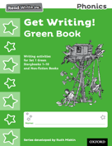

Read Write Inc. Phonics daily lessons
Children practice reading and spelling words containing these sounds.
We teach sounds.
Then we give children decodable books containing sounds and words they can read.
They read each Storybook three times at school and again with you at home.
On each reading, children’s fluency increases and the more they can focus on what the story is about.
Children also learn to spell the words they have been reading and develop their ideas into sentences so that they can write about the Storybooks they read.
They also bring home a RWI Book Bag Book which links to what they have been practicing in class that week.

Slide 5





Read Write Inc. Phonics daily lessons
Alongside this we read stories to children: stories they cannot yet read for themselves
Our aim is for children to finish the RWI Phonics programme so they can start reading these books for themselves.

Slide 6
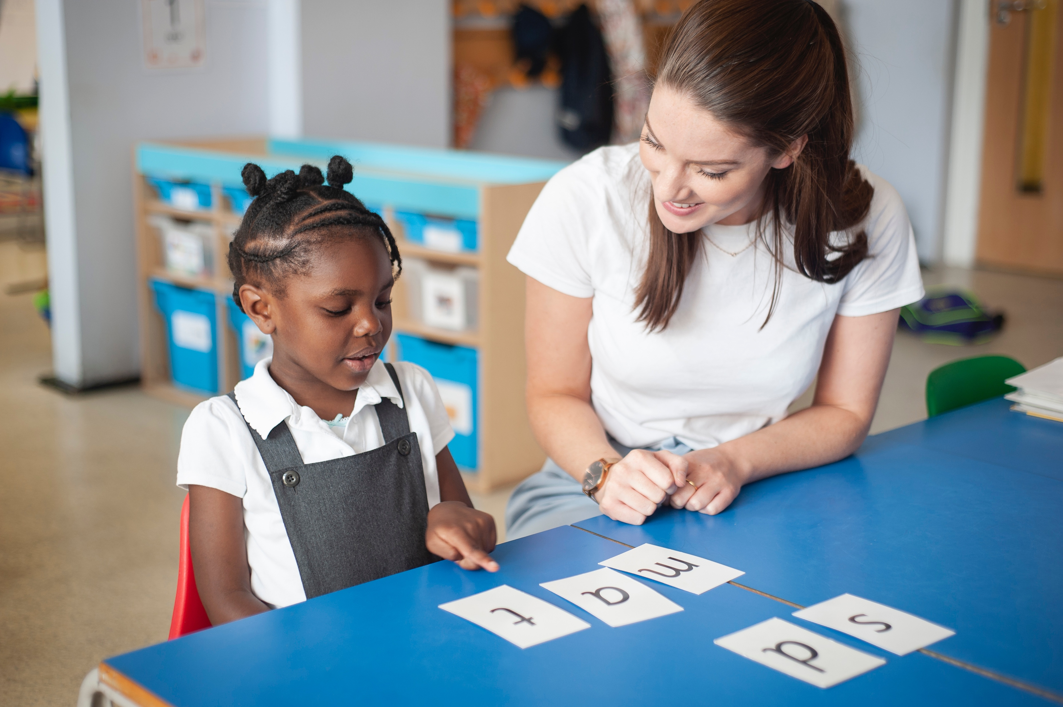
One-to-one tutoring – ‘keep up, not catch up!’
We want to make sure every child learns to read in our school.
Some children need extra practice when learning to read so we teach these children one-to-one or in smaller groups as an intervention– on top of their group lesson.
We make sure they ‘keep up’ from the beginning and don’t need ‘catch up’ later on.

Slide 7
What is phonics?
Sounds –
All words are made up of individual sounds. These sounds are merged together to form words.
e.g. in ‘mat’ we have the sounds ‘m’, ‘a’, ‘t’,
ship – ‘sh’, ‘i’, ‘p’.
Graphemes
A grapheme is another name for the letters we use to write the sound. The spelling of that sound on the page.
The National Curriculum ensures that all children are taught Phonics systematically.
This gives your children the tools to read any word.

Slide 8
English alphabetic code
We use 44 sounds to make all the words in the English language.
This means we’ve got a problem!
We’ve got 44 sounds and only 26 letters.
The 26 letters work singly, in pairs and sometimes in threes to represent one sound.
We have to group letters together to write some sounds
e.g. ‘igh’, ‘air’.
In English we have more than 150 ways to represent 44 sounds, using the 26 letters in the alphabet.
This makes our language one of the most complex in the world!

Slide 9
Speed Sounds Set 1 and Set 2
Using RWI, we make learning to read easy for children because we start by teaching them just one way of reading and writing every sound. Here they are on the Simple Speed Sounds chart we use in class.
We teach Set 1 sounds first - (sounds as far as a e i o u).
Children need to know sounds – not letter names – to read words.

Slide 10
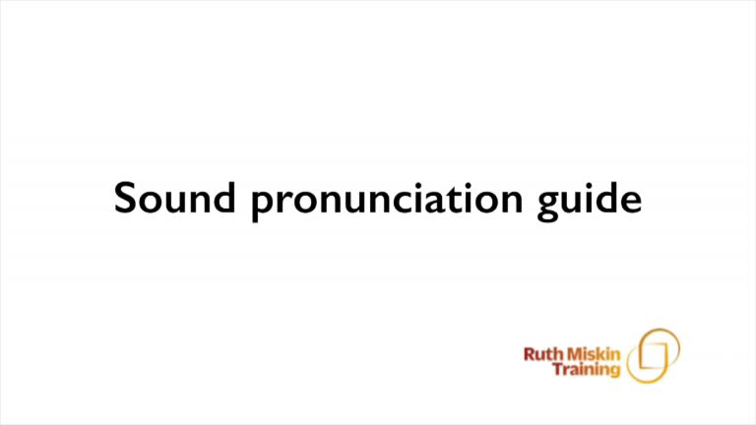
Pure Sounds (ruthmiskin.com)
Notes:
We teach using pure sounds.
We pronounce the sounds clearly, using pure sounds (‘m’ not’ muh’, ’s’ not ‘suh’, etc.) so that your child will be able to blend the sounds together to make words more easily.
You can watch this film of little Sylvie on the Ruth Miskin website to practise using pure sounds. Play a little bit of the video.

Slide 11
Speed Sounds Set 3
Once children know one way of reading and writing every sound, they start to learn spellings for each sound they already know.
For example, they know ‘ay’ and now learn a-e and ai as other spellings for the same sound.

Slide 12
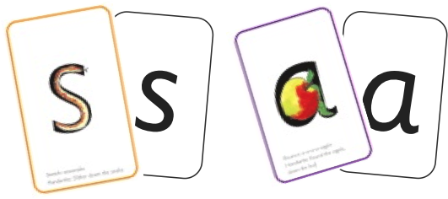
Sounds + blending = reading
Alongside teaching children sounds, we teach them to blend sounds to read words e.g. s-a-t, sat.
We use Fred Talk to help children read.
+

Slide 13
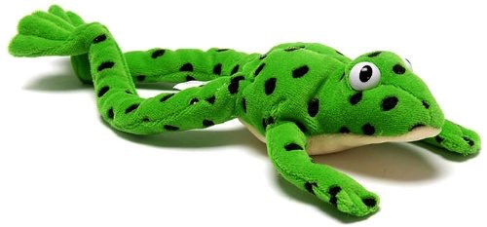
Fred
Fred can only speak in sounds. He says d-o-g, h-a-t etc.
Speaking like Fred helps children to understand that words are made up of sounds.
Fred helps children practice blending sounds together because he needs the children to say the words for him. Fred says d-o-g, children tell him the word is dog.
This is how we quickly teach all of our children to blend.

Slide 14
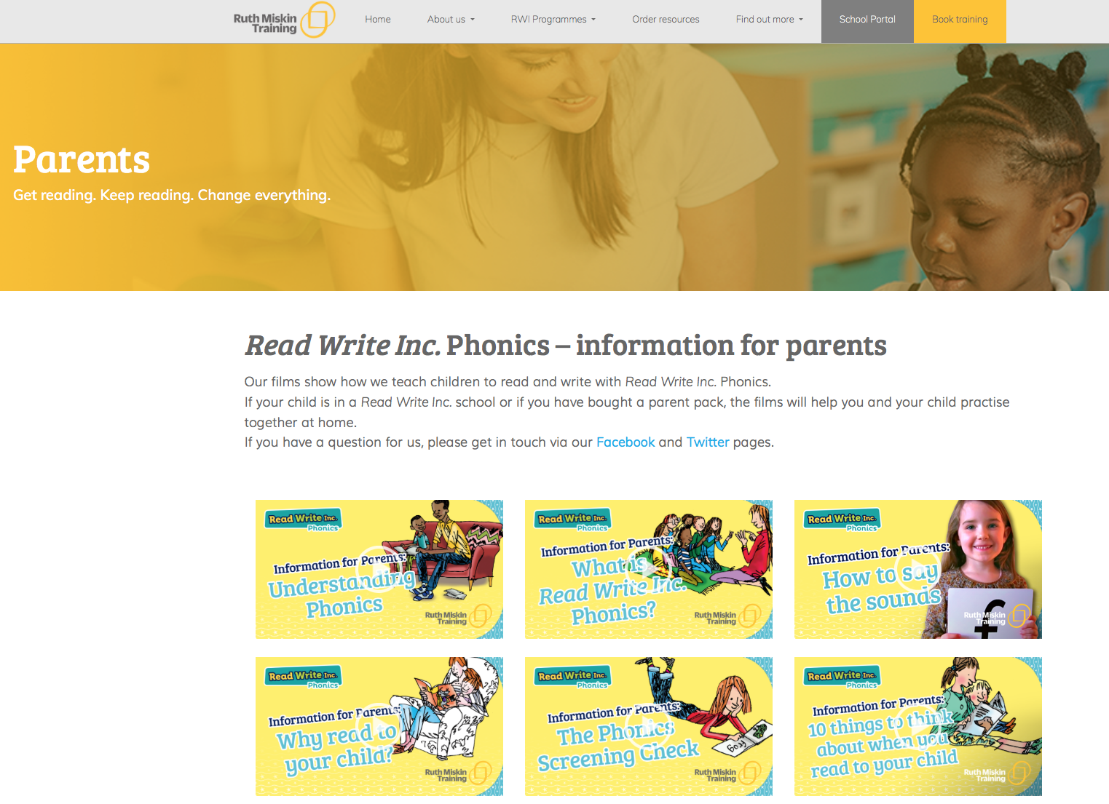
Free Video Tutorials (ruthmiskin.com)
Notes:
Watch video tutorials on the Ruth Miskin website to help you to understand more about Phonics, Read Write Inc. and how to practise reading and writing with your child at home.

Slide 15
What can I do?
Use pure sounds, not letter names
Use Fred Talk to read and spell words
Listen to your child read their RWI Book Bag Book every day
Read ‘Reading for Pleasure’ stories to your child every day

Slide 16
Online resources available
Ruth Miskin Parents’ Page:
http://www.ruthmiskin.com/en/parents/
Ruth Miskin Facebook:
https://www.facebook.com/miskin.education
Free e-books for home reading:
http://www.oxfordowl.co.uk/Reading/

Slide 17
Reading feeds the imagination, it expands
horizons and offers new and exciting ways of
seeing and making sense of our lives and of
the world around us.
Michael Morpurgo

