Slide 1
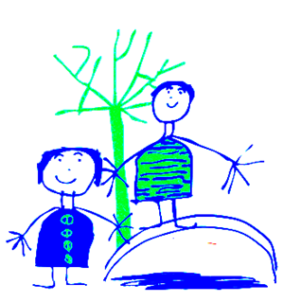

Dobcroft Infant School
SEN Coffee Morning
https://www.attwoodandgarnettevents.com/blogs/news/preparing-for-christmas-with-autistic-children-a-guide-for-families
Chris Packham clip

Slide 2
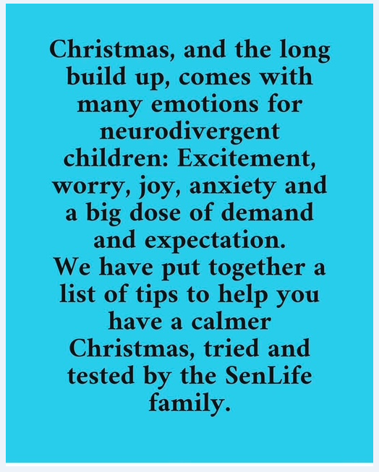


Slide 3
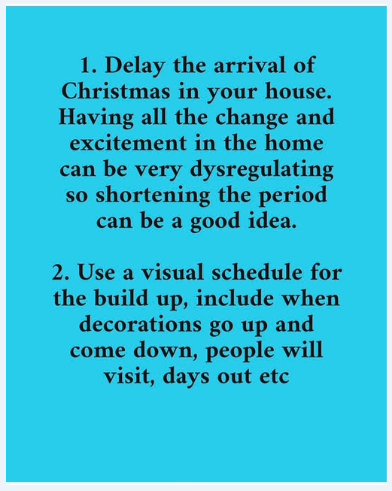
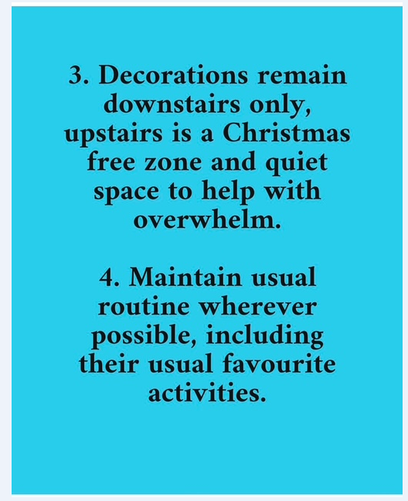

Slide 4
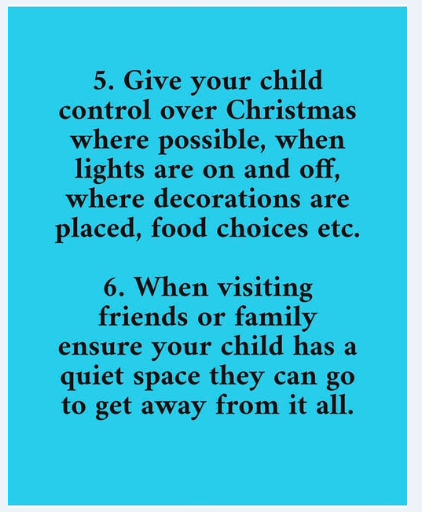
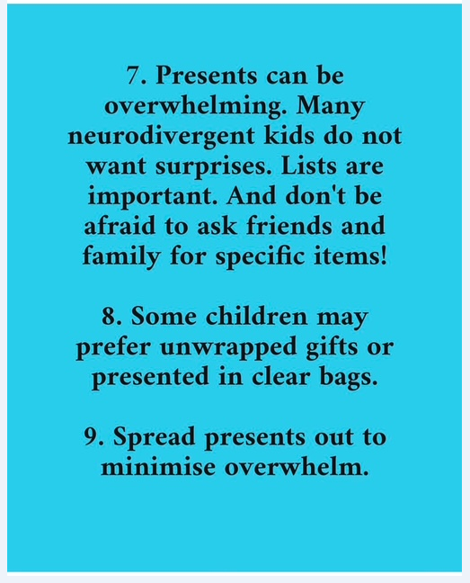

Slide 5
