Slide 1
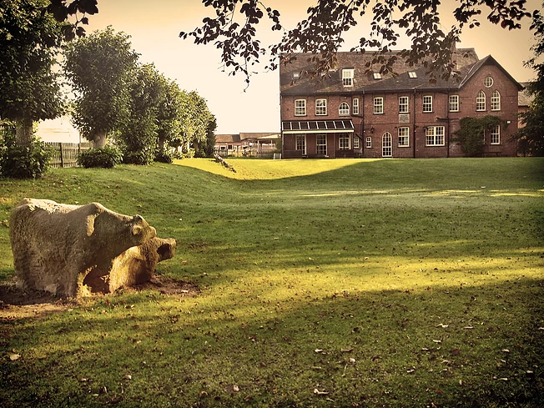
Year 6 residential 2017
Monday 15th May to Friday 19th May

Slide 2
Standon Bowers
http://www.entrustoutdoors.co.uk/standon-bowers

Slide 3




Explore and Inspire

Slide 4
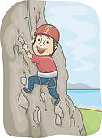

Activities

Slide 5
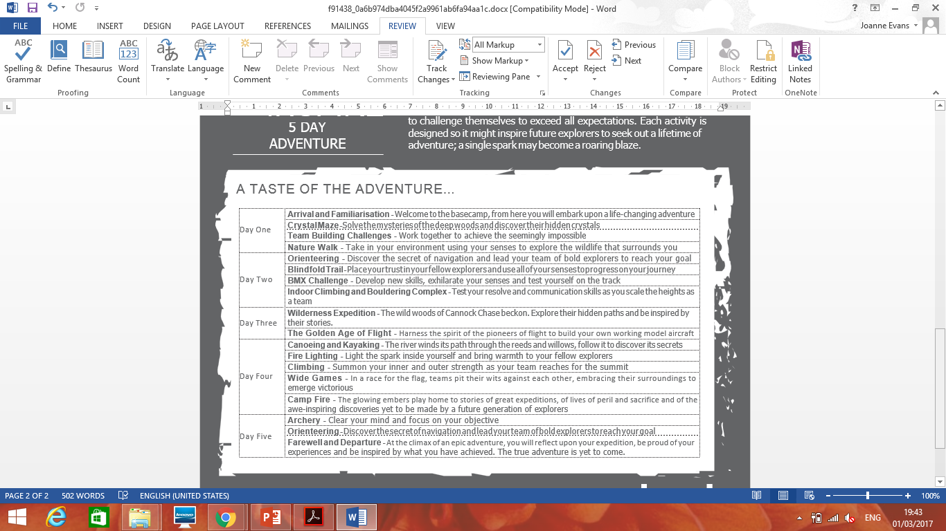

Slide 6
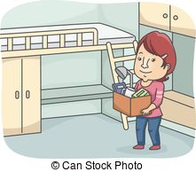
Accommodation

Slide 7
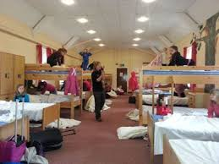
The children sleep in separate dormitories for boys and girls. Each dormitory has its own toilet and wash facilities. School staff sleep in rooms nearby and available in case of a problem during the night. One of the staff from Standon Bowers is also on duty all night in case of an emergency. Standon Bowers requests that parents supply their own duvet cover and pillow case for their child for their stay at the centre.

Slide 8


Meals

Slide 9
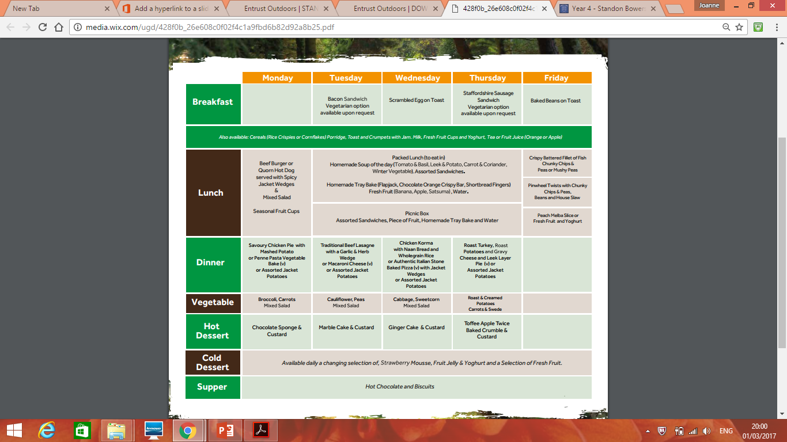

Slide 10

Kit

Slide 11
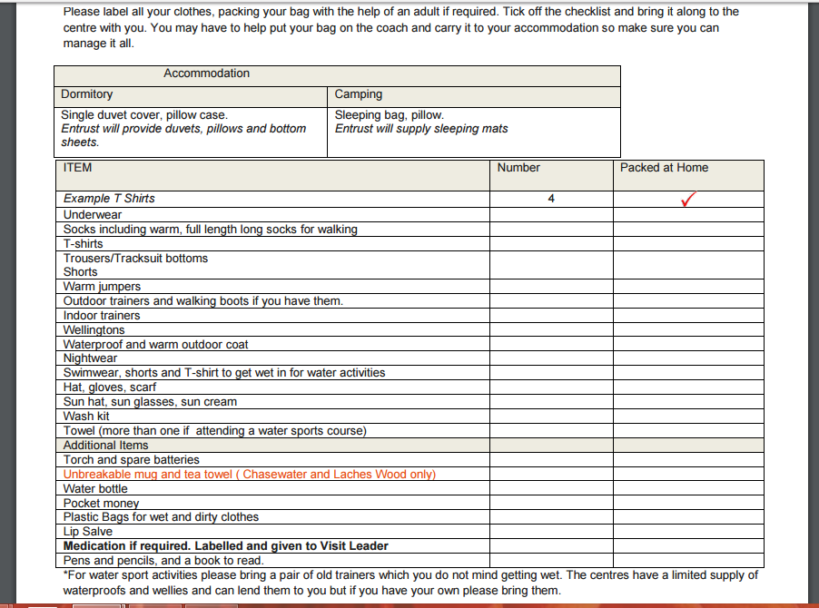

Slide 12

Safety

Slide 13
All the staff are first aid trained, have been checked by the Disclosure and Barring Service (DBS) and have been trained in safeguarding and child protection. Many of the delivery staff hold development training and teaching qualifications as well as having undergone additional specialist driver training to ensure they are equipped to look after the children during every aspect of their experience. As well as holding National Governing Body qualifications the staff also undergo in-house training and assessments and continual professional development to ensure knowledge stays up to date
At the centre the staff and children use the latest personal protective equipment, activity equipment, vehicles, and other equipment which has a stringent inspection, management and replacement process so that anything that the children and staff rely on to stay safe is always at its best and there if needed.

Slide 14
Explore and Inspire
https://www.youtube.com/watch?v=A4ZZAes2-kU

