Slide 1

Dates and times of the visit
Depart: Monday 18th May 2026
Return: Friday 22nd May 2026
Chateau de Grande Romaine
77150 Lesigny
France
20miles from the centre of Paris
Set in 70 acres of its own grounds

Slide 2
Staff attending
Mrs Fierro-Hammond
Miss Greenfield
Miss Green
Mrs Connock
All excursions and on-site activities will also be accompanied by PGL centre staff.

Slide 3
Meals:
• Children require either packed meals for the outward journey or money to cover the cost of buying these – 1 for breakfast and 1 for lunch.
A supply of cereal bars or similar snacks would be a good idea.
All other meals during the stay are provided.
Children will need money to cover the cost of a service station meal on the way home.
• PLEASE BRING A STURDY RE-FILLABLE WATER BOTTLE

Slide 4
Luggage:
Space for luggage is limited.
Pupils are allowed one large holdall or suitcase to be kept in the luggage hold until we reach the centre.
One smaller shoulder bag/ rucksack can be kept in the coach. This should contain their packed lunches and magazine, book, crossword or pocket game for the journey.

Slide 5
Clothing:
Pupils will need comfortable clothing for the journey and for each day. The weather can vary so please bring layers to help keep warm if required but also suitable clothes if we experience a summer heatwave!
Sensible shoes or trainers will be required as there will be a lot of walking!
A waterproof will be essential.
They will need two towels (one for showering and one for swimming) and toiletries; bedding is provided.

Slide 6
Pocket Money:
All of the admission prices and leisure facilities are included in the price of the tour.
Children may require pocket money for souvenirs and snacks.
We suggest an amount of €70/80 (in €5 or €10 notes) but not more than around €120.
This needs to be looked after by your child.
Children can use cards such as Monzo, GoHenry etc but they are responsible for these. Please check your child’s card will work in France before sending it.
The staff will advise children as to how much money they should take each day but children will be responsible for this.

Slide 7
Further details:
Cameras or any other electronic equipment are the responsibility of the individual child. A disclaimer must be completed.
Names on everything would be extremely useful!
No mobile phones are to be taken.
We recommend not to take valuable and breakable possessions and electronics. Remember if you take them, you will need a travel adapter.
Music players, handheld game consoles and so on can help pass the journey time but so can magazines, books and puzzles.
There is no wifi available for children at the chateau or on the coach.

Slide 8
Insurance:
• We kindly request that your child’s European Health Insurance Card (EHIC) or new GHIC card is handed into school as soon as possible if not done already. We must have received your child’s card and passport between Tuesday 5th May and Friday 8th May. These will be stored securely.
• These will be returned to you immediately after the tour.
• Apply online at https://www.nhs.uk/using-the- nhs/healthcare-abroad/apply-for-a-free-uk-global-health- insurance-card-ghic/
• Any medication to be handed in on the Monday morning, CLEARLY LABELLED WITH NAME AND DOSAGE please including inhalers. No medication is to be sent with the children themselves, including travel sickness tablets.

Slide 9
Updates while we are away:
During the visit, Fulfen staff will upload photos and updates from the Paris visit. These will be published to the Fulfen Facebook page.
Children who do not have school photo permissions will not feature in photo updates from the residential.

Slide 10
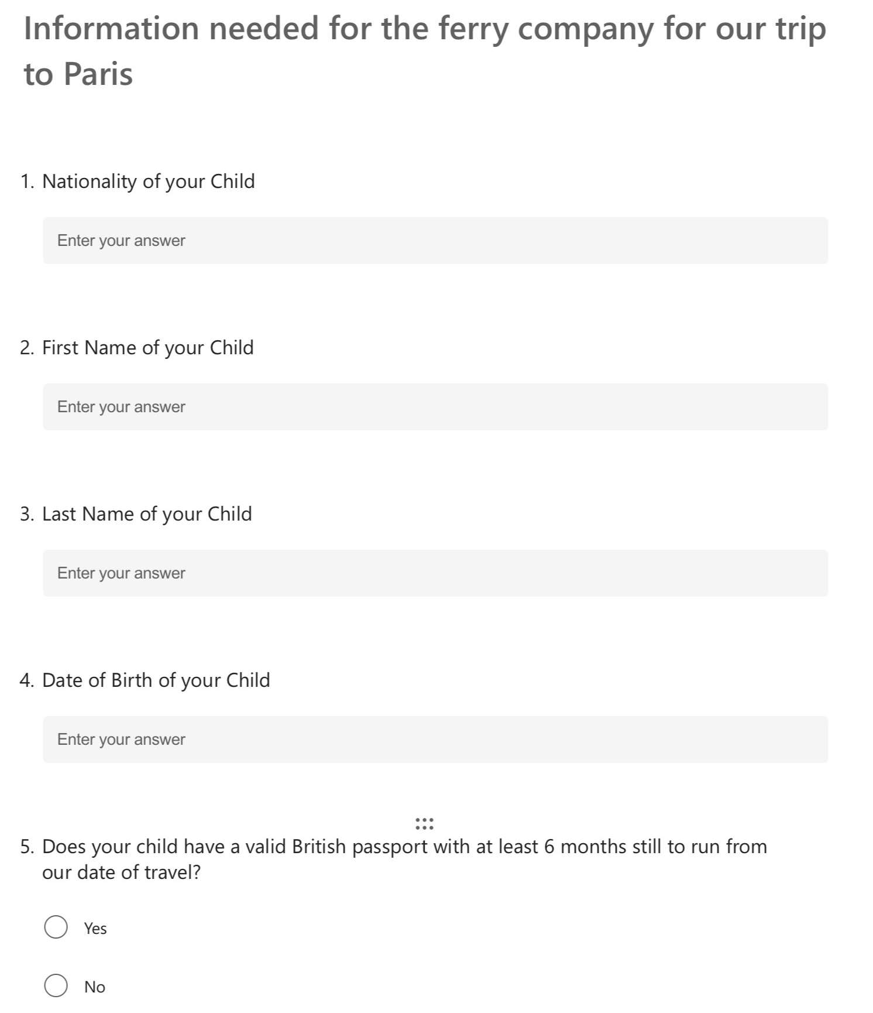


Slide 11
Things to prioritise:
Check that your child’s passport has at least ….
Apply for a GHIC card if your child does not already have one.
Check the expiry date on GHIC cards, if you already have them.
Complete both Microsoft forms which will be emailed to you following this meeting.
If your child has a non British passport, please see us after the meeting.

