Slide 1

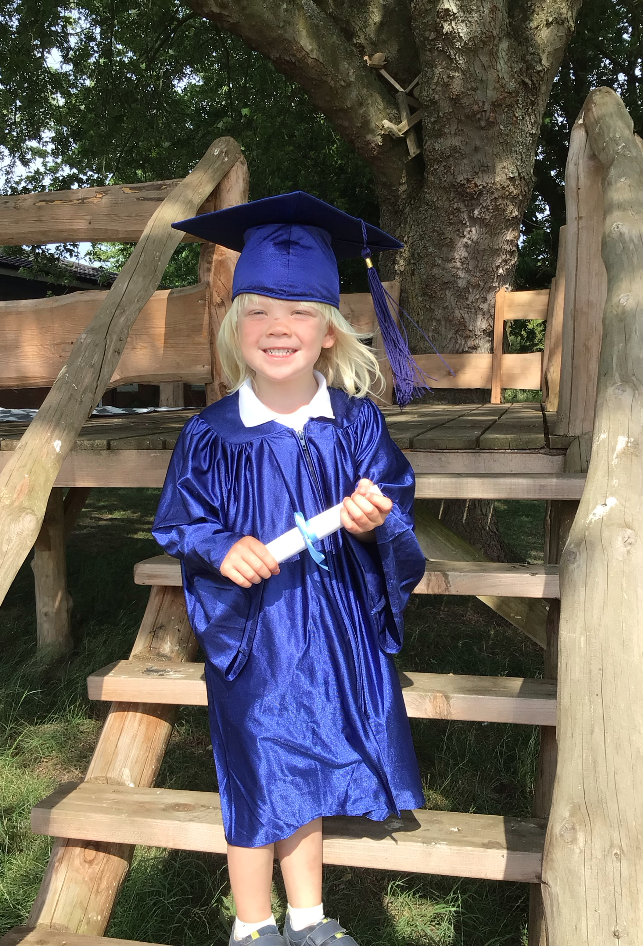
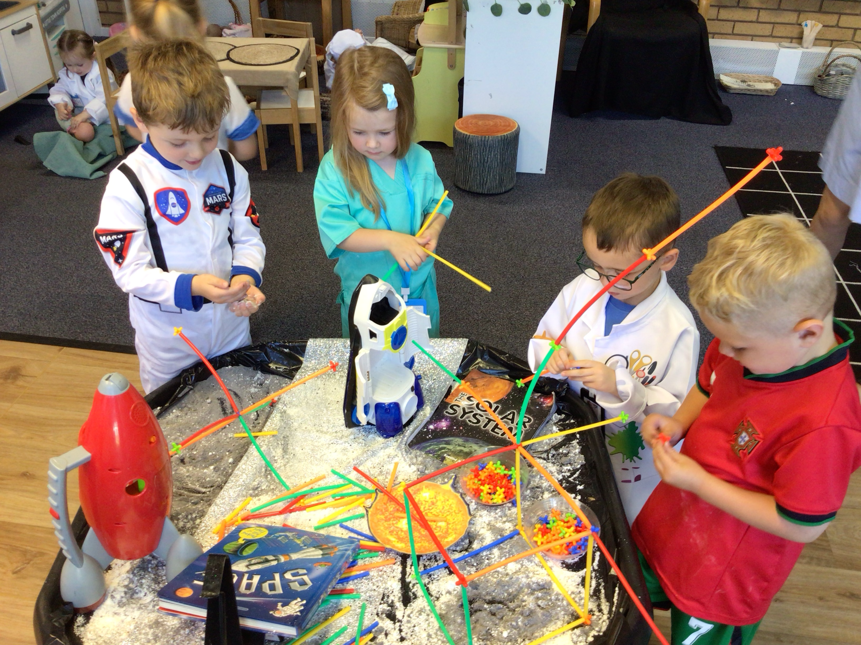
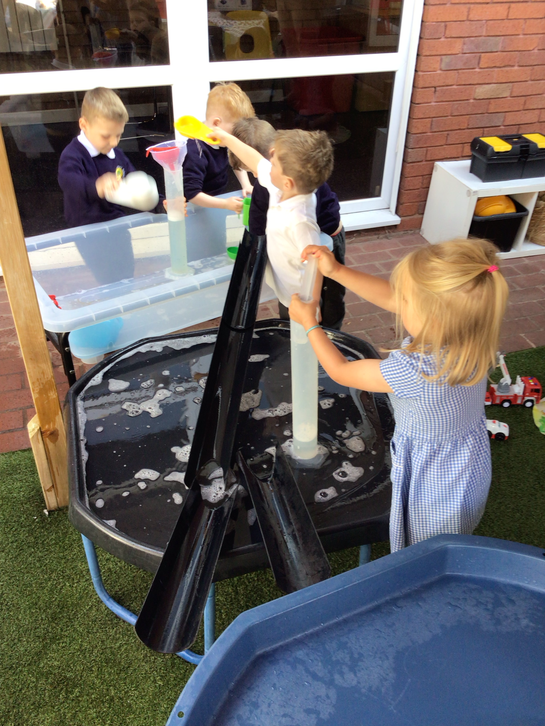
Fulfen Pre-School
Pre-School
Welcome Meeting
for Parents
September 2025

Slide 2

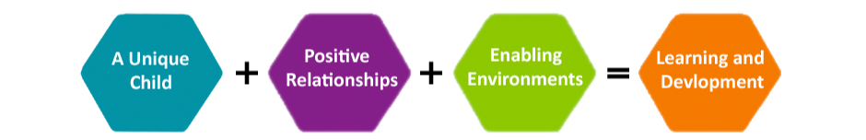
EYFS Curriculum
We follow the Statutory Framework for the Early Years Foundation Stage (EYFS) ​
​​There are 7 areas of learning
3 Prime areas:
Communication and Language
Physical Development
Personal, Social and Emotional Development
4 Specific areas:
Literacy
Mathematics
Understanding the World
Expressive Arts and Design
We ensure we offer a careful balance of adult led and child-initiated activities throughout the day in order to maximise potential for learning and development across all 7 areas of learning.
We uphold the following Early Years Principles:
A Unique Child- Every Child is a competent learner from birth who can be resilient, capable, confident and self-assured.
Positive Relationships- Children learn to be strong and independent from a base of loving and secure relationships with parents and/or a key person.
Enabling Environments- The environment plays a key role in supporting and extending children’s development and learning.
Learning and Development- Children develop and learn in different ways and at different rates, and that all areas of learning and development are equally important and interconnected.

Slide 3


Pre-School Timetable
8:30am-9:05am Registration / Days of the Week / Calendar
9:05am-9:45am Indoor/Outdoor Exploration and Play; including child- initiated learning and adult-led activities
9:45am-10:15am Snack Time / Prime Time / Phonics / Maths
10:15am-11:00am Indoor/Outdoor Exploration and Play; including child- initiated learning and adult-led activities
11:00am-11:30am Story, Song & Rhyme Time
11:30am Home Time
11:30am-12:15pm Lunch
12:15pm-12:30pm Registration
12:30pm-1:00pm Enrichment Input
1:00pm-2:00pm Child Initiated Learning (Indoors/Outside)
2:00pm-2:15pm Snack Time
2:15pm-3:00pm Story, Song & Rhyme Time
3:00pm-3:15pm Home Time

Slide 4






Pre-School Themes
Autumn 1​ | Autumn 2​ | Spring 1​ | Spring 2​ | Summer 1​ | Summer 2​
​ Ourselves​ ​ Autumn​ ​ | ​ Celebrations​ ​ Winter​ | ​ Traditional ​ Tales​ ​ Spring​ ​ | ​ People who help us​ ​ Easter​ ​ | ​ ​ Animals & Plants​ ​ | ​ Holidays​ ​ Summer​ ​

Slide 5


What will my child need?
School Uniform
Children are required to wear:
White polo shirt
Blue school jumper or cardigan, including school logo
Grey trousers/shorts/skirt/pinafore
White socks
Sensible black school shoes
PE Kit:
White t-shirt
Black/Navy shorts
Navy jogging bottoms or black/navy leggings (unbranded)
Navy Hoodie (with school logo)
Black Trainers
Children come to school dressed in their PE kit on their PE Day.
Spare change of uniform - this is to be kept in School on your child’s peg. Please include underwear and a spare pair of shoes if possible.
Book Bags - please note we do NOT have room to store rucksacks or other large bags in school so please avoid sending these into school.
Water bottle into school every day.
Please ensure all items are clearly labelled with your child’s name.

Slide 6
Forest School
At Fulfen, we offer all Pre-School children the opportunity to participate in forest sessions in our on-site woodland area every week.
It is proven from research that the learning that takes place in the outdoors can be much more powerful and memorable as all the senses are involved.
We go out in all weathers, making sure that children are suitably dressed and that conditions are safe. All activities are thoroughly risk-assessed, staff encourage safe risk-taking.
Benefits for children
Increased confidence and self esteem
Group cohesion and a sense of community
Understanding own and other’s needs, developing empathy
Lots of new skills
Understanding of healthy choices
Heightened self-awareness and behaviour modification
Understanding risk and how to stay safe
Knowledge of the natural environment
Loads of fun
Forest Kit:
Wellington boots (to be left in school)
White t-shirt
Navy jogging bottoms/leggings
Navy school hoodie with (with school logo)
Waterproof coat and trousers
Spare socks
Children come to school dressed in their Forest Kit on their Forest Day

Slide 7




Parent Partnership
ClassDojo is an effective communication system, which we use in EYFS, that allows parents and teachers to connect by sharing photos, videos and messages.
We regularly update the Pre-School page on the school website and School Facebook page. We also send out a fortnightly newsletter
Parents are regularly invited into school for ‘stay & play’ sessions and workshops
We will keep in touch via these methods
You will receive info/updates via email and text.
Please ensure the school office have the most up to date details!

Slide 8
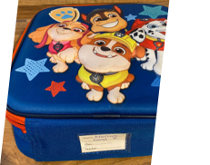
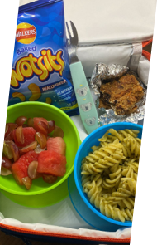
Lunchtime
11:30am to 12:15pm
Lunch is served in the school hall
School meal (hot dinner or sandwiches) or packed lunch option
School meals are ordered and paid for in advance via ParentPay
You will receive your login details in September

Slide 9
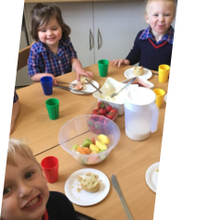


Snack time
We offer children a free drink of milk as part of their morning snack
Children can have a piece of fresh, good quality fruit each school day. This can help our children to enjoy fruit and understand the benefits of healthy eating
Snack contributions are paid via ParentPay each term

Slide 10


Settling in Sessions
Children are invited into school with parents for a ‘stay and play’ session on
Thursday 3rd July 2025
9:15am-10:00am surnames A-M
or
10:15am-11:00am surnames N-Z

Slide 11
Induction Week
Monday 1st September - School CLOSED
Tuesday 2nd September - School CLOSED
Wednesday 3rd September
1.5 hours with parents
9:00am-10:30am or 1:00pm-2:30pm
Thursday 4th September
Morning session ONLY
8:30am-11:30am ALL children
Friday 5th September
Usual pre-booked Pre-School sessions commence
8:30am-11:30am / 8:30am-3:15pm

Slide 12

Our EYFS Vision
To provide a safe, nurturing and stimulating environment which supports the growth of independence, collaboration and a love of learning
To provide an excellent and enjoyable education, where each unique child, is valued and enabled to achieve the highest possible outcomes and realise their true potential
To value and develop a close partnership with families to facilitate close links in children’s learning and wellbeing between home and school

Slide 13
Funding / Costs
All three-year-olds become eligible for 15 universal hours of free nursery education funding in the term after they turn 3. Some 3-year-olds are also eligible for an additional 15 hours funding (30 hours in total). For further information go to: www.childcarechoices.co.uk Please note to be eligible for the funding from September 2025, this must be applied for before 31st August 2025.
Afternoon Session £21.00 (or EEF extended funding)*
Lunch Session (11:30am-12:15pm) £6.00 (or EEF extended funding)*
Morning Snack 50p per day**
*Sessions are still chargeable if your child is absent, either due to illness or holiday.
**Payable each term by all parents (not included in funded hours).
If childcare is not required during the lunch session (11:30am-12:15pm), children can go home for lunch.
If a school meal is required, this needs to be selected and paid for in advance on ParentPay. The cost of this is £2.00.

