Slide 1

Famous scientists to inspire you!
Find each of the ten scientists around the school. Use the QR code to help you find out more about each scientist and answer the questions.

Slide 2
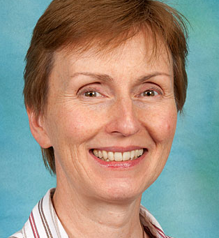
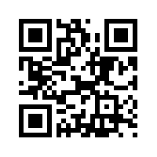
Helen Sharman
1963-today
Helen was the first British…… ?
When did she do it?
Where did she go?

Slide 3
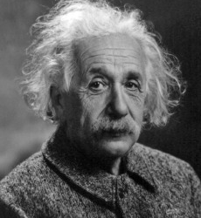
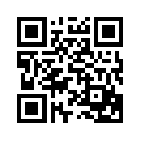
Albert Einstein
1879-1955
Albert Einstein is probably the most famous scientist that ever lived.
What gift got Albert interested in science?
What didn’t Albert do as a child?

Slide 4
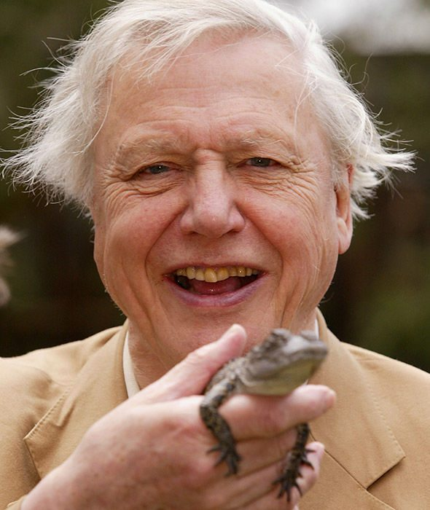
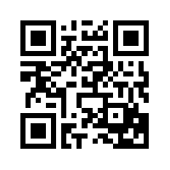
David Attenborough
1926- today
Have you watched Blue Planet? Sir David Attenborough has been making TV programmes about wildlife all his adult life.
What animal doesn't Sir David like?

Slide 5
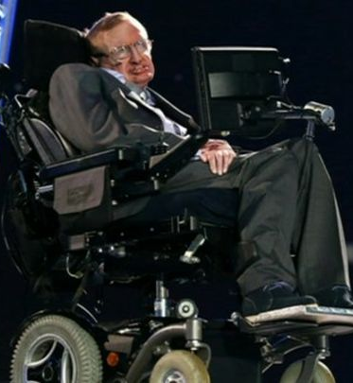
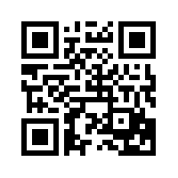
Stephen Hawking
1942-today
Stephen is a most remarkable man. At the age of 21 he was told he had Motor Neurone Disease and would only live for three more years. He is now 75 years old.
What does Stephen study?

Slide 6
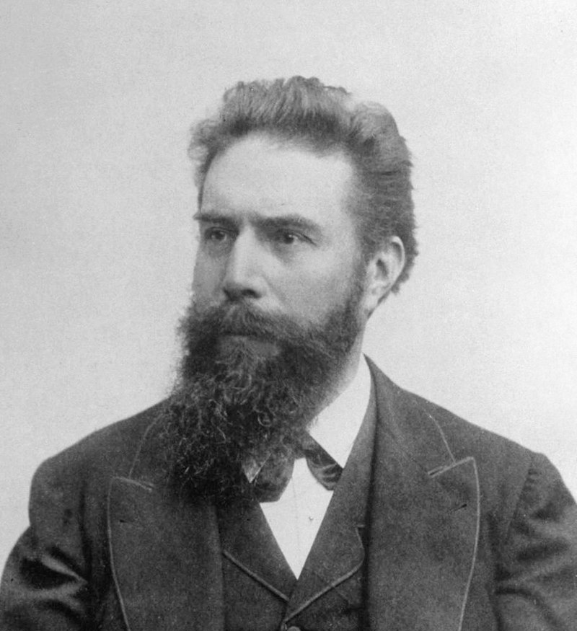
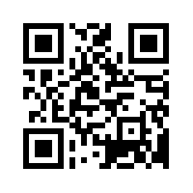
Wilhelm Röntgen
1845-1923
What did Wilhelm discover by accident?

Slide 7
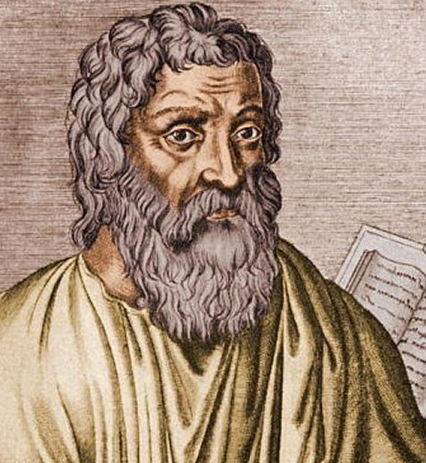
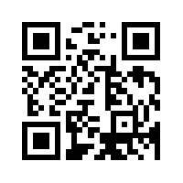
Hippocrates
460 BC - 377 BC
What was his job?
He is known as the “Father of ___________”

Slide 8
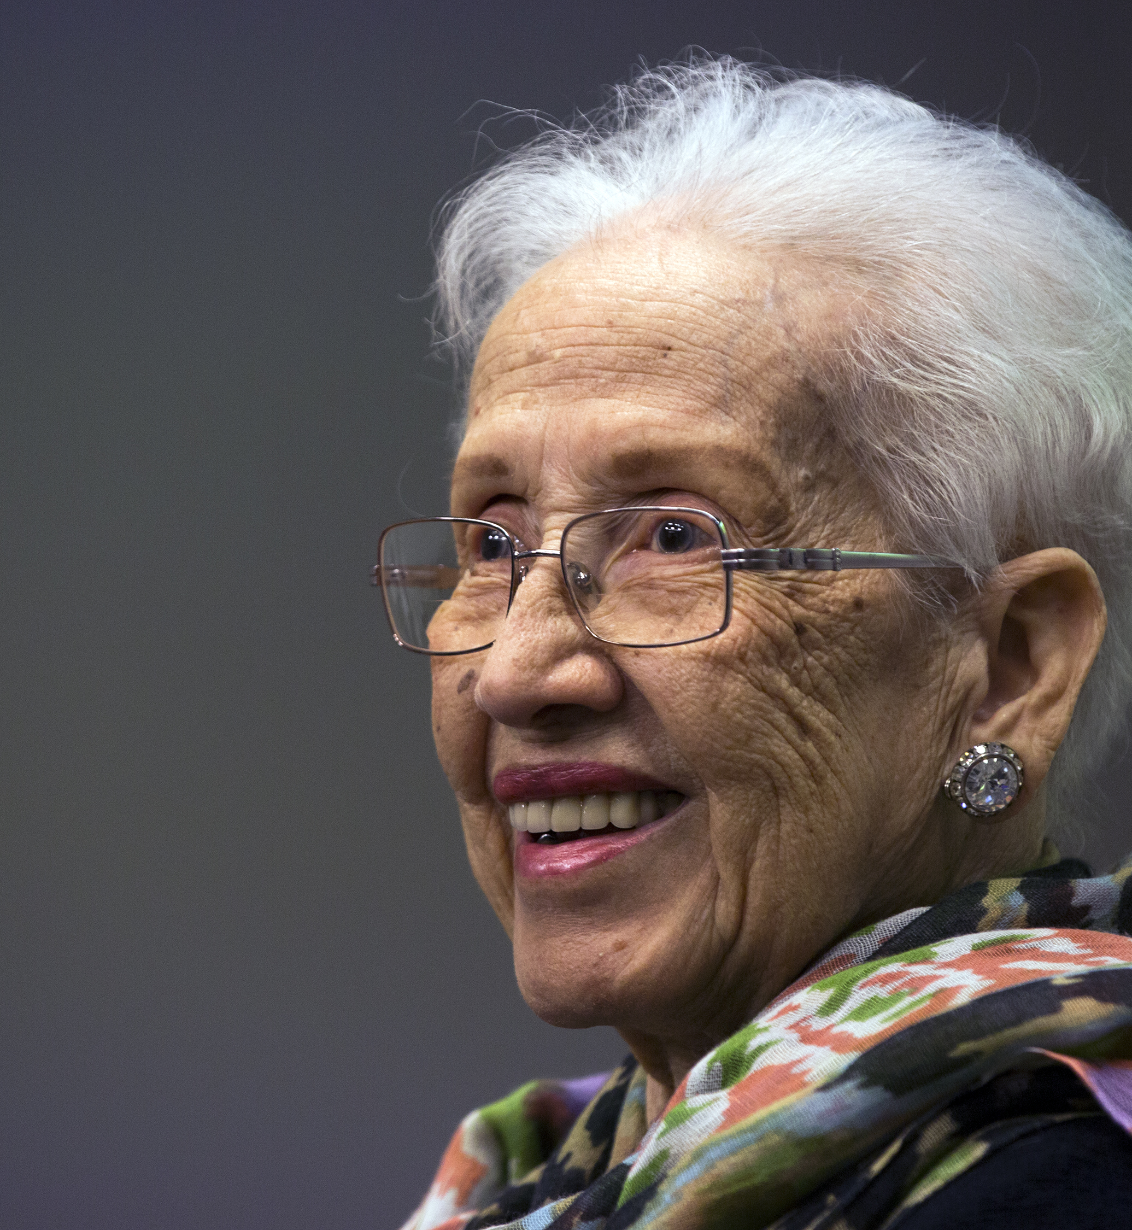
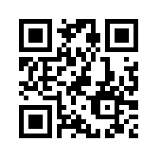
Katherine Johnson
1918-today
What was her job?
What amazing historic achievement did she contribute to?

Slide 9
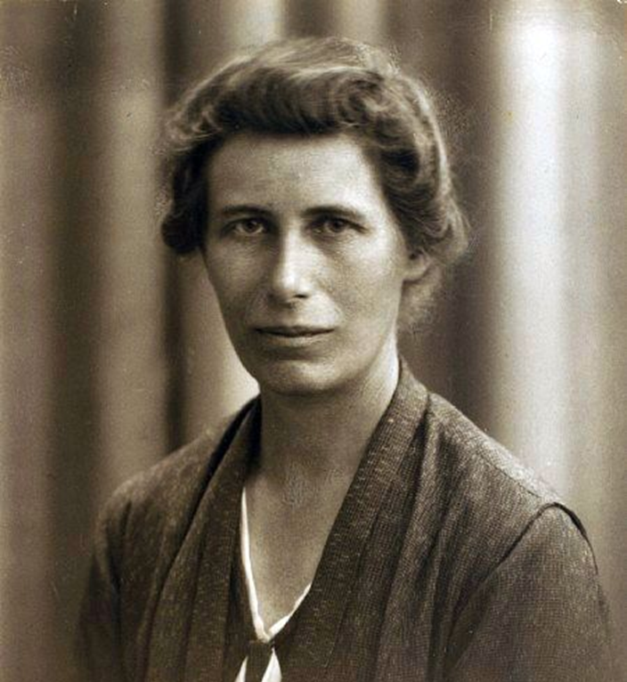
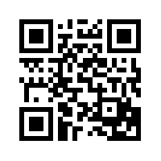
Inge Lehmann
1888-1993
What did Inge Lehmann discover about the Earth?
Where was she born?
How old was she when she died?

Slide 10
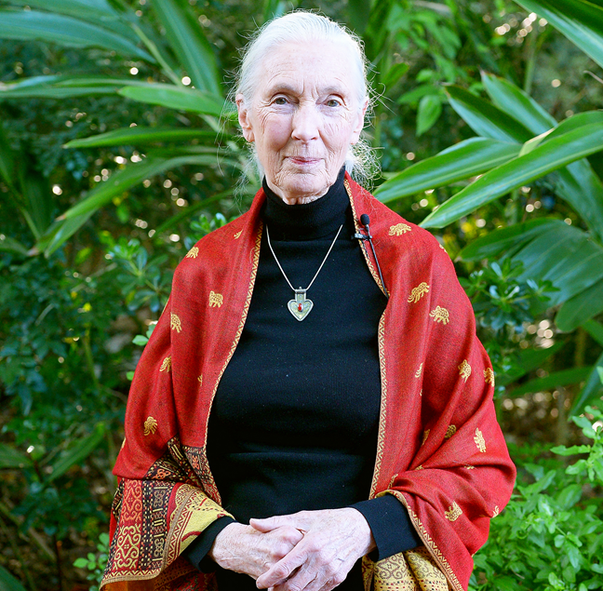
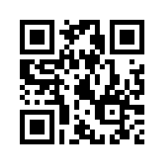
Jane Goodall
1934 - today
Which animals has Jane famously studied?
Which famous scientist inspired Jane when she went to Kenya in Africa?

Slide 11
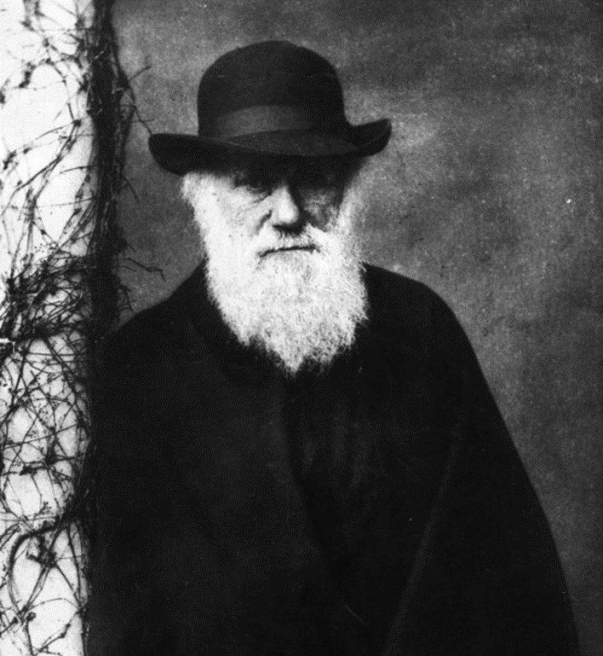
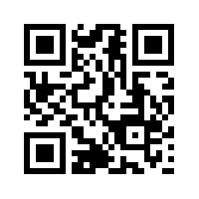
Charles Darwin
1809-1882
In 1831 Charles set out on a five year sailing trip around the world to study plants and animals. He came up with the Theory of Evolution and noticed that animals adapt to survive.
What was the name of the ship he sailed on?
What was the name of the
book he wrote over 20 years after the voyage?

