Slide 1

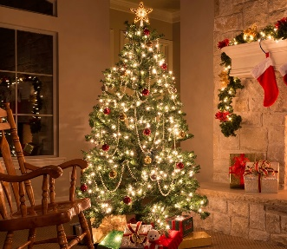
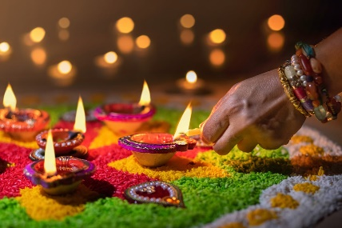
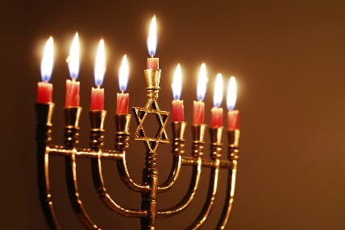
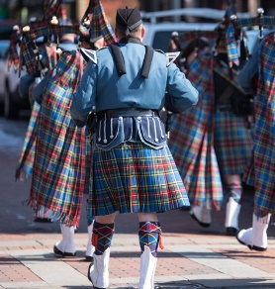
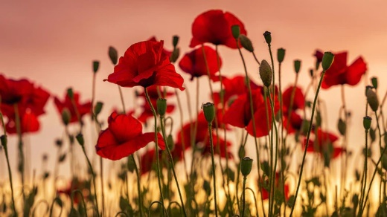
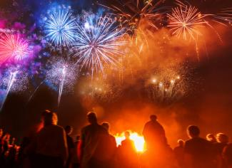
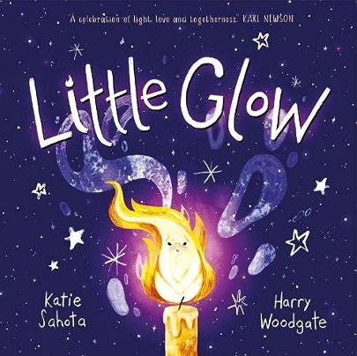
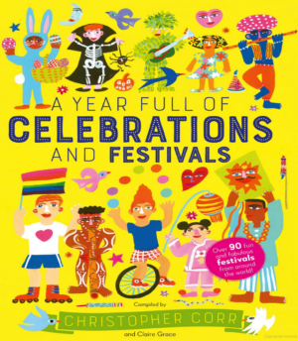
Vocabulary
Festival | A ceremony or celebration that repeats, often once a year, and involves special activities or amusements.
Celebrate | To do special things to honor a person or an occasion or to express happiness concerning some event.
Culture | The language, customs, ideas, and art of a particular group of people.
Fireworks | Devices that burn or explode to make noise, bright lights, or brilliant colors.
Gifts | Something a person gives without wanting anything in return.
Decorations | An item added on to something else to make it prettier, more complete, or more useful.
Reception Knowledge Organiser
Autumn 2 – Let’s Celebrate
Summary
We will learn about: Different festivals from around the world. How people celebrate these festivals.
Books

