Slide 1
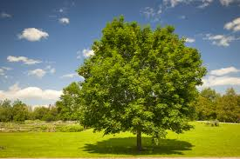
Maple Class
Mrs Priest

Slide 2
Routines
Walking on the track - 8:30am
Register - 8.45am
Shared Reading – 8.50am
English- 9.20am
Break– 10:35 am
Maths – 10.50am
Handwriting / Spelling – 12pm
Lunch – 12.10pm –12.55pm
Worship – 1pm-1.30pm
Curriculum – 1.30pm
Afternoon Break – 2.45pm-2.55pm
Maths fluency – 2.55pm-3.10pm
End of the day – 3:15pm

Slide 3
Routines
Mr Lewis will take the class swimming on Thursday afternoon.
Mrs Darlington will cover Forest School every other Monday afternoon.
She will teach Music and French every other Tuesday (this begins next week)
PE is on a Friday afternoon.
Spelling tests are now on a Friday afternoon.

Slide 4
Routines
PE – Friday afternoon
Pupils must wear correct kit. Indoor: PE top, shorts, pumps. Outdoor: PE top, jogging bottoms and trainers.

Slide 5
Curriculum
The children have a book focus for English each half of term linked to the humanities objectives
Whiterose is followed for maths
All pupils will cover objectives related to their year group across all curriculum subjects – please see the Autumn term overview on the class page
Support and targeting where needed

Slide 6
Homework
Homework is the Humanities and health and Well-being grid provided every half term; available on our class page.
It is school expectation the children read at least 4 times a week (1 Class Dojo)
5+ reading signatures a week is 3 Class Dojos
Diaries are checked on Friday
For messages please use Class Dojo, email or telephone; the diary is a reading record – this must be brought with a reading book to school every day.
They will have weekly spellings – tested on Friday (please speak to or message me if your child is struggling with the 10 spellings).
Maths Homework is TT Rock Stars – please get your children to practise every day.

Slide 7
Help at Home
Reading –Pupils are expected to regularly through the week and have their diaries signed. I will reward signatures and reading. This can be them reading to you, you reading to them. Discuss a text and vocabulary. It doesn’t have to be the same each night.
As Year 4 the children are expected to say when they need to change their book. Please notify me (Class Dojo) if your child needs encouragement to remember.
We will hopefully get all books out by the end of this week from Star Reader Assessments.

Slide 8
Class Dojo
Dojos for reading.
2 Dojos for Homework grid work completed.
25 dojos = change avatar.
50 dojos = 1 raffle ticket & certificate.
100 dojos = 5 raffle tickets & hot chocolate or ice cream with Mr Lewis or Mrs Carr.

Slide 9
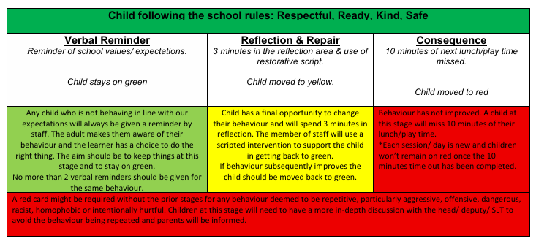
Behaviour Curriculum

Slide 10
Snacks
The children are asked if they would like to order a snack. It is bagel or toast, there is a charge. Please talk to your children; bacon butty in Friday.
They can bring their own healthy, no nuts, snack if they want.

Slide 11
Additional
Positive Relationships
Independence
Communication

Slide 12
Any Questions?

