Slide 1

Meet the teacher
Beech Class 2025 - 26

Slide 2
School Values
“Let your light shine”
Ready Respect Kind Safe

Slide 3
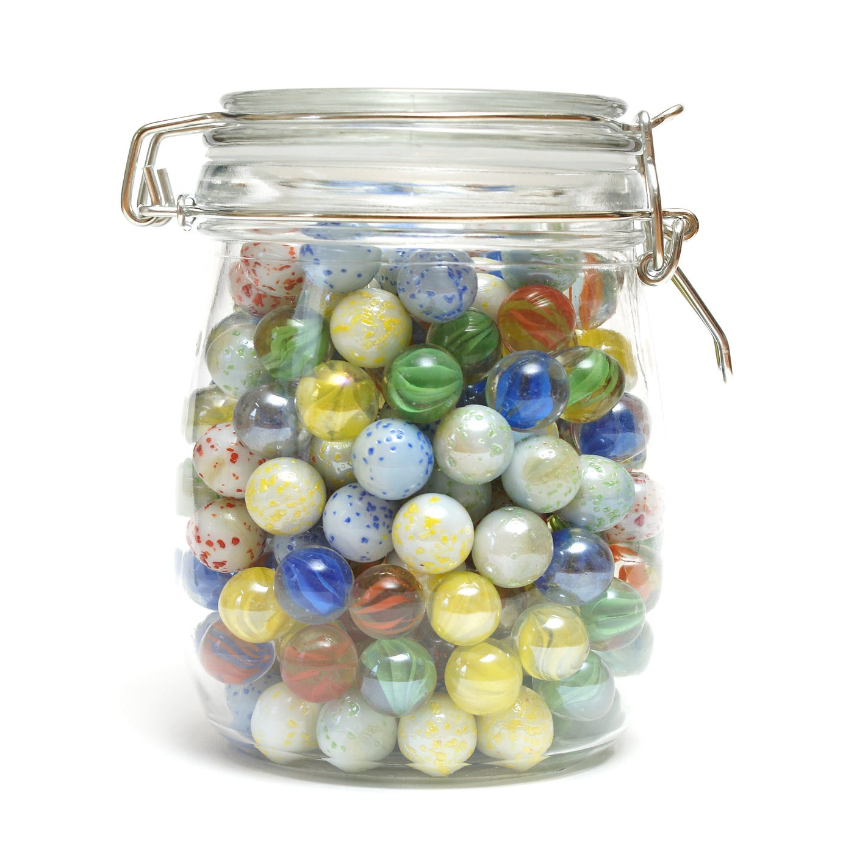


Behaviour Policy
Positive reinforcement first
- Praise
Class marbles
Dojos
Special chair!
Consequences
- Reflection time

Slide 4
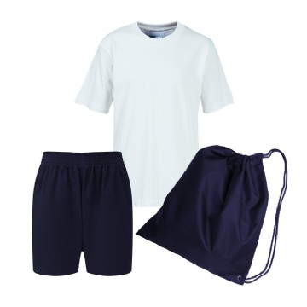
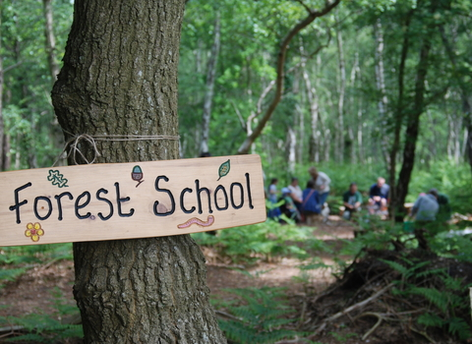
PE and Forest School days
Pe – Each Tuesday afternoon
Forest schools – alternating Thursdays starting from the 18th. Children to come in wearing their forest school clothes.

Slide 5
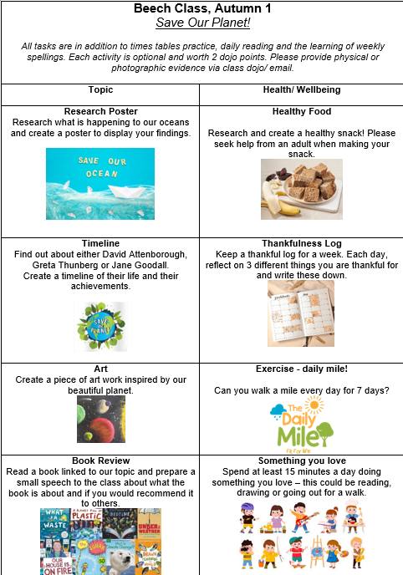
Homework
Compulsory
Reading 4x a week (ideally more!)
Spelling practice
Times Tables Rock Stars
Reading records, spelling and times table tests are each Friday.
Please let me know if there are any issues!
Optional
Homework Grids
On the grids is a collection of activities related to the current topic and well being .

Slide 6
Topics
Save Our Planet!
English – Greta and the Giants
Maths – Roman Numerals and Place Value
Science – Materials and their properties
Geography – Save our Planet!
PE – Dance
Design and Technology – Solar Powered Light

Slide 7
Any questions?
Contact
- Face to face before or after school
- Class Dojo
- Call

